Slide 1
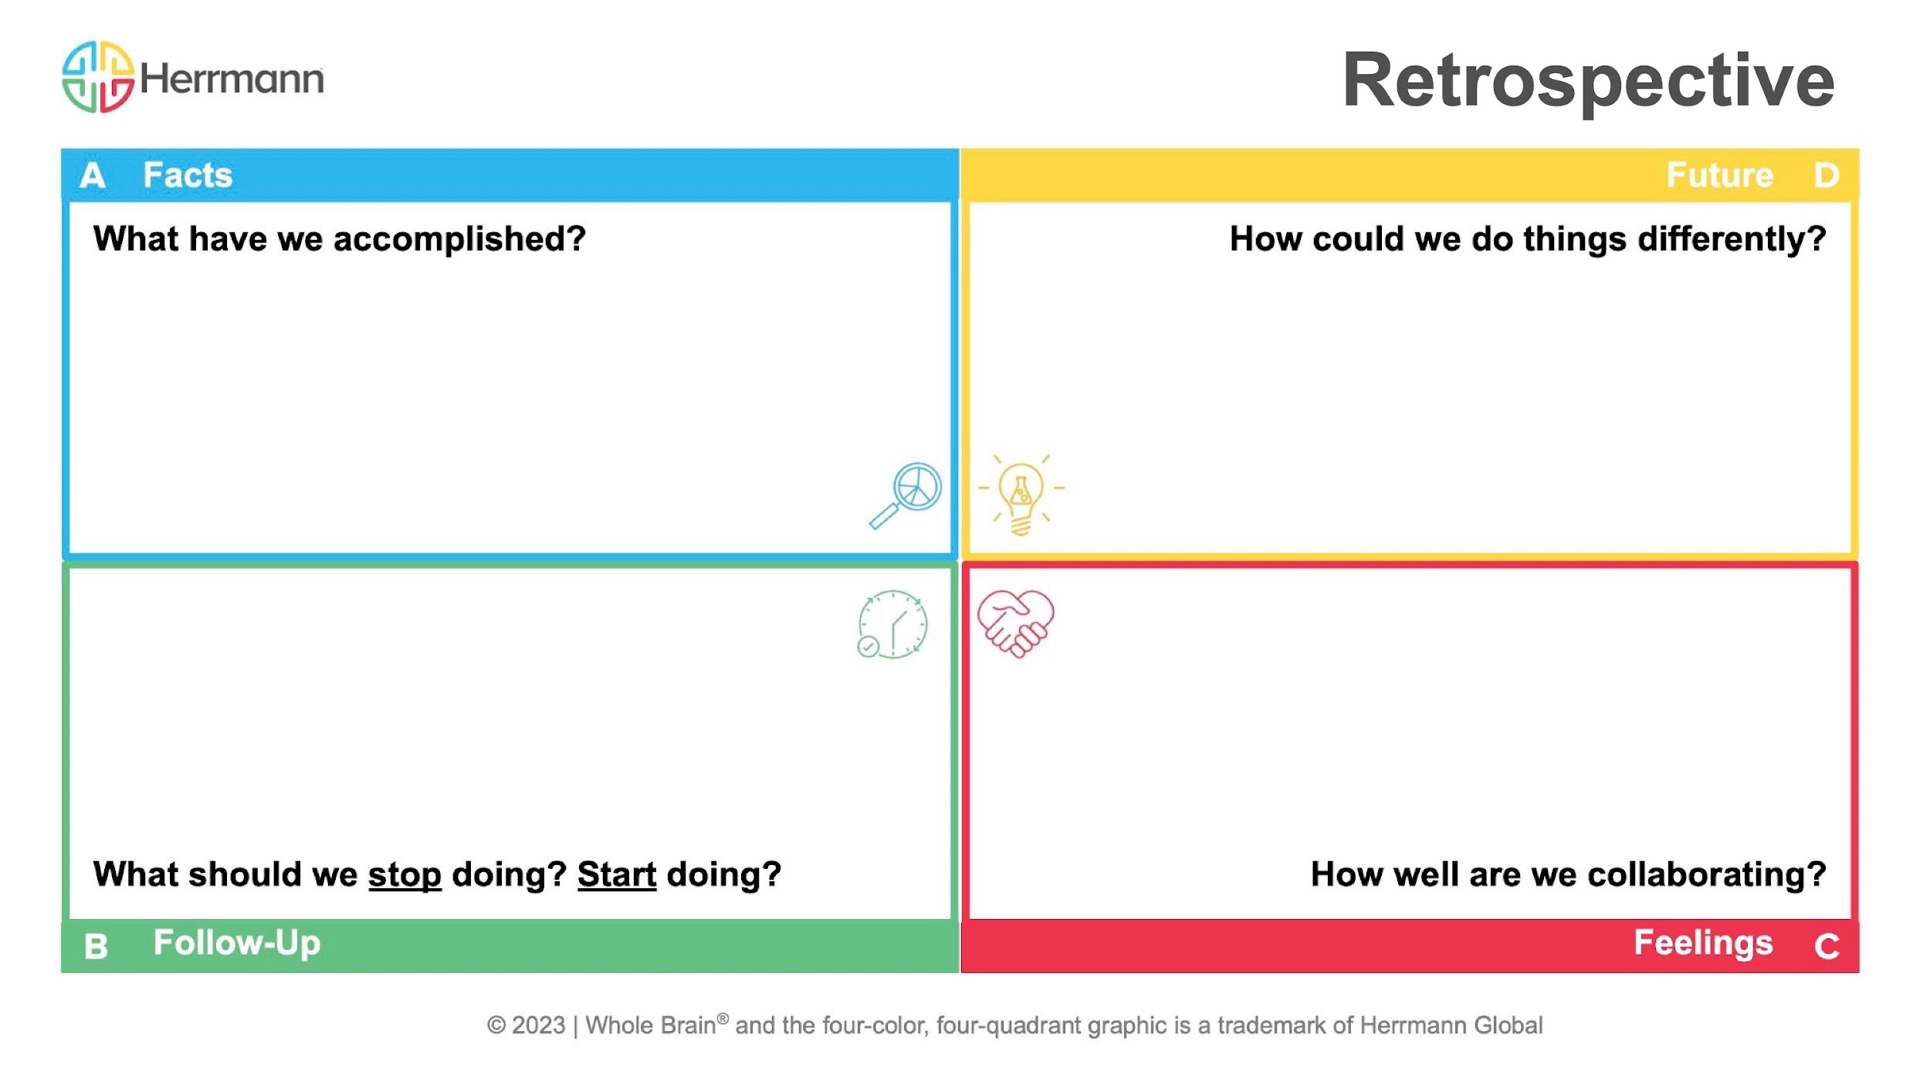
Copy + add your response!
Copy + add your response!
Copy + add your response!
Copy + add your response!

Slide 2
