Slide 1

Notes:
Welcome to Stop & Think in Microsoft Teams - a new way to access Whole Brain® Thinking tools, tips, and templates in the flow of work in Microsoft Teams. These slides offer a quick tour through the app to show you how it works, what it can do, and why it can help solve real workplace challenges.

Slide 2
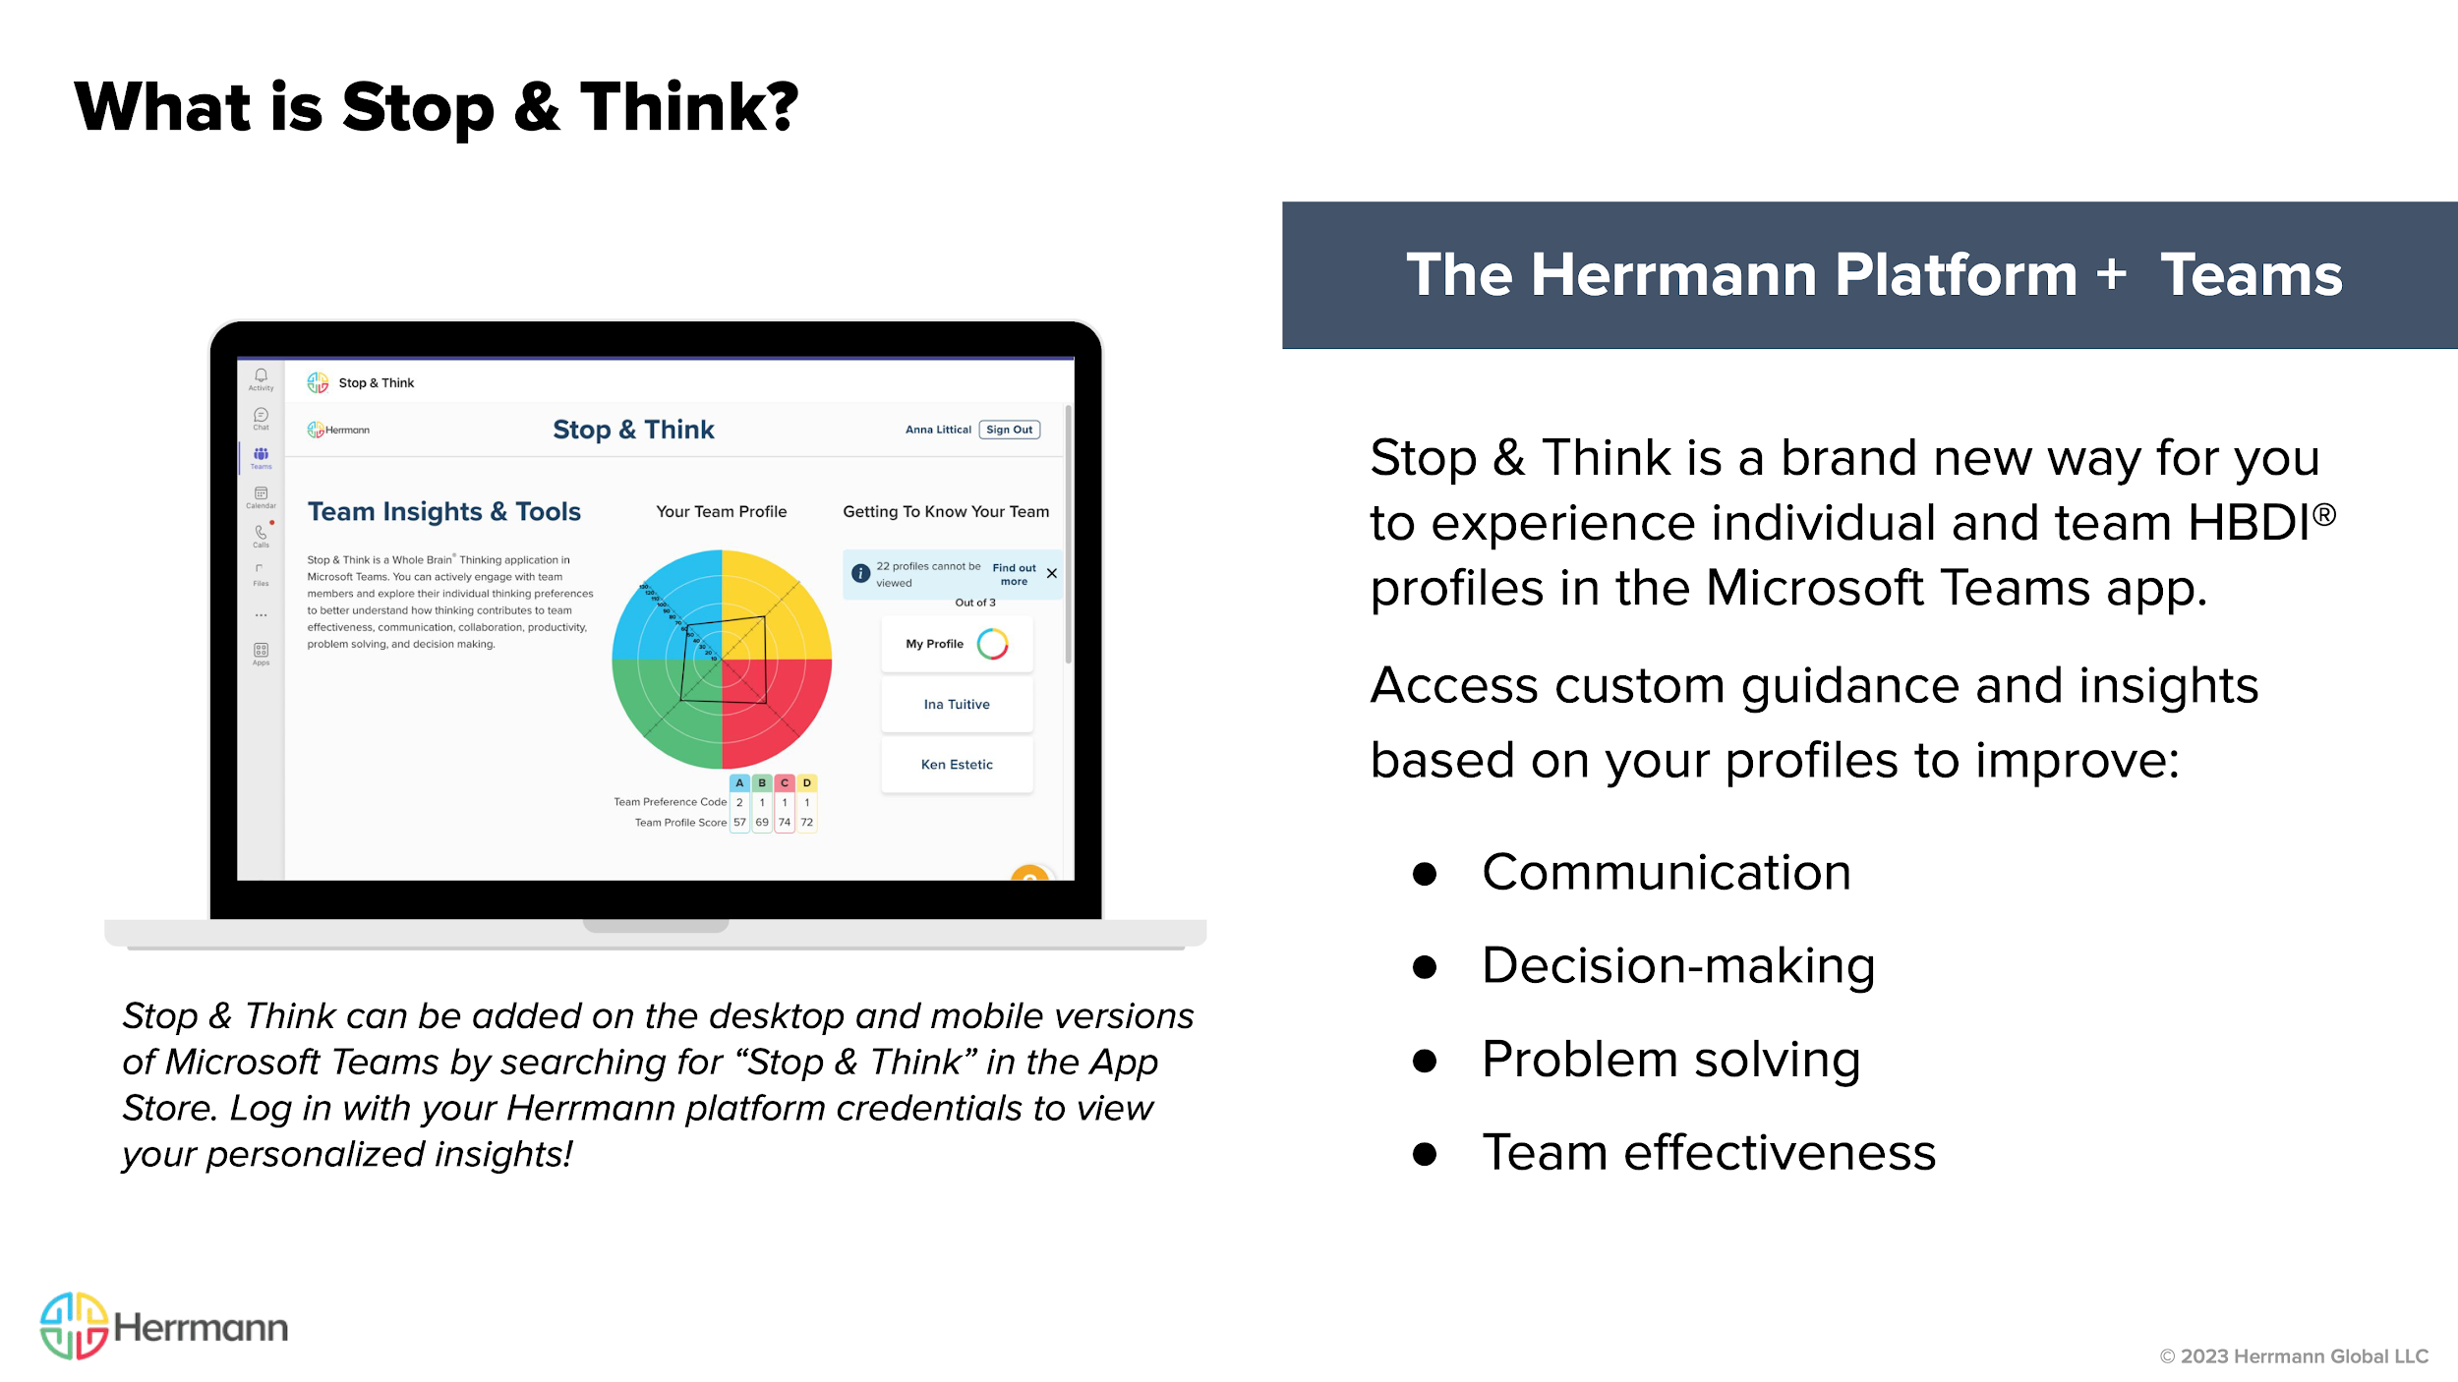
Notes:
Stop & Think is a brand new way for you to experience individual and team HBDI profiles from any device (phone, tablet, desktop) in the Microsoft Teams app. Get team-based guidance on communication, decision-making, and problem solving customized to the individual’s and/or team’s profile.
Provides real-time application tools for teams to use in meetings and other workplace scenarios
Creates “stop & think” moments with built-in solutions and strategies
Puts Whole Brain® Thinking at your fingertips, when you’re already working with your teams

Slide 3
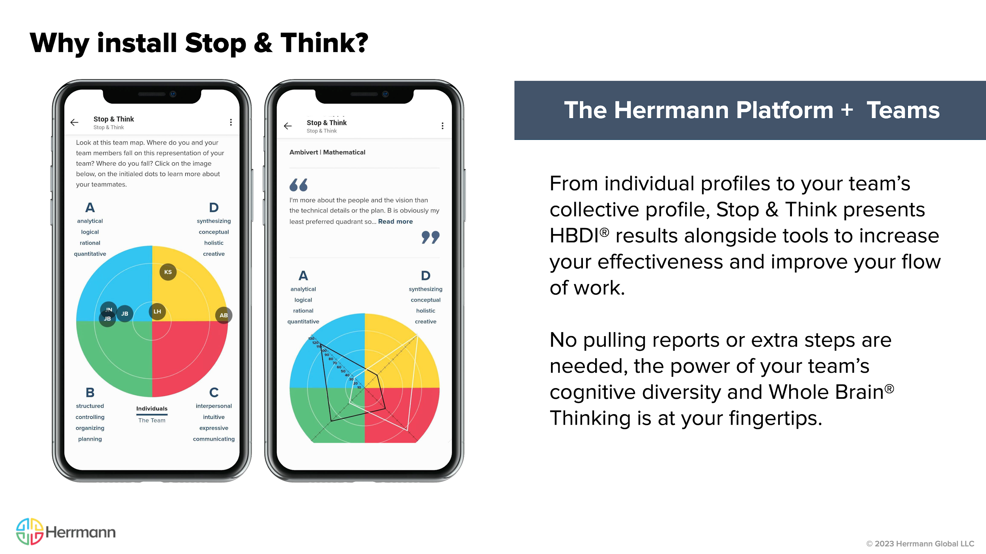
Notes:
Stop & Think is a brand new way for you to experience individual and team HBDI profiles from any device (phone, tablet, desktop) in the Microsoft Teams app. Get team-based guidance on communication, decision-making, and problem solving customized to the individual’s and/or team’s profile.
Provides real-time application tools for teams to use in meetings and other workplace scenarios
Creates “stop & think” moments with built-in solutions and strategies
Puts Whole Brain® Thinking at your fingertips, when you’re already working with your teams

Slide 4
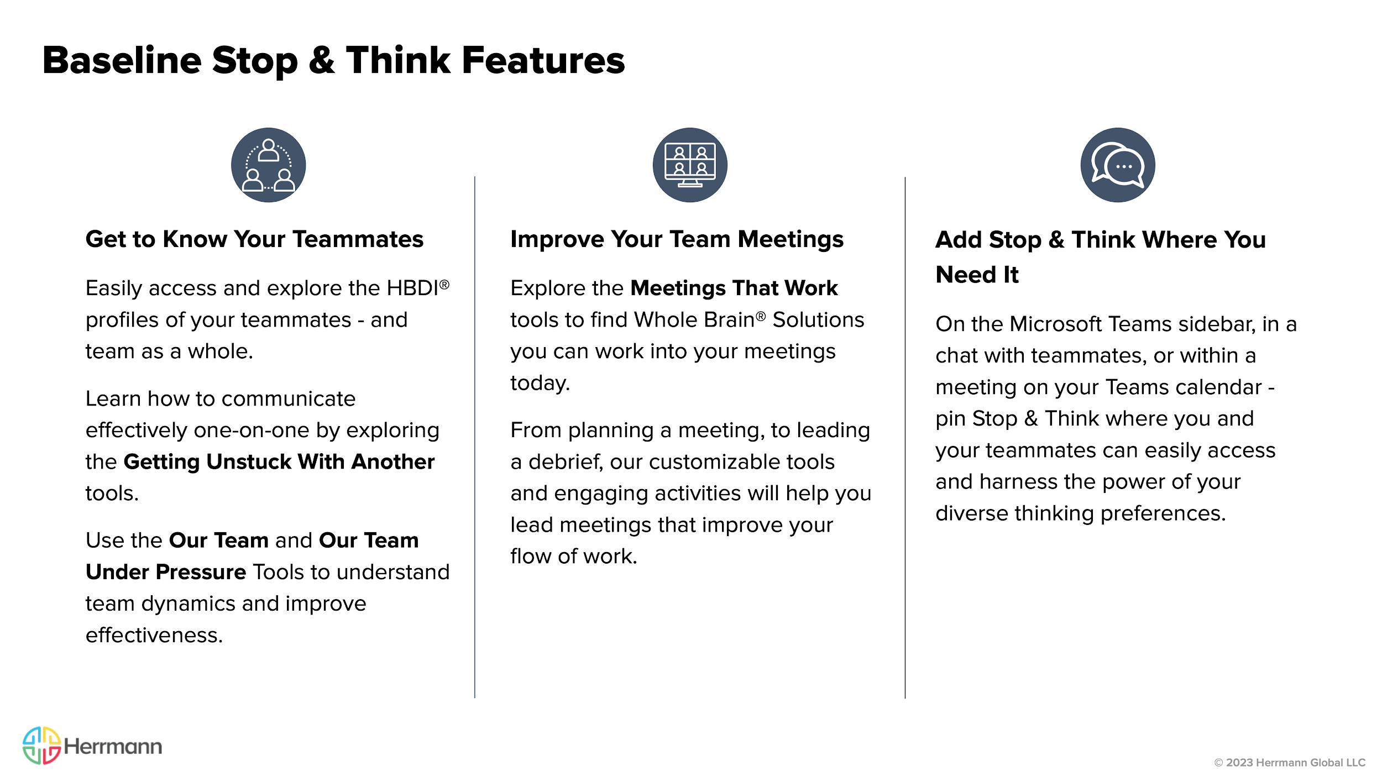
Notes:
The Stop & Think app in Microsoft Teams provides many ways to get to know your own thinking and that of your teammates, along with specific tools and strategies for integrating Whole Brain® Thinking into your workflow.

Slide 5
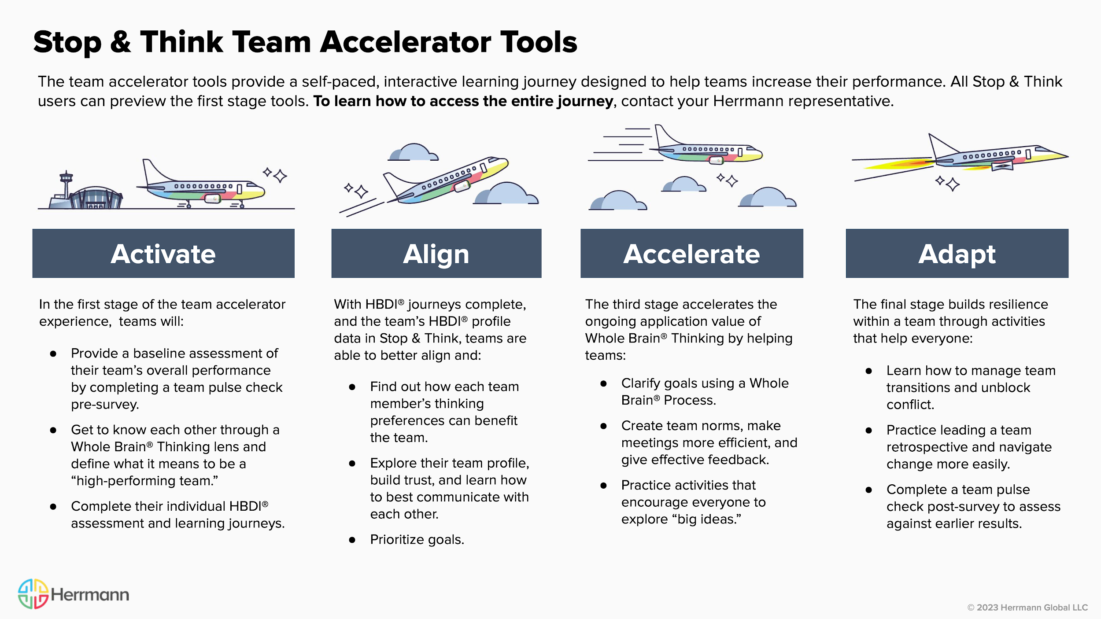

Slide 6
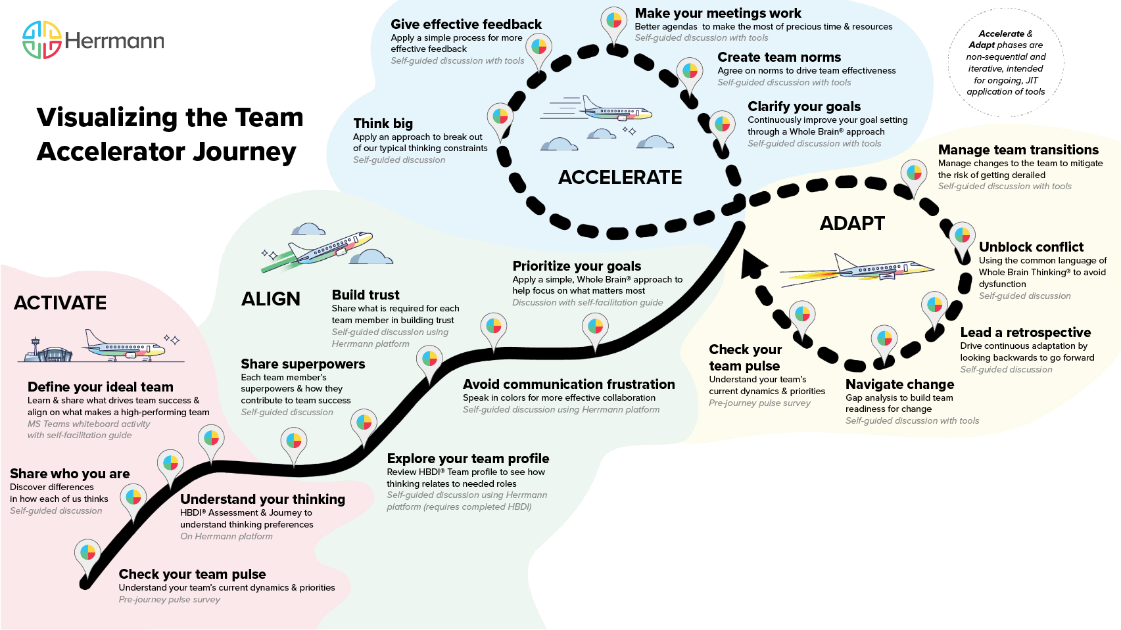
© 2023 Herrmann Global LLC
Notes:
The goal of this graphic is to demonstrate the sequential nature of the the first two steps of the team accelerator tools and ongoing value provided in the second half. You will also notice the quadrant colors shaded behind the stages - this helps show which quadrants are focused on as teams work through the journey.

Slide 7
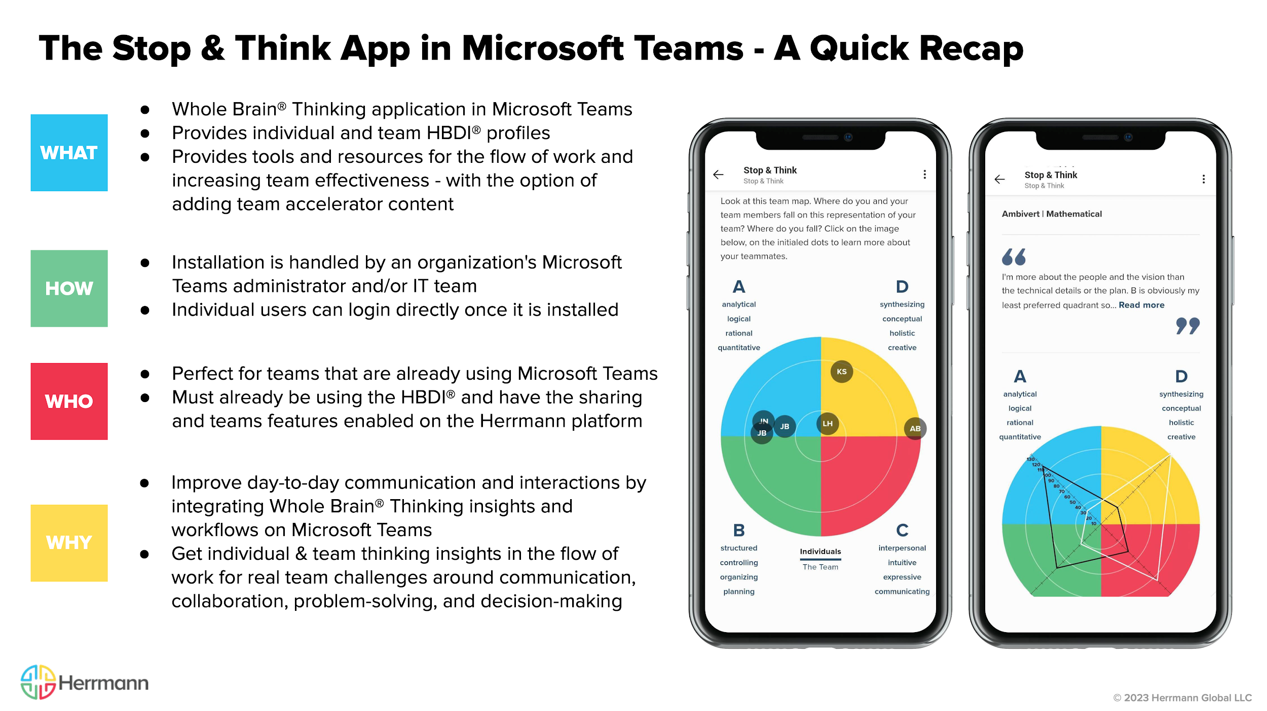
Notes:
Note to Presenters: This is a good time to recap, field any questions, and circle back to specific sections as needed.

