Slide 1
Herrmann Whole Brain® Year in Review
Activity Template
Notes:
Use the slides in this deck to facilitate a “Year in Review” retrospective activity with an intact or functional team.
DELETE THIS SLIDE

Slide 2
Planning with Whole Brain® Thinking: Goal Setting and Year in Review
20xx
Notes:
[Update the year as needed]

Slide 3
Activity: Accomplishments & Improvements Retro
Why
It’s easy to forget what went well. It’s easy to miss the lessons from what went wrong and take actions to improve.
Others may have different memories or experiences. Hearing different perspectives adds depth to our perception and insights.
What
Uses the Whole Brain® Strengths and Frustrations Checklists for reference, then complete Goals & Accomplishments Retro, Needs Improvement Retro, and a Goals Walkaround
How
Individual reflection followed by team discussion for insights and takeaways
Who
Any functional or special project team and manager, leader, supervisor
Notes:
SAY Let’s walkaround today’s activity. We’ll be doing a Year in Review; a retrospective of accomplishments and Improvements [READ EACH QUADRANT]

Slide 4
Accomplishments & Improvements Needed
Why Strengths Matter
They are opportunities
Leverage your strengths to ease discomfort for you and for others
Accelerate positive outcomes by repeating behavior that works
They are indicators of areas of accomplishment
Why Frustrations Matter
Opportunities to stretch your thinking!
Understand how other’s profiles interact with yours
Your frustrations are indicators of areas you need to work on
Notes:
[First, Share why strengths matter…] Why Strengths Matter
Your strengths represent our opportunities to thrive by leaning in to what we do best. This is where ww feel comfortable and can contribute best at work and at home. In challenging times we can leverage our strengths to ease discomfort for ourselves and for others and accelerate positive outcomes.
In every situation ask, how can my/our strengths contribute to this?
[Share why frustrations matter…] Why Frustrations Matter
Frustrations represent opportunities to stretch our thinking. We’re frustrated because other people’s thinking doesn’t match our preferred thinking style. For example, you prefer A quadrant logical thinking based on facts and data. You were frustrated every time you talked to the Marketing Team because they spent too much time on big ideas that had no data to back up potential approach.
These are you opportunities to stretch our thinking into less preferred ways of thinking.

Slide 5


Strengths Checklist
Check every item below that represents strengths you clearly demonstrated this past year.
Goals & Objectives
Big Picture
Gathering facts
Analyzing issues
Arguing rationally
Forming theories
Measuring precisely
Problem solving logically
Understanding technical elements
Working with numbers, statistics, data & precision
Reading the signs of coming change
Seeing the “big picture”
Recognizing new possibilities
Tolerating ambiguity
Integrating ideas and concepts
Challenging established policies
Synthesizing unlike elements into a new whole
Inventing innovative solutions to problems
What
Why
Plans
Others
How
Who
Finding overlooked flaws
Approaching problems practically
Standing firm on issues
Maintain a standard of consistency
Reading fine print in documents/contracts
Organizing and keeping track of data
Developing detailed plans and procedures
Articulating plans in an orderly way
Recognizing interpersonal difficulties
Anticipating how others will feel
Intuitively understanding how others feel
Picking up the non-verbal cues of interpersonal stress
Engendering enthusiasm
Persuading, conciliating
Teaching
Sharing
Notes:
[Use this Strengths Checklist with the team as an activity to recognize what went well and what was accomplished this year. Give team members 10 minutes on their own to do this slide and the frustrations slide - use annotate in Zoom of have the screenshot and check of on the desktop - to check off what they think went well. Then lead a 15-20 minute discussion and have them compare and share their thinking about the strengths in each quadrant. Ask, what are your insights about this year now that you have reflected and heard the thoughts of others? What do you feel proud of?. ]
SAY Identifying and reflecting on what went well shows us behaviors and practices that we want to repeat in the future. Often we find there were many things that went well, but those can be easy to forget.

Slide 6
Frustrations Checklist
Check every item below that was a great source of frustration for you in the past year.
Goals & Objectives
Big Picture
Inarticulate, “off the track” communication
Excessive “chatter”
Vague, ambiguous approaches or instructions
Illogical comments
Inefficient use of time
Lack of facts or data
Inappropriate informality
Fear of challenge or debate
Too slow paced
Overtly structured, predictable
Absence of humor and fun
Lack of flexibility, too rigid
Inability to get concepts or metaphors
Drowning in detail
Too many numbers
Dry, boring topic or style
What
Why
Plans
Others
How
Who
Unknown or absence of a clear agenda
Disorganized
Too many ideas at once
Unpredictable
Too fast paced
Unclear instructions or language
Not getting to the point fast enough
Lack of closure
Lack of interaction
No eye contact
Impersonal approach or examples
Dry or “cold” unenthusiastic interaction
Insensitive comments
No time for personal sharing
Lack of respect for feelings
Overly direct or brusque dialogue
Notes:
[Use this Frustrations Checklist with the team as an activity to recognize what could have gone better. Give team members 10 minutes on their own to do the Strengths slide and this one. Then lead a 20-30 minute discussion and have them compare and share their thinking about the strengths in each quadrant. Decide if they should make notes on their own slide, take their own notes on paper, or use Zoom annotate as a group to add checkmarks to the slide.]
SAY It’s important to resolve frustrations before they turn into increased stress and burnout. Use this list to recall areas of frustration for you personally and for the team.

Slide 7

Whole Brain Year in Review:
Team Accomplishments and Needs Improvement
Use Strengths and Frustrations checklist slides for reference to indicators of your 1. Team Accomplishments and areas that 2. Team Needs Improvement.
Take 10 minutes to do this by yourself.
Share with the team
Notes:
SAY In this breakout activity we’ll discuss what worked and what didn’t for the team this year. I’ll give you 10 minutes to reflect by yourself. Use the the Strengths Checklist and the Frustrations Checklist. You will need to record your learnings and be prepared to share your thoughts when I call time’s up. [Facilitation decision: Do you want them to take notes in their own slide on paper or a group slide?]

Slide 8

Team Discussion
Notes:
[Use this slide to refocus the team to prepare for sharing]

Slide 9
Team Goals & Accomplishments Retro
In each quadrant make a list of accomplishments from this past year.
Goals & Objectives
Big Picture
EX: Identified, tracked and measured goals for hi-po program
EX: Designed innovative program for employee engagement using a Whole Brained design
Planned development strategy for product division
What
Why
Plans
Relationships
How
Who
EX: Created system to keep track of data
Developing detailed plans and procedures for onboarding using Journey
EX: Trained employees in new tools
Created stronger partnership with vendor using WBT
Mentored a new CP
Notes:
[Invite volunteers to share, make sure everyone’s voice is heard. Collect all the input into one document] SAY Who would like to share?
Think about how your preferences/strengths helped you here…..What do you notice?

Slide 10
2. Team Needs Improvement Retro
Create a list of of what needs improvement for you in the past year.
Goals & Objectives
Big Picture
EX: needed better data and measures for the C-suite
Needed time to learn better tech tools
EX: Needed to think the whole year out as a strategy to guide better decision making
Could anticipate needs month to month vs hour to hour to help with better planning
What
Why
Plans
Relationships
How
Who
EX: Needed to be more consistent with agendas for meetings
Needed to build better processes for documenting learnings
EX: Needed to reach out and learn more from vendor partners
Could share my thinking more with my employees
Notes:
SAY Now let’s look a what we could have done better as a team. What are your insights about this year now that you have reflected and heard the thoughts of others? Who would like to share?
[Invite the team to share their thoughts. Make sure every voice is heard. Record their insights].

Slide 11
Goal Setting for 202x
the Whole Brain® Way
Notes:
[Use this slide by updating the year in the date.]
SAY Now let’s use the insights from our last activity to set goals for next year.

Slide 12
Why Goals Matter...
If you can’t define your goal and be specific about what it is you want to achieve, then how do you know if you’re taking the right steps or if you’re getting closer to reaching your goal?
Not answering WHY may lead to you running around without a purpose and losing buying and reducing motivation.
What
Wy
Why
Hw
How
Who
Who
Planning and focusing on doing without asking why, what and who can lead you into a false sense of achievement without hitting the actual goal.
Failing to reflect on how your goals affect other people, or not seeking out others’ opinions, or drawing on other assistance, can lead to failure or disappointment.
Notes:
SAY Setting goals is an important practice because…
[READ THROUGH EACH QUADRANT STARTING WITH WHAT AND GOING COUNTER CLOCKWISE]

Slide 13
What each quadrant needs to know about a goal for it to be meaningful
Focus on facts
SMART goals
Organizational metrics (numbers)
Define outcomes
Connection of the big picture (vision/mission)
A defined end state (what complexion looks like
How it fits in overall with other goals
What
Wy
Why
Hw
A clear process to achieve goals
Process plan, steps
Facts and figures and how they fit together to support the goal
Monitor progress (milestones)
Small group meetings, review tasks
How
Who
Who
Needs - resources
Skills people need
Celebration/rewards for achievement
Who will be involved, impacted
Notes:
SAY Let’s look at what each quadrant needs when creating a goal.
[READ THROUGH EACH QUADRANT]

Slide 14


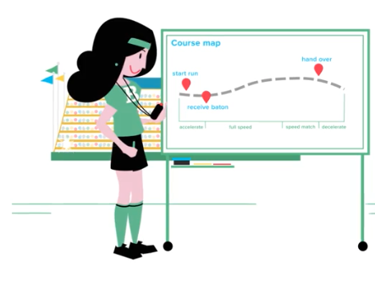
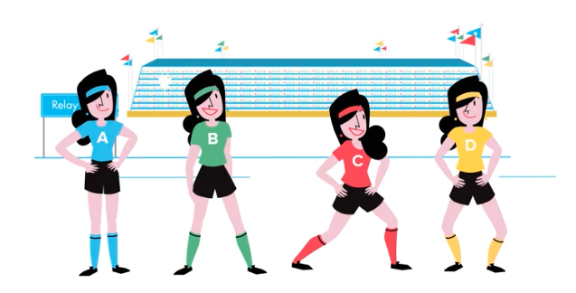
3. Goals for next year
Goals & Objectives
Big Picture
EX: Run a 5k in under 25 minutes
EX: Vision is to win in my age class
What
Why
Plans
Relationships
How
Who
EX: Follow a schedule to train for a 5K
EX: Join a running group to train
Notes:
SAY Before we set our goals, let’s walk through an example goa using the Whole Brain WalkAround. In this example, the goal is to win a medal in a 5k race.
[READ THROUGH EACH QUADRANT starting in the yellow quadrant]

Slide 15
3. Goals for next year
Goals & Objectives
Big Picture
Xx
Xx
xx
Xx
Xx
Xx
What
Why
Plans
Relationships
How
Who
Xx
Xx
Xx
Xx
Xx
Xx
Notes:
SAY Now, let’s set some goals for this team for next year
[WALK THE TEAM THROUGH THE ACTIVITY BT STARTING IN THE A QUADRANT, THEN GO COUNTER CLOCKWISE.]

Slide 16
Notes:
Any comments or questions?

