Slide 1

The Business of Thinking®
ThinkAbout Problem Solving
The Business of Thinking®
Notes:
DO: Have an executive or sponsor kick-off.
DO: Welcome participants and introduce yourself as the facilitator.
SHOW: slide: ThinkAbout Problem Solving

Slide 2
ThinkAbout Problem Solving Sections
Whole Brain® Problem Solving
Partnering for Better Problem Solving
Flexing to Solve Problems
The Problem Behind the Problem
Notes:
SAY: The ThinkAbout Problem Solving workshop consists of four sections. (Read the titles.)

Slide 3
Section 1: Whole Brain® Problem Solving
Problem Solving Methods
“Survival”
The Whole Brain® Model
The Whole Brain® at Work
Action Plan
Notes:
SAY: In this ThinkAbout Your Problem Solving workshop, you will learn how Whole Brain® Thinking can help you to become better prepared to solve problems in your work life as well as personal life.

Slide 4
Learning Objectives
At the end of this section, you will be able to:
Understand how your thinking preferences affect the way you solve problems.
Appreciate how others thinking preferences can impact the problem-solving process.
Leverage Whole Brain® Thinking in problem solving.
Notes:
Note to Facilitator: Prepare the video on the next slide in advance so that it is queued up to begin promptly. The example video shown comes from the television sitcom Big Bang Theory, demonstrating a simple problem that four friends are trying to solve. A similar video can be used as an alternative.
DO: Review learning objectives with the group.
SAY: Let’s begin our section with this video clip.

Slide 5
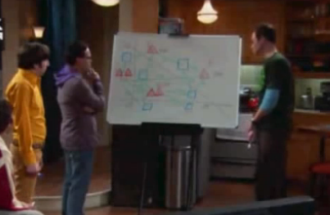

“The Problem Appears to be Unsolvable”
Notes:
https://www.youtube.com/watch?v=lm9gOxnX5XM (1:48)
SAY: “The problem appears to be unsolvable.” That’s how the friends’ discussion began, and yet, after mapping it out, considering the facts, and sharing their opinions, they did arrive at a solution. And although someone got left out, he too realized it was the best solution for the group to make (with humor).
In this module, ThinkAbout Problem Solving, we are going to focus on solving problems. Some problems we run into are simple, like the one illustrated in the video, and some are more complex and difficult to solve.
Note to Facilitator: Be familiar with any problem-solving strategies or method(s) that the organization endorses. (e.g. Fishbone/Ishikawa Diagram, GROW Model)
SAY: Let’s begin by analyzing the way we currently solve problems. Does your organization have a method that you currently use? Are there problem-solving strategies put in place?
DO: Encourage the participants to discuss and offer explanations of how they see their organization handle problem solving currently. They may also want to include in their discussion examples of their experiences in other work situations that worked or did not work well.
SAY: Let’s take a moment and consider just a few well-known problem-solving methods.

Slide 6
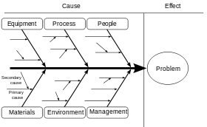
Problem Solving Methods
• Root Cause Analysis (RCA)
• Fishbone (Ishikawa) Diagram
• GROW Model
• 8D
• TRIZ
G | Goal
R | Reality
O | Obstacles/Options
W | Way Forward
Notes:
READ and REVIEW Problem Solving Methods
Root Cause Analysis (RAC)
Fishbone (Ishikawa) Diagram
GROW Model
8D
TRIZ
SAY: Some of you may not be aware of these methods, or your organization doesn’t use one method consistently; but, regardless, I’m guessing that you still struggle a bit with problem solving.
SAY: We are going to see how well you solve problems by giving you one right now.

Slide 7
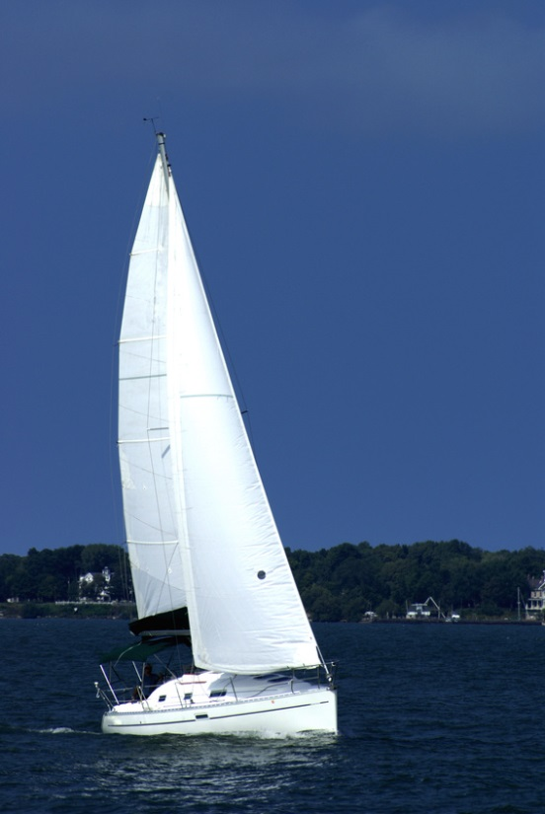
“Survival”
A sextant (instrument measures longitude and latitude at sea)
A shaving mirror
Mosquito netting
A 25 liter container of water
Case of army rations
Maps of Atlantic Ocean
A floating seat cushion
A 10 liter can of oil/gasoline mixture
A small transistor radio
20 square feet of opaque plastic sheeting
A can of shark repellant
One bottle of 160% proof rum
15-foot nylon rope
2 boxes of chocolate bars
An ocean fishing kit with pole
Source: http://insight.typepad.co.uk/lost_at_sea.pdf
Notes:
Note to Facilitator: You will want to break the large group into smaller groups for this activity. If you are meeting virtually, assign groups of 3-4 people, if meeting f2f you can assign groups by tables or another simple method. http://insight.typepad.co.uk/lost_at_sea.pdf
SAY: This exercise is called “Survival,” which implies of course that the goal is to survive.
SAY: Listed, here, are the 15 items that you have near you as your ship is sinking fast. Discuss among yourselves which items would be the most valuable to take from the ship into your life raft, which you have also managed to salvage along with a box of matches. Rank them 1 to 15, with 1 being most important. I will assign you small groups to rank the items and you will have 8 minutes to complete the activity.
ALLOW: The groups 8 minutes.
ASK: Groups to share their lists and their reasoning.
SAY: Before I show you the Coast Guard’s answers, let’s discuss how your groups approached the problem. What did you notice? How did your group members interact during the problem solving process?
SAY: No matter what method was used, there are some additional factors to consider when trying to solve a problem, especially on a team.
SAY: Consider the Whole Brain® Model.

Slide 8

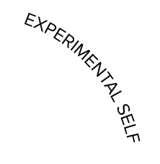


Our Four Different Selves
A
D
Analyzes
Quantifies
Is logical
Is critical
Is realistic
Likes numbers
Knows about money
Knows how things work
Infers
Imagines
Speculates
Takes risks
Is Impetuous
Breaks rules
Likes surprises
Is curious / Plays
Takes preventive action
Establishes procedures
Gets things done
Is reliable
Organizes
Is neat
Timely
Plans
Is sensitive to others
Likes to teach
Touches a lot
Is supportive
Is expressive
Is emotional
Talks a lot
Feels
B
C
The four-color, four-quadrant graphic and Whole Brain® are registered trademarks of Herrmann Global, LLC.
Notes:
SAY: If you recall, each of us has our preferred thinking styles. Consider your own profile. Refer to your HBDI® Profile at this time.
SAY: As you review the Whole Brain® Model, and your own profile with your thinking preferences, consider where this came into play in the little problem solving exercise we just did.
SAY: For example, consider the Green/B quadrant. This is referred to as the ”How” quadrant of the model. If any of you have this as your highest preferred thinking preference, it’s possible that you like to solve problems in a very orderly fashion. You may prefer a step-by-step process, a well-planned method to arrive at a solution.

Slide 9
Problem-Solving Walk Around
Having a technical perspective
Checking the numbers closely
Examining things critically
Concentrating on fixing it
Calling in an expert
Analyzing in depth
Doing research
Getting excited, maybe impatient
Generating lots of “crazy” ideas
Looking for new perspectives
Breaking the rules to solve
Looking at “the big picture”
“Sleeping on it”
Brainstorming
Making a plan
Minimizing the risk
Taking first things first
Organizing the information
Focusing on time and timelines
Searching for overlooked details
Considering steps to be completed
Talking it out
Building a team
Calling a friend for help
Listening to own intuition
Getting emotionally engaged
Considering own values/feelings
Persuading those involved to help
Notes:
Note to Facilitator: If available, provide a Thinking Desk Flip for each table. Ask that someone at each table please flip to the Problem-Solving Walkaround page.
SAY: This Problem-Solving Walk-Around provides a clear picture of how a person’s thinking preferences may affect their method for problem solving.
DO: Briefly review the slide and discuss the various quadrants.
SAY: Take a few minutes and check the items that best reflect your preferred approach to problem solving.
SAY: Perhaps your organization uses a standard process for solving problems; but, as you can see, the team members’ preferences add other layer to that method. Let’s take a minute to consider your “survival groups” and the effect that thinking preferences had on your problem-solving task.

Slide 10
The Whole Brain at Work
Notes:
SAY: Use what you know about Whole Brain® Thinking to answer the following questions in your small group. I will give you a moment to think about each question.
Write down your observations of how your group worked in the survival problem-solving scenario, related to the Whole Brain® Model. For example:
Did someone in your group bring blue-quadrant thinking, such as providing factual information (i.e. the absence of mosquitos in Atlantic Ocean)? (give each group a moment to discuss)
Did someone in your group think of procedure like rationing food, bringing green-quadrant thinking? (give each group a moment to discuss)
Were any quadrants’ thinking preferences obviously missing, which led to some important survival omissions? (give each group a moment to discuss)
Would you do anything differently? (give each group a moment to discuss)
Are there any changes you’d like to make to your rank order? (give each group a moment to discuss)
DEBRIEF: Share relevant outcomes form the list below and invite a short discussion:
Your most preferred method of thinking (highest profile score/ quadrant) took over in the task of solving the problem.
You did not utilize the other quadrants as much.
You weren’t aware of the thinking preferences of others, or you were not very open to them.
SAY: As we continue through this module, we will show you how to use Whole Brain Thinking® to become a better problem solver yourself, as well as helping your team solve problems more effectively.
SAY: I’ve kept you in suspense long enough. Here is how the experts would rank these items.

Slide 11
“Survival”
15 - A sextant
1 - A shaving mirror
14 - Mosquito netting
3 - A 25 liter container of water
4 - Case of army rations
13 - Maps of Atlantic Ocean
9 - A floating seat cushion
2 - A 10 liter can of oil/gasoline mixture
12 - A small transistor radio
5 - 20 square feet of opaque plastic sheeting
10 - A can of shark repellant
11 - One bottle of 160% proof rum
8 - 15-foot nylon rope
6 - 2 boxes of chocolate bars
7 - An ocean fishing kit with pole
Source: http://insight.typepad.co.uk/lost_at_sea.pdf
Notes:
http://insight.typepad.co.uk/lost_at_sea.pdf
Review the rankings.

Slide 12
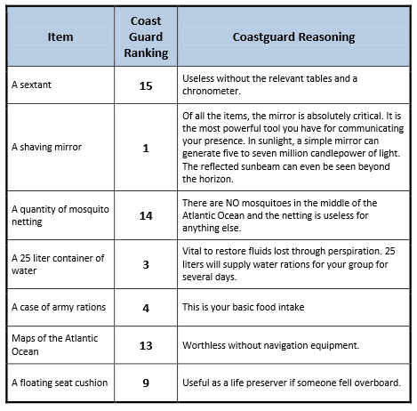
Coast Guard Expert Analysis
Notes:
Note to Facilitator: Explanations appear on the two subsequent slides.

Slide 13
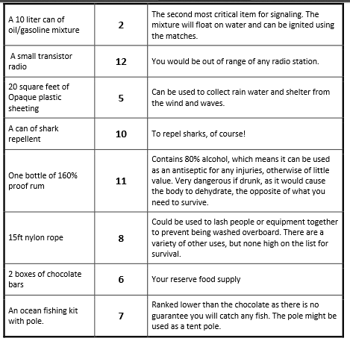
Coast Guard Expert Analysis

Slide 14

Key Thoughts
Your thinking preferences play a big part in how you go about solving problems individually and as a team.
Engaging people with other thinking preferences will make the problem-solving process more inclusive.
You may need to stretch into your less-preferred quadrant(s) to arrive at a more whole-brained solution.
Notes:
DO: Share Key Thoughts:
Your thinking preferences play a big part in how you go about solving problems individually and as a team.
Engaging people with other thinking preferences will make the problem-solving process more inclusive.
You may need to stretch into your less-preferred quadrant(s) to arrive at a more whole-brained solution.
SAY: This ends Section 1, Whole Brain® Problem Solving.
SAY: After completing this first section, you should have achieved these outcomes.

Slide 15
Learning Objectives
At the end of this section, you will be able to:
Understand how your thinking preferences affect the way you solve problems.
Appreciate how others thinking preferences can impact the problem-solving process.
Leverage Whole Brain® Thinking in problem solving.
Notes:
DO: Review each earlier stated objective.
SAY: All that remains is creating your action plan.

Slide 16

Action Plan
Consider the problems that you have had to solve in the past – in the workplace or in your personal life.
Take a few moments to write down your observations of the effects of your own thinking preferences, and also of a team’s thinking preferences, on problem solving.
What will you do differently, when confronted with a problem that needs to be solved?
Notes:
SAY: Consider the problems that you have had to solve in the past – in the workplace or in your personal life.
Take a few moments to write down your observations of the effects of your own thinking preferences, and also of a team’s thinking preferences, on problem solving.
What will you do differently, when confronted with a problem that needs to be solved?
ALLOW: 2 minutes.

Slide 17

Section 1: Whole Brain® Problem Solving
End of Section 1
Next:
Partnering for Better Problem Solving

Slide 18
Section 2: Partnering for Better Problem Solving
What’s for Lunch?
Thinking Partnerships
Invite Cross-Training
Action Plan
Notes:
SAY: Thinking back to our last section, Whole Brain® Problem Solving, we acknowledged that each individual’s thinking preferences affect “How” they solve problems.
SAY: In this section, we will continue to learn about the power of Whole Brain® Thinking and how diverse thinking styles can contribute to the problem-solving process.

Slide 19
Learning Objectives
At the end of this section, you will be able to:
Recognize the role each quadrant plays in problem solving.
Leverage contrasting thinking preferences to increase possibilities.
Use the Problem-Solving Walk-Around to create a problem-solving process.
Notes:
DO: Review learning objectives with the group.
SAY: Let’s work on a common group problem, “What’s for lunch?” It’s hard to get a group of people to agree on where to go for lunch, isn’t it?

Slide 20

“What’s for Lunch?”
Notes:
SAY: Take a moment, individually, to think about what you might want for lunch today, and write it down. If you aren’t sure of what is available in the area, feel free to use your smart phones or laptops to find nearby restaurants and menus. Please do this on your own – no talking or asking your neighbors.
Note to Facilitator: This is just an exercise; it is not what the class is really going to do for lunch. If this section is being conducted in the afternoon, it can be for tomorrow’s lunch or lunch for an upcoming meeting.
ALLOW: 2 minutes.
DO: Group the participants in groups of 5-6.
SAY: Here is the fictitious problem. You have a 45-minute lunch break, an $8.00 limit per person, and you all need to get your lunch from the same restaurant. Oh, and you probably all want something different, right?
SAY: You have about 10 minutes to come to consensus, dealing with issues of time, quality, cuisine, and cost.
ALLOW: 10 minutes.
DEBRIEF: Ask each group to take a closer look at the way they solved this problem.
Were you able to come to consensus?
Who did what?
Did anyone try to use the Problem-Solving Walk-Around? How detailed is your order? (e.g. does it include special requests, condiments, side items,
beverages, desserts, cost for each person?)
Was anyone annoyed by or uncomfortable with the process you used?
Did anyone compromise? Did they do it willingly?
Does this relate in any way to the way you, your team or your company solves problems?
SAY: Have you ever noticed that some problems seem to be designed for certain people to solve? And some groups are able to arrive at solutions more easily?
Homogeneous, or like-minded, groups might quickly solve problems more quickly, but that doesn’t necessarily mean that it is a good solution.
Heterogeneous, or diversely thinking, groups may require more time to solve problems, but are more likely to consider more possibilities and viewpoints.

Slide 21

"Thinking styles play a part in one of the most important factors in a team’s ability to innovate and solve problems – its diversity.
Because diversity is critical to successful idea generation in
teams, the greater the diversity, the exponentially greater the number of ideas a team can generate in response
to a problem or opportunity."
Associate Professor of English
Margaret (Margo) Lukens
Notes:
SAY: This comes from the University of Maine case study, which can be found on the Herrmann website. The case study notes that a person’s approach to problem solving will reflect their thinking preferences to some extent.
URL: http://www.herrmannsolutions.com/university-of-maine-developing-innovative-thinkers/

Slide 22




University of Maine – Cross-Training
A
D
B
C
The four-color, four-quadrant graphic and Whole Brain® are registered trademarks of Herrmann Global, LLC.
Notes:
SAY: In the university’s entrepreneurship program, individuals are paired who have adjacent profiles (ex: A/D and B/C). This type of “cross-training” allows each to bring a different perspective and stretch their thinking, thus increasing the number of possible solutions and opportunities.
SAY: This leverages the perspectives of “contrasting” quadrants – the upper and lower modes. These are additive and synergistic, but not without challenges. (Note that pairings between the quadrants of the left or right hemispheres would be “compatible” – supportive and reinforcing – so the perspectives would not be very different. Pairings of diagonal quadrants would be opposing and possibly confrontational.)

Slide 23

Cross-Training
“Cross-training refers to an athlete training in sports other than the one that the athlete competes in, with a goal of improving overall performance.
It takes advantage of the particular effectiveness of each training method, while at the same time attempting to negate the shortcomings of that method by combining it with other methods that address its weaknesses.”
- Wikipedia
Notes:
http://en.wikipedia.org/wiki/Cross-training
SAY: (paraphrasing the slide) In this context, we are defining “cross-training” in the athletic sense. By training in multiple
sports, an athlete’s overall performance is improved, through exposure to the best of different training methods.
SAY: The University of Maine has found the program to be so successful, that it is offered as a minor to anyone in their university, no matter what their major area of study.
SAY: Here is what Ann Herrmann-Nehdi has to say about cross-training.

Slide 24

Cross-Training Your Brain
Notes:
URL: https://www.youtube.com/watch?v=hxpOT3N3iaY&feature=youtu.be (3:53)
PLAY: The video clip: Cross-Training Your Brain. (3:53)
Note to Facilitator: Review the sample problems in the slide, “Invite Cross-Training.” Add or remove sample problems as needed for this group. You may opt to use a real-life problem, provided by the organization or intact team in advance. Caution: Do not allow a real problem to derail the workshop or turn into a blaming session.
SAY: Earlier we solved a fairly simple problem in the activity, “What’s for Lunch?” Each person, no matter what their thinking preference, brought a little something to the problem-solving task.
What if the stakes were higher? Let’s imagine a few more authentic problem that might exist at work. In this next activity, remember to consider all four quadrants.
Consider:
What could a person with the thinking preferences in each quadrant bring to a problem-solving task?
Who would you want to be on the team, so that you could “cross-train” with them, and increase the possible solutions and opportunities?

Slide 25
Invite Cross-Training
Select one problem:
Delayed delivery times repeatedly with certain customers
Personnel problem – two team members are disagreeable
The need to create new procedures for processing orders
Implementation of management’s decision for two team members to job share, splitting a role
Training is to be put online, to include regional divisions
Your organization feels the need for an online presence
You are not to solve the problem.
Discuss what beneficial ideas and questions might come from each of the four quadrants.
Notes:
SAY: In a moment, I’m going to group you into small groups. Listed here, are several problems. Select the one that your group can most relate to in your current workplace environment.
SAY: Use the Whole Brain® Problem-Solving Walk-Around that is in your workbook to assist you in clarifying what each thinking preference would bring to help solve the particular problem.
SAY: Your task in this exercise is not to solve the problem, but to discuss and determine what beneficial ideas and questions might come from each of the four quadrants.
Possible problems can include:
Delayed delivery times repeatedly with certain customers
Personnel problem – two team members are disagreeable
The need to create new procedures for processing orders
Implementation of management’s decision for two team members to job share, splitting a role
Training is to be put online, to include regional divisions
Your organization feels the need for an online presence
DO: Divide the participants into groups of 3-4 people.
ALLOW: 10-12 minutes.
DEBRIEF: Share with the group that In an ideal work situation, you would invite someone to join your team, or problem-solving meeting, who could provide the thinking preferences that are often avoided or overlooked, the less-preferred thinking preferences. But, if that is not an option, make a conscious effort to consider all four quadrants in your problem solving.
ASK:
Did you discover some questions and possibilities that were generated by teammates who have your less- preferred thinking styles?
Can you remember a work-related problem, or think about one you are working on currently, that would be easier to solve with the benefits of Whole Brain® Thinking?

Slide 26
Key Thoughts
People with different thinking preferences solve problems differently.
Partnering with a co-worker can increase possible solutions and opportunities.
The application of the Problem-Solving Walk-Around creates a problem-solving process that includes all preferences.
Notes:
DO: Share key thoughts:
People with different thinking preferences solve problems differently.
Partnering with a co-worker can increase possible solutions and opportunities.
The application of the Problem-Solving Walk-Around creates a problem-solving process that includes all preferences.
SAY: This ends Section 2: Partnering for Better Problem Solving.
SAY: After completing this section, you should have achieved the outcomes on the following slide.

Slide 27
Learning Objectives
At the end of this section, you will be able to:
Recognize the role each quadrant plays in problem solving.
Leverage contrasting thinking preferences to increase possibilities.
Use the Problem-Solving Walk-Around to create a problem-solving process.
Notes:
DO: Review each earlier stated objective.
SAY: All that remains is creating your action plan.

Slide 28
Action Plan
Take a few moments to create a problem-solving network.
Identify a list of people who have thinking preferences that contrast with yours, who can add fresh perspectives to your problem-solving process.
Notes:
SAY: Take a few moments to create a problem-solving network. Identify a list of people who have thinking preferences that contrast with yours, who can add fresh perspectives to your problem-solving process.
DO: Encourage participants to think beyond their standard work group or circle.
ALLOW: 2 minutes.

Slide 29
Section 2: Partnering for Better Problem Solving
End of Section 2
Next:
Flexing to Solve Problems

Slide 30
Section 3: Flexing to Solve Problems
Natural Problem-Solvers
“Think Outside the Box”
Whole Brain® Problem Solving
Using the Whole Brain® Problem Solver
Action Plan
Notes:
Note to Facilitator: Prepare the video in advance. The video chosen should emphasize our natural instinct to solve problems. The sample video chosen is from the work of B.F. Skinner, “A Pigeon Solves the Classic Box-and-Banana Problem”. An alternate video can be chosen to show an animal instinctively solving a problem.
SAY In this section, you will discover your personal tendencies when solving problems. Sometimes you will need to control these tendencies in order to solve problems more effectively.

Slide 31
Learning Objectives
At the end of this section, you will be able to:
Identify your tendencies in solving problems.
Think beyond your own perspective to more effectively solve problems.
Utilize various techniques to improve your problem solving skills.
Notes:
REFER participants to their workbooks.
READ and REVIEW the objectives
SAY Let’s begin by watching this short video.

Slide 32
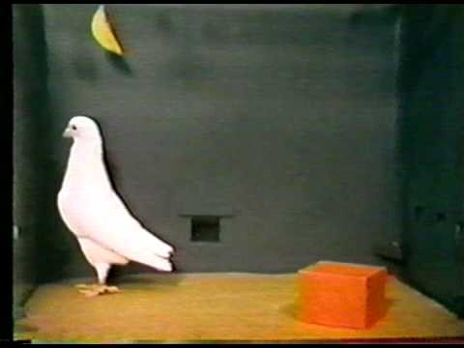
Natural Problem Solvers
Notes:
https://www.youtube.com/watch?v=mDntbGRPeEU
PLAY the video clip: “A Pigeon Solves the Classic Box-and-Banana Problem.” (1:09)
URL:
http://www.bing.com/videos/search?q=bird+problem+solving+videoS FROM=VIRE15#view=detail&mid=F697C918CD415F14C558F697C918CD415F14C558
SAY Just as this bird demonstrates, we too are natural problem solvers. In our quest to survive, we figure out a way. We solve problems to get us out of our uncomfortable status, whatever that may be.
SAY Let’s try a little problem that will require some thinking.

Slide 33
Connect the Dots
Connect all 9 dots by drawing
4 straight consecutive lines.
Notes:
DO Read the slide aloud, explaining the task - Connect all 9 dots by drawing 4 straight consecutive lines.
DO Encourage each participant to try this at their seat individually without sharing their solution, should they get it.
SAY If you have seen this before, do not give away the answer.
ALLOW 1-2 minutes.

Slide 34
Connect the Dots
Notes:
ASK who was able to get the right solution, of those who had not seen it before.
SAY At times, we get stuck, viewing things in only one way. In this exercise, our brain naturally places a frame around the nine dots.

Slide 35
“Think Outside the Box”
Notes:
SAY By doing this, we immediately limit the possibilities of making a solution work. So we need to free ourselves of some of the limitations we put into place as we try to solve problems.
SAY Just out of curiosity, out of those of you who were able to “connect the dots” the first time you saw this activity, who has a preference in the yellow/D quadrant? Why would I ask that? The Yellow/D-quadrant of the Whole Brain® Model aligns with people who often do “think outside the box”. They are innovative; they break rules to solve problems; they are always looking for new perspectives. So if this is your strongest thinking preference, you may find it easier than others to “think outside the box.” But everyone is capable. You just have to retrain your brain.

Slide 36

Optical Illusions
Notes:
SAY You may have been teased with these optical illusions before. Yet even if you have seen them in the past, it may take your mind a few minutes to rethink it through.
SAY Can you see the two different images women – young and old? (Assist as needed.)

Slide 37
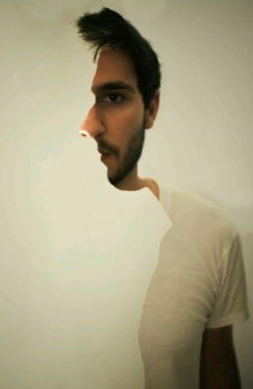
Optical Illusions
“First-rate intelligence: The ability to hold two opposed ideas in the mind at the same time, and still retain the ability to function.”
F. Scott Fitzgerald
Notes:
SAY Can you see the two man facing two ways – left and forward? (Assist as needed.)
ASK How does it make you feel as you try to retrain your brain to see something that does not come to you naturally?
Possible discussion points/ observations:
Did these images actually make your brain ”hurt” a little?
Do you get frustrated when the images didn’t come to you quickly? (especially if you’ve seen them before)
Did you concentrate on a smaller piece of the larger picture to try to bring the image into focus?
SAY The reactions you have when trying to retrain your brain on these images, may be similar to what you feel when you try to solve problems. It may “hurt” a little bit. You may have to focus on a small piece. You may have to “think outside the box.” You may want to step back and look for new visuals, or new concepts, in order to solve problems.
Whole Brain® Thinking encourages this kind of Thinking Agility. By stretching into the other quadrants, your less- preferred thinking styles, you are going to be able to think in ways that you would not think instinctively.

Slide 38
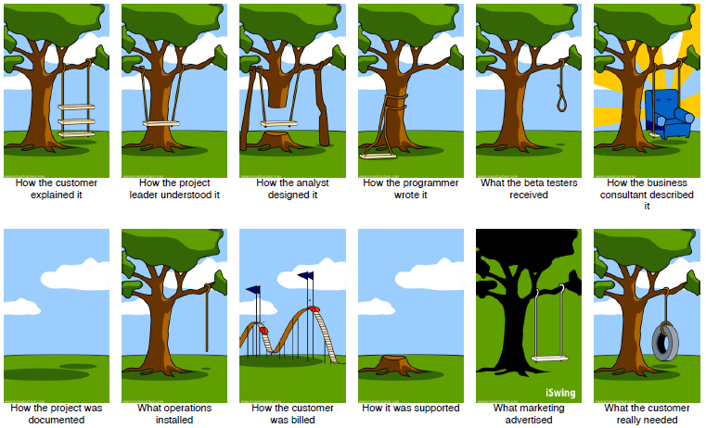
Whole Brain® Problem Solving?
Notes:
Source: http://www.projectcartoon.com/pdf.php?CartoonID=2&PaperSize=Letter
SAY It seems that this team of problem solvers operated with each individual member having an isolated idea, with little or no communication between the team members. They did not work together for Whole Brain® Problem Solving.

Slide 39

Situational “Stretch”
“Life is like a ten speed bicycle –
we all have gears that we never use.”
- Charles Schultz
The four-color, four-quadrant graphic and Whole Brain® are registered trademarks of Herrmann Global, LLC.
Notes:
SAY We need help to stretch into new ways of thinking, communicating and collaborating. Problem solving in a
vacuum may lead to a viable solution, but necessarily not the best one.
SAY The Whole Brain® Problem Solver is one tool to help with that stretching of your thinking preferences, to improve your
Thinking Agility..

Slide 40
Whole Brain® Problem Solver
The Steps The Questions The Answers
Step One:
Gather the facts
A. What are the key facts? Who? What? When? Where? Why
B. I have all the details? Is there an important bit I am missing?
C. What does my intuition tell me? What do other people feel about it?
D. What is the main issue? Am I missing any links?
Step Two:
Define the problem
^{A. Based purely on the facts …}
B. From an organizational point of view …
^{C. From a people perspective …}
D. From a big-picture holistic view ...
Step Three: Develop solutions, then select the best one.
A. What tools, techniques, and technology can we use?
B. What processes, procedures, or structures could we use?
C. Who else can help us solve this?
D. What wild, outside-of-the-box ideas can you think of?
Step Four: Implement the best solution
^{A. What resources do we need?}
^{B. What are the action steps?}
C. Who do we need to involve, and are they available?
D. How will we know we are getting maximum results from the solution?
Notes:
REFER participants to their workbooks.
SAY Let’s take a few minutes to review the four steps and see how each quadrant is addressed through this problem solving process.

Slide 41
Whole Brain® Problem Solver - Step 1
The Steps The Questions The Answers
Step One:
Gather the facts
A. What are the key facts? Who? What? When? Where? Why
B. I have all the details? Is there an important bit I am missing?
C. What does my intuition tell me? What do other people feel about it?
D. What is the main issue? Am I missing any links?
Notes:
SAY In the real world, this process will likely be iterative. You may go through steps 1 and 2 and then come back to 1 for
more fact-gathering before moving forward.
SAY By using this tool, everyone in a problem solving team can address all thinking styles.
Even as an individual solving a problem, you can use the tool to ensure that you are including the thinking styles that are not naturally your most preferred. You, in effect, become a team,” as you use Whole Brain® Problem Solver.
DO Divide the participants to groups of 3-4 people, as heterogeneous as possible.
Note to Facilitator: Prepare a potential problem to be solved by the group of participants. Some generic problems are suggested below. If using a real problem provided in advance by the organization or intact team, suggest that they use a “parking lot” to capture things that need to be verified outside of class. Don’t allow roadblocks and blame to consume the exercise.

Slide 42
Whole Brain® Problem Solver - Step 2
The Steps The Questions The Answers
Step Two:
Define the problem
^{A. Based purely on the facts …}
B. From an organizational point of view …
^{C. From a people perspective …}
D. From a big-picture holistic view ...

Slide 43
Whole Brain® Problem Solver - Step 3
The Steps The Questions The Answers
Step Three: Develop solutions, then select the best one.
^{3.} Develop solutions then select the best solution (circle
A. What tools, techniques, and technology can we use?
B. What processes, procedures, or structures could we use?
C. Who else can help us solve this?
D. What wild, outside-of-the-box ideas can you think of?

Slide 44
Whole Brain® Problem Solver - Step 4
The Steps The Questions The Answers
Step Four: Implement the best solution
^{A. What resources do we need?}
^{B. What are the action steps?}
C. Who do we need to involve, and are they available?
D. How will we know we are getting maximum results from the solution?

Slide 45
Using the Whole Brain® Problem Solver
Select one problem to work through using the Whole Brain® Problem Solver:
Delayed delivery times repeatedly with certain customers
Personnel problem – two team members are disagreeable
The need to create new procedures for processing orders
Implementation of management's decision for two team members to job share, splitting a role
Training is to be put online, to include regional divisions
Your organization feels the need for an online presence
Notes:
SAY Now that you are on a problem-solving team, agree on a problem to solve together. Feel free to modify the one you choose to relate more to your real-world circumstances.
Possible problems can include:
Delayed delivery times repeatedly with certain customers
Personnel problem – two team members are disagreeable
The need to create new procedures for processing orders
Implementation of management’s decision for two team members to job share, splitting a role
Training is to be put online, to include regional divisions
Your organization feels the need for an online presence
SAY After your group has had a chance to select a problem, use the Whole Brain® Problem Solver in your workbooks to come up with some solutions to the problem.
SAY Since these are fictitious problems, you may need to “make up” some of the facts as you go. Remember, the focus is to get familiar with the four-step process.
ALLOW 25 minutes.
Debrief

Slide 46

Fresh Eyes
“It's so much easier to suggest solutions when you don't know too much about the problem.”
Malcolm S. Forbes
Notes:
SAY After your group has had an initial chance to address the problem, it is sometimes beneficial to have another person or group take a look at the problem and offer their suggestions. “Fresh eyes” can bring a new perspective.
Note to Facilitator: If time permits, you can take approximately 10 additional minutes to continue this exercise with the “fresh eyes” perspective. Ask one or more small groups to briefly share their problem, discussion and potential solutions. Ask the remaining groups to share their view and “builds” on the other group’s problem. Alternatively, the Problem-Solver answers could be captured on flip charts and the teams could rotate to the team’s flip chart next to them.
REFER participants to their workbooks.
ASK:
What are some of the benefits of using the Whole Brain®Problem Solver?
What ideas came into the conversation that would not have otherwise been a part of the discussion if you did not increase your Thinking Agility?

Slide 47
Key Thoughts
We tend to try to solve problems based on our own thinking preferences.
The Whole Brain® Problem Solver can trigger new ways to think about problems that do not occur to you automatically.
“Think outside the box” and leverage “fresh eyes,” to improve your ability to solve problems.
Notes:
DO Share key thoughts:
We tend to try to solve problems based on our own thinking preferences.
The Whole Brain® Problem Solver can trigger new ways to think about problems that do not occur to you automatically.
“Think outside the box” and leverage “fresh eyes,” to improve your ability to solve problems.
SAY This ends Section 3, Flexing to Solve Problems.
SAY After completing this section, you should have achieved these outcomes.

Slide 48
Learning Objectives
At the end of this section, you will be able to:
Identify your tendencies in solving problems.
Think beyond your own perspective to more effectively solve problems.
Utilize various techniques to improve your problem solving skills.
Notes:
DO Review each earlier stated objective.
SAY All that remains is creating your action plan.

Slide 49
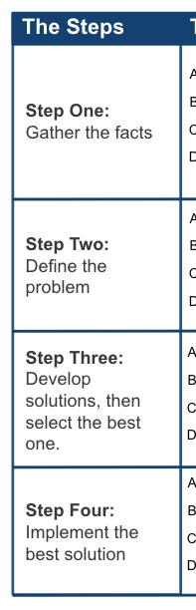
Action Plan
Identify an opportunity you have in the next two weeks to use the Whole Brain® Problem Solver with a group or team. Note some things you need to do to prepare for using this tool.
Notes:
REFER participants to their workbooks.
SAY In this section, we learned how to use techniques and tools, such as the Whole Brain® Problem Solver, to improve your ability to solve problems. Identify an opportunity you have in the next two weeks to use the Whole Brain® Problem Solver with a group or team. Note some things you need to do to prepare for using this tool.
ALLOW 2-3 minutes.
SAY In the next section, The Problem Behind the Problem, we will continue to use Whole Brain® Thinking to help us solve real problems in our workplace.

Slide 50
Section 3: Flexing to Solve Problems
End of Section 3
Next:
The Problem Behind the Problem

Slide 51
Section 4: The Problem Behind the Problem
The Elephant in the Room
“The Five Whys”
Whole Brain® Problem Solving
Action Plan
Notes:
SAY In this section, we will pull it all together.

Slide 52
Learning Objectives
At the end of this section, you will be able to:
Identify actual problems in your organization that can be solved using the Whole Brain® method.
Analyze a problem from all four quadrants of the Whole Brain® Model.
Apply Whole Brain® problem-solving tools to solve problems.
Notes:
READ and REVIEW objectives
REFER participants to their workbooks.

Slide 53
The Problem
What?
Why?
How?
Who?
The four-color, four-quadrant graphic and Whole Brain® are registered trademarks of Herrmann Global, LLC.
Notes:
SAY We have been making our way around the Whole Brain® model.
In the first section we looked at How we go about problem solving. We are able to “survive” any problem, by utilizing all the thinking preferences.
In section two we looked at Who we can partner with, to solve problems. We discovered that all of us can be good problem solvers, especially when we work with contrasting quadrants.
In the third section, we discussed Why we need to be flexible when solving problems. We need to augment our tendencies by thinking beyond your own perspectives when problem solving.
So, now we are at the last quadrant, and we are faced with the question What is the real problem?
Note to Facilitator: The phrase “elephant in the room” may not be familiar to all cultures. If it is not known to the participants explain that "elephant in the room" is an English metaphorical idiom that refers to an obvious truth that no one seems to want to address.
SAY Sometimes we think we have identify the problem, but later realize that we really were focusing on symptoms, or effects, of the problem rather than the problem itself – the root cause.
ASK Have you ever been in a team meeting where everyone knew that the project or conversation was going down the wrong path, but didn’t want to say anything because it would be awkward or uncomfortable? We call this “the elephant in the room.” It’s obvious, but we choose to overlook it.

Slide 54
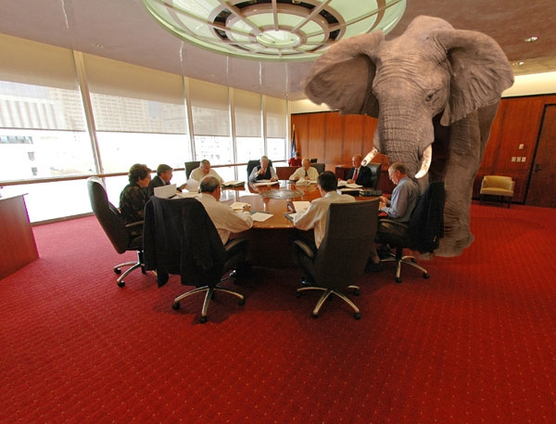
The Elephant in the Room
“An important and obvious topic, which everyone present is aware of, but which isn’t discussed, as such discussion is considered to be uncomfortable.”
Image source: www.davepear.com
Notes:
http://www.phrases.org.uk/meanings/elephant-in-the-room.html
If we are going to address the “elephant in the room,” we are going to need to ask, “What is the real problem?”

Slide 55
Whole Brain® Problem Solver
Steps:
Gather the Facts
Define the Problem
Develop Solutions
Implement the Best Solution
Notes:
REFER participants to their workbooks.
SAY Once we have identified the real problem, we can move through the four steps of the “Problem Solver.”
SAY Have you heard of “The Five Whys?” It is an iterative question-asking technique to help you dig deeper into finding the root cause(s) of a problem. The technique was originally developed by Sakichi Toyoda, Japanese inventor and industrialist, and founder of Toyota Industries. It was used within the Toyota Motor Corporation during the evolution of its manufacturing methodologies.
URL: http://en.wikipedia.org/wiki/5_Whys

Slide 56

“The Five Whys”
The alarm clock did not go off.
The time reset to 12:00 a.m.
The alarm clock lost power.
The battery backup was not installed.
We didn’t have a battery.
You woke up late.
Why?
Why?
Why?
Why?
Why?
Notes:
http://en.wikipedia.org/wiki/5_Whys
SAY Here is an example. [Click to reveal the five whys and the answers.] By the time you get to the fifth Why, you have probably discovered the real problem, or root cause.
SAY When we approach a problem with Whole Brain® Thinking, however, we don’t just ask, “Why?”. We ask “Who,” “What,” “Why” and “When.” Here is a Whole Brain®walk-around to help you get to the real problem.
Another example:
The vehicle will not start. (the problem)
Why? - The battery is dead. (first why)
Why? - The alternator is not functioning. (second why)
Why? - The alternator belt has broken. (third why)
Why? - The alternator belt was well beyond its useful service life and not replaced. (fourth why)
Why? - The vehicle was not maintained according to the recommended service schedule. (fifth why, a root cause)

Slide 57
Getting to the Real Problem
What broad, general issue seems to cause me to be less productive at work?
What is it that interferes with my progress numbers, sales, quantity or quality of my work?
Why does this issue affect my work?
Why is this issue important from the big picture view?
Who else is affected?
Who do I affect because of this issue?
My feelings about this topic are …
When am I affected the most? (time of day/week/month/year?
How do I cope now with this issue?
Notes:
REFER participants to their workbooks.
DO Briefly review the questions in the four quadrants.
SAY In the previous exercises we have been using hypothetical problems as examples; they were not your problems. The problems were provided for you so that you could concentrate on the solving tools. Now, it’s time to address your problems.
SAY Take a few moments to complete the exercise independently in your workbook. Answering this series of questions, will help you focus on a real work issue. Please work on an issue that you would feel comfortable sharing with others in class. You can certainly work on more private issues outside of class, using the same series of questions.
ALLOW 6-7 minutes.
DO divide the participants into small groups of 4-5 people.
SAY Share your problems with your small group and, in one or two minutes, agree on one problem that will be most relevant to everyone in the group. Remember, no solutions at this time; just state the problem. This is the problem that they will use in the next exercise.
DO Make sure people don’t jump in to solve each other’s problems or minimize other’s problems. (e.g. “That’s easy; I can solve that one.” Ask them to listen respectfully and keep the discussion in confidence. “What happens in the room, stays in the room.”
ALLOW 2 minutes.
SAY Now, let’s “run the problem” through the Whole Brain® Problem Solver.

Slide 58
Whole Brain® Problem Solver
Steps:
Gather the Facts
Define the Problem
Develop Solutions
Implement the Best Solution
Notes:
Note to Facilitator: Prepare several flip charts or posted pages for each group to use in this activity.
SAY Within your group, you now have a problem to be addressed, by working through the four steps of the Whole Brain® Problem Solver.
REFER participants to their workbooks.
SAY Your group will have approximately 25 minutes to solve the problem. Use the Whole Brain® Problem Solver on the flipchart pages provided. Be prepared to share your flip- charted solution, and your group’s thought process and learnings. There is also room in your workbooks to capture your final work.
ALLOW 25 minutes.
ASK Does anyone have anything they’d like to share, coming out of that exercise?
SAY Remember, a problem is not solved until action has been taken.
Optional:
Note to Facilitator: With additional time and/or in follow-up sessions, the solution(s) may be carried forward into the “Whole Brain® Project Mapping Process,” which includes the “Team Ready-for-Action Assessment.” These can be found in the Business of Thinking® module, ThinkAbout Teams.

Slide 59
Key Thoughts
Devote the time and effort to discover the real problem, rather than focusing only on the symptoms of the problem.
Thorough use of the Whole Brain® Problem Solver ensures that you don’t overlook least-preferred quadrant(s).
Heterogeneous or diverse-thinking groups represent the views of all four quadrants.
Notes:
DO Share key thoughts:
Devote the time and effort to discover the real problem, rather than focusing only on the symptoms of the problem.
Thorough use of the Whole Brain® Problem Solver ensures that you don’t overlook least-preferred quadrant(s).
Heterogeneous or diverse-thinking groups represent the views of all four quadrants.
SAY After completing this section, you should have achieved these outcomes:

Slide 60
Learning Objectives
At the end of this section, you will be able to:
Identify actual problems in your organization that can be solved using the Whole Brain® method.
Analyze a problem from all four quadrants of the Whole Brain® Model.
Apply Whole Brain® problem-solving tools to solve problems.
Notes:
DO Review each earlier stated objective.
SAY All that remains is creating your action plan.

Slide 61

Action Plan
A problem is not solved until action has been taken.
What are the next steps, to take action on the problem that your group solved?
Are there problems that were addressed by other groups that you can be a part of solving? If so, how can you help in that action plan?
Notes:
REFER participants to their workbooks.
SAY A problem is not solved until action has been taken. Take a moment to capture some action items.
What are the next steps to take action on the problem that your group solved?
Are there problems that were addressed by other groups that you can be a part of solving? If so, how can you help in that action plan?

Slide 62
Section 4: The Problem Behind the Problem
End of Section 4
Next:
Think About Problem Solving Wrap-Up
Notes:
SAY This brings us to the end of the ThinkAbout Problem Solving workshop. Let’s review.

Slide 63
ThinkAbout Problem Solving
What We’ve Covered
Why Whole Brain® Thinking
How We Did It
Who Benefits
Notes:
SAY
What We’ve Covered
How We Did It
Who Benefits
Why Whole Brain®Thinking

Slide 64
A – What We’ve Covered
Problem-Solving Methods
Problem-Solving Walk-Around
Thinking Partnerships
Cross-Training
Whole Brain® Problem Solving
Whole Brain® Problem Solver
Getting to the Real Problem

Slide 65
B – How We Did It
“Survival”
Problem-Solving Walk-Around
The Whole Brain at Work
“What’s for Lunch?”
Invite Cross-Training
“Think Outside the Box”
Using the Whole Brain® Problem Solver

Slide 66
C – Who Benefits
Self
Team Members
Colleagues
Coworkers
Managers
Organization
Clients
Customers
Others Outside our Organization

Slide 67
D – Why Whole Brain® Thinking
Better Thinking. Better Performance. Better Results

Slide 68
Questions?
Notes:
ASK Are there any questions?

Slide 69







Introducing the …
Better Thinking, In Hand
UNDERSTAND YOUR HBDI® PROFILE
APPLY THE INSIGHTS
SHARE YOUR THINKING
Learn more at http://app.hbdi.com
Notes:
SAY Be sure to download the HBDI App from the App Store on your mobile device. You can explore your own profile,
share it on social media, and make guesstimates about others’ profiles by identifying clues.

Slide 70
The Business of Thinking®
ThinkAbout Problem Solving
The Business of Thinking®
Notes:
Draft: BOTPS2.2, 03-2015
SAY Thank you for your active participation. This has been just one of the workshops in the Business of Thinking® Series.

Slide 71
The Business of Thinking® Series
Start Thinking
ThinkAbout Teams
ThinkAbout Communicating
ThinkAbout Creative Thinking
ThinkAbout Decision Making
ThinkAbout Problem Solving
ThinkAbout Your Customer

Slide 72

Presenter Name
+1 212-555-5555
presenter@email.com
ThinkHerrmann.com

Slide 73
Appendix
Additional Facilitator Resources

Slide 74

Break it up!
The brain needs time to process.
Taking a break during class/learning helps retain the information
just learned.
Notes:
Insert in deck as needed.

