Slide 1

The Business of Thinking®
The Business of Thinking®
ThinkAbout Communicating
Notes:
Version: BOTC2.2, 03-2015

Slide 2
Sections of ThinkAbout Communicating
Whole Brain® Communication
Knowing Your Audience
Communicating in the Workplace
Presenting Your Ideas

Slide 3
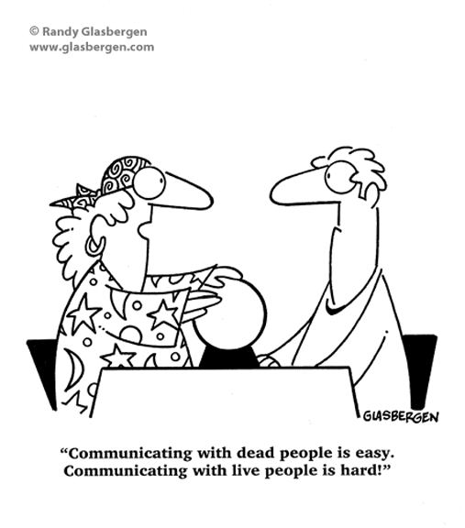

Slide 4

Participant Workbook

Slide 5

Section 1: Whole Brain® Communication
Newspaper Creativity Build
Whole Brain® Thinking Overview
ThinkAbout Communicating
ThinkAbout Listening
“Talk Nerdy to Me”
Action Plan

Slide 6

Learning Objectives
At the end of this section, you will be able to:
Understand how your thinking preferences affect your communication style.
Identify others’ thinking preferences in relation to your preferences and the situation.
Adapt your communication style to the thinking preferences of others as needed.

Slide 7

Newspaper Creativity Build

Slide 8
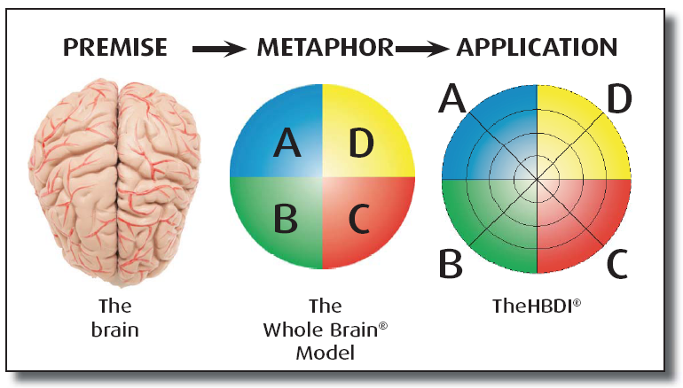
The Organizing Principle and Architecture
The basis of our mental preferences: four interconnected, specialized processing modes that function together situationally and iteratively.
The four-color, four-quadrant graphic and Whole Brain® are registered trademarks of Herrmann Global, LLC.

Slide 9




Our Four Different Selves
A
D
Analyzes
Quantifies
Is logical
Is critical
Is realistic
Likes numbers
Knows about money
Knows how things work
Infers
Imagines
Speculates
Takes risks
Is Impetuous
Breaks rules
Likes surprises
Is curious / Plays
Takes preventive action
Establishes procedures
Gets things done
Is reliable
Organizes
Is neat
Timely
Plans
Is sensitive to others
Likes to teach
Touches a lot
Is supportive
Is expressive
Is emotional
Talks a lot
Feels
B
C
The four-color, four-quadrant graphic and Whole Brain® are registered trademarks of Herrmann Global, LLC.

Slide 10
ThinkAbout Communicating
A
D
Critical analysis
Facts – no fluff
Technical accuracy
Goals and objectives
Well articulated ideas
Data – fact based charts
Brief, clear, precise info
Minimal details
Freedom to explore
Metaphors – visuals
Overview – “big picture”
New, fun, imaginative
Conceptual framework
Aligns with long term strategy
The four-color, four-quadrant graphic and Whole Brain® are registered trademarks of Herrmann Global, LLC.
Detailed time-action plan
Through with references
Rules and procedures
Step by step – concise
In writing, in advance
Contingency plan
No digressing
Open, informal discussion
Expressive body & voice
Intros and conversation
Knows effect on others
Knows how people feel
Hear & understand all
No hidden agendas
B
C

Slide 11
ThinkAbout Listening
A
D
Technical accuracy
Brief, clear & precise info
Data & fact-based charts
Materials that are direct and to the point
Presentation in alignment with corporate goals & objectives
Well articulated ideas presented in a logical format
An overview
A conceptual framework
Idea chunks
Freedom to explore
Metaphorical examples
Frequent, spontaneous tasks
Visuals
Long-term objectives
Connection to the “big picture”
The four-color, four-quadrant graphic and Whole Brain® are registered trademarks of Herrmann Global, LLC.
Step-by-step unfolding of the topic
Assurance that this has been done before
Explanation of how it will happen
Thorough, timely & reliable follow through
References & background info
Alignment with well-
established procedure
A written schedule &
action plan
Consistency
For all to have equal consideration
Empathy & consideration of their needs
References to people involved
Their feelings to be respected
Personal touch & informality
To know how others will react
Involvement with others
A good attitude & personal relationship
Eye contact
B
C

Slide 12
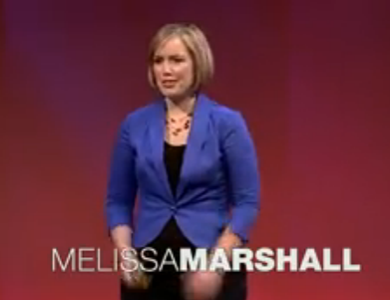

“Talk Nerdy to Me”
Notes:
http://www.ted.com/talks/melissa_marshall_talk_nerdy_to_me.html
4:34

Slide 13
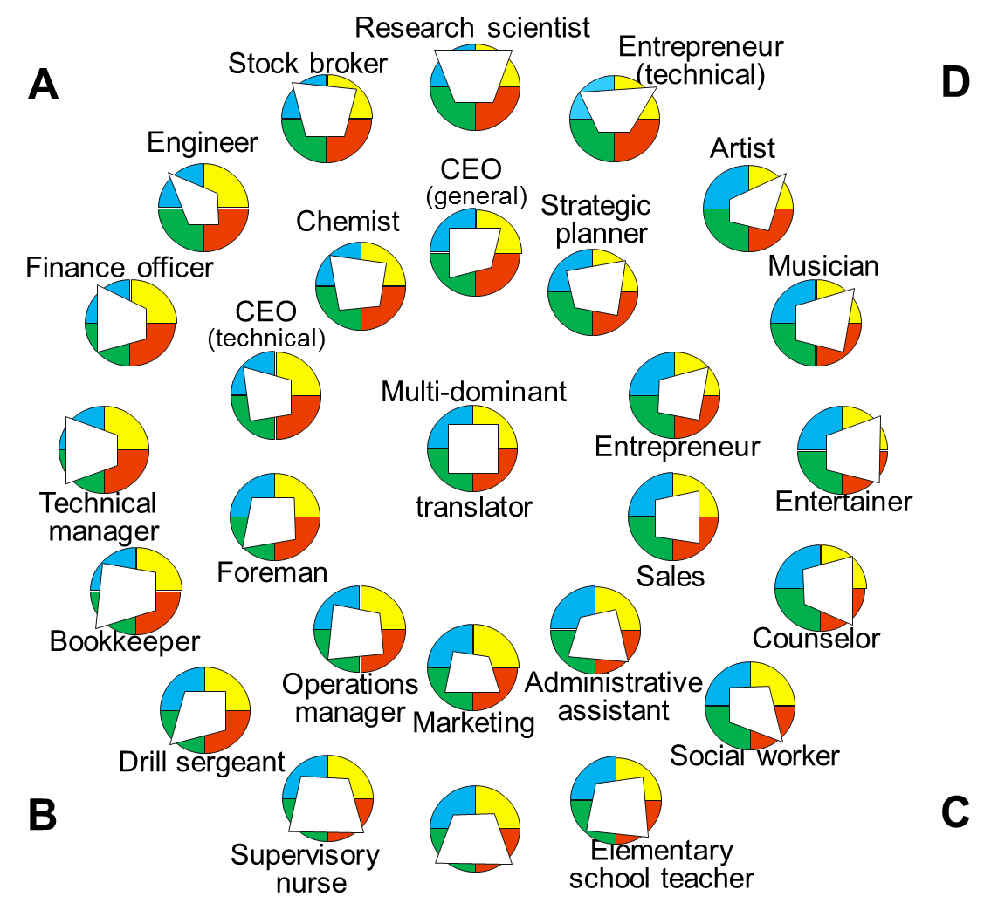
Pro-forma Profiles of the Mentality of Occupations
The four-color, four-quadrant graphic and Whole Brain® are registered trademarks of Herrmann Global, LLC.

Slide 14
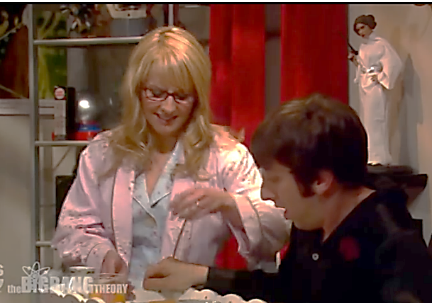
Different Styles of Communication
Notes:
Optional video. Slide is hidden.
https://www.youtube.com/watch?v=1co5bdo3Gyk
1:15

Slide 15

Key Thoughts
Your communication style – speaking and listening – depends largely on your thinking preferences.
When under pressure, your communication style may shift to your under pressure profile.
It may be necessary to adapt your communication style to better match the listener.

Slide 16
Learning Objectives → Outcomes
At the end of this section, you will be able to:
Understand how your thinking preferences affect your communication style.
Identify others’ thinking preferences in relation to your preferences and the situation.
Adapt your communication style to the thinking preferences of others as needed.

Slide 17
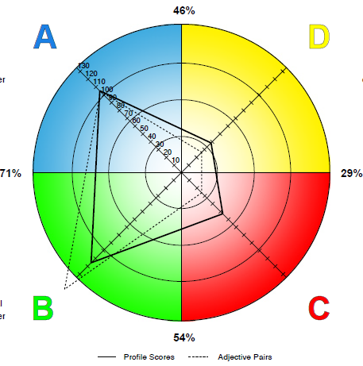
Action Plan
Looking back at the people you identified after the Newspaper Creativity Build, commit to improving your communication with one of them.
Name
Predicted HBDI® Profile Codes (e.g. 1-1-2-2)
What do you commit to do differently to adapt to his/her communicating and listening styles?
The four-color, four-quadrant graphic and Whole Brain® are registered trademarks of Herrmann Global, LLC.

Slide 18

Section 1: Whole Brain® Communication
End of Section 1
Next:
Knowing Your Audience

Slide 19
Section 2: Knowing Your Audience
Introduction
Common Ground
Describe Away
The Language of the Four Quadrants
Across the Quadrants
Whole Brain® Communicator
Planning a Message from All Four Quadrants
Action Plan

Slide 20
Learning Objectives
At the end of this section, you will be able to:
Honor the strengths and frustrations of others’ thinking preferences in your communications.
Recognize how across-quadrant thinking preferences affect communication.
Use the Whole Brain® Communicator to plan a message.

Slide 21
Common Ground
“We used to spend too much time trying to get to common ground.
But now, a conversation that might have taken two hours can happen in about 45 minutes.
It’s refreshing!”
Brian Wheeler
Director of Operations
Lastar, Inc.

Slide 22
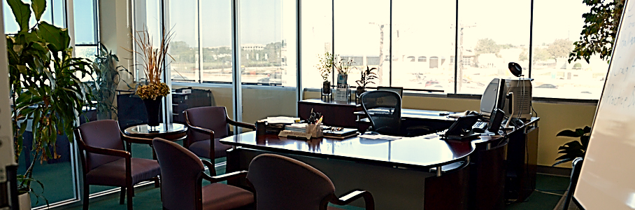
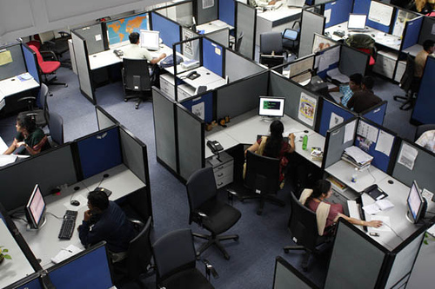
Describe Away
Notes:
Hide this slide if you are using the house example on the next slide.

Slide 23


Describe Away
Notes:
Reveal this slide if you are not using the office example on the previous slide.

Slide 24
Speak Their Language: Blue A Quadrant
Clusters
The Rational Self
Factual
Critical
Rational
Realistic
Rigorous thinking
Knows the
basis of things
Analyzes
Quantifies
Is logical
Is critical
Is realistic
Likes numbers
Knows about money
Knows how things work
A
A
Intellectual
thinking
Logical
Analytical
Problem solving
Test & prove
Knows how
things work
Financial
Numerical
Quantitative
Mathematical
Knows about
money
Technical
Strengths
Frustrations
Gathering facts
Analysis issues
Arguing rationally
Forming theories
Measuring precisely
Problem solving logically
Financial analysis & decision making
Understanding technical elements
Critical analysis
Working with numbers, statistics, data and precision
Inarticulate, off-track communication
Excessive chatter
Vague, ambiguous approaches or instructions
Illogical comments
Inefficient use of time
Lack of facts or data
Inappropriate informality
Overt sharing of personal feelings
Impression of not knowing the “right” answer
Fear of challenge or debate

Slide 25
Speak Their Language: Green B Quadrant
Clusters
The Safekeeping Self
Conservative
Traditional
Controlled
Dominant
Safekeeping
On time
Organized
Reliable
Takes preventive action
Establishes procedures
Gets things done
Is reliable
Organizes
Is neat
Timely
Plans
Detailed
Speaker
Reader
Implementation
Gets things done
B
Linear
Sequential
Step by step
Procedural
B
Neat
Organized
Planning
Administrative
Preventive
Strengths
Frustrations
Finding overlooked flaws
Approaching problems practically
Standing firm on issues
Maintain a standard of consistency
Providing stable leadership & supervision
Reading fine print in documents/contracts
Organizing and keeping track of data
Developing detailed plans & procedures
Articulating plans in an orderly way
Keeping financial records straight
Unknown or absence of a clear agenda
Disorganized
Hopping around from subject to subject
Too many ideas at once
Unpredictable
Too fast-paced
Unclear instructions or language
Too much beating around the bush
Incomplete sentences
Lack of closure

Slide 26
Speak Their Language: Red C Quadrant
Clusters
The Feeling Self
Talker
Expressive
Communicator
Teacher/
trainer
Emotional
Feeling
Spiritual
Is sensitive to others
Likes to teach
Touches a lot
Is supportive
Is expressive
Is emotional
Talks a lot
Feels
Symbolic
Intuitive
(people)
Musical
Friendly
Empathetic
Interpersonal
Intuitive (people)
Sensitive to others
People oriented
Supportive
C
C
Writer
Reader
Strengths
Frustrations
Recognizing interpersonal difficulties
Anticipating how others will feel
Intuitively understanding how others feel
Picking up the non-verbal cues of interpersonal stress
Engendering enthusiasm
Persuading, conciliating
Teaching
Sharing
Understanding emotional elements
Considering values
Lack of interaction
No eye contact
Impersonal approach or examples
Dry or “cold” unenthusiastic interaction
Insensitive comments
No time for personal sharing
All data, no nonsense
Lack of respect for feelings
Overly direct or brusque dialogue
Critical

Slide 27
Speak Their Language: Yellow D Quadrant
Clusters
The Experimental Self
Originates
Imaginative
Innovative
Creative
Curious
Artistic
Infers
Imagines
Speculates
Takes risks
Is Impetuous
Breaks rules
Likes surprises
Is curious / Plays
Playful
Breaks rules
Risk taking
Original
D
D
Artistic
Spatial
Visual
Strategic
Future-oriented
Intuitive (solutions)
Imaginative
Integration
Synthesizing
Holistic
Impetuous
Simultaneous
Likes surprises
Intuitive
(solutions)
Conceptual
Metaphorical
Strengths
Frustrations
£ Reading the signs of coming change
£ Seeing the big picture
£ Recognizing new possibilities
£ Tolerating ambiguity
£ Integrating ideas and concepts
£ Challenging established policies
£ Synthesizing unlike elements into a new whole
£ Inventing innovative solutions to problems
£ Problem solving in intuitive ways
£ Simultaneous processing of different input
£ Repetition
£ Too slow-paced
£ “Playing it safe” or “by the book”
£ Overly-structured, predictable
£ Absence of humor and fun
£ Lack of flexibility, too rigid
£ Inability to get concepts or metaphors
£ Drowning in detail
£ Too many numbers
£ Dry, boring topic or style

Slide 28
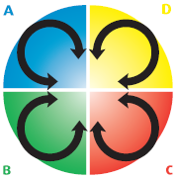
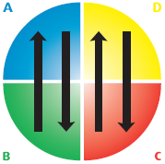
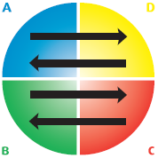
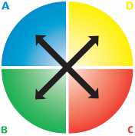
Across the Quadrants
Same Quadrant
Compatible Quadrant
Contrasting Quadrant
Cross Quadrant
The four-color, four-quadrant graphic and Whole Brain® are registered trademarks of Herrmann Global, LLC.

Slide 29
Whole Brain® Communicator
What
Why
How
Who

Slide 30
Whole Brain® Communicator
A
Tell them
Your objective
What you want to achieve by the end of the presentation
Key facts and numbers
Research that backs up what you’re saying
Underlying assumptions
Show them by
Using facts and numbers
Showing evidence of clear analysis
Keeping to the point
Showing the logic of the ideas
Providing references
D
Tell them
Why you are talking to them
Why this is important to them
What other significant issues are involved
The main points
Where this fits in the big picture
Show them by
Using color
Using conceptual, big-picture visuals
Using metaphors
Talking in a fast and engaging manner
WHAT
WHY
The four-color, four-quadrant graphic and Whole Brain® are registered trademarks of Herrmann Global, LLC.
Tell them
How much time you need
When and where events will occur
What resources you’ll need
How many people are involved
What constraints you are under
What approach you’ll use
What safety measures are in place
Show them by
Explaining how your presentation is organized
Providing details
Using bullet points
Presenting in sequential order
Using a neat, clear & structured format
Providing references
Tell them
Who the audience is
What you know about them
Who has used this
How others feel about it
How it is user-friendly
How it benefits others
Show them by
Introducing everyone
Letting them touch, feel and experience it
Telling real customer stories
Being enthusiastic
Acknowledging emotions
Interacting with the audience
HOW
WHO
B
C

Slide 31
Planning a Message from All 4 Quadrants
What
Why
How
Who

Slide 32
Key Thoughts
Plan your message in a Whole Brain® way so it can be well-received by a broad audience.
Being aware of others’ strengths and frustrations allows you to adapt your style for improved communication.
Don’t assume that someone with a similar HBDI® Profile communicates the same as you do.

Slide 33
Learning Objectives → Outcomes
At the end of this section, you will be able to:
Honor the strengths and frustrations of others’ thinking preferences in your communications.
Recognize how across-quadrant thinking preferences affect communication.
Use the Whole Brain® Communicator to plan a message.

Slide 34
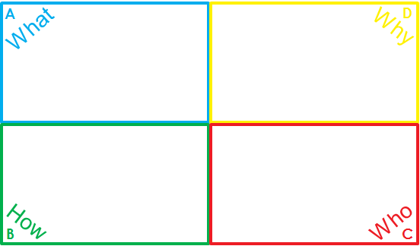
Action Plan
Take a few moments to consider a recurring communication and make it a more Whole Brain ® communication; for example: a monthly newsletter, a weekly memo, a quarterly department update, interaction with another department, a project update, etc.
Now, in the walk-around format, plan that message from all four quadrants.
Take the time after this session to plan for a more Whole Brain® communication.
The four-color, four-quadrant graphic and Whole Brain® are registered trademarks of Herrmann Global, LLC.

Slide 35
Section 2: Knowing Your Audience
End of Section 2
Next:
Communicating in the Workplace

Slide 36
Section 3: Communicating in the Workplace
Introduction
Think It Through
Leading the Blind
Miscommunication
Internal Communication Tools
Action Plan

Slide 37
Learning Objectives
At the end of this section, you will be able to:
Analyze messages according to the four quadrants of the Whole Brain® Model.
Personalize messages to match the thinking style(s) of the recipient(s).
Use the Whole Brain® Communicator to plan your own written and oral communications.

Slide 38
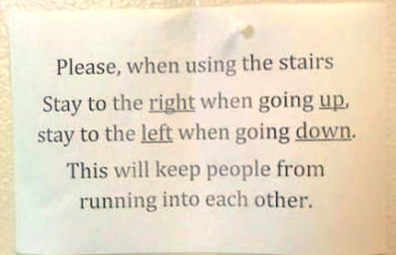
Think It Through

Slide 39


Leading the Blind

Slide 40

Leading the Blind
Sit back-to-back with your partner.
Each person will draw a picture of the provided topic.
Decide who will be the first “speaker” and “listener.”
The first speaker will give directions to listener.
The first listener will attempt to draw the same picture, and cannot ask questions.
Turn around and compare the two drawings.
Switch roles and repeat the exercise.

Slide 41
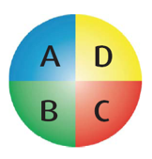
Control the Communication, not the Person
Mute
Shut Up!
“A remote control I wish worked
on people”
Take that back!
Get on
with it!
Stop,
Just Stop
Increase
Intelligence
Decrease
Repetition
Let it
Go
The four-color, four-quadrant graphic and Whole Brain® are registered trademarks of Herrmann Global, LLC.

Slide 42
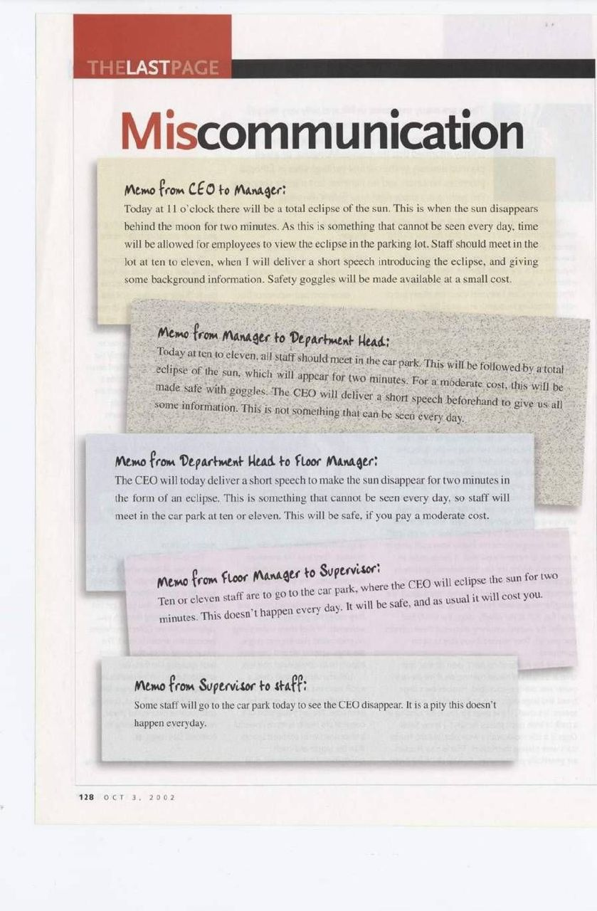
Miscommunication

Slide 43
Miscommunication

Slide 44

Internal Communication Tools
Which ones do you use in the workplace?
Which ones could be used more effectively?
Tool | Use in Workplace | Could be More Effective
Texting
Instant Messaging
Voice Mail
Email

Slide 45


Texting
Hey GF
sup
fyi mtg 2moro not hapning
?
FWIW IMHO i think its alot FUD on H’s part
whatever
LMK if ur going Fri
stsp?
Yep
L8r
TTYL

Slide 46
Texting
Hey GF
sup
fyi mtg 2moro not hapning
?
FWIW IMHO i think its alot FUD on H’s part
whatever
LMK if ur going Fri
stsp?
Yep
L8r
TTYL

Slide 47
Texting
Hi, Mark
Hello
The meeting on Project Think scheduled for tomorrow is postponed
Why?
A change in schedules.
Okay. Do we have a new date?
Friday, 10 a.m. EST, Conference Rm 12th floor. Email to follow.
Thanks
Have a good day.

Slide 48
Instant Messaging - #1
Katherine – Available
Support Team Manager
Katherine: Good morning.
Mark: Hi, Katherine. How are you today?
Katherine: I’m good. Did you have a nice weekend?
Mark: It was okay. The weather here has been horrible lately though. It doesn’t allow us to get out much. How was your weekend? Did you do anything fun?
Katherine: Well the weather here is much warmer. Sunshine and 80ºF … Nice. We did get out with our children to the park on Saturday. Picnic, some baseball. It was really great. Sorry you’re not having great weather over there. Hopefully the sun will return to you soon.
Mark: Sounds like a great time. I’m anxious for warm temperatures to return. So what’s on your agenda today?
Katherine: Just wanted to check your calendar. The Project Think meeting that was scheduled for tomorrow must be postponed. We would like to reschedule it for Friday at 10:00 a.m. EST. Are you available then?
Mark: Yes that works for me. Same location?
Katherine: Yes. The conference room on the 12th floor. That’s this Friday, 10:00 a.m. I look forward to talking with you more then. Have a great week ahead.

Slide 49
Instant Messaging - #1
Katherine – Available
Support Team Manager
Katherine: Good morning.
Mark: Hi, Katherine. How are you today?
Katherine: I’m good. Did you have a nice weekend?
Mark: It was okay. The weather here has been horrible lately though. It doesn’t allow us to get out much. How was your weekend? Did you do anything fun?
Katherine: Well the weather here is much warmer. Sunshine and 80ºF … Nice. We did get out with our children to the park on Saturday. Picnic, some baseball. It was really great. Sorry you’re not having great weather over there. Hopefully the sun will return to you soon.
Mark: Sounds like a great time. I’m anxious for warm temperatures to return. So what’s on your agenda today?
Katherine: Just wanted to check your calendar. The Project Think meeting that was scheduled for tomorrow must be postponed. We would like to reschedule it for Friday at 10:00 a.m. EST. Are you available then?
Mark: Yes that works for me. Same location?
Katherine: Yes. The conference room on the 12th floor. That’s this Friday, 10:00 a.m. I look forward to talking with you more then. Have a great week ahead.

Slide 50
Instant Messaging - #2
Katherine – Available
Support Team Manager
Katherine: Good morning.
Mark: Hi, Katherine.
Katherine: I wanted to check your calendar. The Project Think meeting that was scheduled for tomorrow must be postponed. We would like to reschedule it for Friday at 10:00 a.m. EST. if you are available.
Mark: One moment. Yes, I have put that on my calendar.
Katherine: Thank you. I will send a confirmation e-mail with a meeting invitation. This will have the location information as well. Have a good rest of your week.
Mark: Thanks. You too.

Slide 51
Instant Messaging - #2
Katherine – Available
Support Team Manager
Katherine: Good morning.
Mark: Hi, Katherine.
Katherine: I wanted to check your calendar. The Project Think meeting that was scheduled for tomorrow must be postponed. We would like to reschedule it for Friday at 10:00 a.m. EST. if you are available.
Mark: One moment. Yes, I have put that on my calendar.
Katherine: Thank you. I will send a confirmation e-mail with a meeting invitation. This will have the location information as well. Have a good rest of your week.
Mark: Thanks. You too.

Slide 52


Voicemail - #1

Slide 53
Voicemail - #1
Hey, uh…. Hi, Mark…. How’s it going? Hope all is well with you…. Hey, Listen, I just want to get some ideas together on our Project Think session that’s coming up. Oh, this is Katherine by the way. Well, the meeting was suppose to be tomorrow, but it’s been rescheduled. Now it is Friday. Let’s see, double checking…. Yea, Friday at 10:00 a.m. Same place…. I believe it’s still in the conference room 12th floor. Yes, so. I hope you can put that on your calendar. We just want to go over the ideas everyone has for products that will be available for third quarter sales. The east coast is going to be able to make this meeting now too.… So that will be good. Anyway, see ya Friday.

Slide 54

Voicemail - #2

Slide 55
Voicemail - #2
Hello, Mark. This is Katherine.
The Project Think meeting that was scheduled for tomorrow has been postponed to this coming Friday, 10:00 a.m. EST. It will be held in the 12th floor conference room. Please inform me if you are unable to attend. Otherwise we will expect you there. Thank you.

Slide 56

Voicemail - #3

Slide 57
Voicemail - #3
Hello, Mark. This is Katherine. I hope you are doing well, and you enjoyed a wonderful weekend.
I’m calling about the upcoming Project Think meeting. First of all, the meeting date has been changed from tomorrow to this Friday. It will still be held at 10:00 a.m. your time, in the 12th floor conference room. I’m looking forward to seeing your presentation about the new product line. I’m sure you are just as excited to get our new innovative products out there so we can start driving revenue for the third quarter. This is a big move in the right direction, and I’m so glad you’re on board with us. See you on Friday.

Slide 58
Voicemails with Whole Brain® Communicator
What
Why
upcoming Think Project
meeting
to get our new innovative products
This is a big move in the right direction
seeing your presentation on new product line
start driving revenue for the third quarter
To: Mark
From: Katherine
doing well, enjoyed weekend
excited about new products
so glad you’re on board with us
meeting date changed from tomorrow to this Friday
10:00 a.m. your time, in the 12th floor conference room
How
Who

Slide 59
Start with the Whole Brain® Communicator
What
Why
Meeting: Project Think
Your presentations on new product line
Increase 3rd quarter sales revenue
Meeting rescheduled
Share ideas
New Innovation
Drive Sales
Redirection for Team
New Meeting time
Friday
10:00 a.m. EST
12th floor conference room
To: Sales team
East Cost Reps too
From: Project Manager
Excited to see new ideas from all
How
Who

Slide 60
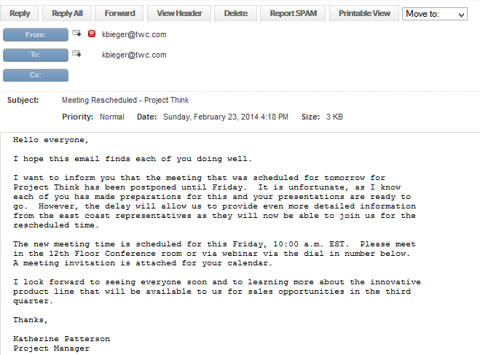
Email Messages
Mark
Katherine
Webinar: Dial in at 1-800-555-1234

Slide 61
Email Messages
Mark
Katherine
Webinar: Dial in at 1-800-555-1234

Slide 62

Whole Brain® Communication Tools
“Make everything as simple as possible, but no simpler."
Albert Einstein
The four-color, four-quadrant graphic and Whole Brain® are registered trademarks of Herrmann Global, LLC.

Slide 63
Key Thoughts
The Whole Brain® Communicator can help you craft a clear and whole-brained message.
Be mindful of Whole Brain® Thinking in order to avoid miscommunication.
The situation, tool, context and thinking preferences all contribute to the effectiveness of the communication.

Slide 64
Learning Objectives → Outcomes
At the end of this section, you will be able to:
Analyze messages according to the four quadrants of the Whole Brain® Model.
Personalize messages to match the thinking style(s) of the recipient(s).
Use the Whole Brain® Communicator to plan your own written and oral communications.

Slide 65

Action Plan
Reflect on a piece of communication, like an email, and color code it by quadrants. Going forward, pair up with a coworker to review each other’s communications.
The four-color, four-quadrant graphic and Whole Brain® are registered trademarks of Herrmann Global, LLC.

Slide 66
Section 3: Communicating in the Workplace
End of Section 3
Next:
Presenting Your Ideas

Slide 67
Section 4: Presenting Your Ideas
Introduction
Whole Brain® Presenting
“Am I Talking to Myself?” – Tips for Better Communication
Getting People On Board
Action Plan

Slide 68
Learning Objectives
At the end of this section, you will be able to:
Create impromptu Whole Brain® messages.
Apply the four tips for better communication.
Move people to action through Whole Brain® communication.

Slide 69
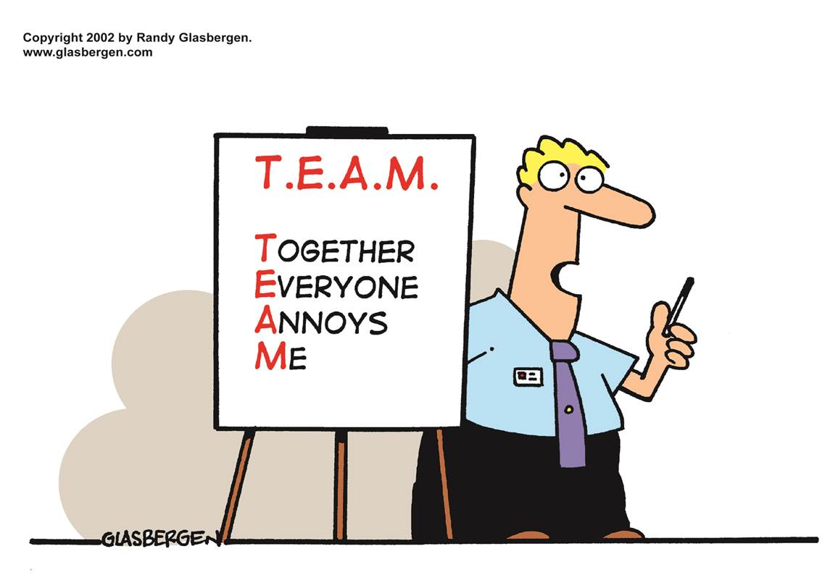

Slide 70
The Elevator Speech
About you
Introduce yourself
What you offer – What
A product, solution, return on investment
What are the benefits – Why
Advantages, future outcomes, strategic alignment
How you do it – How
Processes, plans, resources, timeline
Call for action – Who
How someone can get involved, how people might be impacted, or what you’d like them to do next

Slide 71
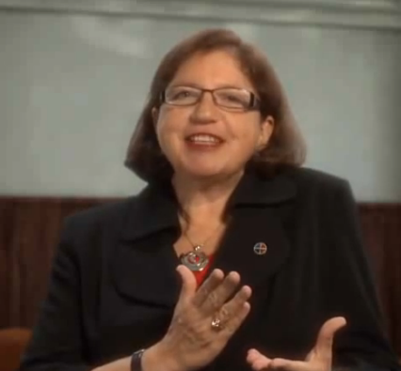
“Am I Talking to Myself?” – Tips for Better Communication
Notes:
http://www.youtube.com/watch?v=E5KCvoz4XUk&feature=youtu.be
5:01

Slide 72
Tips for Better Communication
Provide context
Your audience may not have the same context as you. Clarify your focus for the audience.
Give them an agenda
How long is it going to take?
What can they expect?
Dive into content
Share data, facts so people can understand them within the framing that you desire.
Engage your audience
Use stories and interaction so they can connect. It will “stick” much better.

Slide 73
Communicate So They Understand
I’M ONLY
RESPONSIBLE
FOR WHAT I SAY
NOT FOR WHAT
YOU UNDERSTAND

Slide 74
Getting People on Board with Change
What’s the bottom line?
What are the facts?
What are the financial consequences?
What’s the logic behind the decision?
What’s the goal or objective of the change?
How is this going to affect my future?
How does this fit into the big picture?
What’s the “why” behind the change?
Do I have freedom to influence how this gets rolled out?
How might this constrain me?
Is there a specific timeline?
What are the specifics of the change?
What’s the track record for this type of change?
Are there references I can talk to?
How can I minimize surprises?
What are the risks to me?
What will the emotional impact be on my team and me?
What are the implications for my customers?
Who will be available to listen to my concerns?
Can you engage with me personally before you get focused on the facts?
Notes:
Purpose: As a leader or manager, you are often faced with the need to get people on board with change. Describing the change in a way that minimizes resistance can be challenging. This job aid will help you anticipate reactions to the change and develop a message that proactively addresses what people what to hear about it.
Instructions: Consider your audience. Which quadrant(s) are the most prevalent? Start with what you consider to be the most preferred quadrant. Anticipate how people with that preference will react to change. What concerns will they have? Move to the next most preferred quadrant. Follow the same process for the remaining quadrants. Prepare your explanation with emphasis on the answers to the questions from the preferred quadrants. Alert: Address the questions and concerns for all quadrants even those less preferred by the group. Using this Whole Brain Thinking approach will ensure that you’ve covered all perspectives and will accelerate the adoption of change.

Slide 75
Key Thoughts
Engage your audience with stories and interaction that make your message “stick.”
When you are not sure what language to speak, the best language is Whole Brain® language.
You are responsible for what is understood, not just what you say.

Slide 76
Learning Objectives → Outcomes
At the end of this section, you will be able to:
Create impromptu Whole Brain® messages.
Apply the four tips for better communication.
Move people to action through Whole Brain® communication.

Slide 77
Action Plan
Consider a presentation you will be delivering in the next week or so – formally or informally. What will you do to make it more whole-brained?
The four-color, four-quadrant graphic and Whole Brain® are registered trademarks of Herrmann Global, LLC.

Slide 78
Section 4: Presenting Your Ideas
End of Section 4
Next:
ThinkAbout Communicating Wrap-Up

Slide 79
ThinkAbout Communicating
What We’ve Covered
Why Whole Brain® Thinking
How We Did It
Who Benefits

Slide 80
A – What We’ve Covered
Whole Brain® Communication
Whole Brain® Communicator
Language of Four Quadrants
How to Plan a Message from All Four Quadrants
Miscommunications
Tips for Better Communication
Communication in the Workplace
Whole Brain® Presenting

Slide 81
B – How We Did It
Whole Brain® Model
Newspaper Creativity Build
Noting our own Communicating and Listening Preferences
Identifying How Others Communicate – “Talk Nerdy to Me”
Practice Communicating and Listening – Describe Away
The Whole Brain® Communicator
Technical Communication – Leading the Blind
Types of Communications – Texts, Emails, Voicemails
Four Tips for Better Communication – Video from Ann Herrmann
PowerPoint Presentations
Notes:
Additional bullet if including Section 5:
Online Interactions

Slide 82
C – Who Benefits
Improved Self as a Whole Brain® Communicator
More Successful Professional Collaboration
Team Members
Colleagues
Coworkers
Managers
Clients
Customers
Others Outside our Organization

Slide 83
D – Why Whole Brain® Thinking
Better Thinking. Better Performance. Better Results

Slide 84

Questions?

Slide 85







Introducing the new…
Better Thinking, In Hand
UNDERSTAND YOUR HBDI® PROFILE
APPLY THE INSIGHTS
SHARE YOUR THINKING
Learn more at http://app.hbdi.com

Slide 86
The Business of Thinking®
The Business of Thinking®
ThinkAbout Communicating

Slide 87
The Business of Thinking® Series
Start Thinking
ThinkAbout Teams
ThinkAbout Communicating
ThinkAbout Creative Thinking
ThinkAbout Decision Making
ThinkAbout Problem Solving
ThinkAbout Your Customer

Slide 88
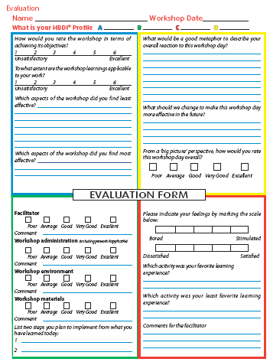
The four-color, four-quadrant graphic and Whole Brain® are registered trademarks of Herrmann Global, LLC.

Slide 89


Better Thinking. Better Performance. Better Results.
828.625.9153 l herrmannsolutions.com
Connect with us:

Slide 90
Appendix
Break Slide
Optional Activity: Communicate My Strengths on a Team

Slide 91

Break it up!
The brain needs time to process.
Taking a break during class/learning helps retain the information
just learned.
Notes:
Insert in deck as needed.

Slide 92



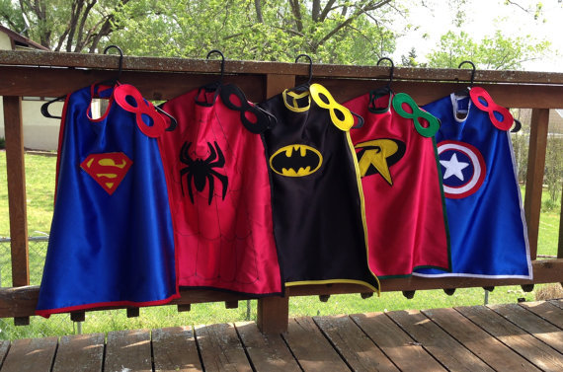
Communicate My Strengths on a Team

Slide 93



Communicate My Strengths on a Team
Instructions:
Review the activities listed for your start-up business.
Select which two tasks/activities you would prefer to take on for your team.
Communicate in all four languages to convince teammates that your skills match the particular task for the start-up business.
Think “outside the box” as needed.

