Slide 1

Discovering your HBDI® Team Profile
and Applying Whole Brain® Thinking
Notes:
You took the HBDI online assessment and were asked a lot of questions about how you like to approach things. At times you might have found the answers a little difficult to choose from and that’s ok.
We took the results of your individual HBDI assessments and combined them to give us an HBDI Team Profile. We’ll look at those results together today.

Slide 2
Team Profile Overview
The HBDI® Team Profile is a set of reports that help you develop more productive and cohesive teams based on an in-depth analysis of team members’ HBDI data.
The HBDI® Team Profile leverages a view of their cognitive diversity that:
enables alignment between the way the team thinks and how they approach their work
reduces the stress and conflict that impedes group interactions by providing shared awareness of team dynamics using a common language
facilitates better, faster decisions, and outcomes from every team engagement
Notes:
HIDE THIS SLIDE

Slide 3
Privacy
The value of these reports is that they are data driven. The data often helps to remove the emotion from sensitive areas. However, as you go through the reports watch for sensitive or potentially challenging topics.
The report is created solely for the use of these participants in order to help them develop efficiency as they operate as an intact team. Since the individual information is treated as confidential, care needs to be taken to maintain the confidentiality of the information of individuals. As a consequence, individual profiles in the report are represented anonymously and in random order to prevent any inappropriate inferences about participants.
You, as Certified Practitioner are not to share the content of this report with anyone other than the immediate participants. The participants may share the information as they deem appropriate and when consent is given from all participants.
Notes:
HIDE THIS SLIDE

Slide 4
Appropriate Uses
The HBDI® Team Profile can be effectively used in the following scenarios:
Team meetings
Existing team
Conflict within team
New boss
New team member
New task or project/new work group
When guest (e.g., external facilitator) enters the team
When reflecting on or problem solving a challenging team dynamic
Strategic planning meeting
Executive teams offsites
Sales teams
Notes:
HIDE THIS SLIDE

Slide 5
Instructions for Using this Deck
This slide deck includes animations. Use presentation mode for full use of animation.
Use speakers notes as needed as a guide.
Adjust the slides as needed: hide, delete, or rearrange as needed to fit your situation. Do not alter the Herrmann logo or the Whole Brain® Thinking model or other registered trademarks without obtaining permission.
This deck is for use during a Team Profile results debrief:
In person or remote
For a team that has or has not seen their individual results or been debriefed
individually. (It is recommended that the team members have at least reviewed their
HBDI® Digital profile results before reviewing Team Profile results during your debrief session.)
For a team that has received individual debriefs prior to this session
Notes:
HIDE THIS SLIDE

Slide 6
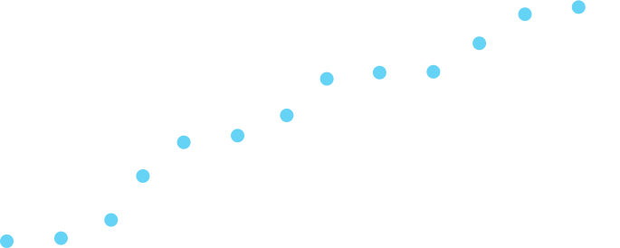

Your thinking journey...
You & your world
You & your organization
You & your team
You
You & your colleagues
Notes:
ANIMATED [Activate animation by clicking, this will display each tagged milestone in the journey]
When we think about our thinking, we begin with ourselves [CLICK] as we learn about our unique HBDI results and thinking preferences. As we learn about ourselves we become more aware of others [CLICK] , realizing that they are also influenced by THEIR thinking preferences.
Then we can think about how we are interacting with our team [CLICK] and our organization [CLICK]. And, of course, we will naturally begin to apply all of this understanding about how thinking preferences shape everything we do and apply that to everything in our world [CLICK]- at work and outside of work.
Today we’re going to start your Whole Brain Thinking journey with [you and then you and your team or you & your team].

Slide 7
Today’s Agenda
You
xxx
xxx
xxx
Your Team
xxx
xxx
xxx
Wrap Up
Questions
Actions
Notes:
[NSERT YOUR AGENDA]
[Be sure to end with an action plan so that the team is committed to taking action with what they learned in the session.]

Slide 8
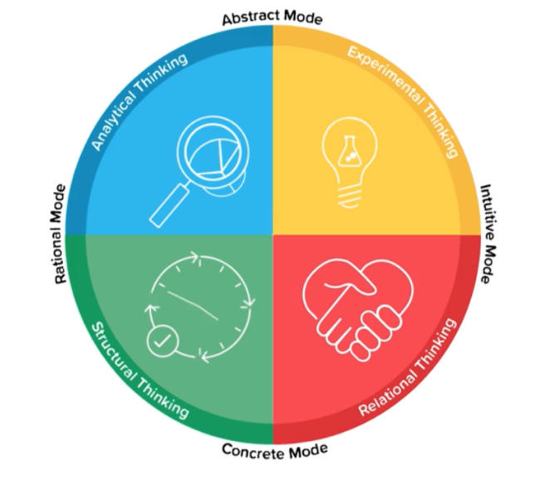
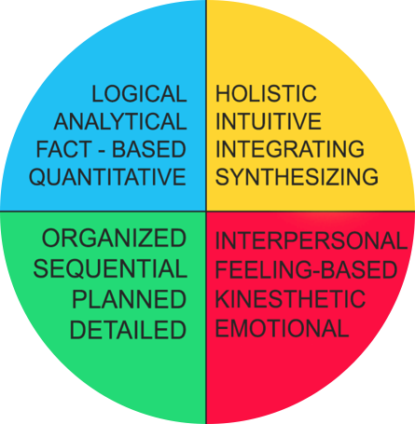
Whole Brain® Thinking Model
A
D
B
C
Notes:
[REVIEW if team has received individual debriefs. Perhaps add a few questions to quiz their memory.]
[INTRODUCTION - if team is not familiar with the model]
Let’s review/look at the Whole Brain Model. It consists of 4 integrated systems of thinking preferences that are color coded and lettered. Moving counter clockwise we have [walk through each one, adding the quadrant theme an characteristics]
A/blue - B/green - C/red - D/yellow
[Walk through modes...we call the left two quadrants -or modes the Rational Mode etc- …]
As you answered questions on the HBDI those questions were mapping your thinking against the 4quadrants in this model.
We all can and do use each of these thinking styles, but we prefer some over others.
We may even avoid some thinking styles.
Although we have natural preferences, it is possible and often necessary to be able to stretch into another thinking style.

Slide 9
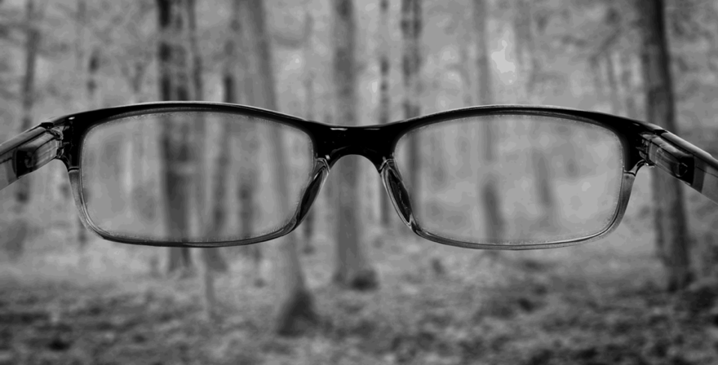
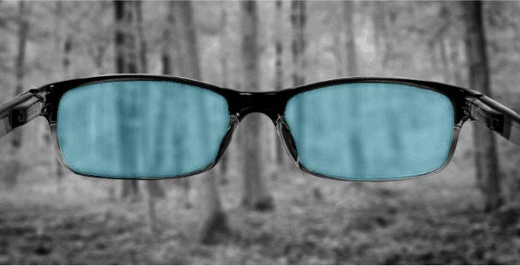
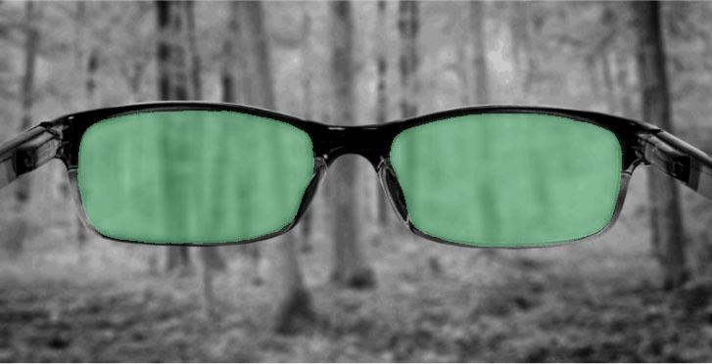
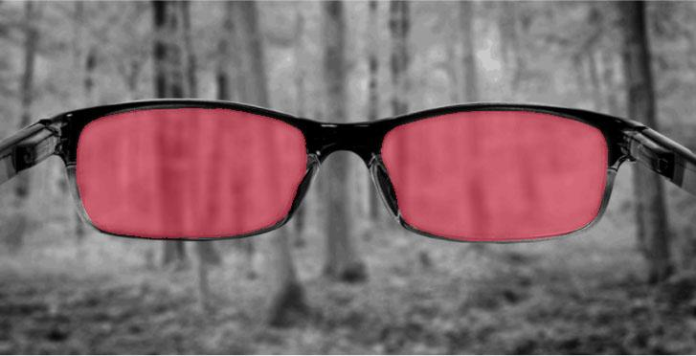
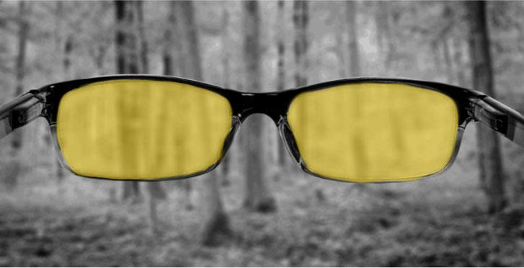
Thinking Agility:
The ability to consciously shift your thinking and learning
when and how the situation requires it.
Notes:
[HIGHLIGHT THINKING AGILITY]
One of keys to the Whole Brain Model is that you are more than just your normal thinking preferences. You can practice thinking agility: [CLICK to activate animate lens in four colors]
…consciously and deliberately shifting your thinking style as you approach problems, decision making, or just in every day communication with others have a different thinking style than you.
You can think of HBDI profile and Whole Brain Thinking as being a secret recipe that you can use when communicating with others.

Slide 10
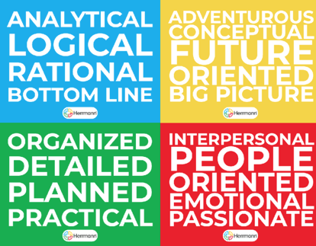
Guess Your Profile
A
D
B
C
Notes:
[IF team has not done HBDI or gotten their individual results use this activity to help them guess their most/least preferred]
[Group, in person activity – use the 4 Color Convince Me cards or, if remote, use this slide as a substitute)
Look at the words in each of the color and lettered boxes. Which words best describe how you approach things when your relaxed and in the flow either in your personal life or at work? When you are most “you” and in your happy place? You may select as many of the quadrants as you like or just one.
Type into the chat [Or pull cards apart and hold up] your preferences. Any answer is ok as long as you select AT LEAST ONE because everyone has at least one primary preference. Most people have more than one.
Let’s take 2 minutes to do that now.
Note the variety of responses and varied number of preferences we have in this group.
[Discuss database distribution – most having 2 or more primary, 5% having only 1, etc.]

Slide 11
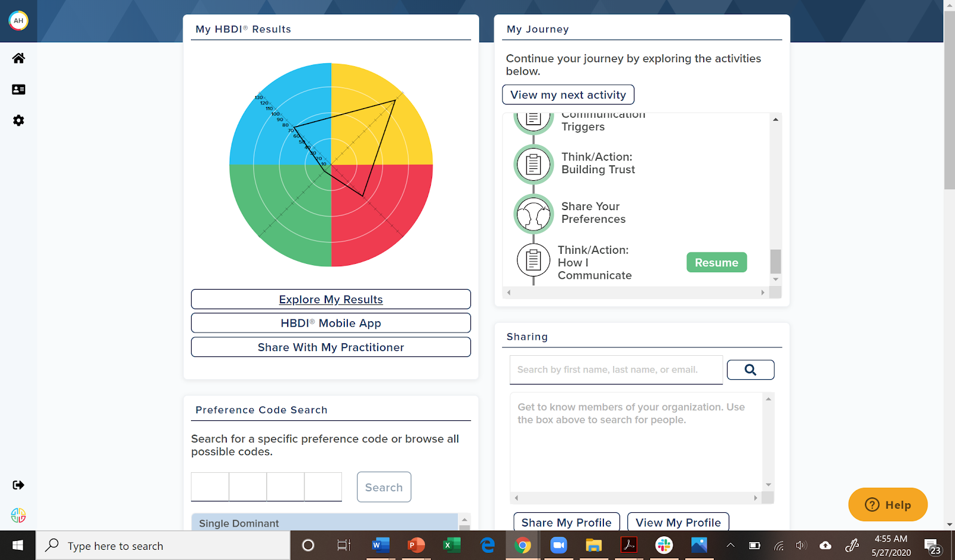
View Your HBDI® results
Open another browser window and go to:
https://journey.herrmannsolutions.net/thinker
Log in with same password used to complete the HBDI®
Notes:
[REMOVE THIS SLIDE if individuals have already been debriefed.]
[VIEW INDIVIDUAL RESULTS IN DIGITAL for those who have not seen results previously]
At this time I invite you to go to this URL to activate access your results on the Herrmann Platform.

Slide 12
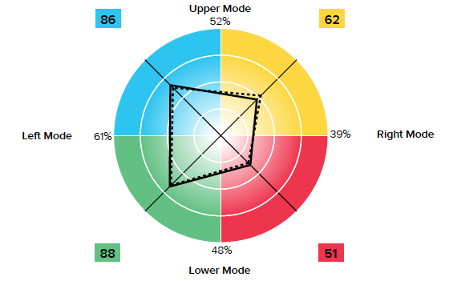




Reading HBDI® Profile Results
Measures the degree of preference for each quadrant: 3, 2, 1
Notes:
[USE AS REVIEW or INTRODUCTION]
This is a sample HBDI profile. Its the result of the HBDI assessment that you took. Let’s walk through the results of this sample.
The solid line (kite shape) represents this person’s natural thinking preferences by degree of preference in each of the 4 quadrants. We have a coding system - or preference code - that we use to help us describe the degrees of preference: 3, 2, 1, and 1+.
3 is a score that lands in the inner most circle. This is a low preference and may even be an avoidance for some. Not everyone has a 3 in their HBDI profile.
2 is score in the next concentric circle or ring out from the center. We call this intermediate or secondary.
A score landing in the next ring out is a 1 or strong preference. This is a primary preference. Everyone has a least one primary preference. In our research database of over 2 million thinkers most people have 2 or 3 primary preferences.
A score in the outermost circle is a 1+. That’s a very strong preference, probably so strong that people could identify that as your preference with no problem.
[FACILITATION TIP: ask the manager or team lead for permission to use their profile on this screen and tell the team they will be guessing who’s profile this is]
This sample profile is [ASK PARTICIPANTS TO PROVIDE THE ANSWER] …yes, a 1122. So, strong preference in A/blue and B/green. This person prefers logical, fact based (A) and ,more structured, detailed (B)approaches to thinking.
The dotted line on the profile is this person’s profile under pressure. What is happening with this person’s under pressure profile? [PARTICIPANT RESPONSE].
In the Herrmann database we find no correlation with profile scores and shifts under pressure. Some shift a little under pressure and some shift only slightly. Some shift more into their preferred quadrants and some shift out of their primary preference. Your under pressure profile is just as unique as your normal HBDI profile.

Slide 13

Key points
Shows your natural preferences and tendencies
Your thinking is flexible - you can stretch!
No one is just “one” preference
Preferences, not competencies
Starts with self awareness
Notes:
[REVIEW points and note that these are important points to remember as you move to reviewing team results]

Slide 14

HBDI® results are not to be used as a ...
Label
Weapon
“Box” to put people in
Good or bad, right or wrong
Notes:
[REVIEW points and note that these are important points as you shift to reviewing team results]

Slide 15
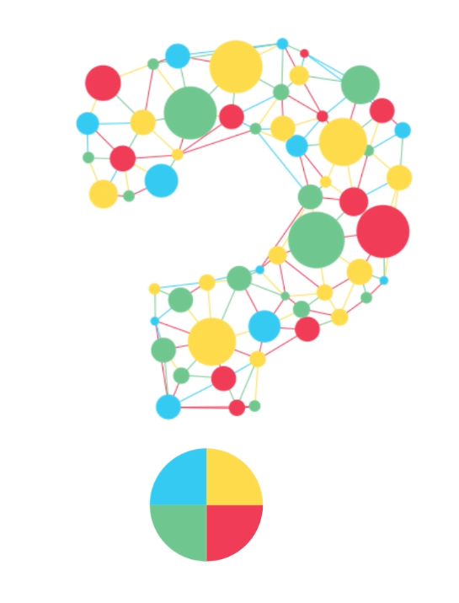
Notes:
Questions so far?

Slide 16

Knowledge Check
A profile code of 1, 1, 1, 1 is not possible?
A profile can change over time?
The four thinking preferences are the same things
as skills and competence?
Notes:
[ANIMATED click to add the next question to the screen as each question’s answer is revealed and discussed.]
I’m going to ask a series of questions. Chime in with your answer to win bragging rights. [LET then know how to respond – raise hand, shout out, type in chat etc]
A profile code of 1, 1, 1, 1 is not possible? Please answer with “True” or “False” [ANSWER: False 1 1 1 1 IS POSSIBLE, ALTHOUGH RARE]
A profile can change over time? Please answer with ”Yes” or “No” [ANSWER: YES, EVENTS SUCH AS DIVORCE. MARRIAGE, CHILDREN. LOSS OF A LOVED ONE, MOVING TO ANOTHER COUNTRY CAN BE SO IMPACTFUL THAT YOUR PROFILE SHIFTS.]
The four thinking preferences are the same things as skills and competence? Please answer with ”Yes” or “No” [ANSWER: NO, WHILE THERE IS SOME CORRELATION BETWEEN PREFERNES AND DEVELOPTING SKILS – BECAUSE IF WE LIKE TO DO SOMETHING WE’LL DO IT MORE AND MAY DEVELOP COMPETENCY – PREFERENCE DOES NOT CAUSE COMPETENCY.]

Slide 17
The journey continues...
You & your world
You & your organization
You & your team
You
You & your colleagues
Notes:
Now let’s think about this team and team dynamics related to your thinking styles when you’re working together.
Each time you add a Thinker to the team, there is the potential for more friction and frustration. Or more value because of increased cognitive diversity. How well you understand other’s thinking, and get them to understand your thinking makes all the difference in how you work together. That’s why it is so powerful for you to have a common language for your thinking preferences. You can convert frustrations into opportunities for better collaboration, better products and services for your customers.

Slide 18
In your opinion, which of the following is
MOST IMPORTANT for team success?
Focus, role clarity, data, and results
Commitment, accountability, execution
Trust, communication, balanced participation, diversity, collaboration
Creative contention, innovation, vision, flexibility, big picture orientation
Notes:
[ASK THE TEAM to reflect on what’s most important. The next slide aligns each point with a quadrant in the model]
Pick the two most important items from this list and type into chat your 1 or 2 letter choices. I’ll give you a few minutes to do that now.
[TELL them how to respond: in chat, shout out, type in chat, etc]
Now let’s look at these choice from another perspective...a Whole Brain perspective. [ADVANCE SLIDE]

Slide 19




In your opinion, which of the following is
MOST IMPORTANT for team success?
Focus, clarity of roles, data and results orientation
Commitment, clear accountabilities, execution orientation
Trust, communication, balanced participation, embracing diversity, collaboration orientation
Creative contention, innovation, vision, flexibility, big picture orientation
Notes:
Did you pick the options that match your thinking preferences?.
If so, that’s really common. We tend to judge how our team “should” operate from the lens of our own thinking preference. We tend to judge everything through the lens of our thinking preferences. How effective do you think that is? Maybe leads to some frustrations, right?

Slide 20
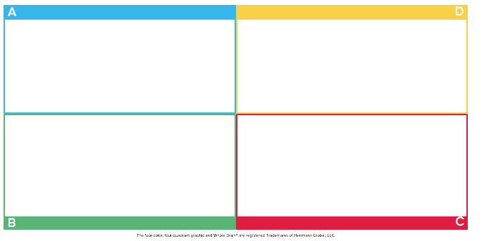
Characteristics of High Performing Teams
Attention to Results
Clear Roles and Goals
Specific Purpose
Confronts Reality
Effective Use of Technology
Agreement on Future Outcomes
Flexible, Open to Different Ideas
Creative Contention
Synergy
Open-ended Discussions
Individual & Team Accountability
Alignment Around Process
Decides & Does Real Work Together
Closure and execution
Commitment
Knowledge about Each Other
Trust
Shared Leadership Roles
Balanced Participation
Good Meeting Environment
Notes:
As we look around the Whole Brain Model in this Walk Around for High Performing Teams, we see a list of characteristics by quadrant that represents essential cognitive diversity. All teams need to be able to function in these areas - even if it’s not their natural tendency to do so. That’s why thinking agility is so important. We can stretch into thinking styles that aren’t our primary preference.

Slide 21

Leveraging Your Team’s Cognitive Diversity
Notes:
Let’s take a look at your Team Profile results now.

Slide 22
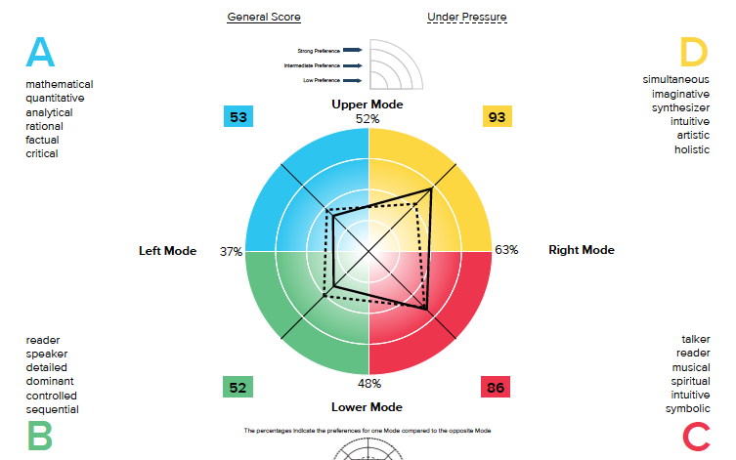
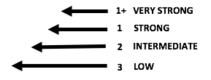
HBDI® Team Average Profile
REPLACE WITH YOUR
TEAM IMAGE
Notes:
This is built from the average of all your scores in each of the quadrants. [Use animation of preference code levels to discuss level of preference or delete].
[PROMPTS]
What do you see?
How does the team shift under pressure?
How might this impact how the team works together?
What might you miss?

Slide 23
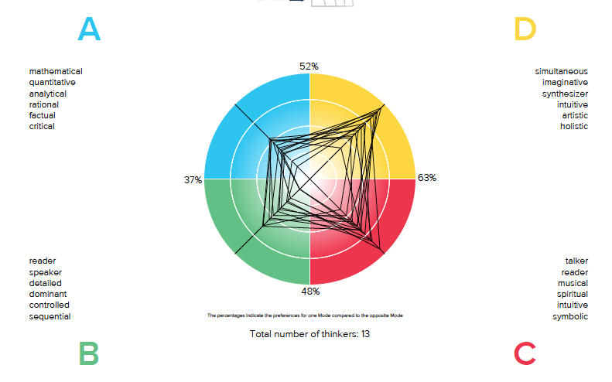
HBDI® Group Composite Profile
REPLACE WITH YOUR
TEAM IMAGE
Notes:
This is a more detailed view, with each of your profiles overlaid.
[PROMPS]
What can we see now that we didn’t see in the average view?
What’s going on on the right side of the model versus the left/upper versus lower? And what might the implications of that tilt be?

Slide 24
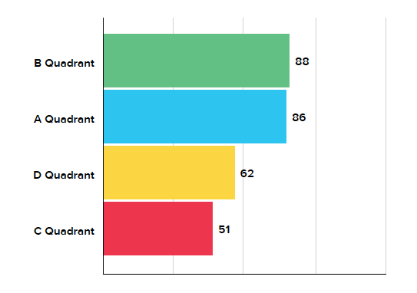
HBDI® Group Rank Order of Preferences
REPLACE WITH YOUR
TEAM IMAGE
Notes:
This is the Group Rank order of Preferences for the team, in descending order from most preferred to least preferred. This often reflects the direction of the team’s thinking in non-stress situations.
Often when teams gather for a meeting or start to work a problem they begin where they are most comfortable and run out of time before they get to areas where they are less comfortable.
[PROMPTS]
Have you seen this preference demonstrated by the team?

Slide 25
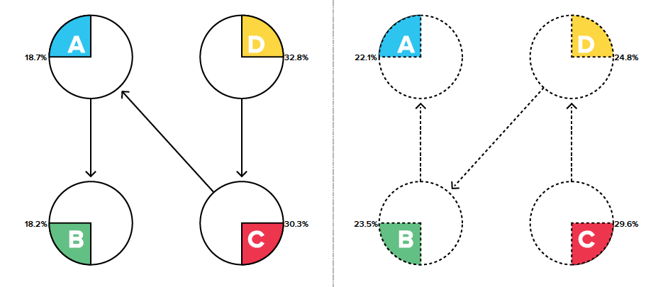
HBDI® Team Process Flow
REPLACE WITH YOUR
TEAM IMAGE
Notes:
[ANIMATION – THE UNDER PRESSURE FLOW IS REVEALED ON CLICK]
The Team Process Flow shows us how the team is likely to think through a problem or challenge. First we have the natural state flow. It starts with the [explain the team’s flow]
What might be the danger of taking this approach every time? (last in the flow may get skipped due to time constraints or avoidance)
[CLICK TO REVEAL UNDER PRESSURE FLOW]
This is the same process flow only under pressure. It may be that the team follows this flow most of the time. What might be a danger of this process flow?
[PROMPTS]
How might you approach not falling into the same process flow?
[Review options such as “include all voices, deliberately start in the least preferred so it isn’t missed]

Slide 26
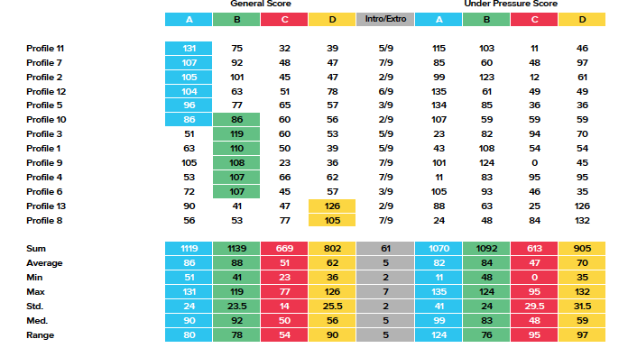
HBDI® List of Scores
REPLACE WITH YOUR
TEAM IMAGE
Notes:
Here is a comprehensive, anonymous list of profile information for this group, including A, B, C, and D quadrant scores on the top left. You’ll se that each person’s highest profile score is highlighted in that quadrant.
The Introversion/Extroversion scale (from 1-9) is in the middle, top. and Under Pressure scores are top right.
Below is additional statics including group average, min and max scores by quadrant.
[PROMPTS]
What do you see about the range of scores in each quadrant and across quadrants?
Are there scores above 133? Below 33?

Slide 27
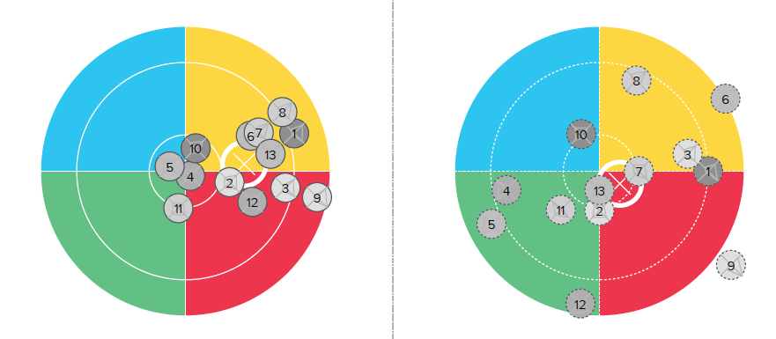
HBDI® Preference Map - Normal vs Under Pressure
REPLACE WITH YOUR
TEAM IMAGE
Notes:
[ANIMATED left/normal profile appears on the slide. Right/under pressure appears on CLICK.]
The preference map takes each profile and maps it to a specific point on the model. Each of you are represented here by a number - to keep it anonymous- and the light to dark color indicates degree of extroversion, with highest extroversion in light gray and highest introversion in dark gray.
This is the team in normal conditions. The white X represents the overall average location of the group. What do we see? Where is the X?
[CLICK]
[PROMPTS]
This is the team under pressure.
What happens?
Where is the white X now?
Can you think of times when you’ve seen this shift?

Slide 28
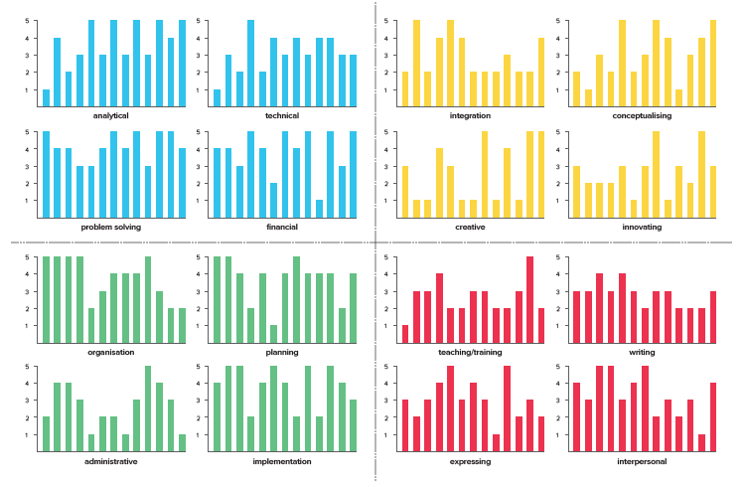
HBDI Works Elements by Quadrant
REPLACE WITH YOUR
TEAM IMAGE
Notes:
This data view shows us the results of the part of the HBDI in which you were asked to rank Work Elements from 1 to 5, with 5 being work you do best and 1 being work you feel you do least well. This report presents the data from each of you displayed individually, but groups your answers by topic (the position of the bar for each person is consistent in all of the graphs).
Note that a score of 3 can be misleading because sometimes people rate an element a 3 because they have run out of 4s and 5s. So, some 3s actually represent areas of strength.
[PROMPTS]
Is there at least one 5 on each Work Element?
Are there Work Elements that have mostly 1s? What are the implications?
Are there any Work Elements where the group is divided between extreme preference and a lack of preference?
What are the implications?

Slide 29
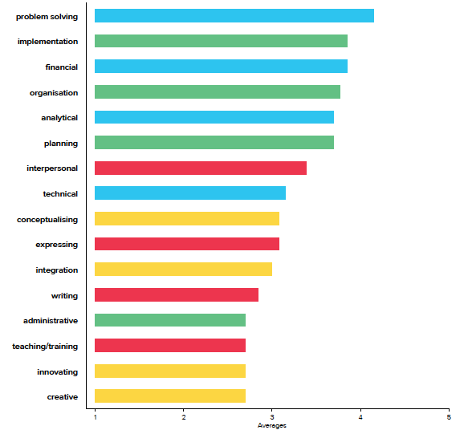
HBDI® Rank Order of Work Elements
REPLACE WITH YOUR
TEAM IMAGE
Notes:
If we average and rank order the ratings of each Work Element by the team, we can recognize the strengths of the team’s preference rather easily.
You can also easily recognize areas of lesser preference as they appear lower on this bar chart.
Work Elements are focused on how people see themselves at work.
[PROMPTS]
Which Work Elements are rated the strongest?
Which are rated the weakest?
Which quadrants have the strongest preferences? What are the implications?
How do the preferred Work Elements align with the team’s tasks?

Slide 30
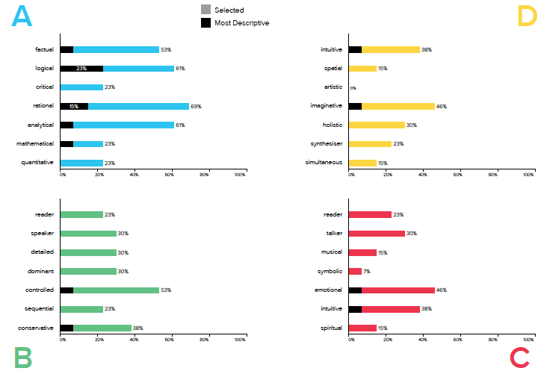
HBDI® Key Descriptors by Quadrant
REPLACE WITH YOUR
TEAM IMAGE
Notes:
In the HBDI you each choose 8 Key Descriptors that best describe you and then identified 1 of the 8t as the most descriptive of you. In this data view each bar displays the percentage of the team that chose each of the 28 Key Descriptors and displays the percentage of the team that has descriptors chosen as MOST descriptive.
There can be differences between the Key Descriptors and the Work Elements because sometimes people have preferences that they are not able to satisfy through work.
The Key Descriptors may also reflect preferences team members would like to satisfy through work, especially if you aren’t able to meet those needs through non-work related activities. The Key Descriptors selected as most descriptive can often have a strong impact on team interaction.
[PROMPTS]
What’s the distribution by quadrant?
Which quadrants have the most?
Which quadrants have the least?

Slide 31
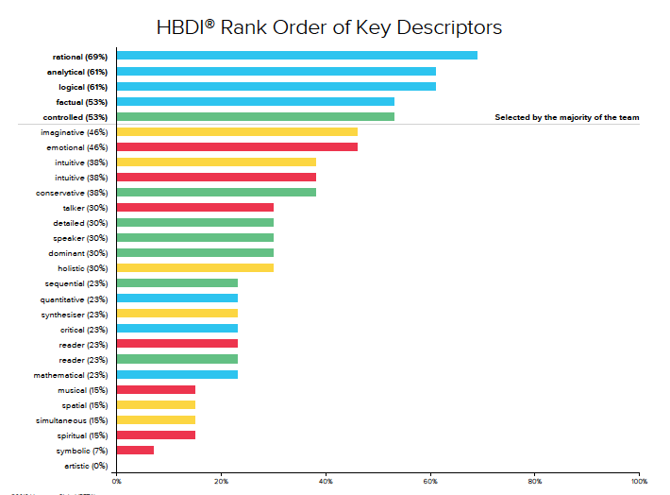
HBDI® Rank Order of Key Descriptors
REPLACE WITH YOUR
TEAM IMAGE
Notes:
This bar chart shows which descriptors were selected more than others and which descriptors were not selected at all. The bars are color coded by quadrant for easy identification.
We can see that [enter highest five here] were selected the most by the team and [enter 0% descriptor here] wasn’t selected at all.
The top 4-5 key descriptors can have a significant impact on how they team thinks.
[PROMPTS]
Are the top descriptors balanced across all 4 quadrants?
What do you notice about the distribution at the bottom?
Which Key Descriptors are possible developmental areas? (typically those that score below 50%).

Slide 32
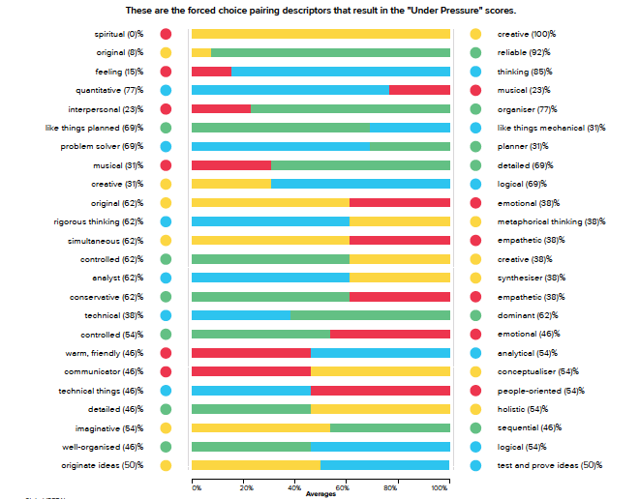
HBDI® Adjective Pairs Comparison
REPLACE WITH YOUR
TEAM IMAGE
Notes:
This Adjective Pairs Comparison shows which of each Adjective Pair was selected by the team. The bars are color coded by quadrant. The % figures along the bottom of the chart show how many of the team selected each adjective. The Adjective Pairs reflect how the team may think under pressure by demonstrating which thinking style is preferred between two choices.
[PROMPTS]
Which Adjective Pair did the majority of the team select?
Which Adjective Pair did the team avoid?
Which of those selections might be significant?
Where are the areas of potential conflict?

Slide 33
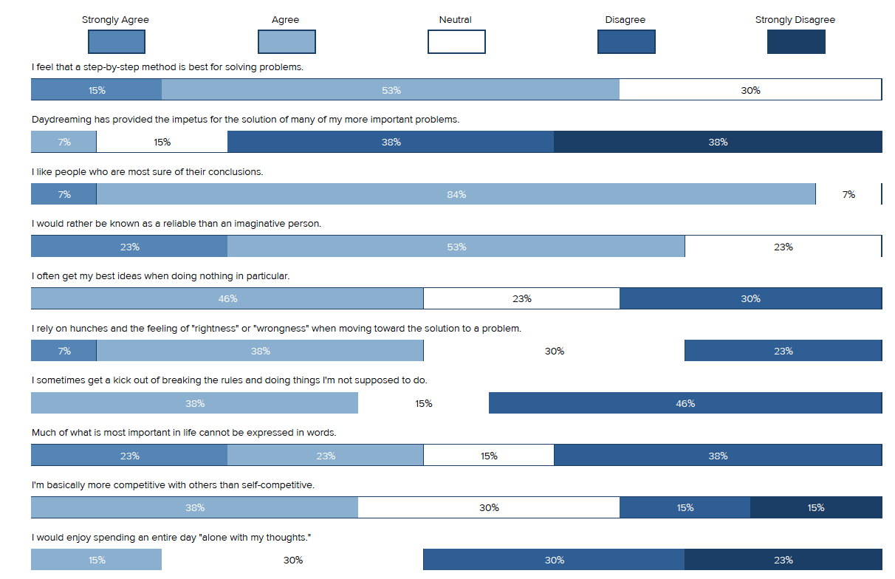
HBDI® 20 Questions
REPLACE WITH YOUR
TEAM IMAGE
Notes:
[IF THE TEAM is reviewing this information on a slide and does not have a copy of the report, you may find it more productive to review responses to the questions in advance and identify those most relevant for discussion. Type the questions and significant response data and present each as a bullet point for discussion.]
The 20 Questions shows how the team answered each of the questions at the end of the HBDI.
The % figures along the top of each question indicate the % of the team that made that particular selection. For example, if there is a figure of 5% at the “strongly agree” end, that indicates that 5% of the group selected “strongly agree”. The % figures in brackets indicate the total % of the group that selected either “agree or strongly agree” as opposed to “disagree or strongly disagree”.
[PROMPTS]
Where is the team in strong alignment?
Where does a variety of responses appear? What might that mean about the team’s response to this topic?

Slide 34
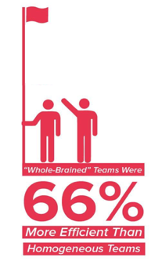
Team Productivity
A six-year study
Thinking balanced teams are more effective
Whole Brain® Teams were 66% more efficient
70% or more of the whole brained teams were successful (versus not whole-brained teams).
Notes:
[THIS slide provides some A quadrant data around team productivity and Whole Brain Thinking for those team members strong in the A quadrant. It also helps sell the value of keeping the team profile top of mind every day as they interact]
What impact does Whole Brain Thinking have on team productivity?
[READ through the rest of the bullet points]

Slide 35

Optimize your “Thinking Operating System”
How to apply Whole Brain® Thinking
Own your own preferences and their impact
Know your teammate’s preferences and how they
process under pressure.
Commit to stretching your thinking to meet the
needs of the team, customers, and the situation.
Use the language of Whole Brain® Thinking
to accelerate understanding and clarity.
Notes:
Now that you understand your individual and team profiles, how do you apply Whole Brain Thinking every day?
First, be aware of your own profile: understand that you are naturally filtering everything you experience through your own lens – and that others are too!
[READ through the rest of the bullet points]

Slide 36
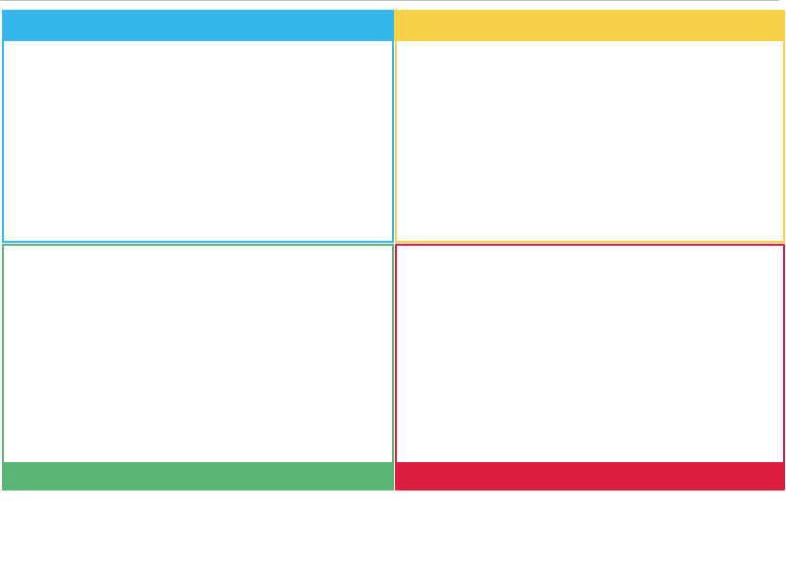
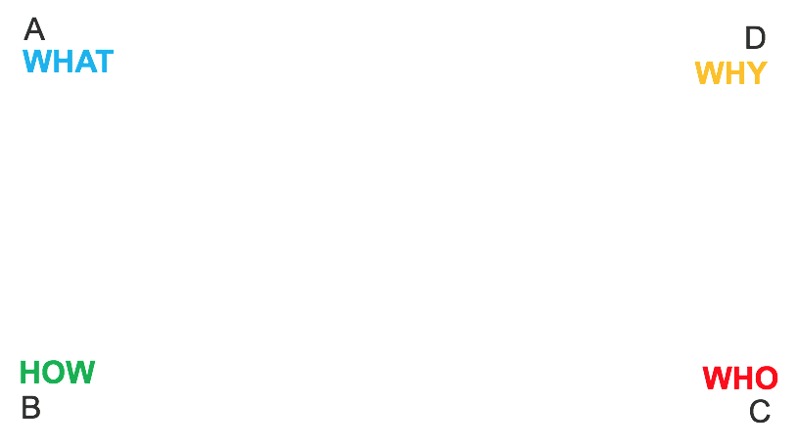
Whole Brain® WalkAround
Notes:
Here’s a quick and simple tool you can use any time in any situation to help you be more Whole Brained.
Start with your topic and write it in the middle.
Then, starting with A quadrant add details to each quadrant.
Make sure you have listed items in every quadrant to ensure you are thinking in a Whole Brain way.

Slide 37
Questions, comments

Slide 39
Add Header
Notes:
[Blank slide for additional content].

Slide 40
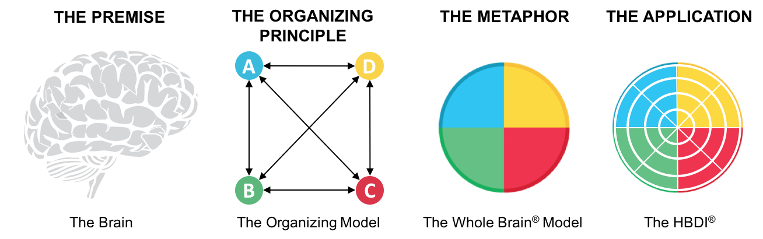
The Organizing Principle and Architecture

Slide 41
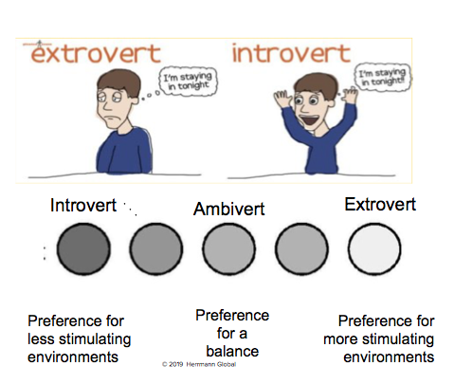
Notes:
[USE for questions about the impact of introversion and extroversion scale]
Teams often ask for the definition of introversion and extroversion and why it matters. Team dynamics can be greatly influenced when critical thinking styles aren’t represented because a certain team member doesn’t speak up while another or more introverted team member often speaks up.

Slide 42
How we use HBDI® Profile results
Communication and interpersonal effectiveness
Improve productivity and efficiency
Learning and development
Leadership development
With common business problems: cognitive diversity, inclusion, innovation
Notes:
[USE to review the value of the HBDI Profile and awareness]

Slide 43
Which words best describe you?
Logical
Analytical
Fact based
Quantitative
Holistic
Intuitive
Integrating
Synthesizing
Organized
Sequential
Planned
Detailed
Interpersonal
Feeling-based
Kinesthetic
Emotional

Slide 44
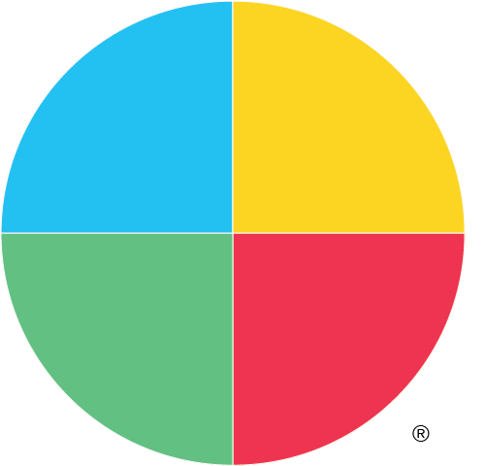
Which words best describe you?
A
D
Logical
Analytical
Fact based
Quantitative
Holistic
Intuitive
Integrating
Synthesizing
Organized
Sequential
Planned
Detailed
Interpersonal
Feeling-based
Kinesthetic
Emotional
B
C

