Slide 1

Herrmann Team Effectiveness Dashboard
Sample Group with Facilitator Notes
Notes:
SHARE PURPOSE/INTENT OF THIS REPORT The purpose of the Team Effectiveness Dashboard is to get team members thinking about their team’s Current functioning in relationship to their Ideal State. This report will give participants insight for greater alignment and better agreements and commitments about the ways that the team currently work together, and how they could work together more effectively.
It gives perspective on what the team is focusing on and what they may be missing and the insights help define and clarify the teams collective objectives and outcomes.
NOTES: CONSIDERATIONS: If the team you are working with has had individual debriefs and a team report you can spend the first 20-40 minutes depending on time and audience knowledge with a “refresh”. Reintroduce WBT, Their Team data and then move into the TED.
If they have not been exposed to the individual or team report, you can create the context of the session around the importance of teams/collaboration, the VUCA environment and the need for leaders to have thinking agility. Share the Whole Brain Business Model representation and get agreement about the need for “whole”/all of these descriptors for a solid/efficient/effective business. You can also discuss the challenge/complexity of competing priorities.

Slide 2
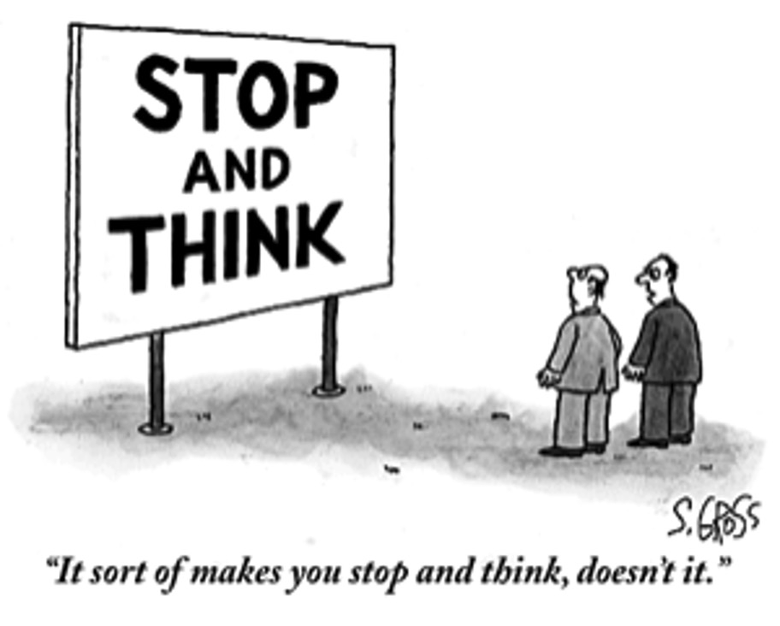
Notes:
STOP AND THINK :
SAY: Today is an opportunity to “stop and Think” about our teams’ effectiveness. Let’s start by looking at today’s environment

Slide 3
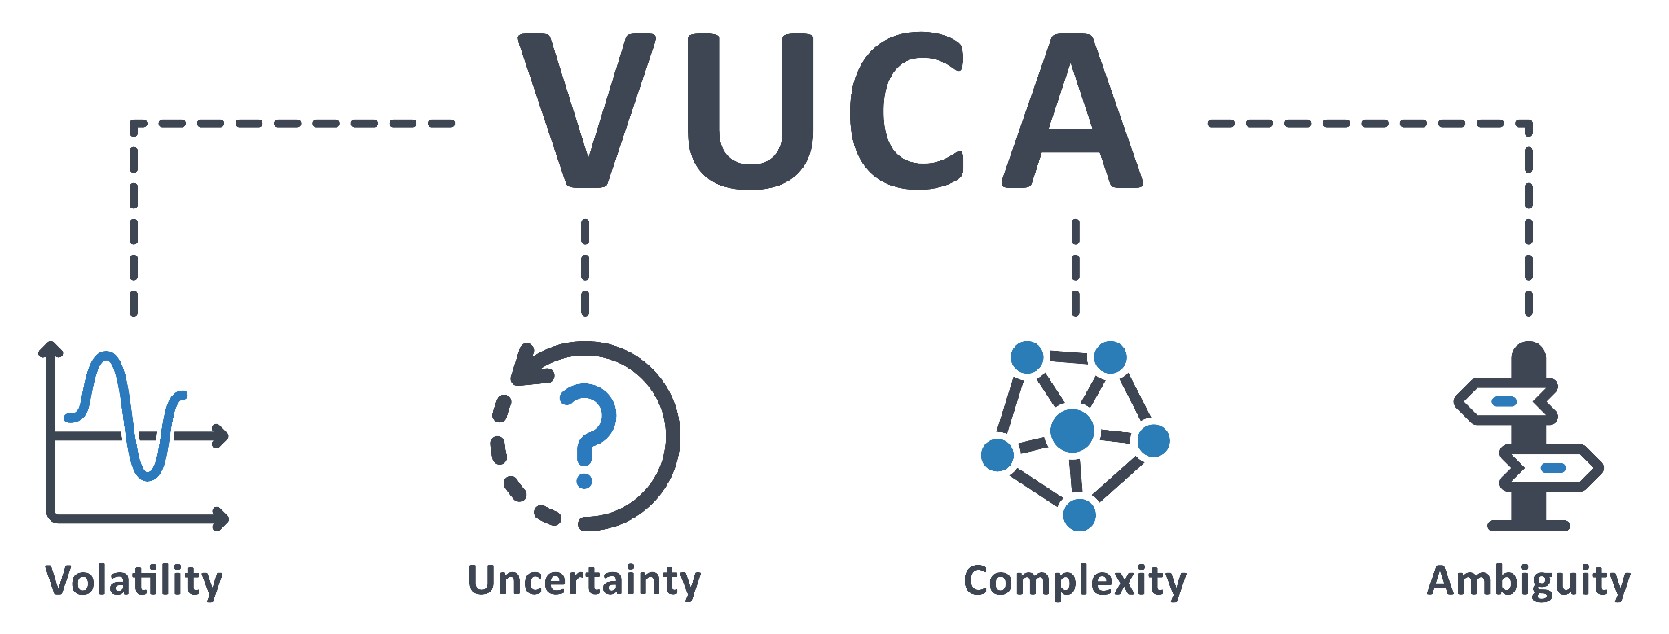
VUCA (Future) The Environment of Today
Notes:
Set the context for their teaming related to the VUCA environment and share how Whole Brain Thinking can help us navigate the complexity.
Can ask if anyone knows the acronym “VUCA”? It Was developed by the US War College 25 years ago to describe the world we live in TODAY. It stands fo Volatile, Uncertain, Complex and Ambiguous Ask, do you think that accurateky describes todays environment? You can also ask what skills are needed to navigate this type of environment?
OR, you can share, the best way to navigate this complexity is to approach things through the lens of wholeness and use the WBT roadmap to flex where you need to be when needed. This is about our personal and teams agility.
Next Slide: Thinking Agility

Slide 4

Thinking Agility
The ability to consciously shift your thinking and learning when and how the situation requires it.
Notes:
GIF IMAGE: glasses will shift color automatically
SAY: In light of this VUCA environment, teams need to be agile in their thinking to adapt to constant change.
A big APPLICATION of Whole Brain Thinking is thinking Agility, which we define as The ability to consciously shift your thinking and learning when and how the situation requires. Each one of you and your team as a whole can be agile in your thinking.

Slide 5
Whole Brain® Business Model
Leadership is responsible for integrating all these dimensions.
Payoff
Possibilities
Goals
Objectives
Efficiency
Financials
Technology
Past Trends
Performance Measurements
Future Trends
New Concepts
National/Global
Long-term Strategy
Vision
Purpose
Competition
Environment
A
D
Processes
B
C
People
Training/Dev
Teams/Relationships
Recognition
Customer Relations
Communications
Community
Culture
Values
Methods
Regulations
Quality Assurance
Risk Reduction
Resources
Control
Timing
Policy
Notes:
SAY: Successful business equals Whole Brain® Business. In business, we all need to use agility to manage complexity and competing priorities. As such all of us need to realize that all four of these areas are critical to business success.
CLICK: Reveal the 4 P’s one at a time.
SAY: The 4 P’s are: PROFITS, PROCESSES, PEOPLE and POSSIBILITIES.
SAY: Learning the language of Whole Brain® Thinking will help you work as a team and the whole business with more ease. The method scales so it can also help you understand others - clients, stakeholders, colleagues, departments, divisions, and an entire organization. And yes, even your friends and family!
SAY: Now let’s use this model to think about your business.
ASK: Where do you see the culture of your organization paying the most attention? What happens if you ignore any one of these quadrants? Hold up the color card or cards that best reflect your view of the culture at this organization. Use the color cards to show the tile of your culture
Successful Business = Whole Brain Business
Leaders and managers need have the agility to manage the complexity/the competing priorities

Slide 6
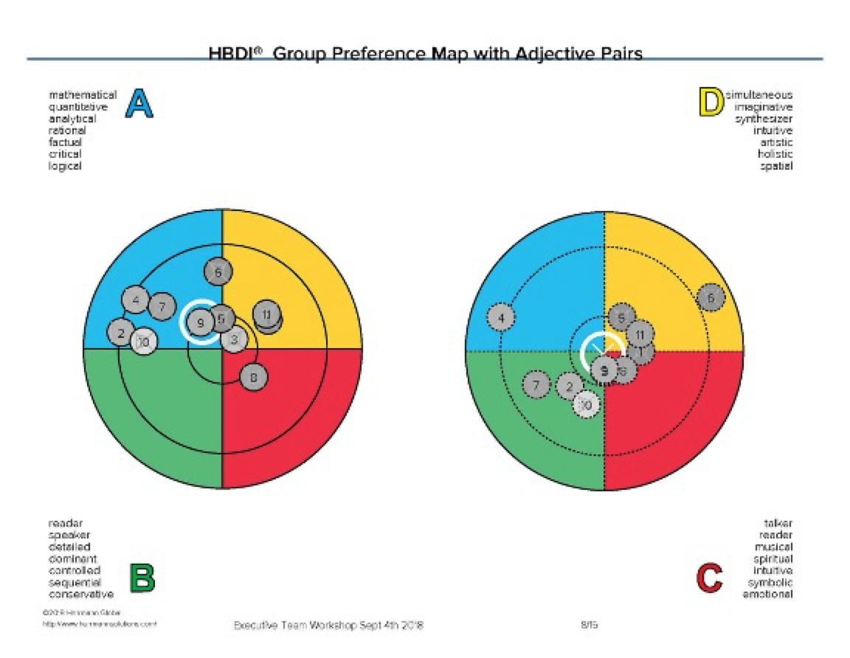
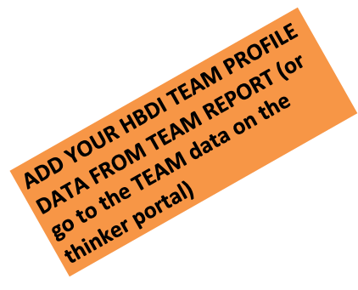
HBDI® Team Profile
Notes:
IF YOUR TEAM HAS HAD A TEAM REPORT – Review 2-4 slides from the team report or go to the team data in the Thinker portal or MSFT Stop and Think APP
Highlight individual preferences and the team results (average/composite)

Slide 7
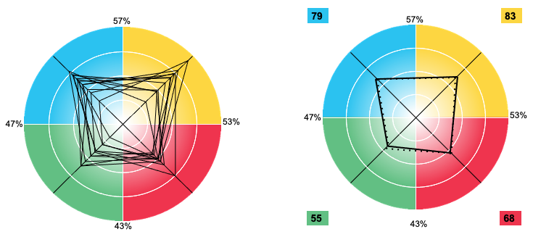
HBDI Team Profile
Notes:
IF YOUR TEAM HAS HAD A TEAM REPORT – Review 2-4 slides from the team report or go to the team data in the Thinker portal or MSFT Stop and Think APP
Highlight individual preferences and the team results (/preference maps (regular and under pressure)
TRANSITION:
Now that we have reviewed the Whole Brain Model and our team results, let’s look at the Team Effectiveness Dashboard – where we did a quick survey about where we think we are as a team now (current state) and where we say we want to be in the future (Ideal State)

Slide 8
Whole Brain® Team Effectiveness Model
Goals
Measurement
Research & Analysis
Finance & Budget
Risk-Taking
Brainstorming
Strategy
Synthesis
A
D
B
C
Plans & Schedules
Organization
Process
Details
Communication
Empathy
Relationships
Collaboration
Notes:
The Whole Brain® Team Effectiveness Dashboard (TED) uses the Whole Brain® Team Effectiveness Model as the foundation of its diagnostic survey, with each area evaluated anonymously by each participant. Participants are also asked to respond to the following open-ended questions, with the aim of providing a snapshot of the current and envisioned operational state of the team from the perspective of all of its members: • What are the purpose and goals of this team? • Is this team working to its maximum potential? • What are the strengths of this team? • What do you see as the biggest challenge facing this team?
Basically, we are doing a quick gap analysis using the Whole Brain Thinking Model as a roadmap/baseline/foundation to determine “where are we now?”, “where do we want to be?” and in this session we can begin to discuss how we can get to our ideal state from where we are/given our preferences.
TRANSITION:
Let’s see your results.

Slide 9
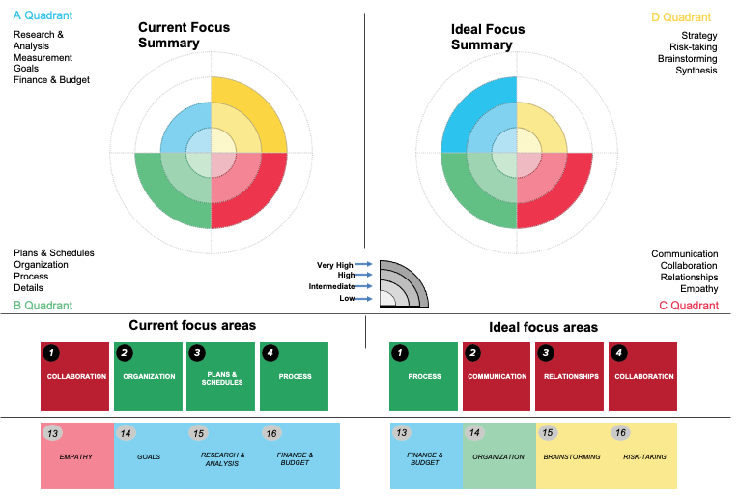
Sample Group Summary
Notes:
DESCRIBE REPORT Page 1: Summary comparison of 1) the team’s views on where the team is currently focused and 2) where it should be focused. Each of the two graphs has the 4 quadrants of the Whole Brain® Model, and each quadrant has 4 potential “layers” representing the degree of focus.
The more colored layers in a quadrant, the higher the degree of focus.
The first page also includes a ranking of the top and bottom 4 areas for both current and ideal focus.
NOTES:
ASK:
How is this true for you as a team? Individuals in the team? Can you think about specific work examples where (pick one or two) ABCD quadrants is demonstrated at the current state level? What can we stop, start and/or modify to shift the focus from current state to our ideal state?
IF SHARING THE TEAM REPORT ALSO: How do our individual/team preferences line up with the Ideal state?
IN PLANNING
Highlight your key observations related to patterns and degree of preference per quadrant and shifts in the rankings top/bottom in both current and ideal state.
TRANSITION
Digging deeper into the data, the next four slides represent how each member of the team ranked each of the descriptors in each of the quadrants.

Slide 10
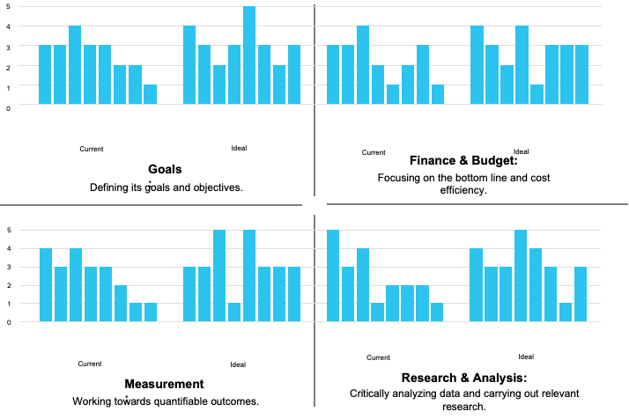
Sample Group Responses
Notes:
DESCRIBE REPORT Pages 3-6: Detailed overview of the team’s individual responses for each of the 16 areas of Team Effectiveness (4 in each quadrant), for both current and ideal focus. Note that although the individuals’ responses are in the same order and can therefore be reviewed on an participant-by- participant basis, the answers are anonymous and should be treated as such.
NOTES:
ASK:
What do you see as you look at this data? Examine all four descriptors following patterns of high score, low score, current state vs. ideal state, difference in individual scores. ASK: where do you see examples of the “visual” (pick any current state data) in your current work? What would you have to start, stop or modify to shift from current to ideal state?
As the facilitator be prepared to discuss your view of the data and what you see in the highs/lows of the current and ideal state.

Slide 11
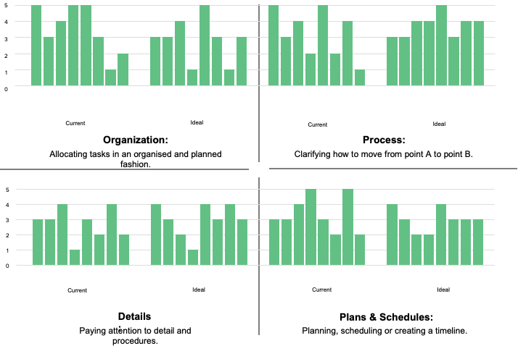
Sample Group Responses
Notes:
Pages 3-6: Detailed overview of the team’s individual responses for each of the 16 areas of Team Effectiveness (4 in each quadrant), for both current and ideal focus. Note that although the individuals’ responses are in the same order and can therefore be reviewed on an participant-by- participant basis, the answers are anonymous and should be treated as such.
NOTES:
ASK:
What do you see as you look at this data? Examine all four descriptors following patters of high score, low score, current state vs. ideal state, difference in individual scores. ASK: where do you see examples of the “visual” (pick any current state data) in your current work? What would you have to start, stop or modify to shift from current to ideal state?
As the facilitator be prepared to discuss your view of the data and what you see in the highs/lows of the current and ideal state.

Slide 12
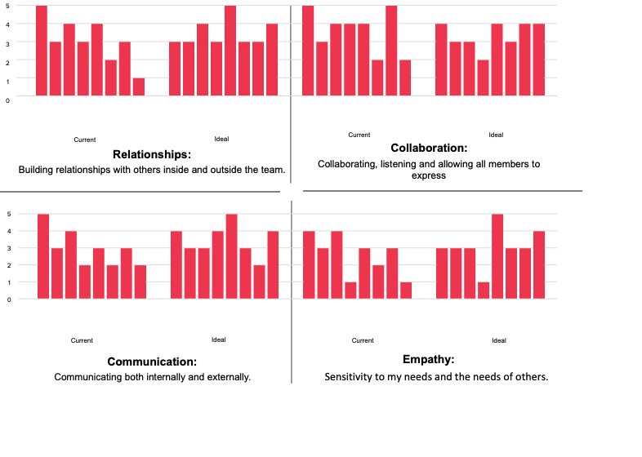
Sample Group Responses
Notes:
Pages 3-6: Detailed overview of the team’s individual responses for each of the 16 areas of Team Effectiveness (4 in each quadrant), for both current and ideal focus. Note that although the individuals’ responses are in the same order and can therefore be reviewed on an participant-by- participant basis, the answers are anonymous and should be treated as such.
NOTES:
ASK:
What do you see as you look at this data? Examine all four descriptors following patters of high score, low score, current state vs. ideal state, difference in individual scores. ASK: where do you see examples of the “visual” (pick any current state data) in your current work? What would you have to start, stop or modify to shift from current to ideal state?
As the facilitator be prepared to discuss your view of the data and what you see in the highs/lows of the current and ideal state.

Slide 13
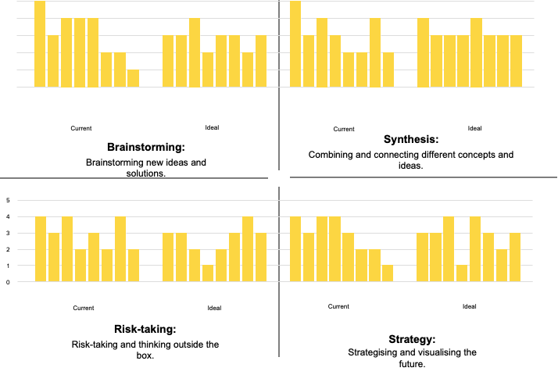
Sample Group Responses
Notes:
Pages 3-6: Detailed overview of the team’s individual responses for each of the 16 areas of Team Effectiveness (4 in each quadrant), for both current and ideal focus. Note that although the individuals’ responses are in the same order and can therefore be reviewed on an participant-by- participant basis, the answers are anonymous and should be treated as such.
NOTES:
ASK:
What do you see as you look at this data? Examine all four descriptors following patters of high score, low score, current state vs. ideal state, difference in individual scores. ASK: where do you see examples of the “visual” (pick any current state data) in your current work? What would you have to start, stop or modify to shift from current to ideal state?
As the facilitator be prepared to discuss your view of the data and what you see in the highs/lows of the current and ideal state.

Slide 14
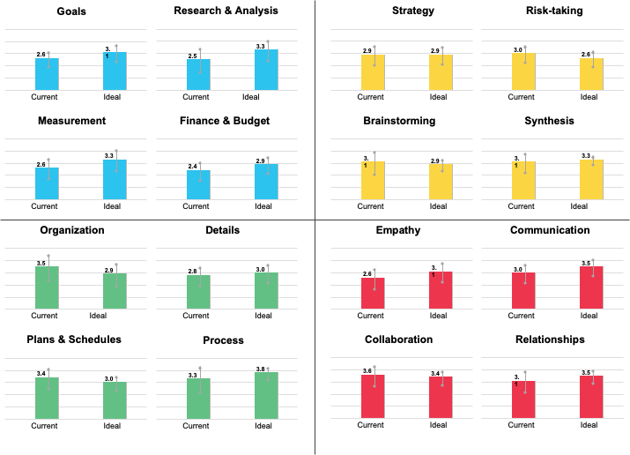
Sample Group: Quadrant Data Summary
The bars represent the average of responses. The longer the gray line on each bar, the greater the difference of opinion in the responses.
Notes:
Describe Report Page 6: Note– due to font size you may want to zoom in for eaxh quadrant and/or highlight key areas of focus for easier redability.
Quantitative graphical summary of the responses for each of the 16 Team Effectiveness areas, each of which shows the team’s aggregate view of current and ideal focus.
The graphs show the team’s views on a scale of 1 (lowest) to 5 (highest). The average score for each aspect’s current and ideal focus is shown on the bar graphs. Overlaid on the bar charts is a vertical line representing the degree of agreement, based on the standard deviation of the team’s responses. A shorter line implies more agreement among team members, and a longer line implies more disagreement.
ASK: What do you notice as you look at the averages in each quadrant from current to ideal state? Where has the average increased? Stayed the same? Decreased? Where is the arrow longer (more difference in opinion)? Where is there more agreement (shorter arrow)? Based on this data, what might you start, stop or modify to move from your current state to the future state?
NOTE: You can refer to the previous 4 slides to analyze the data and find deeper relationships and patterns.

Slide 15
Sample Group: Purpose
What is the purpose/goal of this team?
Restoring communications among upper levels on Management evaluation
Working with upper management to solve big problems
To be AWESOME
Create a better user experience and overall user experience for our Software Products
My purpose is to encourage employees through HR work
This team must come up with new and innovative ways to work with management
To try to come up with ways to make our product line more interesting…which it is not.
Notes:
Pages 8-11: the team’s aggregated responses to the qualitative aspects of the survey, specifically:
Page 8 - What is the purpose / goal of this team?
Page 9 - Is this team working to its maximum potential?
Page 10 - What are the strengths of this team?
Page 11 - What do you see as the biggest
SHARE
Share your observations of this data and start a conversation around any gaps or places that do not feel aligned or clear.
NOTE
You can share this data or, if this is a full slide or several pages given the size of the group, you can create your own slide with a summary of the patterns and themes. Do look for in outlying comments that could be flags to a deeper discussion for greater clarity of purpose. OPTIONAL: Create a word cloud of the purpose using a word cloud generator
Note that the open-ended responses may extend to multiple pages and there may be sensitive comments. These should be reviewed and shared with care to protect anonymity. In some instances, you may wish to not share these pages directly with the team, but instead call out broad themes or areas of further exploration.

Slide 16
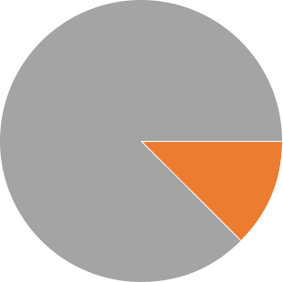

Sample Group: Potential
Is this team working at its maximum potential?
Notes:
Pages 8-11: the team’s aggregated responses to the qualitative aspects of the survey, specifically:
Page 8 - What is the purpose / goal of this team?
Page 9 - Is this team working to its maximum potential?
Page 10 - What are the strengths of this team?
Page 11 - What do you see as the biggest
Note that the open-ended responses may extend to multiple pages and there may be sensitive comments. These should be reviewed and shared with care. In some instances, you may wish to not share these pages directly with the team, but instead call out broad themes or areas of further exploration. OPTIONAL: Create a word cloud of the purpose using a word cloud generator
SHARE
Share your observations of this data. Note that anything less than YES Usually represents :room for growth” an opportunity for better utilization of the group’s potential (which is positive)
ASK
Depending on the results, ask questions related to the %’s of each area. ASK: How can you move the needle from one area to another? For example: I notice that we have 0% in Yes, usually, What can we do to move more into this area? OR “We have 12.5 % in No, rarely, What’s happening that we don’t work at our potential?

Slide 17
Sample Group: Strengths
What are the strengths of this team?
Innovation, and using our unique perspective to get more creativity happening in the company
Working with upper management
Developing new products
We’re a good looking bunch
Idea generation, taking ideas into implementation
Working together with a common goal always at the forefront
We enjoy working as a team. We rarely have difficulties.
We have a strong passion for the work we do, even when things get tough we still enjoy the work we do
Notes:
Pages 8-11: the team’s aggregated responses to the qualitative aspects of the survey, specifically:
Page 8 - What is the purpose / goal of this team?
Page 9 - Is this team working to its maximum potential?
Page 10 - What are the strengths of this team?
Page 11 - What do you see as the biggest
SHARE
Share your observations of this data and start a conversation around the team strengths, ASK “how do your strengths align with your individual/team preferences? Is there an area of preference that is not touched on given your strengths? What do these strengths say about this team and its effectiveness?
NOTE
You can share this data or, if this is a full slide or several pages given the size of the group, you can create your own slide with a summary of the patterns and themes. Do look for in outlying comments that could be flags to a deeper discussion of strengths. OPTIONAL: Create a word cloud of the strengths using a word cloud generator
Note that the open-ended responses may extend to multiple pages. This data should be reviewed in advance and shared with care. In some instances, you may wish to not share these pages directly with the team, but instead call out broad themes or areas of further exploration.

Slide 18
Sample Group: Challenges
What do you see as the biggest challenges facing this team?
Getting our ideas “sold” to the powers that be
Being open to outsiders
Receiving feedback and acting on it
Being receptive to upper management’s criticism
External Comms and Processes
We’re having so much fun I rarely think about our challenges
Gossip
The biggest challenge is that we have to find a way to make our product line more exciting
Notes:
Pages 8-11: the team’s aggregated responses to the qualitative aspects of the survey, specifically:
Page 8 - What is the purpose / goal of this team?
Page 9 - Is this team working to its maximum potential?
Page 10 - What are the strengths of this team?
Page 11 - What do you see as the biggest
SHARE
Share your observations of this data and start a conversation around the team challenges, ASK “how do your challenges align with your individual/team preferences? Is there an area of preference that you could stretch into based on working to minimize your challenges?
NOTE
You can share this data or, if this is a full slide or several pages given the size of the group, you can create your own slide with a summary of the patterns and themes. Do look for in outlying comments that could be flags to a deeper discussion of challenges. OPTIONAL: Create a word cloud of the challenges using a word cloud generator
Note there may be sensitive comments especially in the challenges report.. These should be reviewed and shared with care. In some instances, you may wish to not share these pages directly with the team, but instead call out broad themes or areas of further exploration.
Transition to activities in the Facilitators guide:
You can work with the Investigating Questions (FG PG 8)
The Think about Insights (FG PG 9)
And/or The Team Action Sheet (FG PG 12-13)

Slide 19
The Whole Brain Walk-Around: 4 Critical Questions
WHAT?
WHY?
A
D
B
C
HOW?
WHO?
Notes:
This is called a the “Whole Brain Walk-Around” . As we look at our team and look to taking actions for greater improvements, we need to remember to be “whole” in our approach. We can use this “toolkit” the critical questions to evaluate and plan our next steps.

Slide 20
Focus for improvement on…
What key challenges?
Why are these important?
A
D
How might we take action?
B
C
Who is impacted and/or involved?
Notes:
ACTIVITY/DISCUSSION: Use the “Whole Brain Walk-Around” to discuss where you want to FOCUS for improvements based on the data reviewed so far?

Slide 21
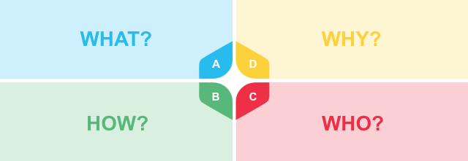
Team Effectiveness Action Plan
What | Action | Thinking Required | Who | Due Date | Done
Notes:
Once the group agrees the focus areas, use the Team Effectiveness Action Plan to allocate the tasks to the team members. Commit to who will do what by when and create a follow up plan to review the actions we are committing to.
NOTE:
You may want to revisit individual preferences and consider them as you choose people on the team to do various tasks.
Handout in Facilitator Guide

Slide 22
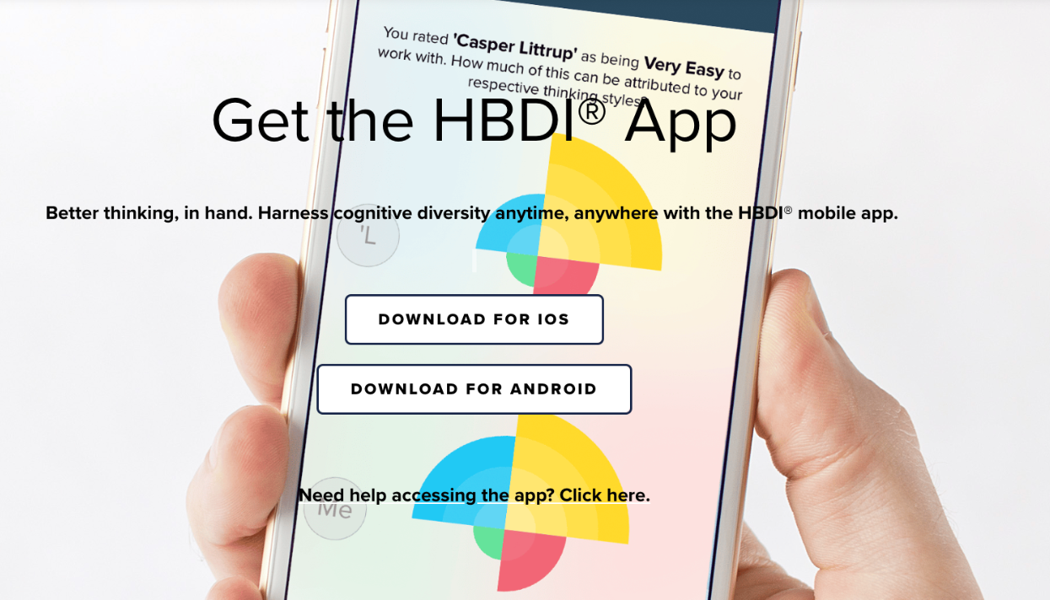
Additional Resources
Desk Flip
Book: The Whole Brain Business Book - 2nd Edition
Website: https://thinkherrmann.com
Thinker Portal: https://journey.herrmannsolutions.net/thinker
Microsoft Teams App: Stop & Think
HBDI App: http://app.hbdi.com
Notes:
Here are some other resources available for application.

