Slide 1
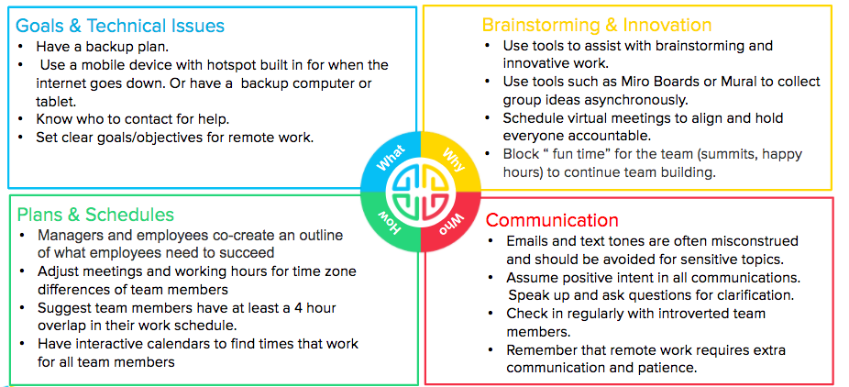
Reduce Remote Work Frustrations
Manager WalkAround

Slide 2


