Slide 1

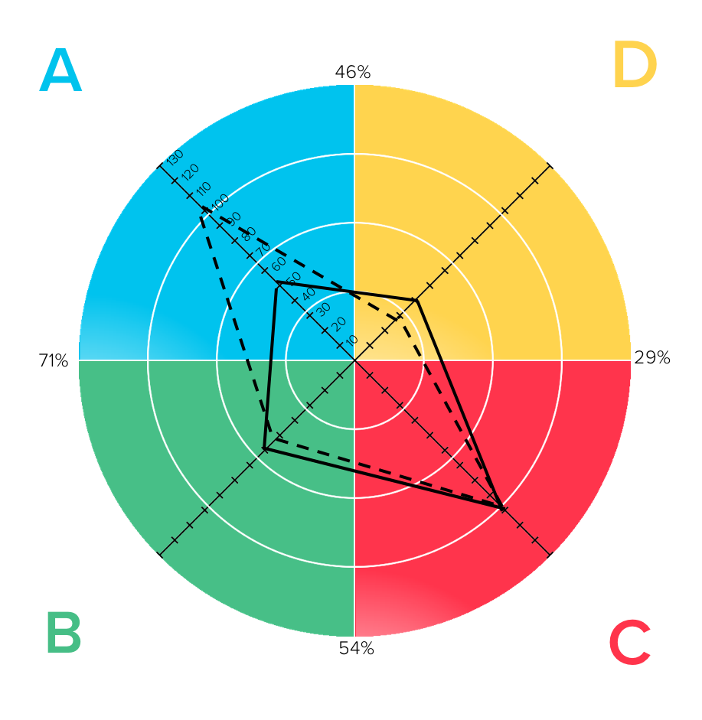

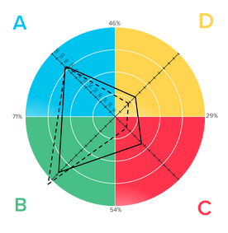


WHAT’S YOUR STORY?
HBDI® Debrief
and Team Discussion
Learn about your HBDI® assessment results
Discuss how to take your team effectiveness to the next level
Whole Brain® Thinking
Application Series
©2023 Herrmann Global

Slide 2
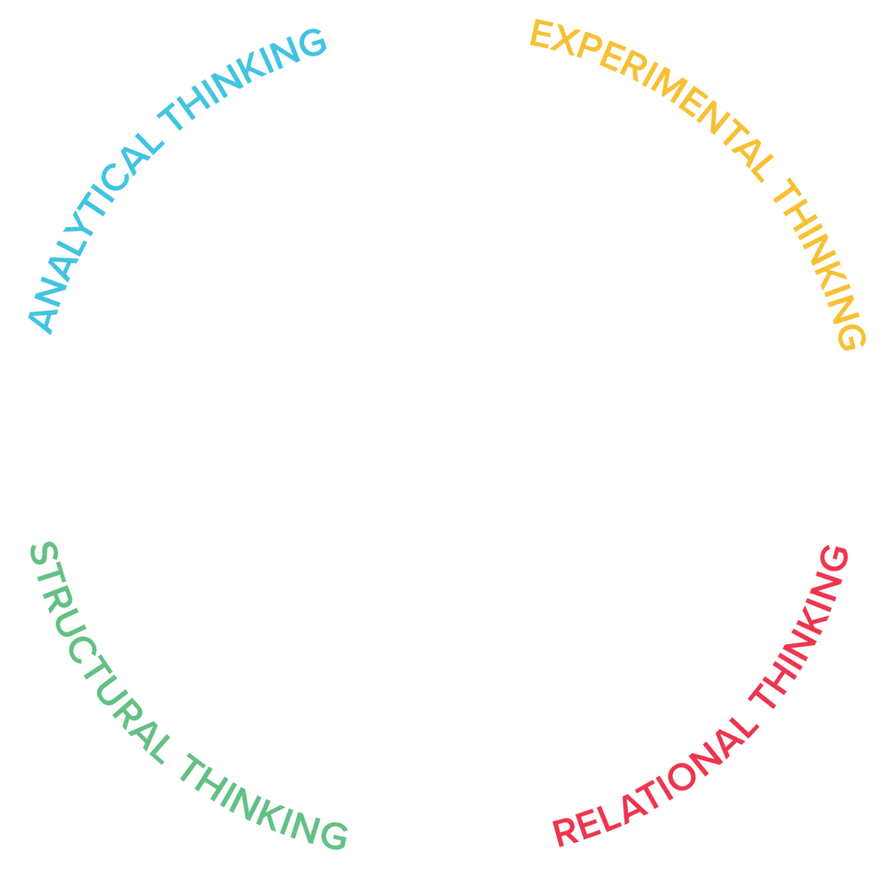
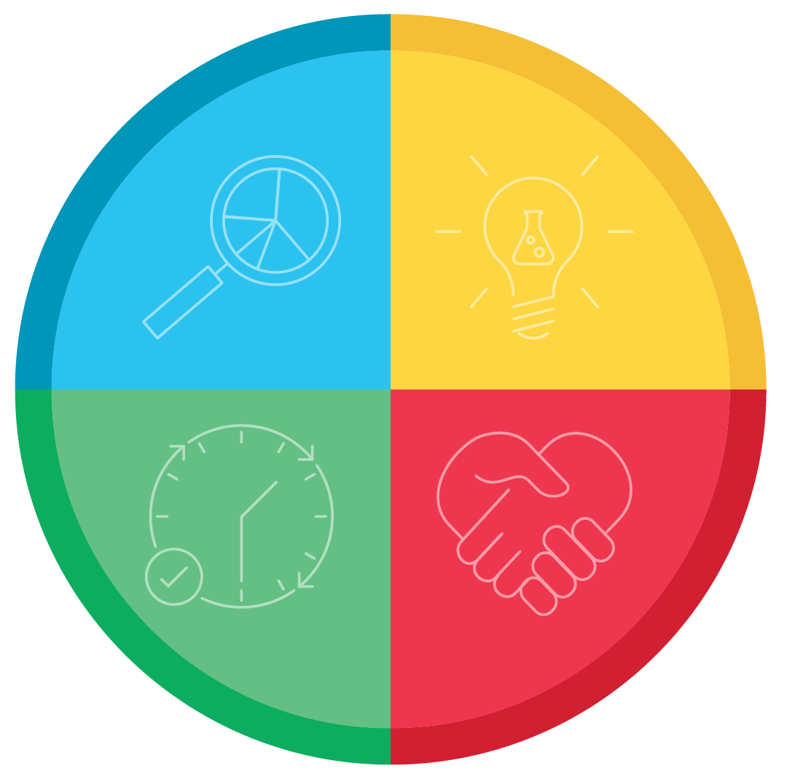
Whole Brain® Model: A Framework
A
D
Logical
Analytical
Fact-based
Quantitative
Holistic
Experimental
Integrating
Synthesizing
Organized
Sequential
Planned
Detailed
Interpersonal
Empathic
Kinesthetic
Emotional
B
C
© 2023 | Whole Brain® and the four-color, four-quadrant graphic is a trademark of Herrmann Global
Notes:
SAY: You learned about the Whole Brain® Model in your HBDI® journey. Let’s do a quick review. The Whole Brain® Model is an organizing principle for how we think. Walk through each quadrant sharing the words that appear and the key questions for each. Note that we can describe the quadrants using both colors (blue, green, red, yellow) and letters (A, B, C, D).
CLICK: Reveal a quadrant at a time – click through to reveal the full model. The last click will display the type of thinking in each quadrant – Analytical, Structural, Relational, Experimental.
SAY: Let’s start with the A/Blue quadrant. (Read the descriptors.)
ASK: What types of occupations often demonstrate this kind of thinking? Correct and add examples as needed.
Repeat this process for all four quadrants. Make sure to emphasize and explain how the Whole Brain® Model is a framework – or an organizing principle to understand our natural thinking preferences.
ASK: Do you have any questions about the Whole Brain® Model?

Slide 3
Whole Brain® Model: The Framework
HBDI®: The Assessment
What?
Why?
Logical
Analytical
Fact-based
Quantitative
Holistic
Experimental
Integrating
Synthesizing
How?
Who?
Organized
Sequential
Planned
Detailed
Interpersonal
Empathic
Kinesthetic
Emotional
© 2023 | Whole Brain® and the four-color, four-quadrant graphic is a trademark of Herrmann Global
Notes:
SAY: Just as the Whole Brain® Thinking model is an organizing principle, the HBDI® is an assessment that measures our degree of preference in each quadrant.
SAY: The HBDI® also provides some insight into how our thinking shifts under pressure. The under pressure profile, indicated by the dotted line, may or may not be the same as our primary profile.
ASK: Can you share an example of how your thinking shifts under pressure? How do your behaviors change when you’re experiencing stress?

Slide 4
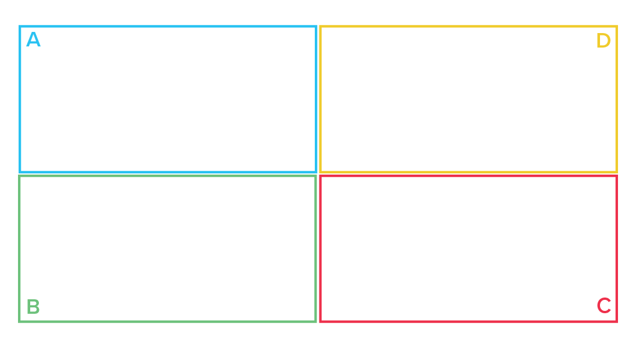
Four Key Questions (4Q's)
To have your direct reports answer before any meeting.
What results do we want?
Why is it important?
WHAT
WHY
How can we execute
with success?
What is the impact on
our people?
HOW
WHO
© 2023 | Whole Brain® and the four-color, four-quadrant graphic is a trademark of Herrmann Global
Notes:
SAY: How many of you find that when your direct reports come to you with a request or idea – you find yourself needing to ask several questions – then they go back to get the answers and the process takes much longer than it needs to. One of the easiest ways to get immediate benefits from Whole Brain® Thinking is to broaden the thinking of your direct reports. Have them answer these 4 key questions before any meeting with you. This will automatically broaden their thinking, save you time, and help them grow. Also, you will notice if they are consistently missing a quadrant – giving you a potential development path to follow with them to bridge that gap.
ASK: What questions do you have?

Slide 5
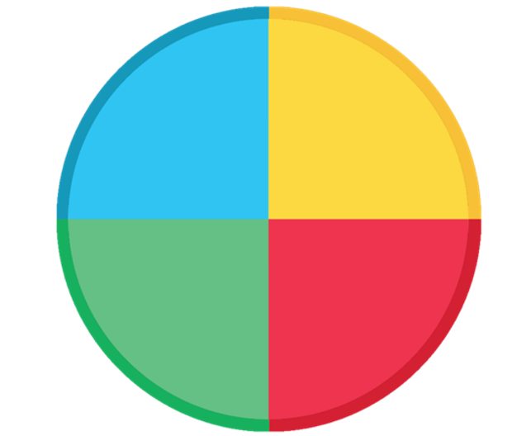
Whole Brain® Business Model
Successful business is
Whole Brain® Business.
Goals
Objectives
Efficiency
Financials
Technology
Past trends
Performance
Measurements
Vision
Purpose
Competition
Environment
Future trends
New concepts
National/global
Long-term strategy
A
D
Possibilities
Profits
Methods
Regulations
Quality assurance
Risk reduction
Resources
Control
Timing
Policy
Training and development
Teams
Relationships
Recognition
Customer relations
Communications
Community
Culture
Values
B
C
Processes
People
© 2023 | Whole Brain® and the four-color, four-quadrant graphic is a trademark of Herrmann Global
Notes:
SAY: Successful business equals Whole Brain® Business. In business, we all need to use agility to manage complexity and competing priorities.
CLICK: Reveal the 4 P’s one at a time.
SAY: The 4 P’s are: PROFITS, PROCESSES, PEOPLE and POSSIBILITIES.
SAY: Learning the language of Whole Brain® Thinking will help you work the whole business with more ease. The method scales so it can also help you understand others - clients, stakeholders, colleagues, teams, departments, divisions, and an entire organization. And yes, even your friends and family!
SAY: Now let’s use this model to think about your business.
ASK: Where do you see the culture of your organization paying the most attention? What happens if you ignore any one of these quadrants?

Slide 6
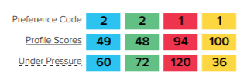
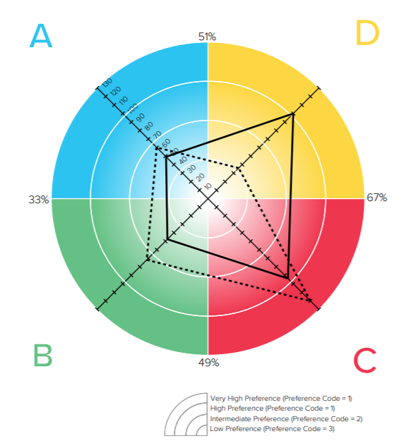
John Doe
Jane Doe
Reading a Sample
HBDI® Profile Preference Code
The HBDI® measures the degree of preference for each quadrant:
VERY STRONG 1+
STRONG 1
2
INTERMEDIATE
3
LOW
UNDER PRESSURE
© 2023 | Whole Brain® and the four-color, four-quadrant graphic is a trademark of Herrmann Global
Notes:
BUILD: Low, Intermediate, Strong, Very strong, Under pressure
SAY: Here is how the HBDI profile works. The degree to which a point is further away from the center shows a stronger preference in that quadrant/color.
CLICK to reveal LOW.
SAY: A score of 33 or less is a LOW preference, perhaps even something you might avoid. The evidence for a low preference is that it saps your energy faster. Not
everyone has a low preference. For example, people with low scores in RED, have feelings like anyone else, they love others like everyone else, but they may not
express it as much as other people.
CLICK to reveal INTERMEDIATE.
SAY: Scores 34-66 are intermediate or midrange. People are fine with it, but it’s not a preference and not something they find draining.
CLICK to reveal STRONG.
SAY: 67-100 is a strong preference and these preferences will be more energizing - not draining.
CLICK to reveal VERY STRONG.
SAY: from 100 up is a very strong preference. The stronger the preference - the more visible it is to others.
CLICK to reveal UNDER PRESSURE.
SAY: Notice the dotted line. This suggests how you prefer to think under pressure or stress. Sometimes the under pressure profile is very close to the day-to-day –
which means others don’t see “the pressure” even if a person is feeling it. Or, it can also be noticeably different. A big difference may sometimes mean a person is in
process of transition. Often, people perceive you more from the dotted line…because they remember you under pressure. When people have big differences between
their regular and under pressure preferences, it may be confusing for others as they may appear to make decisions in different ways. Note that a difference of 10-15
points in a dotted line profile from the regular profile isn’t that significant. We read the preference code from A to B to C to D as you see in the upper right hand corner.
There are descriptions for each preference code that include typical occupations and traits.
ASK: What questions do you have about the preference code?

Slide 7
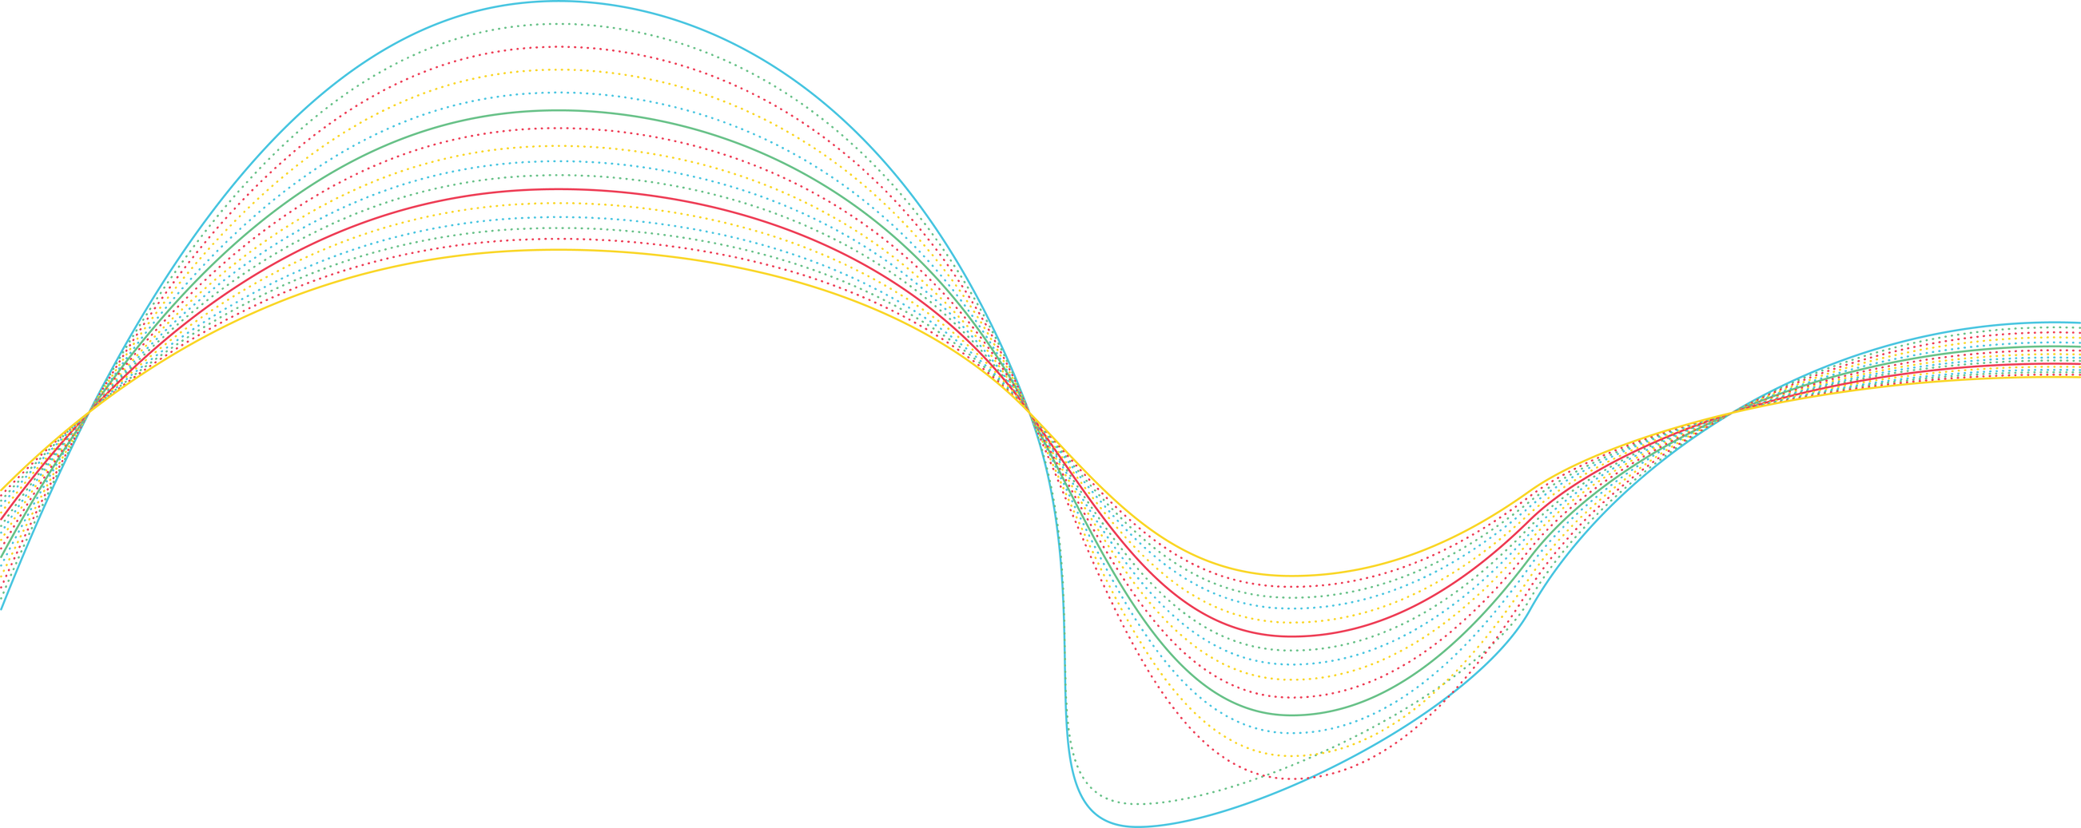
Important reminders:
Your HBDI® profile shows your natural preferences.
Your thinking is flexible: you can stretch!
No one is just “one” preference.
These are preferences, not competencies.
©2023 Herrmann Global
Notes:
BUILD: Each bullet from top to bottom. Read as you click.
SAY: These are important points to remember as you look at your profile.

Slide 8

The HBDI ® should
not be used as:
A label or “box” to put people in.
A weapon to denigrate others.
As a judgement of good, bad, right, or wrong.
©2023 Herrmann Global
Notes:
SAY: And of course, the HBDI® results are not to be used as:
A label or “box” to put people in
A weapon to denigrate others
A judgment of good, bad, right or wrong.

Slide 9
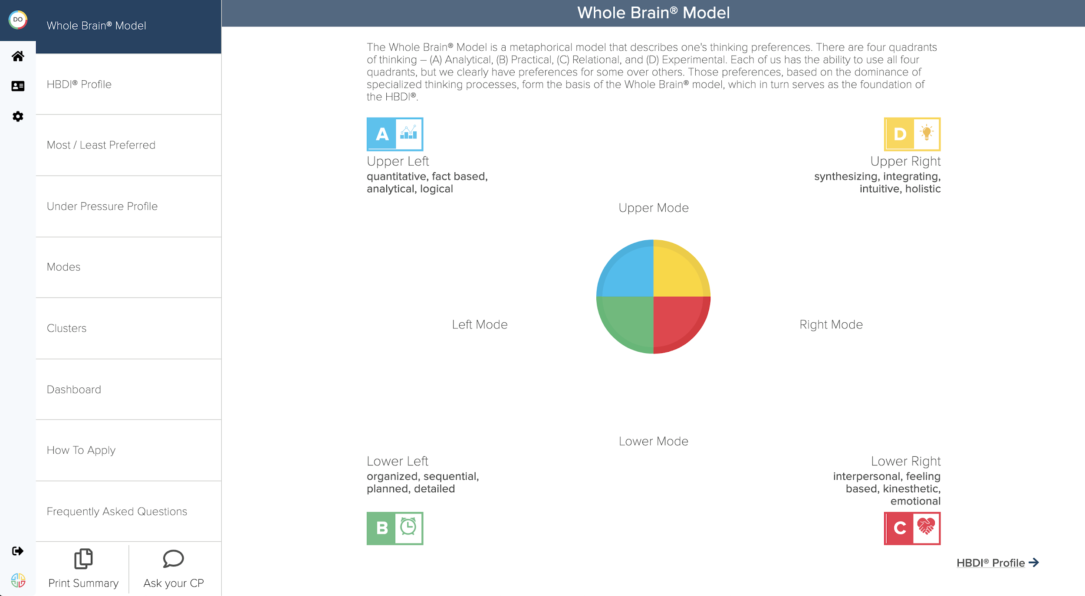
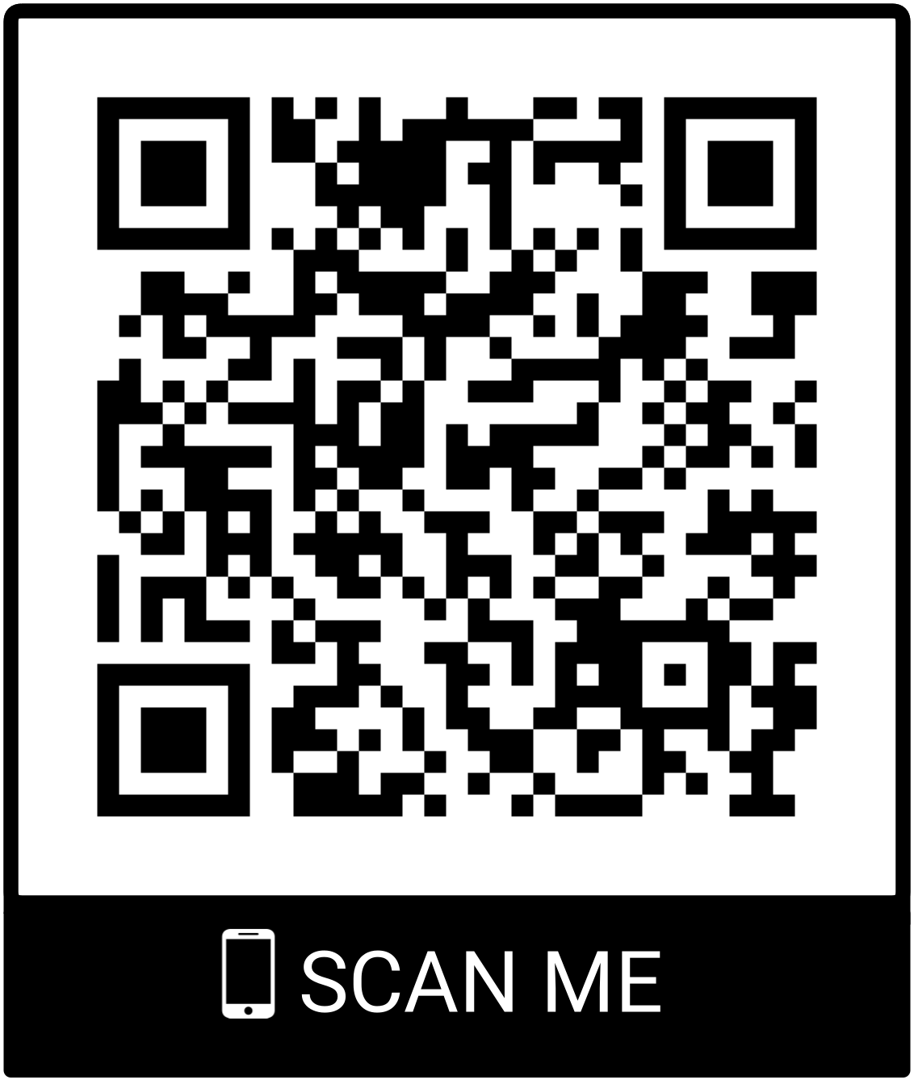
HBDI® Digital profile:
https://journey.herrmannsolutions.net/thinker
©2023 Herrmann Global
Notes:
Option 1: Debrief using HBDI® Digital and follow the script below.
Note: If debriefing using the 2-page PDF HBDI® results, let them know they also have access to their digital profile in the Thinker Portal - and that you’ll send the link in the follow-up email. Be prepared to close the PowerPoint presentation slides and open up their HBDI® Digital results. You can also give them the link and have them open it up and share their screen – but make sure to allow more time for them to navigate the screen.
SAY: Feel free to open your HBDI® Digital results in the Thinker Portal to follow along if you’d like. Go to journey.herrmannsolutions.net/thinker (drop link in chat) or you can also scan the QR code with your phone.
Walk through their data:
Start with the combo profile including the under pressure profile to save time.
Ask if there are any surprises.
Explore the profile from most to least preferred. Speak to the under pressure profile and let them know they can click to learn more about each quadrant.
Clusters: This helps you understand why one profile with a similar score in a quadrant is different than another.
Dashboard: Highlight at work vs. view of self and discuss any differences.
Explore Introversion/Extroversion data and ask about energy related to working with people as a leader. Point out how energy shifts during time of day.
How to Apply: Pick one to illustrate
Note that FAQs are available and remind them they can return here at any time.
Discuss: Can my profile change?
Remind them that this indicates preference - not competence.
Emphasize wholeness: We all think in all quadrants and can stretch.

Slide 10
HBDI® PDF profile:
Logical Analytical
Asks “What?”
Integrating Synthesizing
Asks “Why?”
Asks “How?”
Organized Sequential
Asks “Who?”
Kinesthetic Emotional
© 2023 | Whole Brain® and the four-color, four-quadrant graphic is a trademark of Herrmann Global
Notes:
Option 2: Debrief using the 2-page PDF HBDI® results and follow the script below.
Note: Let them know they also have access to their digital profile in the Thinker Portal - and that you’ll send the link in the follow-up email. Either insert screenshots from the PDF on this slide in advance of the debrief, or be prepared to close the PowerPoint presentation slides and open up their HBDI® results.
Walk through their data:
Discuss their profile including the under pressure profile.
Ask if there are any surprises.
Explore the profile from most to least preferred. Speak to the under pressure profile and let them know they can learn more about each quadrant in their HBDI® Digital results in the Thinker Portal.
Go through each section: Key Descriptors, Work Elements, Education/Occupation/Hobbies, and Introversion/Extroversion/Energy Level.
Discuss: Can my profile change?
Remind them that this indicates preference - not competence.
Emphasize wholeness: We all think in all quadrants and can stretch.

Slide 11
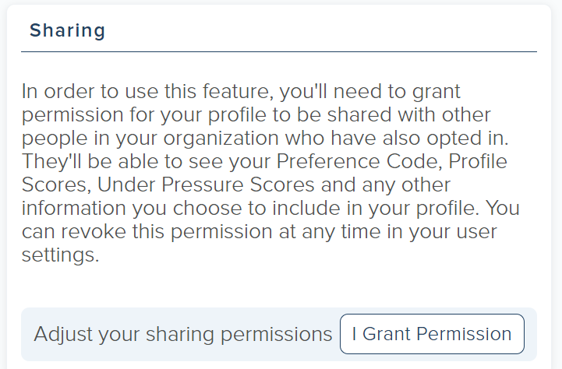
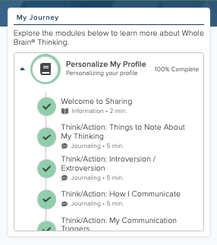
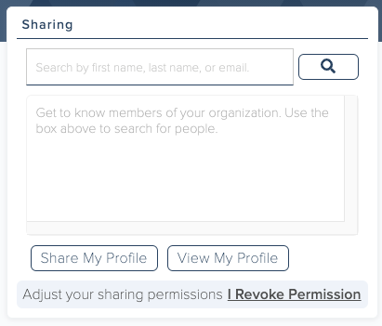
Share & compare HBDI® profiles:
1) In the Sharing tile, click the
“I Grant Permission” button.
2) Customize your profile in the
My Journey tile by completing each section in “Personalize My Profile”:
3) Type a colleague’s name in the Sharing tile to look up and compare HBDI® profiles.
Scan to
login to the
Thinker Portal!
Note: you can change this at any time!
©2023 Herrmann Global
Notes:
Note: Make sure sharing is turned on for this client! (Cover this very briefly.)
SAY: Reminder! Personalize and share your HBDI® profile. This will allow other people in your organization to see your profile, and allow you to see any other profiles
that have been shared. This will help you get insight into your team members’ thinking preferences – and you can use that information to work together more effectively.
As just one idea, look up a teammate’s profile before you meet to get a sense of their preferences, communication style, frustrations, and how to build trust with them.
You can also revoke sharing permission at any time.

Slide 12



Thoughts on your team?
What’s going great on your team?
What are your team’s biggest challenges?
What would make the team workshop have value for you?
©2023 Herrmann Global
Notes:
Note: Be sure to leave 5 minutes (ideally 10 minutes) for this question – and take good notes! You will be reporting on themes from these questions in the workshop, so
it’s important to get as much “real” insight as possible. This can also be asked right at the beginning of the debrief if you prefer, but people are more open after you’ve
established rapport during their debrief.
ASK: What are your thoughts on the team dynamic? Your comments will of course remain confidential. I will report on themes in the session, but I’ll keep insight general
and anonymous. What’s going great on your team? What are the greatest challenges? What would make the team workshop have value for you?

Slide 13

Next Steps
Before the workshop:
Look for my follow-up e-mail.
Review your HBDI® results.
Share and personalize your HBDI® profile.
Prepare your HBDI® Story, including:
Your “backstory”: some personal context for your profile, key influences like family, education, etc.
Your superpowers
Your kryptonite
What happens under pressure
What you need most from the team
One fact that no one else knows about you
My follow-up email will contain a worksheet to outline your HBDI® Story – so stay tuned for that!
©2023 Herrmann Global
Notes:
SAY: Let’s look at some important next steps.

Slide 14

Questions? Thoughts? Reactions?
©2023 Herrmann Global
Notes:
ASK: What questions do you have?

