Slide 1
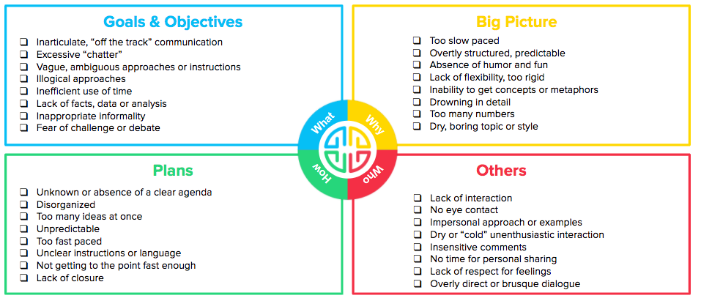
Frustrations by Preference Checklist
Put a checkmark next to your frustrations

Slide 2


