Slide 1
Herrmann Revision History
The following notes highlight the date of the most recent revisions and summarize updates to the slide content.
Revision Date | Summary of Updates
10/4/24 | Slideshow updated and finalized for dedicated certification.

Slide 2
Unlocking Collective Brilliance: 3 hours (can be delivered in sections, see Slide 7)
Duration | Activity | Slides | EST Time 30 mins | Other Time Zone
 | Facilitator Prep | 3-7
15 mins | Welcome and Icebreaker | 8-12
 | Divider Slide and Prep Notes | 8
15 mins | Title Slide, Agenda, Ground Rules, Icebreaker | 9-12
15 mins | Whole Brain® Thinking Introduction | 13-18
 | Divider Slide and Prep Notes | 13
15 mins | Whole Brain® Model, Thinking Agility, Business Model, Stats and Change | 14-18
15 mins | Whole Brain® Activities | 19-30
 | Divider Slide and Prep Notes | 19
15 mins | How Many Dots & Spotting Clues with Whole Brain® Thinking | 20-30
15 mins | Break | 31
60 mins | Individual HBDI® Review | 32-40
1 min | Divider Slide and Prep Notes | 32
60 mins | Whole Brain® Thinking and HBDI® Review, Sharing Activity, Communication | 33-40
10 mins | Break | 41
60 mins | Team Report Debrief | 42-51
 | Divider Slide and Prep Notes | 42
 | Team Report Pages, Individual and Team Activity, Next Steps | 43-51
 | Additional Slides: Next Steps, Team Report Slides | 52-58
Total 3 hours

Slide 3

Facilitator Prep

Slide 4
Design Notes
This slide deck was designed to be delivered in a virtual environment over Zoom, with tools specific to the platform. If you are using a different platform, feel free to make adjustments to this slideshow.
Additionally, this modular design was built based on best practices, but there is room for you to move slides, edit content and replace activities if you wish. The goal is to have a team delivery option that you can use “out of the box” or customize to meet the needs of the team you are working with.
Before you get started, review this Facilitator Prep section. This will highlight important details. Title slides for each section also contain a “Note to Facilitator” if there is something that needs your attention before, or during the delivery.
Before preparing for your first delivery, be sure to understand the flow of the content, the options for delivery and do a practice run of playing the slideshow to see how the builds work.
As you prepare for any delivery, review the slides and look for opportunities to add your own examples, stories and questions related to the content areas and slides. If you are sharing this deck with other Certified Practitioners, save a template to share and make a copy that you can edit and keep as a custom delivery deck.

Slide 5
Preparation Checklist
Lead up to the session:
Work with team and team leader to decide how you will deliver this content (delivery options on Slide 7).
See if the team leader would like to quickly share something as you open the session on Slides 9-10.
Schedule the session with the team and send the invitation. Be sure to ask team members to complete their HBDI® and journey before the session. Also ask team members to update their name on their Zoom (or other platform) to include their profile code.
Review your the team’s HBDI® data (Individual, Linear Continuum and Team Report in Axon) including Introversion/Extroversion. It can be helpful to review individual data so you are prepared for unusual scores, big shifts, or no shifts in under pressure, etc.
Prepare the slide deck. Remember to pay attention to facilitator notes and customize as you wish.
Lastly, each section of the slideshow has a title, or divider, slide with helpful speaker notes on how to prepare - including notes related to specific slides. These titles can be deleted once you are ready.
Before the session starts:
Open any webpages (ex. Thinker Portal), videos, etc. that you will need and make sure they are working.
Be sure you are ready to use chat, Annotate, or any other features on the virtual call that you will need.
Also be sure you have any other resources or notes ready.

Slide 6
Preparation Checklist (cont.)
During the session:
Learn and use the participants names often.
Pause frequently to ask questions (don’t worry about the silence, give people a moment to think and respond). If it stays silent, call on someone or add in an answer yourself.
When people speak, confirm, clarify, or build on their responses.
Keep examples and answers to 2-3 people maximum.
Do let the group discuss amongst themselves from time to time and find slides or sections where you can switch to a gallery view as opposed to the slides. This should add energy and focus.
Interrupt discussions if they are going on too long or going off topic.
Have fun!

Slide 7
Delivery Options
This delivery deck is designed so you can deliver the content in one, 3 hour session. The high-level outline to the right provides an overview.
If scheduling 3 hours is a challenge, we recommend delivering hours 1-2 together with the hour 3 section a week or so later.
You can also consider delivering each hour session individually - this option is highlighted with the blue outlines.
If you break the deck into separate sessions - you can move or copy the title slide and agenda (Slides 9-10), move Slide 53 to the end of a section to outline next steps and update speaker notes as needed.
The high-level overview of this slide deck is as follows:
Total session time: 3 hours
Hour 1
15 mins - Welcome and Icebreaker
15 mins - Whole Brain® Thinking Introduction
15 mins - Whole Brain® Activities
15 mins - Break
Hour 2
50 mins - Individual HBDI® Review
10 mins - Break
Hour 3
60 mins - Team Report Debrief and Action Plan

Slide 8
Welcome and Icebreaker
Notes:
Note to Facilitator: Be sure to review the items below before facilitating your team session (you can keep or delete this slide after your review):
Slide 10: Update agenda to reflect how much content you will be delivering (ex. If you are taking a modular approach, delete what you won’t be covering). You can simply edit the text in the green box.
Slide 11: You can use the ground rules provided here, or create your own.
Slide 12: This activity is from the team accelerator tools. If you want to use a Whole Brain® icebreaker of your own, feel free to substitute.
Slide 12: If you are using the “Who are you on vacation activity?” and breakout rooms, be sure to have breakout rooms ready (random assignments work just fine) and have a screenshot of the slide ready to share with team members before sending them to breakout rooms.

Slide 9


Unlocking Collective Brilliance
Team Introduction to Whole Brain® Thinking
Notes:
4 mins (this time includes a few minutes for team members to arrive)
DO: Be sure to …
Welcome team members as they arrive.
Engage with team members while you wait.
Start the session no later than 5 minutes after your scheduled time.
DO: Craft a short script below that quickly welcomes the entire team to the session, introduces yourself to the group and summarizes your agenda for the day. The agenda summary might look like:
“(Facilitator introduction) …I am excited to be here today so we can start exploring Whole Brain® Thinking and your HBDI® profiles! Today we will spend some time exploring your individual and team reports, all in an effort to start understanding and embracing your thinking preferences so you can unlock your collective brilliance.”
TRANSITION: Let’s take a look at our agenda and ground rules for the day.

Slide 10
Agenda
A big thank you to everyone on the team for being here today! Welcome!
Today will be a formal introduction to Whole Brain® Thinking, the HBDI®
and your profile data.
So you can start to better understand your thinking preferences and find ways to improve how you work together.
Welcome and Icebreaker - 15 minutes
Whole Brain® Thinking Introduction - 15 minutes
Whole Brain® Activities - 15 minutes
Break - 15 minutes
Individual HBDI® Review and Communication - 60 minutes
Break - 10 minutes
Team Debrief and Action Plan for Improved Effectiveness - 60 minutes
Notes:
2 mins
Note to Facilitator: You can edit any of these text blocks based on specific delivery changes you want or need to make.
SAY: Thank you all for being here today! I am excited to be here to provide a formal introduction to Whole Brain® Thinking, the HBDI® and your profile data! The goal of our time together is to use the Whole Brain® Model and HBDI® to help you start to better understand your thinking preferences and find ways to improve how you work together.
This is a 3 hour session with a 15 minute break. If you need to stretch, get some water, answer the door, etc. - please mute your audio, turn off your video and let us know you will be right back in the chat.
The core topic areas we will cover today include:
A Welcome and Icebreaker
Whole Brain® Thinking Introduction
Whole Brain® Activities
Individual HBDI® Profile and Communication
Team Debrief and Action Plan for Improved Effectiveness
TRANSITION: Before we get to our icebreaker, let’s cover a few ground rules for the day.

Slide 11
Ground Rules
Stay Focused and
Think about Goals
Ask Questions and Be
Open to New Thinking
Be Present and
Stay on Task
Engage and Listen
to Each Other
Notes:
2 mins
Note to Facilitator: You can edit any of these text blocks based on specific delivery changes you want or need to make.
Say, Here are some Ground Rules we can follow to allow us to make the most of our time together:
Stay focused and think about goals: Think about how this can be helpful for you, your team and the goals you want to achieve.
Be Present and stay on task: Be present and and avoid multitasking on your computer or phone.
Engage and listen to each other: Take this opportunity to engage, listen to, and learn more about your colleagues!
Ask questions and be open: Think about what’s possible with this insight and learning.
I am sure you have already noticed the use of the four quadrants. We will be using these throughout the training and learning more about them together.
TRANSITION: Alright, let’s get this started with a fun icebreaker!

Slide 12
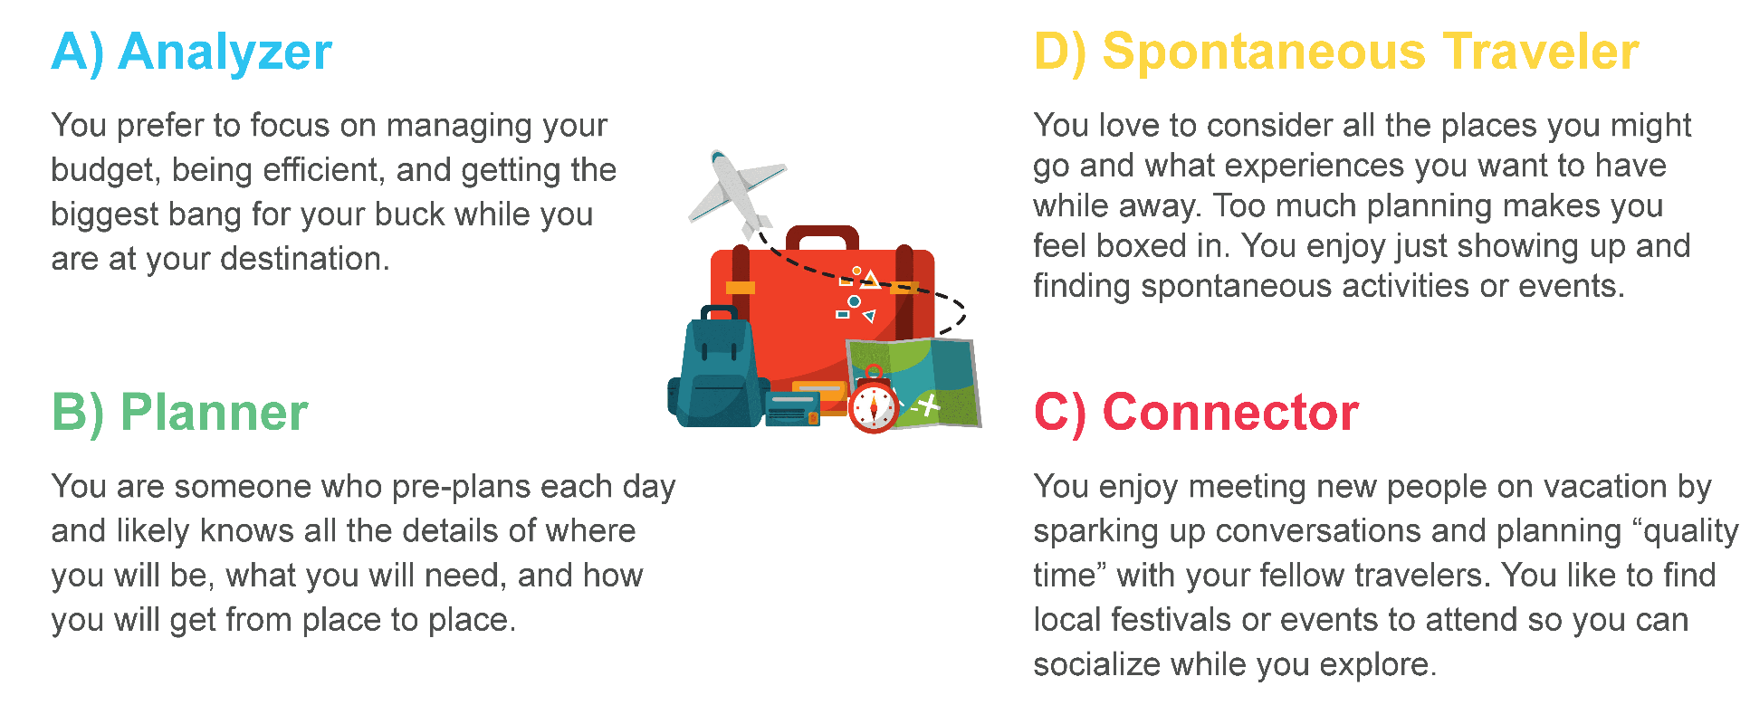
Who are you on vacation?
Notes:
7 minutes
Note to Facilitator: Depending on the team size, consider using breakout rooms. The ideal size for the team members to complete this activity is 4-5. If using breakout rooms, be ready to share a screenshot of the slide with team members in chat and to send them into their breakout rooms.
SAY: This activity is called, “Who are you on vacation?”
We will spend about 5 minutes taking turns sharing which description best captures who we are on vacation and quickly sharing why.
Each team member will have a minute or so to share.
Note to Facilitator: If sending team members to breakout rooms, be sure to share a screenshot of the slide in chat.
DO: Start the activity in the large group by sharing your response or send team members to breakout groups.
DO: When team members are done sharing and together in the main room, close the activity by asking them if they found, “who they are on vacation” aligns with their profile. This is just a quick check in question.
Note to Facilitator: This activity is from the team accelerator tools on the Thinker Portal under the Activate stage. If the team is set up on the Thinker Portal and can access the accelerator tools, let them know that they can use this activity on their own when their team membership changes.
TRANSITION: Now let’s take a closer look at the Whole Brain® Thinking Model.

Slide 13
Whole Brain® Thinking Introduction
Notes:
Note to Facilitator: Be sure to review the items below before facilitating your team session (you can keep or delete this slide after your review):
This section contains three slide builds you will want to familiarize yourself with before you deliver.
Slide 17: This slide delivers six facts that you will read to the team. The stories behind the statistics are at the end of the speaker notes. You will be instructed to have the team pick 2-3 stats to hear more about, so be ready to find the story in the notes.

Slide 14
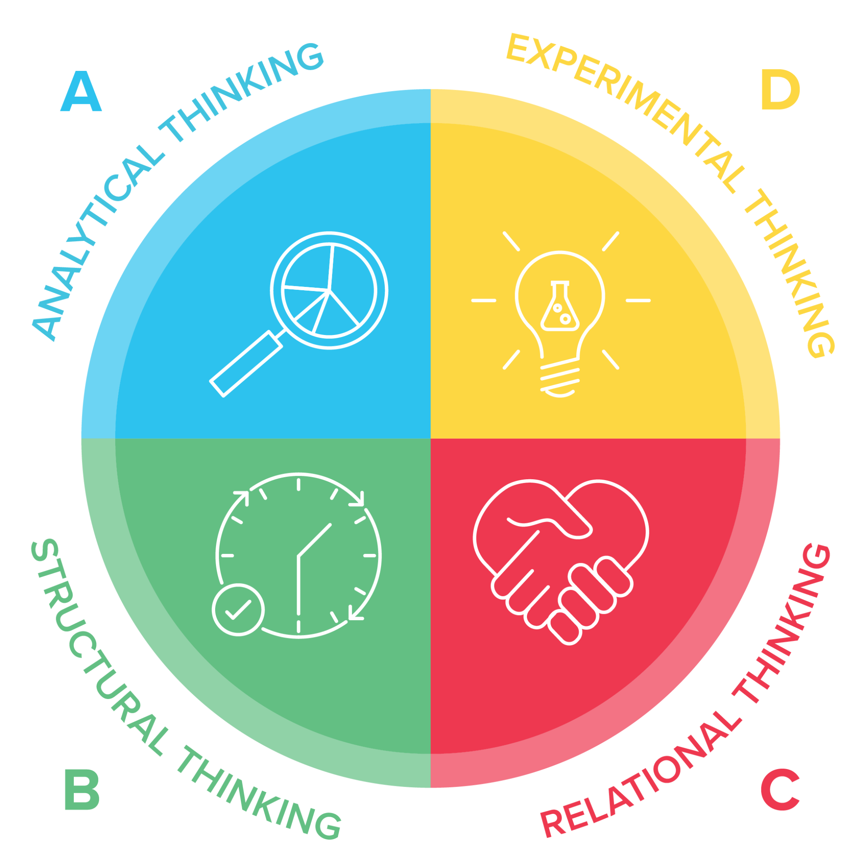
Whole Brain® Thinking Model
A framework that helps clarify how we interact with the world
Logical
Analytical
Fact-based
Quantitative
Holistic
Experimental
Integrating
Synthesizing
Organized
Sequential
Planned
Detailed
Interpersonal
Empathic
Kinesthetic
Emotional
The four-color, four-quadrant graphic and Whole Brain® are registered Trademarks of Herrmann Global, LLC.
Notes:
2 mins
Say: The Whole Brain® Model is a powerful framework that helps us clarify how we interact with the world. For teams, this means that it can help us understand the diverse ways people prefer to think.
It divides thinking into four distinct quadrants: analytical (blue), structural (green), relational (red), and experimental (yellow).
Each quadrant represents a different mode of thinking, from logical problem-solving to strategic visioning, and from detail-oriented execution to interpersonal connection. Most of us have a dominant quadrant or a combination that we naturally gravitate toward, which shapes how we approach tasks, make decisions, and interact with others.
By recognizing these preferences in ourselves and our teams, we can leverage the full spectrum of thinking styles to tackle challenges more effectively.
TRANSITION: This is where thinking agility becomes so important …

Slide 15
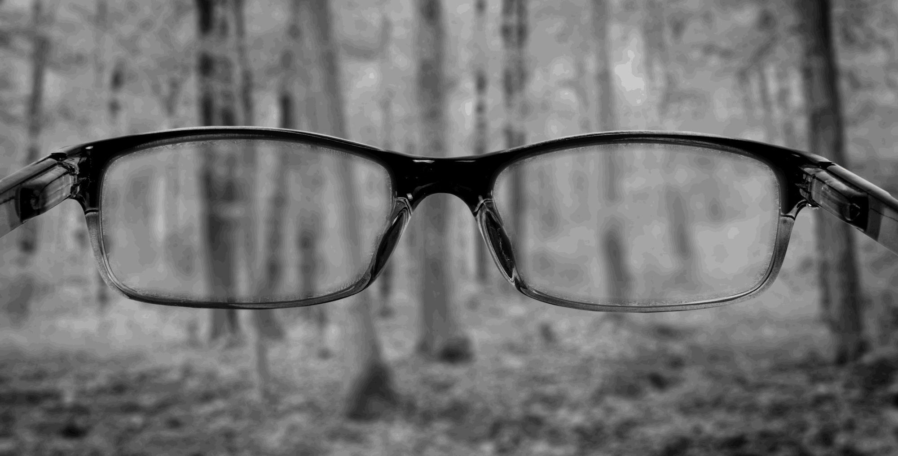
Thinking Agility
The ability to quickly and intentionally stretch beyond your default preferences and biases to adapt to new circumstances.
Notes:
1 min
SAY: It's not just about knowing which quadrants you prefer, but having the ability to quickly and intentionally stretch beyond your default preferences and biases to adapt to new circumstances. Whether you’re problem-solving or collaborating as a team, thinking agility enables you to best deal with change, complexity and uncertainty by unlocking greater collaboration and team agility.
Ask: How many of you would benefit from being more agile?
TRANSITION: And what does Whole Brain® Thinking and Thinking agility have to do with successful teams and business?

Slide 16
The Whole Brain®
Business Model
Efficiency
Financials
Technology
Past trends
Performance
Measurements
Goals/Objectives
Competition
Environment
Future trends
New concepts
National-World
Vision-Purpose
Long term strategy
A
Profits
D
Possibilities
Methods/Regulations
Quality/Perfection
Risk reduction
Resources
Control
Timing
Policy
Training - Development
Teams - Relationships
Community Relations
Customer Relations
Communications
Culture - Values
Recognition
B
Processes
C
People
The four-color, four-quadrant graphic and Whole Brain® are registered Trademarks of Herrmann Global, LLC.
Notes:
Note to Facilitator: This slide has a build. The quadrant and characteristics will appear with the slide. You will need to click forward to reveal the four “P”s that are titles for each quadrant.
2 mins
Say: Successful Business equals Whole Brain® Business. We all need to use the agility we were talking about to manage the complexity and the competing priorities in our day-to-day. We need all these areas working together to have:
DO: (Click to reveal) the “A Profits”, “B Processes”, “C People”, and “D Possibilities” headers one-by-one, reading them aloud to the large group.
Learning the language of Whole Brain® Thinking will help you work the whole business with more ease. As you learn and apply the model, it scales to help you understand others (examples include clients, stakeholders, friends), teams, departments, divisions and an entire organization.
TRANSITION: Leading to …

Slide 17






Applying Whole Brain® Thinking drives better business results:
78% more effective
communication improving customer satisfaction
130% better at decision-making
57% reduction in
talent attrition
66% improvement
in team productivity
$100M in annual
innovations unlocked
70% faster speed
to job mastery
© 2024 Herrmann Global, LLC
Source: Herrmann client experience & research.
Notes:
Note to Facilitator: This slide has a build. It will appear with the first statistic in the top left corner. With each click forward a new statistic will appear going left to right starting with the top row.
5 mins
DO: Read the first statistic on this screen.
DO: (Click to reveal) the remaining statistics one-by-one, reading them aloud to the group.
ASK: When you have read all of the statistics, ask the team for 2-3 data points that they would like to hear more about - the sources are at the bottom of the speaker notes. Let them know you can share any additional data points via chat or after the session.
SAY: Keep these statistics in mind as we get into your data and start to think about how your team can improve your work together.
TRANSITION: Before we wrap up this section, let’s take a look at another area where Whole Brain® Thinking can help teams.
Note to Facilitator: Below you will find the data sources for each statistic.
78% more effective communication: From a study of 951 Thinkers in a 10k employee healthcare organization who participated in Whole Brain® Thinking in an effort to improve patient satisfaction. The organization found that harnessing cognitive diversity helped people communicate more effectively to better meet the needs of patients, and that the Herrmann platform provided the necessary framework and tools to achieve that. According to the Director of Respiratory Care, “Whole Brain® Thinking® has helped us improve communication because now we understand how each other needs to receive information. This knowledge helps us to rearrange how we communicate to be more effective.”
66% improvement in team productivity: A six year US Forest Service case study of more than 500 teams. In literally life-or-death situations (fighting forest fires), cognitively diverse teams who had access to the Herrmann Whole Brain® Toolkit were up to 66% more productive in crisis situations than teams with homogenous thinking.
130% better decision-making: Research with Katherine W. Phillips at Columbia and Northwestern Universities. In a study of teams given different scenarios in which they needed to make a significant decision, in which there was a correct and a variety of incorrect responses, cognitively diverse teams made correct decisions >90% of the time, whereas those without it made correct decisions <40% of the time.
$100m in annual innovation value: One of the world’s largest pharmaceutical companies used Whole Brain® Thinking and the Herrmann platform to create cognitively diverse “bottom-up” innovation teams. The goal was to build an organization-wide innovation ecosystem led by change agents around the world. These change agents are typically fairly junior managers who are encouraged to innovate on how they do their everyday jobs. One of the leaders called it “putting it into people’s DNA to find ways to beat the system.” After the first year of piloting this approach within one division, innovations worth more than $100m in annual value were implemented (and the company had only spent $250k/year… a 400x ROI!)
57% reduction in talent attrition: A case study of 2 banks merging. Like most complex mergers, there were a number of goals: Create one culture through merger of a national and a regional bank; Maintain employee morale and commitment to customer; and minimize employee turnover, disruptions and retrenchments despite opposition from the employee union to the merger. Whole Brain® Thinking was used throughout the merger process, and ultimately resulted in high employee support (86%) despite closing 40 locations AND going from 5 to 6 working days per week. The merger even cost $10 million less than expected! Most importantly, staff turnover reduced from 14% per year before the merger to 6% after the merger, a 57% reduction, due to a new organization structure that leveraged cognitive diversity in creating more productive and engaged teams.
70% faster speed to job mastery: A large pharmaceutical company with more than 40k employees was planning a drug launch into a totally new category for them, and needed to build a team of new sales reps to bring the product to market. The typical time period for new reps to get to what the company considered “job mastery” was 24 months. This meant they were on top of all the aspects of the job of a pharmaceutical sales rep and were selling to their maximum potential - but two years would be too long to wait for this drug introduction to be successful. Implementing a new approach built around cognitive diversity, the company focused on: 1) creating a team culture that recognized the different thinking strengths across the team, 2) trained reps to use a thinking-based approach to understand and address prescriber and influencer needs, and 3) deployed different sales reps to different prescribers based on their unique thinking profiles. As a result, new reps on average achieved job mastery in 7 months (vs. the prior benchmark of 24 months) and a very successful new product launch. The approach was subsequently extended across the entire sales organization over a period of three years, resulting in increased sales revenue and improved results in key sales process metrics.

Slide 18
Whole Brain® Change Success Model
A powerful gap analysis tool!
Focused Vision
Capabilities & Resources
Motivators & Trust
Action Plan
Successful Change
Capabilities & Resources
Motivators & Trust
Action Plan
Confusion
Focused Vision
Motivators & Trust
Action Plan
Frustration
Focused Vision
Capabilities & Resources
Action Plan
Resistance
Focused Vision
Capabilities & Resources
Motivators & Trust
False Starts
The four-color, four-quadrant graphic and Whole Brain® are registered Trademarks of Herrmann Global, LLC.
Notes:
Note to Facilitator: This slide has an animation build. The slide will appear with the first formula at at the top of the screen. When you click to move forward, four unsuccessful formulas will appear one-by-one to demonstrate what happens when one of the quadrant colored elements is overlooked.
5 mins
SAY: This important area is navigating change. Change is hard. Have you experienced any change as a team?
DO: Pause for a moment for team members to respond.
SAY: Let’s look at how successful change works. It requires a focused vision, capabilities and resources, motivators and trust, and an action plan. Change fails when anyone of these elements is missing.
DO: (Click to reveal) the next formula.
SAY: When we don’t have a focused vision, our change efforts will fail because confusion will arise around the question of, “why are we doing this?”
DO: (Click to reveal) the next formula.
SAY: When we don’t look at our available capabilities and resources, our change efforts will fail because frustration will start to boil around a lack of the time, capacity and tools to get things done.
DO: (Click to reveal) the next formula.
SAY: When we don’t take the time to establish motivators and trust, our change efforts will fail because a lack of motivation and trust leads to resistance.
DO: (Click to reveal) the next formula.
SAY: Lastly, when we don’t have an action plan, we don’t have a roadmap or milestones in place to keep our work moving forward. This leads to false starts.
TRANSITION: Thank you all for your participation through this section! Let’s move to some activities!

Slide 19
Whole Brain® Activities
Notes:
Note to Facilitator: Be sure to review the items below before facilitating your team session (you can keep or delete this slide after your review):
This section activities that are executed over several slides. Be sure to do a test run to understand how both activities flow.
There are also a handful of animations built in, so be sure to test the slideshow and familiarize yourself with the animations.

Slide 20
HOW MANY DOTS?
Notes:
1 min
SAY: Let’s do a simple experiment. I am going to show you a slide with lots of dots on it for a count of 3. You need to guess how many dots are on the screen. We will then share the number of dots we all counted in the chat.
ASK: Are we ready?
DO: Go to the next slide, count to 3 in your head, and then go to the next slide.

Slide 21
Notes:
Count to 3 in your head

Slide 22
Notes:
1 min
ASK: How many dots did you count?
Note to Facilitator: You will get many different answers. Someone may guess correctly - but don’t comment. The key point is to highlight there is little agreement, understanding or effectiveness overall.
DO: Note the variety of answers, their frustrations or what the experience was like for them.
SAY: We will try this one more time.
ASK: Are you ready?
DO: Go to next slide, count to 3 in your head, and then go to the next slide.

Slide 23
Notes:
Count to 3 in your head

Slide 24
Notes:
5 mins
ASK: How many did you count?
Note to Facilitator: Almost everyone gets 25. Sometimes a high yellow leaps too far and says 30, or someone says 20.
ASK: What made it easier to get the accurate count so consistently?
Note to Facilitator: You are listening for, “it was organized” or “the pattern helped make it easier.”
SAY: For most of us, we have learned since we were very young how to organize the complexity of numbers so we can learn them faster. As humans, our brain makes it possible to - and is even designed to see patterns. Yet for most of us, we did not learn how to organize quickly the complexity that we see in human behavior.
The key point is that the organizing principle of grouping helps us process information a lot faster. For people, we observe clues and behavioral indicators all the time, but have not had a good organizing framework to put them in. The Whole Brain® Model is that framework!
The Whole Brain® Model is an “organizing principle” that allows us to place the diversity of many behavioral indicators and clues to the thinking preference model. It makes analyzing the complexity of people easier. It creates understanding and helps us see and respect the differences in people.
ASK: How would working with people be easier if you could more quickly understand their preferences in thinking, communicating and problem solving?
Note to Facilitator: You are looking for a response that connects to more easily navigating change, innovating, etc.
TRANSITION: Let’s do a quick activity to see how well you know the model.

Slide 25
?
Spotting Clues with Whole Brain® Thinking
Notes:
1 min
SAY: We want you to know this model well enough to recognize thinking preferences in others! Let’s do some practice!
TRANSITION: We are going to show you some images so you can guess which quadrant they represent.

Slide 26
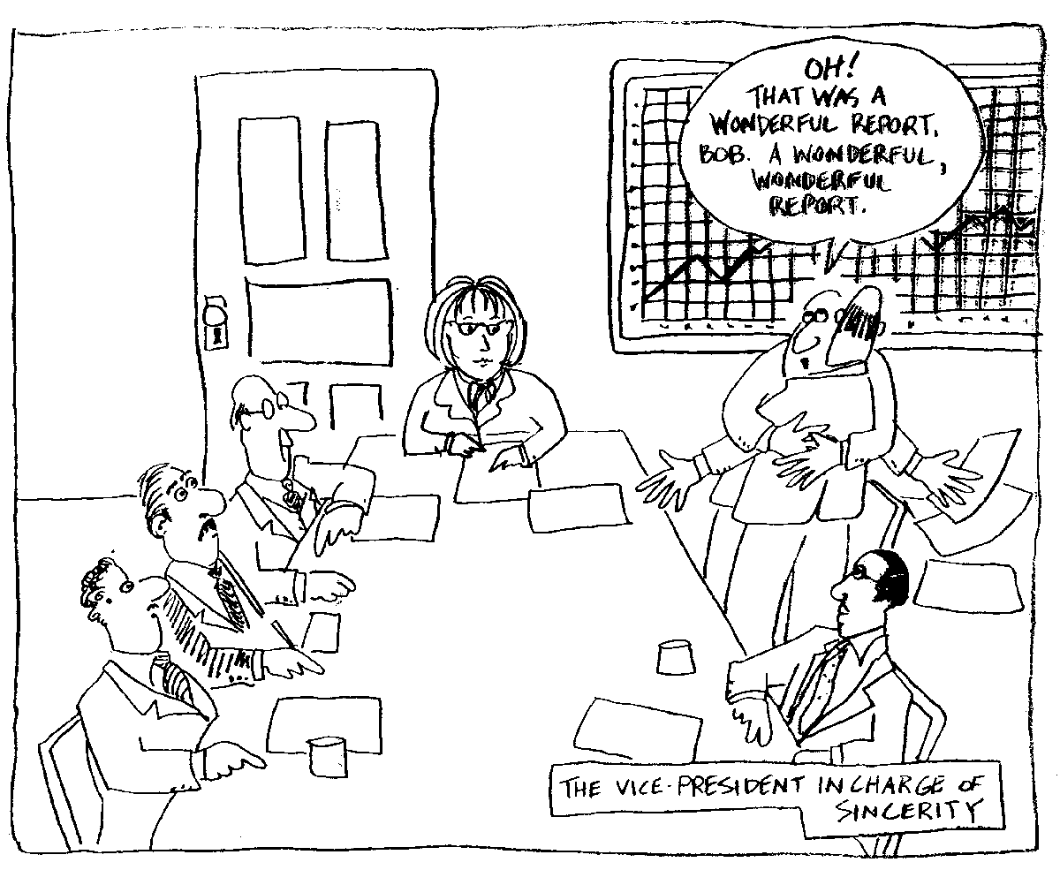
Oh! That was a
wonderful report Bob!
A wonderful report!
THE VICE-PRESIDENT
IN CHARGE OF ENTHUSIASM
Notes:
Note to Facilitator: This slide has a build. The cartoon will be on the screen and the red background will appear when you click forward.
1 min
SAY: What quadrant does this cartoon best represent? Type your response in chat.
DO: Give team members a moment to type their responses.
DO: Share that red is correct because it shows enthusiasm, hugs - a focus on relationships.
TRANSITION: Here’s our next image.

Slide 27
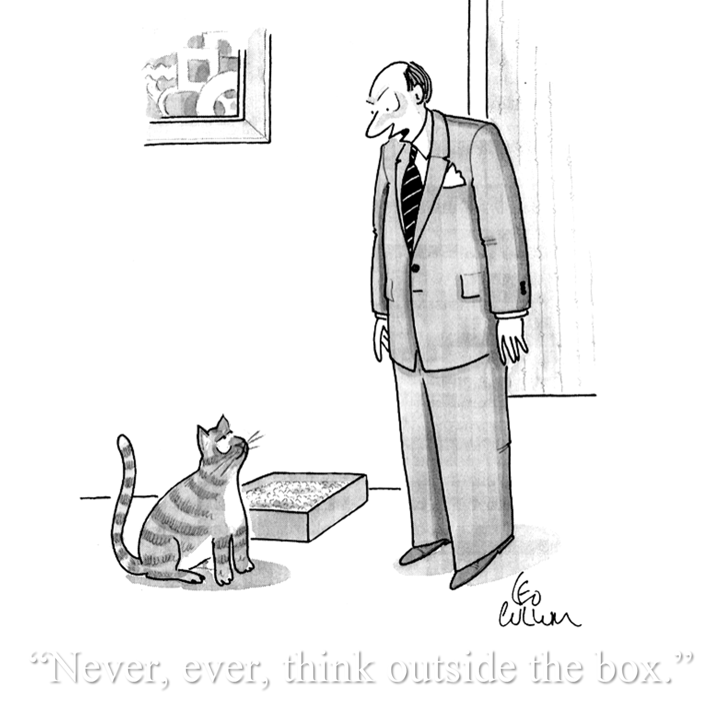
Notes:
Note to Facilitator: This slide has a build. The cartoon will be on the screen and the green background will appear when you click forward.
1 min
SAY: What quadrant does this cartoon best represent? Type your response in chat.
DO: Give team members a moment to type their responses.
DO: Share that green is correct because it shows a commitment to enforcing the rules.
TRANSITION: Here’s our next image.

Slide 28

In God We Trust…
All Others Must Have
Notes:
Note to Facilitator: This slide has a build. The cartoon will be on the screen and the blue background will appear when you click forward.
1 min
SAY: What quadrant does this cartoon best represent? Type your response in chat.
DO: Give team members a moment to type their responses.
DO: Share that blue is correct because it demonstrates a strong trust in data.
TRANSITION: Here’s our next image.

Slide 29
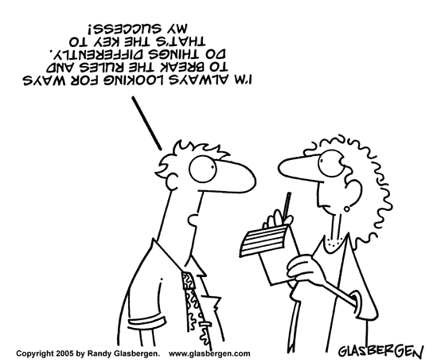
Notes:
Note to Facilitator: This slide has a build. The cartoon will be on the screen and the yellow background will appear when you click forward.
1 min
SAY: What quadrant does this cartoon best represent? Type your response in chat.
DO: Give team members a moment to type their responses.
DO: Share that yellow is correct because it shares a perspective that is not traditional, willing to break the rules.
TRANSITION: Great work! You clearly have a good working knowledge of WBT.

Slide 30
Our Four Different Selves
Your Own Personal Team!
A
Rational Self
Analyzes
Quantifies
Is logical
Is critical
Is realistic
Likes numbers
Knows about money
Knows how things work
Infers
Imagines
Speculates
Takes risks
Is Impetuous
Breaks rules
Likes surprises
Is curious / Plays
D
Experimental
Self
Takes preventive action
Establishes procedures
Gets things done
Is reliable
Organizes
Is neat
Timely
Plans
Is sensitive to others
Likes to teach
Touches a lot
Is supportive
Is expressive
Is emotional
Talks a lot
Feels
B
Safekeeping
Self
C
Feeling
Self
The four-color, four-quadrant graphic and Whole Brain® are registered Trademarks of Herrmann Global, LLC.
Notes:
Note to Facilitator: This slide has a build. Each of the lists of characteristics will be revealed one-by-one in alphabetical order as you click your mouse to move forward. The last part of the build after the characteristics is the text that reads, “Your Own Personal Team!”. This will be revealed before you click to go to the next slide.
3 mins
SAY: Before we move forward, it is important to remember an important part of the Whole Brain® Model. We highlighted some personal thinking preferences in our last activity, but everyone has access to all four quadrants!
ASK: What do you recall about the rational self in the “A quadrant”? What kind of behaviors might you observe?
DO: Give team members a moment to respond.
DO: (Click to reveal) the list in the blue quadrant and confirm correct guesses, highlight any that were missed.
ASK: What do you recall about the safekeeping self in the “B quadrant”? What kind of behaviors might you observe?
DO: Give team members a moment to respond.
DO: (Click to reveal) the list in the green quadrant and confirm correct guesses, highlight any that were missed.
ASK: What do you recall about the feeling self in the “C quadrant”? What kind of behaviors might you observe?
DO: Give team members a moment to respond.
DO: (Click to reveal) the list in the red quadrant and confirm correct guesses, highlight any that were missed.
ASK: What do you recall about the experimental self in the “D quadrant”? What kind of behaviors might you observe?
DO: Give team members a moment to respond.
DO: (Click to reveal) the list in the yellow quadrant and confirm correct guesses, highlight any that were missed.
SAY: The good news is …
DO: (Click to reveal) the “Your Own Personal Team!” text.
SAY: … that this represents your own personal team! We all have preferences, but we all use every part of our thinking in our day-to-day lives.
TRANSITION: Thanks everyone! Let’s take a 15 minute break!

Slide 31
15 Minute
Break
Notes:
Note to Facilitator: This slide is set for a 15 minute break. If delivering the content with a modular approach, feel free to delete.

Slide 32
Individual HBDI®
Review
Notes:
Note to Facilitator: Be sure to review the items below before facilitating your team session (you can keep or delete this slide after your review):
Slide 33: This slide has notes related to the HBDI® story and how you can customize it for your audience.
Slide 36: This slide outlines a 10 minute debrief of the HBDI® Digital for the entire team. Review this slide as you plan so you can map which areas of the digital profile you will highlight.
Slide 37: This slide has a small group activity. Be prepared to send team members into small breakout groups after they have a chance to review their individual profiles.
This section transitions from the individual review of HBDI® profile to a quick presentation on communication. Review the slides to be ready for the pivot and activity.

Slide 33
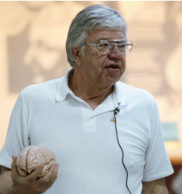
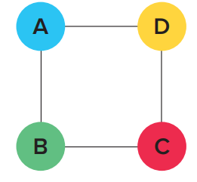
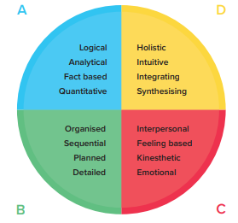
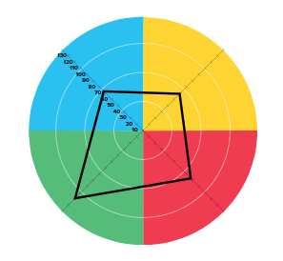
The HBDI® Story
HERRMANN
BRAIN
DOMINANCE
INSTRUMENT
Designed by Ned Herrmann.
Four interconnected clusters of mental processing.
Our preference level in each quadrant.
The assessment you completed to assess natural thinking preferences.
The four-color, four-quadrant graphic and Whole Brain® are registered Trademarks of Herrmann Global, LLC.
Notes:
Note to Facilitator: This slide has been adapted from your workshop so you can edit or add to tell your HBDI® story. There is room in the speaker notes for you to customize and personalize how you deliver this slide.
3 mins
SAY: Before we dive into your individual HBDI® profiles, let’s take a few minutes to talk about the HBDI®.
Herrmann: The HBDI® was designed by Ned Herrmann, who worked at GE exploring why some teams were higher performing than others.
Brain: Ned’s research, along with others, identified a simple structure of left/right brain thinking and cerebral/limbic thinking, which then led him to the notion of four interconnected clusters of specialized mental processing. They function together, making up the Whole Brain® Model.
Note to Facilitator: Feel free to customize the example below. You can use a personal example, or something that will resonate with the work of your audience.
Here’s a practical example of this model - think about buying a car. Depending on your natural thinking preferences, you will have specific questions.
The A, or blue quadrant, might ask, “What’s the gas mileage?” “The cost?”
The B, or green quadrant, might ask, “What are the functions of the car?” “Safety features?”
The C, or red quadrant, might ask, “What color is of most interest?” “How will this car make you feel?”
The D, or yellow quadrant, might ask, “Is this the newest model?” “Future use of the car?”
Dominance: Dominance is our preference level in each quadrant. Not our competency, personality, values, emotions or behaviors - but our natural thinking preference based on the characteristics of the quadrants.
Instrument: The HBDI® assess your natural thinking preferences by asking you to select a characteristic that most resonates with you. The outcome reveals your profile.
TRANSITION: Let’s take a look at reading an HBDI® profile.

Slide 34
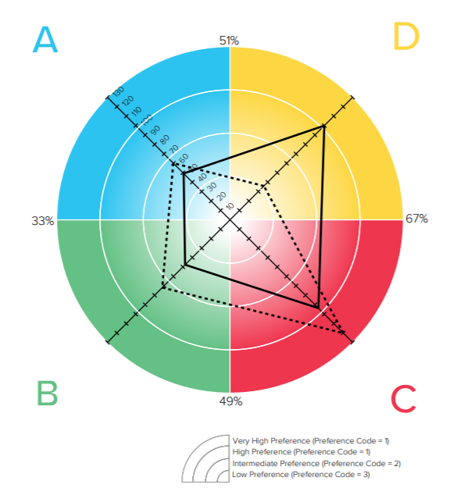
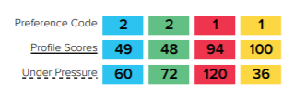
Reading the HBDI® Profile: The Preference Code
The HBDI® measures the degree of preference for each quadrant: 1, 2 or 3
VERY STRONG 1+
STRONG 1
INTERMEDIATE
2
LOW
3
Under pressure
The four-color, four-quadrant graphic and Whole Brain® are registered Trademarks of Herrmann Global, LLC.
Notes:
Note to Facilitator: This slide has a build. The words and arrows that you see will be revealed one-by-one as you read the script below and click forward.
5 mins
SAY Let’s cover a quick reminder of how to read your HBDI® profile. The HBDI® measures your degree of preference using a 1, 2 or 3. The degree to which a point is further away from the center shows a stronger preference in that quadrant.
DO: (Click and reveal) the “Very Strong 1+” text and arrow.
SAY: A score of over 100 in the outer circle, or even beyond the circle, is a thinking preference that is very visible. So if you are trying to hide it, forget it, everyone already knows.
DO: (Click and reveal) the “Strong 1” text and arrow.
SAY: The next circle is a “Strong 1”, or a primary preference. Primary preferences are identified by a score between 67-100.
DO: (Click and reveal) the “Intermediate 2” text and arrow.
SAY: A 2 indicates a secondary preference, or a score of 34-66. A secondary preference is often a comfort zone - neither strong or low to midrange. People are fine with it, but it’s not a preference and not something they find draining.
DO: (Click and reveal) the “Low 3” text and arrow.
SAY: A score of 33 or less is a low preference, for some, perhaps, almost an avoidance. You would rather not think this way unless you absolutely had to. The evidence for a low preference would be when you’re thinking in that mode, it saps your energy faster. If you have to engage with something that aligns with a low preference, your mind drifts away and you want to do something else. Often people will start, move away, then return to find a way of dealing with a low preference task.
A final point on low preferences - people with low scores in red, have feelings like anyone else. They love others like everyone else, but they may not express it as much as other people. You might have people in your family that do this…in fact, you might do this.
DO: (Click to reveal) the “Under Pressure” text and line.
SAY: Next, notice the dotted line profile. This suggests how you prefer to think under pressure or stress. Usually, the dotted line is in the neighborhood of day-to-day profile, but sometimes it can be 30-50 points difference. A big, radical difference may sometimes mean a person is in process of transition.
And an important note - people perceive you more from the dotted line. Because they remember you under pressure. If you have big differences, it may be confusing. You appear to make decisions in different ways. A difference of 10-15 points in a dotted line profile from the regular profile isn’t that significant.
TRANSITION: Let’s go over some important reminders about your HBDI® profile.

Slide 35
Important Reminders
Your profile shows your natural preferences.
Your thinking is flexible: you can and do stretch.
No one is just “one” preference.
These are preferences, not competencies.
Is not meant to label or stereotype others (eg “blue person”)
Self awareness strengthens your thinking agility and your understanding of others’ thinking.
The four-color, four-quadrant graphic and Whole Brain® are registered Trademarks of Herrmann Global, LLC.
Notes:
Note to Facilitator: There is an animation build on this slide. It will appear with the first bullet revealed. The additional bullets will appear one-by-one as you click your mouse forward.
2 mins
SAY: Your profile shows your natural preferences.
DO: Continue to (click and reveal) the following 5 bullet points and read them out loud to the group.
TRANSITION: With our review complete, let’s take a look at your individual profiles.

Slide 36
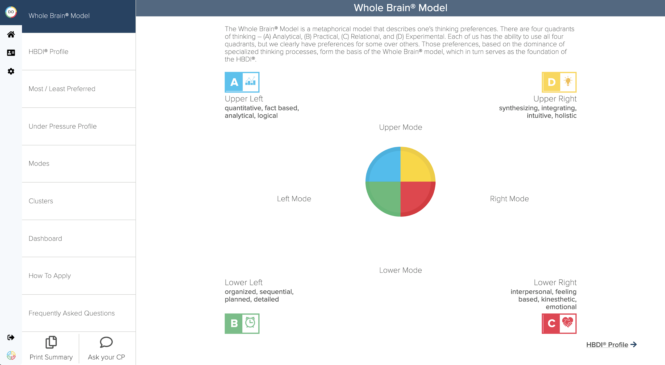
HBDI® Digital Debrief
Go to the Thinker Portal: journey.herrmannsolutions.net/thinker
Select “Explore My Results” on the “My HBDI® Results” tile.
The four-color, four-quadrant graphic and Whole Brain® are registered Trademarks of Herrmann Global, LLC.
Notes:
10 mins
Note to Facilitator: Be prepared to leave the slidedeck and open your HBDI® profile in the Thinker Portal. You can also share the following link in chat for the team to use to log into their Thinker Portal: journey.herrmannsolutions.net/thinker
SAY: Let’s look at your profile! Follow the instructions on your screen. Let me know when you have your profile open.
DO: Open your profile and put the link in chat (journey.herrmannsolutions.net/thinker).
DO: When everyone has pulled up their profile, stop sharing the slide deck and start to share your profile on the Thinker Portal.
DO: Walkthrough a group debrief of the data while answering questions using examples from your profile. Use the notes below to plan what you will do in the 10 minute debrief:
Start with the “Whole Brain® Model tab on the left: Debunk left brain vs. right brain and focus on the “whole” brain.
Explain the help section, which can be opened by clicking the question mark in top right corner.
Ask who has a score over 100 in a quadrant?
Show the “Under Pressure Profile” tab and share an example from the data that is in your profile.
Show “clusters” and explain how this helps you understand why one profile with a similar score in a quadrant is different than another.
Show the “Dashboard and highlight “at work” vs “view of self (at home)”.
In the “How to Apply” tab pick one menu option from the top to highlight.
Show the “Frequently Asked Questions” tab, discuss the question, “Can my HBDI® profile change?” or a question related to preference vs. competence.
TRANSITION: There are other great insights that your HBDI® Digital can provide, but this should give you a baseline for our next activity.

Slide 37

Sharing Our Preferences
For this activity, you will share observations
of your results. You will have 5 minutes to review your profile and take some notes related to the following questions:
How do your results reflect your understanding of yourself?
How are your results true for you:
  What surprised you?
  What was confirmed?
  How do your results shift under stress?
Notes:
20 minutes (5 minutes for individual note taking in the large room, 15 minutes in breakout rooms)
Note for Facilitator: For this small group activity you will want to have team members talk in groups of 3-4, so you will want to use breakout rooms. You can randomly assign the breakout groups.
SAY: For this activity, you will share observations of your results. You will have 5 minutes to review your profile and take some notes related to the following questions:
How do your results reflect your understanding of yourself?
How are your results true for you:
What surprised you?
What was confirmed?
How do your results shift under stress?
SAY: After you have had a chance to take down your notes, I will send you into breakout rooms of 3-4 people and give you 15 minutes for everyone to share the insights they wrote down.
DO: Give the team 5 minutes to write down their individual reflections. Keep the slide on the screen so they can refer to the questions if needed.
DO: Once team members have had a chance to document their insights, send them into their breakout groups of 3-4 people for 15 minutes so everyone can share their answers to the questions.
DO: Welcome everyone back after the time to discuss and breakout rooms and move to the next slide.

Slide 38
Sharing Our
Preferences
Debrief
What can I stop, start, or modify now that I better understand my HBDI® profile?
The four-color, four-quadrant graphic and Whole Brain® are registered Trademarks of Herrmann Global, LLC.
Notes:
5 mins
SAY: As part of reflecting on your data, we are going to take a few minutes to think about the following question:
ASK: “What can I stop, start or modify now that I better understand my HBDI® profile?”
DO: Tell team members that they will have 2-3 minutes to write down their response.
DO: Check in after a few minutes and make sure team members are ready to move forward.
SAY: Share your thinking by unmuting and or adding your thoughts to the chat.
DO: Gather a few comments and have engage team members in a minute or two of conversation.
TRANSITION: Thank you all for sharing, let’s wrap up this section by talking a little bit about communication.

Slide 39

Communication Truths
We tend to speak the language of our most preferred quadrant … this means that other people may not always understand us.
We tend to listen from our most preferred quadrant … this means we may not always understand others.
When you are not sure what language to speak, the best language is … Whole Brain® language.
Notes:
1 mins
SAY: We tend to speak the language of our most preferred quadrant … this means that other people may not always understand us.
We tend to listen from our most preferred quadrant … this means we may not always understand others.
When you are not sure what language to speak, the best language is … Whole Brain® language.
TRANSITION: You just spent some time communicating about your thinking preferences, let’s see if you sharpened your Whole Brain® cluspotting skills.

Slide 40
Think About
Communicating
Critical analysis
Facts – no fluff
Technical accuracy
Goals & objectives
Well articulated ideas
Data–fact based charts
Brief, clear, precise info
Minimal details
Freedom to explore
Metaphors & visuals
Overview–“big picture”
New, fun, imaginative
Conceptual framework
Long term strategy
Detailed time–action plan
Thorough with references
Rules and procedures
Step-by-step & concise
In writing, in advance
Contingency plan
No digressing
Open, informal discussion
Expressive body & voice
Intros & conversation
Knows effect on others
Knows how people feel
Hear & understand all
No hidden agendas
The four-color, four-quadrant graphic and Whole Brain® are registered Trademarks of Herrmann Global, LLC.
Notes:
Note to Facilitator: This slide has an animation build. The lists in each quadrant will be revealed one-by-one in each quadrant as you click forward on your mouse.
4 mins
SAY: To improve our communication, we can listen for the words people use. Their words, the questions they ask - even how they dress, set up their workspace - all give us clues about their preferences. But let’s focus on words and questions, which we can use as clues to both thinking preferences AND the information someone needs to really hear, trust you or take action.
As you think of your stakeholders and people you try to influence, what words do you hear? What questions they ask?
ASK: For the A, or blue, quadrant? What words or questions would this quadrant use or be listening for?
DO: Confirm and clarify before you (click to reveal) the list in the A quadrant.
ASK: For the B, or green, quadrant? What words or questions would this quadrant use or be listening for?
DO: Confirm and clarify before you (click to reveal) the list in the B quadrant.
ASK: For the C, or red, quadrant? What words or questions would this quadrant use or be listening for?
DO: Confirm and clarify before you (click to reveal) the list in the C quadrant.
ASK: For the D, or yellow, quadrant? What words or questions would this quadrant use or be listening for?
DO: Confirm and clarify before you (click to reveal) the list in the D quadrant.
TRANSITION: Thank you for all your great work! Let’s take a quick stretch break.

Slide 41
10 Minute Break
Notes:
Note to Facilitator: Check your time and adjust the break as needed. If you are delivering the sections in a modular fashion, you can cut break slides as needed.

Slide 42
Team Report Debrief
Notes:
Note to Facilitator: Be sure to review the items below before facilitating your team session (you can keep or delete this slide after your review):
The timing for the slides in this section total about 50 minutes. This provides space for extending conversations or answering questions.
This section focuses on debriefing data from the team report. Be sure to pull a report for this team, review the slide deck and decide which data you would like to highlight. We have added templates for the slides we recommend that you share with a team and you will find three more templates in the appendix of this deck that you can easily swap in.
To prep the team data slides, take a screenshot of the team data from the report. You can also decide to switch from the slideshow to the team report if you would like, but still focus on the pages you have selected. You can always lead a more in-depth debrief with the team at a later date.
Slides 44-46: These slides are set up as a template for you to replace the team report images and edit the speaker notes as you would like.
Slide 47: For this activity, you can use annotate or the chat to collect responses from team members. The goal is to be sure the response is highlighted in a way that the entire team can see it. Review the slide and deliver the activity in a way that works best for you.
Slide 50: The notes for the closing are short, but be sure to take the time to think about how you can quickly close out the session with the team in a personal way. You can take notes during the session to find something to highlight, or use insights you gathered when planning the session.

Slide 43
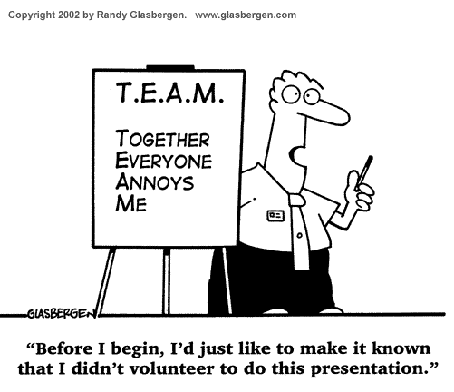
Notes:
Note to Facilitator: This slide has a build. The cartoon will appear on the screen. When you are asked to click, the acronym on the flipchart will appear.
3 mins
SAY: Virtual work as a team, in a complex environment, is not just the new normal - it’s a challenge! We often use the acronym T.E.A.M to say, “Together everybody achieves more”. This is true, however … what is also true is …
DO: (Click to reveal) the acronym on the slide, “T.E.A.M.: Together everybody annoys me” and read it aloud.
SAY: Understanding Whole Brain® Thinking gives you a model for how to better understand not just yourself, but others. When we use the Team Report, we can see how our preferences map across the quadrants, where our strengths show up and where there might be gaps. We can also see the indicators of how best to increase productivity and how to optimize the talent on the team.
Remember the stats we shared about team productivity and the application of Whole Brain® Thinking:
Whole Brain® Teams were 66% more efficient.
70% or more of the Whole Brain® Teams were successful.
TRANSITION: Now we are going to take a look at a few pages of your Team Report. While we go through these report pages reflect on how your team operates and your role in it. Think about what’s working well and what you as a team could start, stop or modify. Also think about what you bring to the team.

Slide 44

Team Composite
A
D
mathematical quantitative analytical rational factual critical
52%
simultaneous imaginative synthesizer
intuitive artistic holistic
SAMPLE
ADD YOUR TEAM DATA HERE. TRANSFER NOTES IF NEEDED
52%
48%
reader speaker detailed dominant controlled sequential
talker reader musical spiritual intuitive symbolic
48%
The percentages indicate the preferences for one Mode compared to the opposite Mode
B
Total number of thinkers: 17
C
The four-color, four-quadrant graphic and Whole Brain® are registered Trademarks of Herrmann Global, LLC.
Notes:
5 mins
SAY: The team composite is a summary of each person on your team.
ASK: What do you notice?
DO: Share key points of the data that they may not have mentioned from your preparation, or use the following recommendations:
% upper and lower, right and left.
High and Lows of individuals.
ASK: How do you see this represented in your team?
TRANSITION: Let’s take a look at the average of your team.

Slide 45

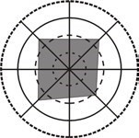
Team Average
A
mathematical quantitative analytical rational factual critical
D
simultaneous
Upper Mode
52%
imaginative synthesizer
intuitive artistic holistic
79
70
SAMPLE
ADD YOUR TEAM DATA HERE. TRANSFER NOTES IF NEEDED
Left Mode
52%
48%
Right Mode
reader speaker detailed dominant controlled
talker reader musical spiritual intuitive
70
48%
Lower Mode
67
sequential
symbolic
B
C
The percentages indicate the preferences for one Mode compared to the opposite Mode
Database Average
The four-color, four-quadrant graphic and Whole Brain® are registered Trademarks of Herrmann Global, LLC.
Notes:
5 mins
SAY: The team average is a summary of each person on your team.
ASK: What do you notice?
DO: Share key points of the data that they may not have mentioned from your preparation, or use the following recommendations:
Share what the preference code is as an average.
Share other observations you might have.
ASK: How do you see this represented in your team?
TRANSITION: Now let’s take a look at your Group Preference Map

Slide 46
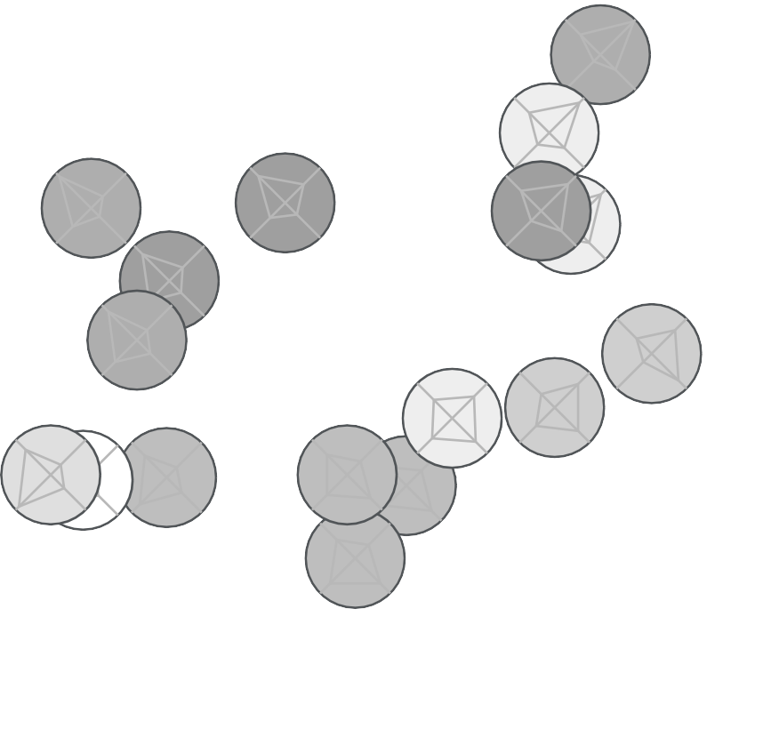
Group Preference Map
A
D
1
mathematical quantitative analytical rational factual critical logical
10
simultaneous imaginative synthesizer
intuitive artistic holistic spatial
16
11
14
4
SAMPLE
ADD YOUR TEAM DATA HERE. TRANSFER NOTES IF NEEDED
2
15
9
17
6
reader speaker detailed dominant controlled sequential conservative
7 ₅
3
13
8
talker reader musical spiritual intuitive symbolic emotional
12
B
C
introvert
extrovert
The four-color, four-quadrant graphic and Whole Brain® are registered Trademarks of Herrmann Global, LLC.
Notes:
5 mins
SAY: This representation shares the preferences as plotted on a Whole Brain® map so that you can see the relationships, preferences and the Introversion/Extroversion scale.
ASK: What do you notice? Can you think of examples of what your team does and talks about that demonstrate what’s on this map?
DO: Share key points of the data that they may not have mentioned from your preparation and highlight the following:
Each circle is a member of the team.
Darker circle is greater introversion as self reported.
Lighter circle is greater extroversion as self reported.
Circle with an X is where the average of the team falls.
TRANSITION: There are additional pages of data that are available for the team, and if you are interested we can find some time to take a closer look at the full report.

Slide 47
Activity: What do I bring to the Team?
Working Solo
Applying Formulas
Accomplishing
Analyzing Data
Putting Things Together
Making Things Work
Solving Tough Problems
Making the Numbers
Logical Processing
Taking Risks
Inventing Solutions
Providing Vision
Having Variety
Bringing About Change
Opportunity to Experiment
Selling Ideas
Developing New Things
Excitement
Building Things
Being in Control
Having an Ordered Environment
Preserving the Status Quo
Paperwork Tasks
Establishing Order
Planning Things Out
Stabilizing
Administrating
Getting groups to work together
Expressing Ideas
Building Relationships
Teaching/ Training
Listening and Talking
Working with People
Persuading People
Being Part of a Team
Counseling
The four-color, four-quadrant graphic and Whole Brain® are registered Trademarks of Herrmann Global, LLC.
Notes:
5 mins
SAY: Now that we have reviewed the team, we want to spend a few minutes and have each of you share something important that you bring to the group. It can be based on your preference, or a skill you have learned, and the goal of this activity is to highlight a value that could be optimized for your overall success working with stakeholders.
I’ll call names and you can share your answers to “what do you bring”.
Note to Facilitator: If you are in Zoom you can use annotate to have team members place their initial by their response. Or you can have them respond in chat. If time is an issue, have the team post their responses in chat.
SAY: Thanks for sharing. This is the beginning of your team’s journey with Whole Brain® Thinking and knowing what you all bring, and the thinking preference you bring it from, is a great baseline.
TRANSITION: Now that we have a lot of perspective on our team, let’s look at what next steps we think we could take!

Slide 48
High-Performing Teams
Focus on excellence and what matters most.
Have clear roles and are focused on outcomes.
Speak up and confront reality.
Make effective use of data to measure and track progress.
Embrace a blameless problem-solving mindset.
Buy into a shared vision.
Are flexible and open to challenges and new ideas.
Stay strategic when needed.
Engage in collaborative, creative discussions.
Have the courage to think big.
Demonstrate individual and team accountability.
Align around process, goals and priorities.
Decide and prioritize in a timely way.
Follow through and do what they say they will do.
Commit to agreed-upon actions and execute well.
Know, respect and trust each other, assuming positive intent.
Are authentic, transparent and truthful.
Are inclusive and empathic, modelling equity.
Communicate directly.
Embrace joy, celebrate, and show appreciation to each other.
The four-color, four-quadrant graphic and Whole Brain® are registered Trademarks of Herrmann Global, LLC.
Notes:
15 mins
SAY: Take a moment to review the Whole Brain® characteristics of a high-performing team on this slide.
Thinking about what we covered today, and the team report data we reviewed, take a minute to think about:
Where are the strengths on your team?
Where might there be gaps?
What’s 1 characteristics you could focus on to increase the effectiveness of your team?
ALLOW: 1-2 minutes for team members to consider the questions.
ASK: Where are the strengths on your team?
DO: Encourage team members to share them verbally or in chat. Look for and discuss themes and which quadrants they fall into.
ALLOW: 3-4 minutes for the discussion.
ASK: Where might there be gaps?
DO: Encourage team members to share them verbally or in chat. Look for and discuss themes and which quadrants they fall into.
ALLOW: 3-4 minutes for the discussion.
ASK: What’s 1 characteristics you could focus on to increase the effectiveness of your team?
DO: Encourage team members to share them verbally or in chat. Find agreement on the team around 1 characteristic, you can defer to the characteristic that is mentioned most and ask for agreement if needed.
ALLOW: 2-3 minutes for the discussion.
SAY: Great work everyone, let’s take the characteristic you selected and talk about how you can work to address it.

Slide 49
Team Action Plan
What characteristic will we focus on?
Why is it important right now?
What can we stop, start, or modify to improve?
How will we leverage each other’s strengths?
The four-color, four-quadrant graphic and Whole Brain® are registered Trademarks of Herrmann Global, LLC.
Notes:
Note to Facilitator: This slide has a build. The slide will appear with the blue quadrant question on the slide. You will need to click to reveal the questions in the other quadrants.
10 minutes
SAY: With that one characteristic in mind, let’s set an action plan. As a team, we will commit to improving the following characteristic: (add characteristic here)
DO: (Click to reveal) the question, “Why is it important right now?”
ASK: Why is it important right now to address this characteristic?
ALLOW: 3 minutes of conversation.
DO: (Click to reveal) the question, “What can we stop, start, or modify to improve?”
ASK: What can we stop, start, or modify to improve?
ALLOW: 3-4 minutes of conversation and encourage the team to take notes.
DO: (Click to reveal) the question, “How will we leverage each other’s strengths?”
ASK: How will we leverage each other’s strengths?
ALLOW: 3 minutes of conversation and encourage them to add to their notes.
TRANSITION: Great work everyone! Be sure to keep this activity in mind and you continue to work together.

Slide 50
Continue to Optimize Your Team’s Operating System
Execute your Team Action Plan!
Use the Thinker Portal to continue learning more about your teammates HBDI® profile.
Intentionally and consciously use the the language of Whole Brain® Thinking as a team for greater clarity and results.
Use Whole Brain® Tools as you engage with each other to communicate, build trust and solve problems.
Notes:
1-2 min
DO: Share the list of recommendations with the team.
DO: Thank everyone for their hard work and close the session by reminding them of a notable insight, “a-ha” or discussion point from your time together.
SAY: If there aren’t any questions, we will sign off for the day.

Slide 51
Presenter Name
+1 212-555-5555
presenter@email.com
Notes:
Note to Facilitator: Feel free to add your name and contact information to this closing slide if you would like. You can also edit the slide to add a photo, or any other details that might relevant to your specific use case.

Slide 52
Additional Slides
Notes:
Note to Facilitator: Be sure to review the items below before facilitating your team session (you can keep or delete this slide after your review):
Slide 53: This slide can be used at the end of a section if you are delivering this content in a modular fashion.
Slide 54: This slide outlines potential next steps you could take with a team if they are interested in learning more about Whole Brain® Thinking or the HBDI®.
Slide 55: Is the start of an appendix that has additional team report slides that you can swap or add depending on the time you have available to present to a team.

Slide 53
Next Steps
Next time we meet, we will:
Go over an individual debrief of your HBDI® as a team.
Debrief your team report.
Next session: _______________
The four-color, four-quadrant graphic and Whole Brain® are registered Trademarks of Herrmann Global, LLC.
Notes:
Note to Facilitator: If you are delivering this content in a modular fashion, you can add this slide to the end of the section you are stopping at. Feel free to update the slide as needed to clearly outline next steps.

Slide 54
Recommendations for Continued Team Learning
If the team or team leader is looking for your support in continuing the learning around Whole Brain® Thinking and the HBDI®, you can consider offering an option from the list below depending on the specific ask:
Time to debrief HBDI® profiles individually with team members.
Deliver a focused team debrief to dig into more data from the Team Report.
Introduction to sharing on the Thinker Portal in order to use:
  The Teams tile to access team data directly on the Thinker Portal.
  Team accelerator tools.
  The Team Pulse Check Survey and Signals Reporting tab.
Have the team participate in the Team Effectiveness Dashboard survey and debrief.
Notes:
Note to Facilitator: This slide covers options for next steps if the team is looking to continue their application of Whole Brain® Thinking. If you have questions about any of the items on this list you can visit the following resources:
Information on the Team Report: https://herrmann.zendesk.com/hc/en-us/articles/360001658213-The-HBDI-Team-Report
Information on Sharing: https://herrmann.zendesk.com/hc/en-us/articles/360053185314-Introducing-the-Herrmann-Platform-Thinker-Portal-HBDI-Sharing-Feature
Information on the Teams feature of the Thinker Portal: https://herrmann.zendesk.com/hc/en-us/articles/360050089854-Teams-in-The-Herrmann-Platform-For-Practitioners
Information on the team accelerator tools: https://herrmann.zendesk.com/hc/en-us/articles/21225089066643-Team-Accelerator-Tools-in-the-Herrmann-Thinker-Portal
Information on the Signals Reporting tab: https://herrmann.zendesk.com/hc/en-us/articles/31126796200979-Understanding-the-Signals-Reporting-Tab-in-the-Herrmann-Platform
Information on the Team Effectiveness Dashboard: https://herrmann.zendesk.com/hc/en-us/articles/360011767434-The-Herrmann-Team-Effectiveness-Dashboard-Assessment-and-Results-Intro-and-How-To-s

Slide 55
Team Report Slides
Notes:
Note to Facilitator: Be sure to review the items below before facilitating your team session (you can keep or delete this slide after your review):
Slides 56-58: Additional template slides for presenting data from the Team Report.

Slide 56
HBDI® Process Flow
Typical Process Flow Under Pressure Process Flow
This graphic presents what a typical process flow would look like for a team with your average thinking preferences. This tells us where our thinking may start when working together as a team, and also what thinking we might overlook.
This graphic presents the alternate flow of preferences under pressure, based on the Adjective Pairs section’s average results. This tells us about how we might think differently when under pressure as a team.
A
SAMPLE
ADD YOUR TEAM DATA HERE. TRANSFER NOTES IF NEEDED
D
A
D
30.0%
28.7%
28.6%
26.7%
18.8%
B
C
22.5%
21.7%
B
C
23.0%
The four-color, four-quadrant graphic and Whole Brain® are registered Trademarks of Herrmann Global, LLC.
Notes:
5 mins
SAY: This is your team’s HBDI® process flow. It shows where your thinking typically starts when working together, and what your thinking might overlook. It also shows how your process flow shifts under pressure.
Typically this is an amplification of energy when under pressure.
ASK: What do you notice? How is this true for you? For your team? What are your observations?
DO: Confirm, clarify and add your thoughts as the facilitator.
TRANSITION: (Add your transition here).

Slide 57
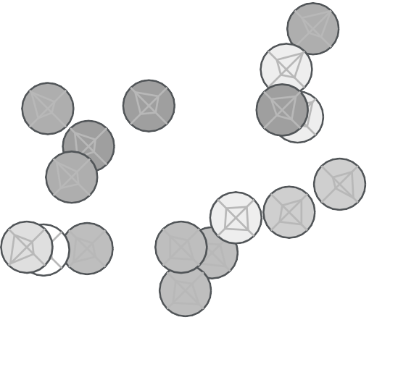
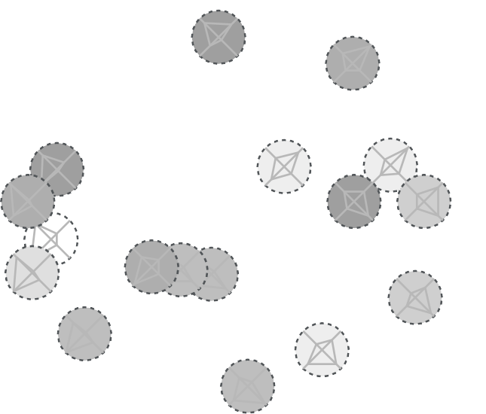
Group Preference Map Under Pressure
Scores
Under Pressure
1
11
SAMPLE
ADD YOUR TEAM DATA HERE. TRANSFER NOTES IF NEEDED
10
14₄
1
16
11
2
15
2
10
4
9
16
14
6
17
6
5
7 ₅
3
13 ₈
7
15 ₁₃ ₈
12
9
3
17
12
Notes:
5 mins
SAY: This is the Group Preference Map Under Pressure.
Typically this is an amplification of energy when under pressure. And certainly the shift in our external world has many of us under pressure.
ASK: What do you notice? How is this true for you? For your team? What are your observations?
DO: Confirm, clarify and add your thoughts as the facilitator.
TRANSITION: (Add your transition here).

Slide 58
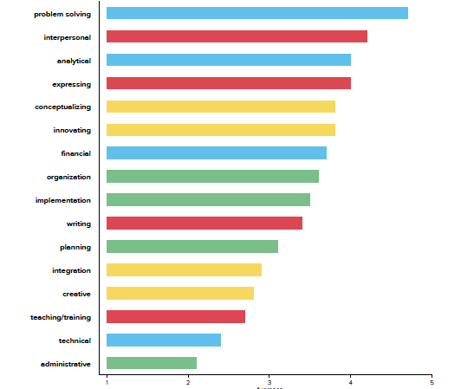
HBDI® Rank Order of Work Elements
SAMPLE
ADD YOUR TEAM DATA HERE. TRANSFER NOTES IF NEEDED
Notes:
5 mins
SAY: This is the rank order of Work Elements. It represents what you each chose about your work. It’s helpful to look at the patterns here and see things like “problem solving” is very strong and “Administrative” is more average as a team.
ASK: What do you notice?
DO: Confirm and clarify what you have heard. Add some of your own observations.
TRANSITION: (Add your transition here).

