Slide 1
CP Booster Workshop
New tools and resources you may have missed

Slide 2
Objectives and Agenda
Goals & Objectives
New ways to debrief with digital tools
New ways to encourage collaboration with sharing & teams
Many ways to stay connected
Introductions -
  Kim White, Organizational Consultant
  Jonathan Berg, VP of Product
  Ryan Cunningham, Product Manager
  Trish Rajewski, Producer
Debrief options
  In person, group
    HBDI® Digital
    HBDI® App
Ways to share and work in teams
Ways to stay connected with Herrmann
Q&A, Wrap Up
Agenda
Notes:
HOST
Let’s get started! We’ll be together for 90 minutes today. Let’s review our goals and objectives for our time today and look at the agenda.
[review goals and agenda]

Slide 3
Rules of Engagement
We agree to...
STAY
FOCUSED
BE
OPEN
STAY
ON TASK
ASK
QUESTIONS
Notes:
HOST
Some housekeeping before we get started.
[IF RECORDING: This workshop will be recorded and be available in the practitioner portal in a few days. Although your names appear now, they do not appear in the recording.
Please keep yourself muted unless needed. This is an interactive workshop, so there will be opportunities for you to respond verbally or in chat.
A quick WB walkaround - we have 90 minutes today. So...
A/blue - let’s stay focused and on topic
B/green - stay on task, which is learning about application tools (if you need technical help or have off topic questions, please drop them in the chat and Trish will respond or capture those for follow up
C/red - please ask questions and share. You can drop your question in the chat and we’ll address them as soon as we can.
D/yellow - we’re going to be learning together, sharing together, and exploring new ways to use these tools.

Slide 4
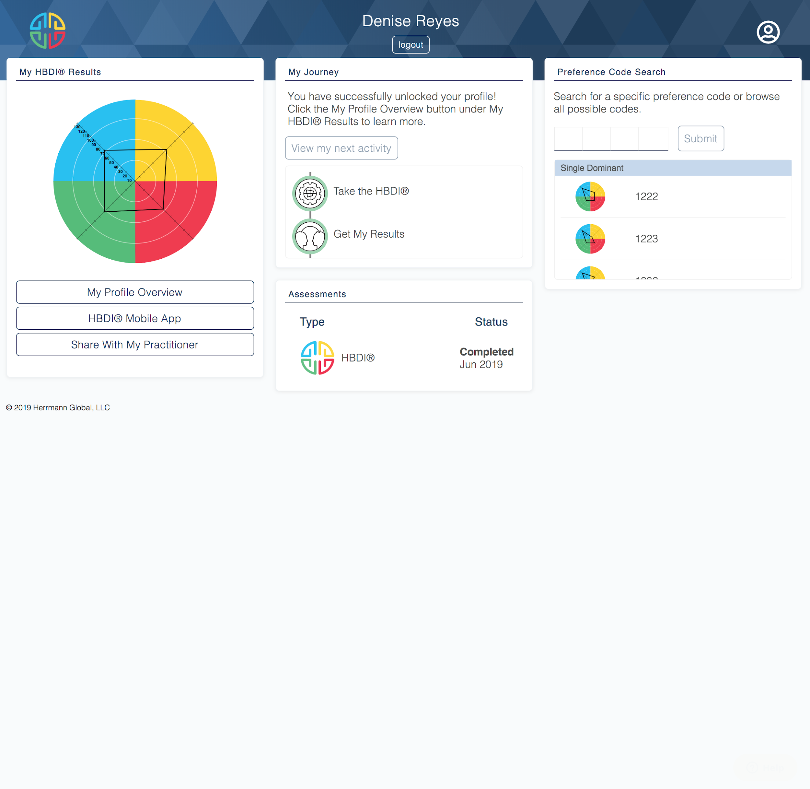
The Herrmann® Platform - Thinker Portal
https://journey.herrmannsolutions.net/thinker/
Bookmark
This page
Notes:
We now have the Thinker Portal as part of our Herrmann platform. You may be familiar with Axon - where you invite people to take the HBDI or the practitioner portal where you can find resources to use as a practitioner. The Thinker Portal is a new webspace that allows viewing of HBDI results, learning about whole brain thinking, sharing profiles (we’ll discuss later) and team activities.
It is available to EVERYONE, not just you!

Slide 5

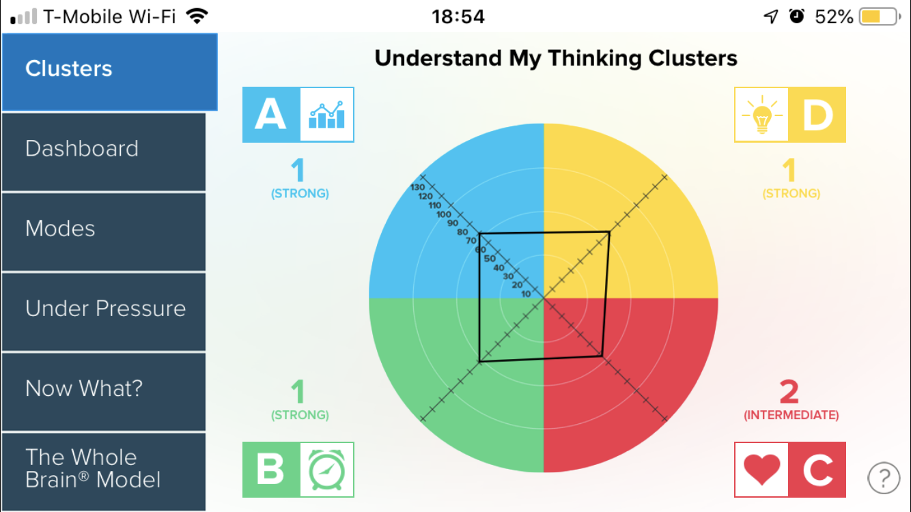
Ways to Debrief
HBDI® Digital
HBDI® Mobile App

Slide 6

In the past year,
how have you approached doing remote debriefs?
Notes:
ASK: In the past year, how have you approached doing remote debriefs?
Drop a quick description in chat or unmute and share.

Slide 7
The Scenario
Introduce Whole Brain Thinking to the marketing team:
1 VP Marketing, 4 Sr Marketing Managers, 30 Marketing Associates (non-managers)
Parameters:
VP and seniors get an personalized debrief
Associates get “some” introduction and their HBDI results
Remote
Short time frame

Slide 8

Debrief the Senior Leaders...
HBDI® Digital

Slide 9
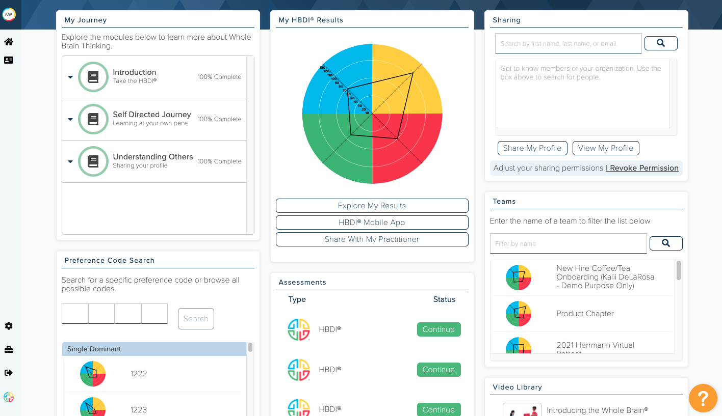
What is HBDI® Digital & Why Use It?
The Thinker Portal
HBDI® Results online
Visual, interactive profile results
Available on any device (computer,
tablet
or mobile phone)
Virtual or in person delivery
Benefits:
Save time and reduce the hassle &
cost of printing
No processing/waiting time
Environmentally friendly alternative
Same in depth conversation
Notes:
Story about client using it successfully

Slide 10
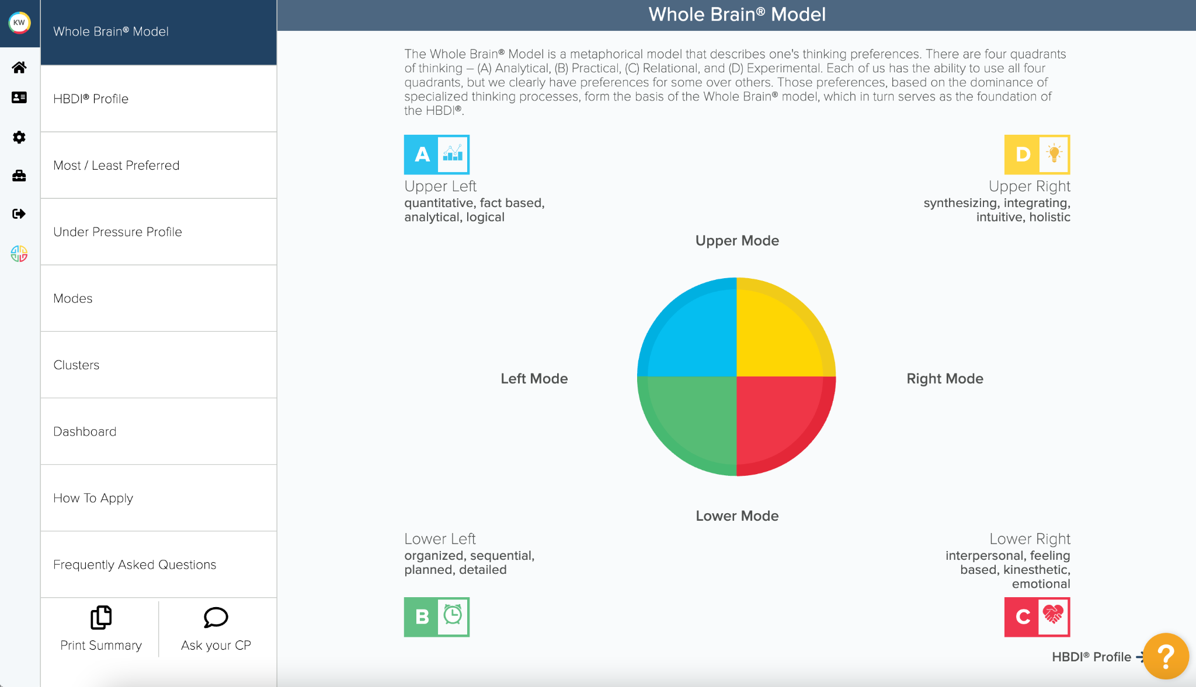
Go to “Thinker Portal” journey.herrmannsolutions.net/thinker
Notes:
HBDI Digital is available on the Thinker Portal I showed you earlier.
Let’s walk through the parts of the HBDI that are available here… [NEXT SLIDE]

Slide 11
What’s Included?
Overview of the Whole Brain® Model
HBDI® Profile
Most / least preferred quadrants
Under Pressure profile
Modes
Clusters by quadrant
Dashboard with insights into:
How I See Myself, At Work,
Energy Level, Intro/Extraversion
How to apply: application insights
for communication, problem solving
and decision making
Download Profile Summary as PDF
FAQs
Interactive: Clickable learning
points throughout the experience

Slide 12
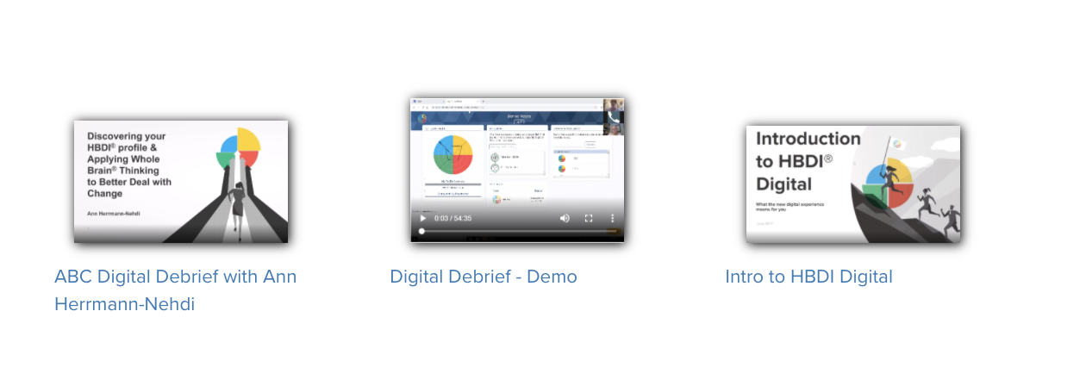
Get Started with HBDI® Digital
Log in and look through your own profile journey.herrmannsolutions.net/thinker
Look through our Digital Debrief materials on the practitioner portal on
http://practitioners.thinkherrmann.com/

Slide 13
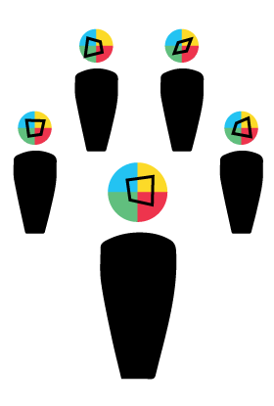
Now to Debrief the 30 Associates...
HBDI® Mobile App, group debrief
Notes:
So, not that we’ve used HBDI digital to debrief our senior leaders, we still need to debrief the associates. Remember that time is short, there isn’t time for 1:1 debriefs. So I’ll use the HBDI App and do a group debrief. Let’s take a look...

Slide 14
Did you know
before today
that there is an
HBDI® mobile app?
Notes:
ASK: Did you know before today that there is an HBDI mobile app? Drop “yes” or “no” in the chat.

Slide 15
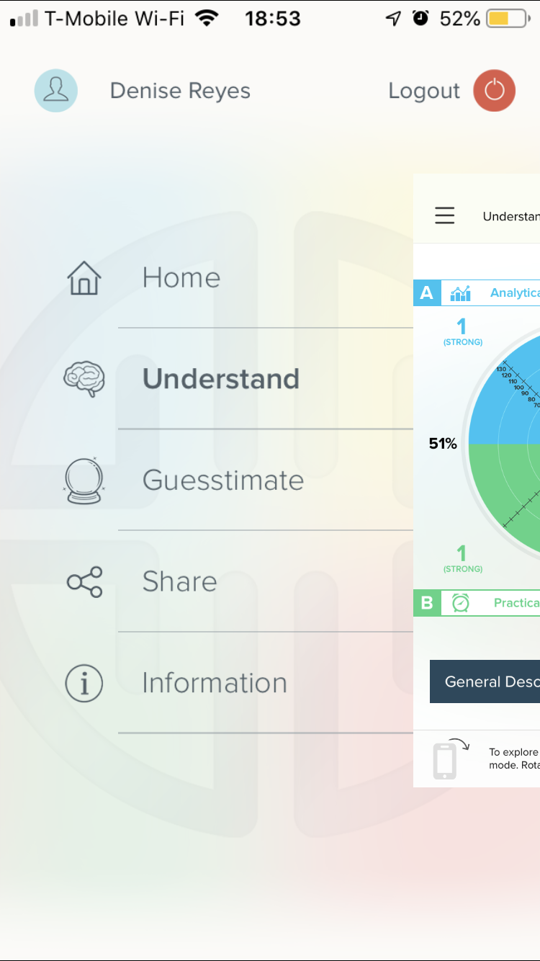
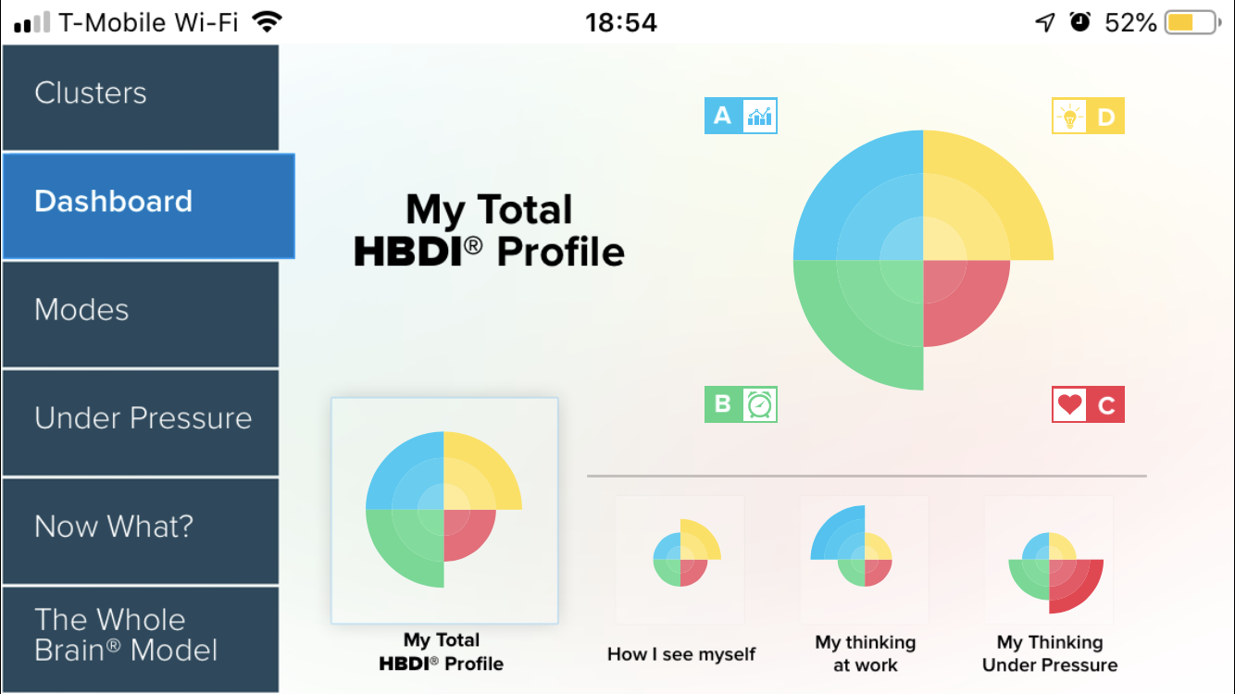

Debrief with the mobile HBDI® App
Available on iOS & Android
Available in all core languages:
  English US, English International, German, French, Chinese Simplified
Thinker can unlock their profile on the mobile app
Perfect for:
  Virtual
  Group debriefs
  With those who don’t have a computer/desk
Download at http://app.hbdi.com

Slide 16
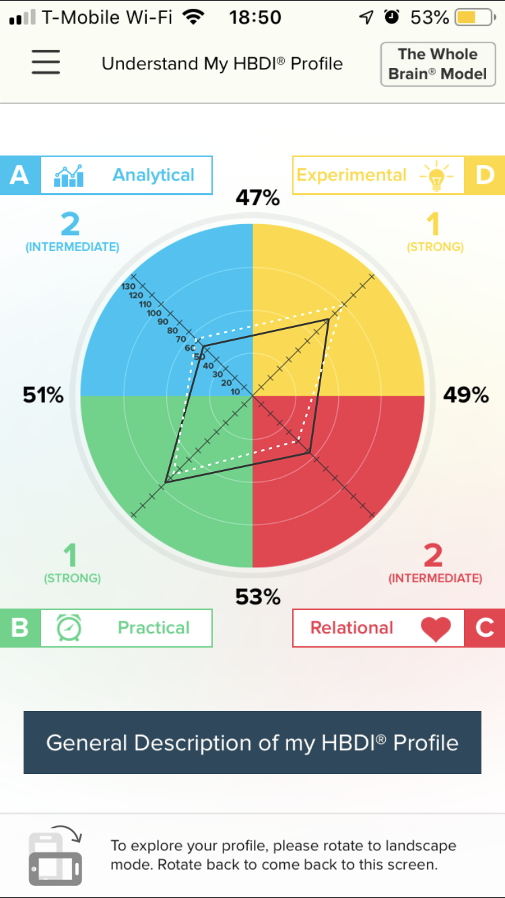
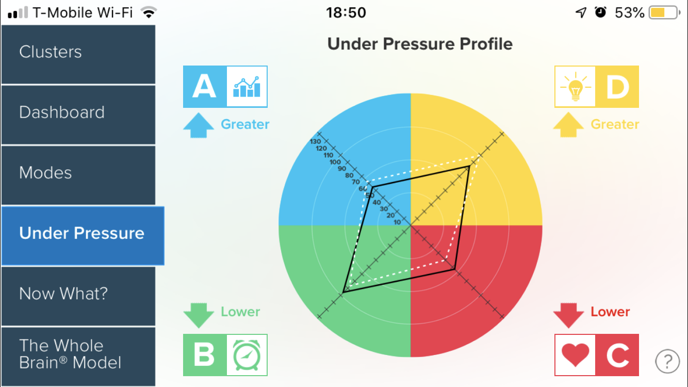
What’s included in the mobile HBDI® App
The Whole Brain® Model
Profile Description
Modes
Clusters
Dashboard:
  How I See Myself
  My Thinking at Work
Under Pressure Profile
Now What?
  Communication
  Problem Solving
  Decision Making
Guesstimate someone else’s profile

Slide 17
Questions
so far...

Slide 18

Engaging with others
New tools on the Herrmann platform
Notes:
How will this make the audience lives better. Remote teams connecting with each other. E.g. 8451- stretching partners that use the sharing feature, NBCu

Slide 19
Think about a time when a manager asked you to help their team become more effective
Notes:
Think about a time when a manager asked you to help their team become more effective. Did it come up doing a team workshop or offsite? Did the manager reach out to ask for help?
Now, let me tell you about a marketing team who had no difficulty coming up with creative ideas, but often seemed a bit disorganized and scrambling to complete projects. They would get them done, but members of other teams were often frustrated with the process, despite excellent results in the end.
ASK: Post in the chat an example of situations where a manager has asked for help with their team
Using some of the newer tools on our platform, you can guide teams to understand their team dynamics, share more about themselves with personalized profiles, leaving more time for you to go deeper using existing reports.

Slide 20
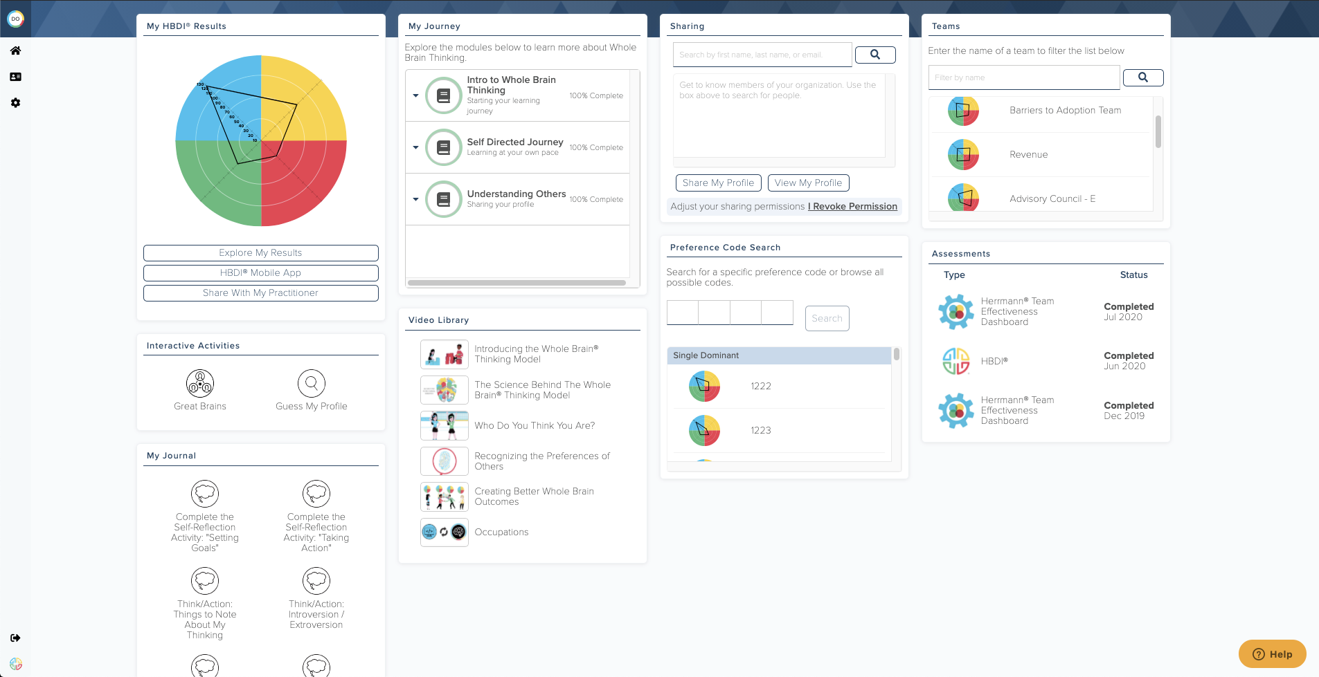
New tools on the Herrmann platform
DEMO
Notes:
Let's take a look ....
Start logged in as Barack Obama on the Thinker portal home page
Go to Teams → Marketing team
Note the teams average profile .... it's pretty evenly distributed across the quadrants ... 2111, with D being the strongest preference quadrant ...
.... but notice the shift to the D quadrant and away from the B quadrant and C quadrant under pressure
Go to Understand my team
Looking at the composite and the preference map, the group can see that profiles look pretty similar, with the biggest differences showing up in the A and C quadrants.
Moving down to How the team operates, we can observe what happens under pressure. The change to the average profile is subtle for the group, but watch how the individuals shift away from each other
Do tribes form under pressure? The team can ask themselves how this showed up in a recent project.
Notice how the project leader moves into the D quadrant under pressure (Barack Obama) ...
But Lech moves further into the left mode
Return to Overview tab
Click on Mother Teresa's profile
Note the blend of HBDI profile data and how she has personalized it
Compare it to my profile. How are we similar? Different
Personalizing the profile is easy
Navigate to the home page, then view profile
Edit About Me, Introversion-Extroversion, Building Trust
During the conversation, the team realize that they're probably getting wrapped up in the ideation and creativity phases, not leaving enough time for planning and process.
Using these tools, they figure out on the team who can help keep them on track.
They use the Profile Lookup and Sharing tools to better understand the needs of profiles from other teams.

Slide 21
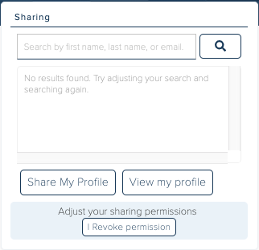
Sharing
Tools for Thinkers to personalize their profile and to learn about others
Notes:
Sharing is the first in a series of application tools coming to the Herrmann Platform to drive engagement and deliver continuous value for Managers, Thinkers, and teams.

Slide 22
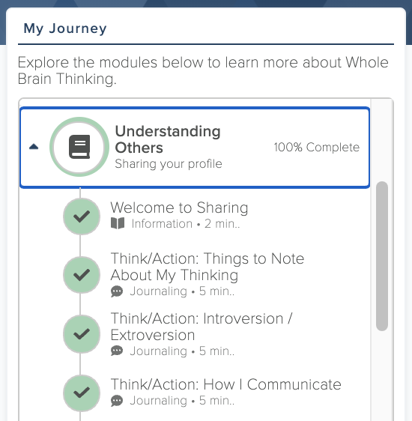
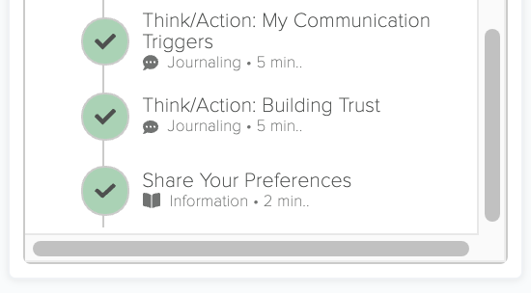
Sharing
Thinkers Are Guided To Personalize Their Profile

Slide 23
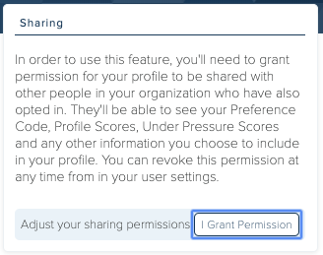
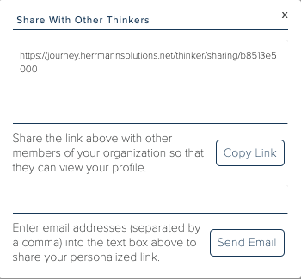
Sharing
Thinker Portal Tile & Opt-in
Encourage each Thinker to opt-in to sharing, allowing access to their organization and the ability to...
...search for colleagues or view and edit their own shared profile...
...get their unique URL and invite others to view their shared profile by sending the URL directly or adding it to public profiles!
Notes:
Unlocking is safe and ALWAYS in the Thinker's hands
Search for colleagues’ profiles
Share your own profile

Slide 24
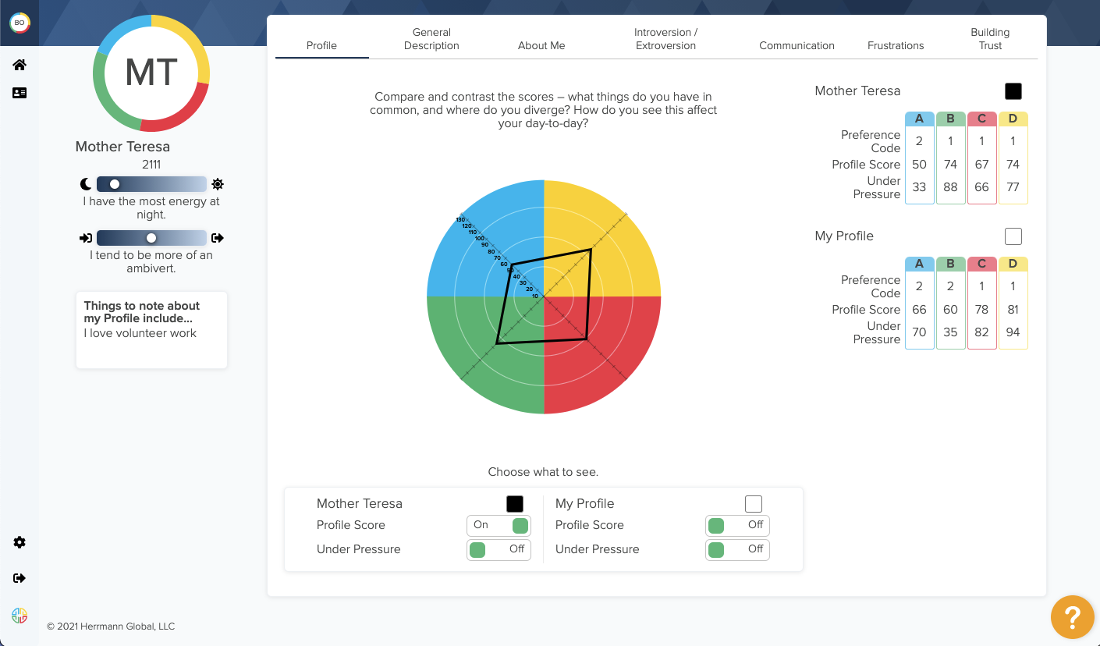
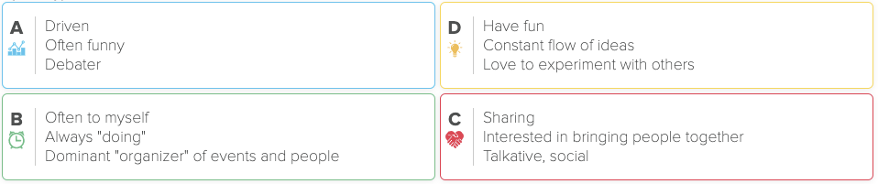
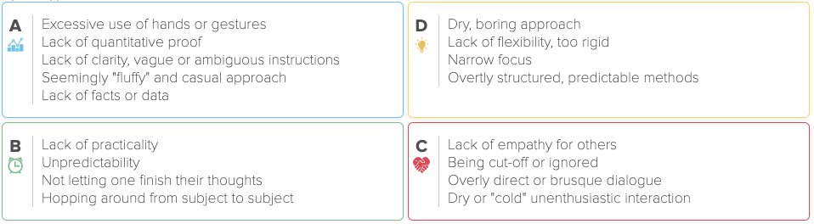
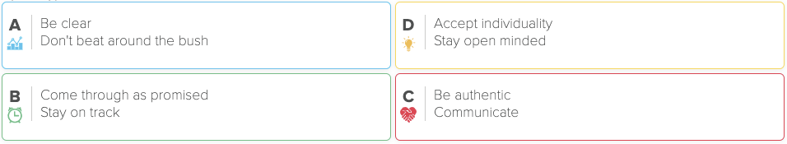
Sharing
Exploring Shared Profiles
Notes:
Overview
Comparing to your own profile

Slide 25
Sharing
Exploring Shared Profiles
Profile
General Description
About Me
Introversion / Extroversion
Communication
Frustrations
Building Trust
Notes:
Overview
Comparing with your own profile
Very easy for Thinkers to personalize their profile … update any time
Uses combination of checklists and open-ended prompts

Slide 26
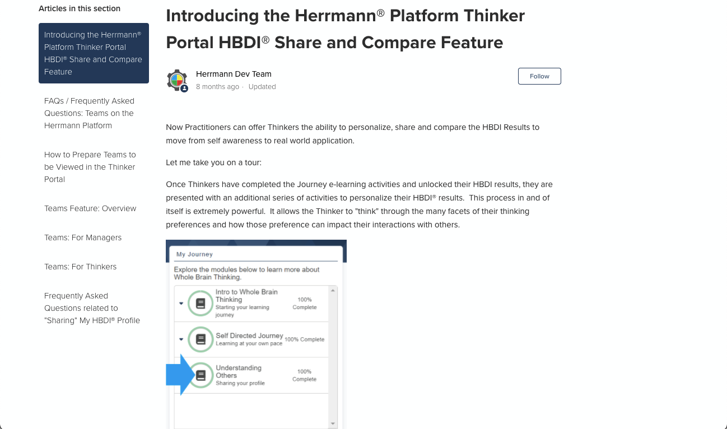
Learn More
Help Article: Introducing the Herrmann Platform Thinker Portal HBDI Share and Compare Feature

Slide 27
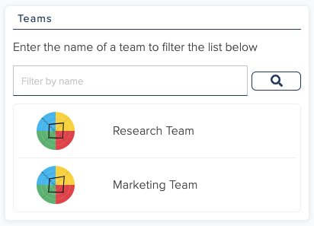
Teams
Tools for managers and teams to apply Whole Brain® Thinking

Slide 28
Teams
Create Teams for Departments or Special Projects
Notes:
CP - how & when to create a team
From CP Tools → create / edit team
From reports
From assessment groups

Slide 29
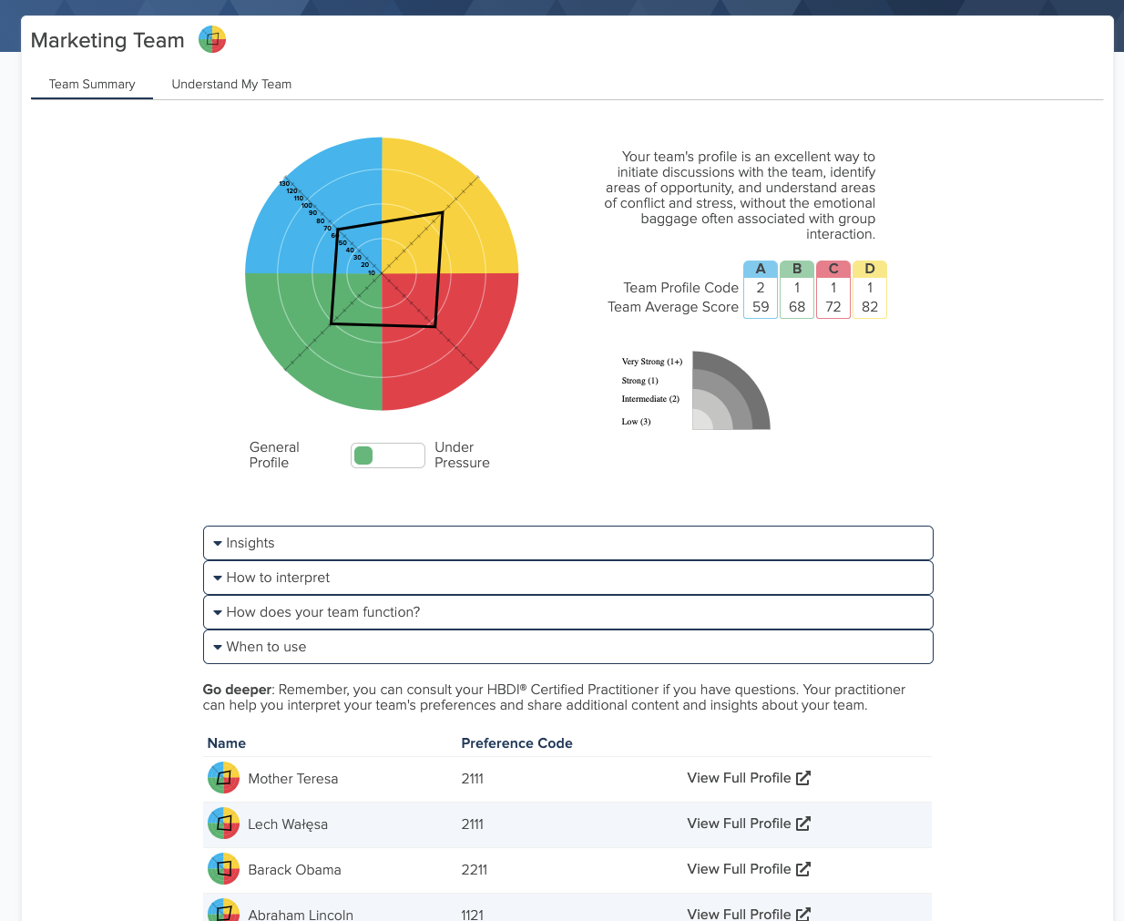
Teams
Team Summary
Team Profile
Under Pressure Toggle
Guidance
Team members’ shared profiles
Notes:
Only Thinkers who share their profile will be visible

Slide 30
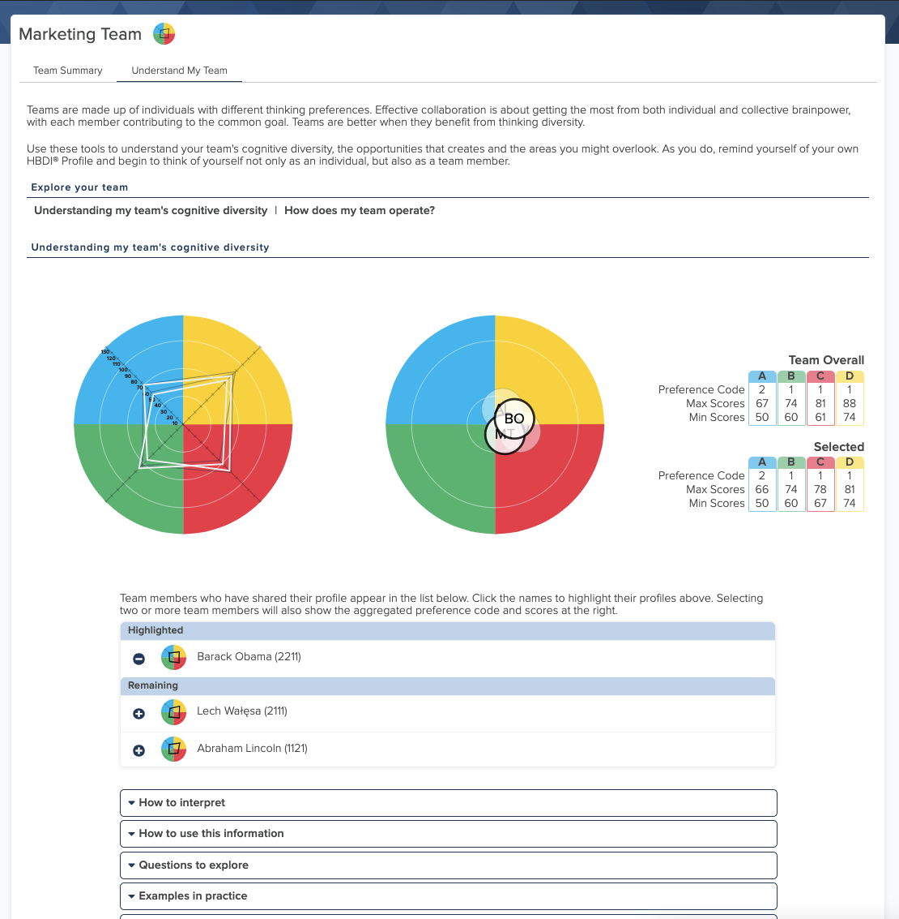
Understand My Team
Understanding My Team’s Cognitive Diversity
Understanding my team’s cognitive diversity
How does my team operate
Team Composite and Preference Map
Team Member Select
Guidance
Notes:
Includes:
Understanding my team’s cognitive diversity
How does my team operate

Slide 31
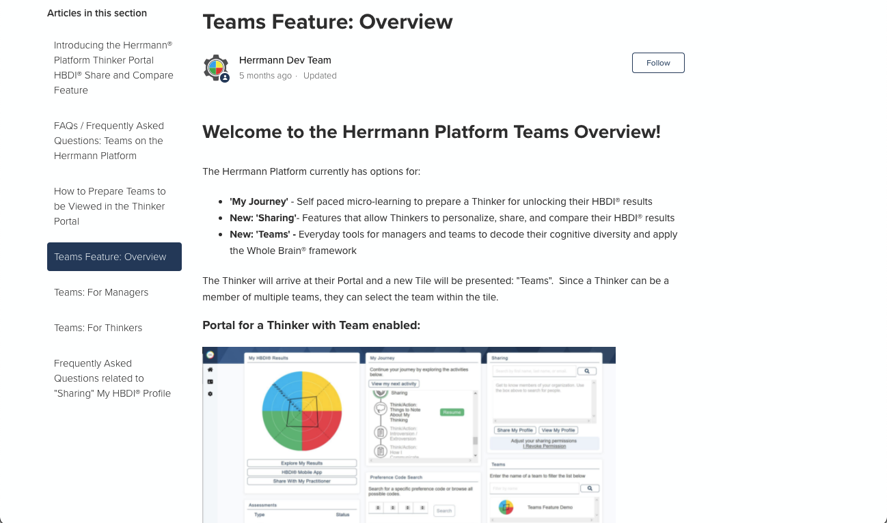
Learn More
Help Article: Team Feature Overview

Slide 32
How might you use these tools to coach your teams?
Notes:
ASK: Can you think of ways you might coach your teams to use these features?

Slide 33
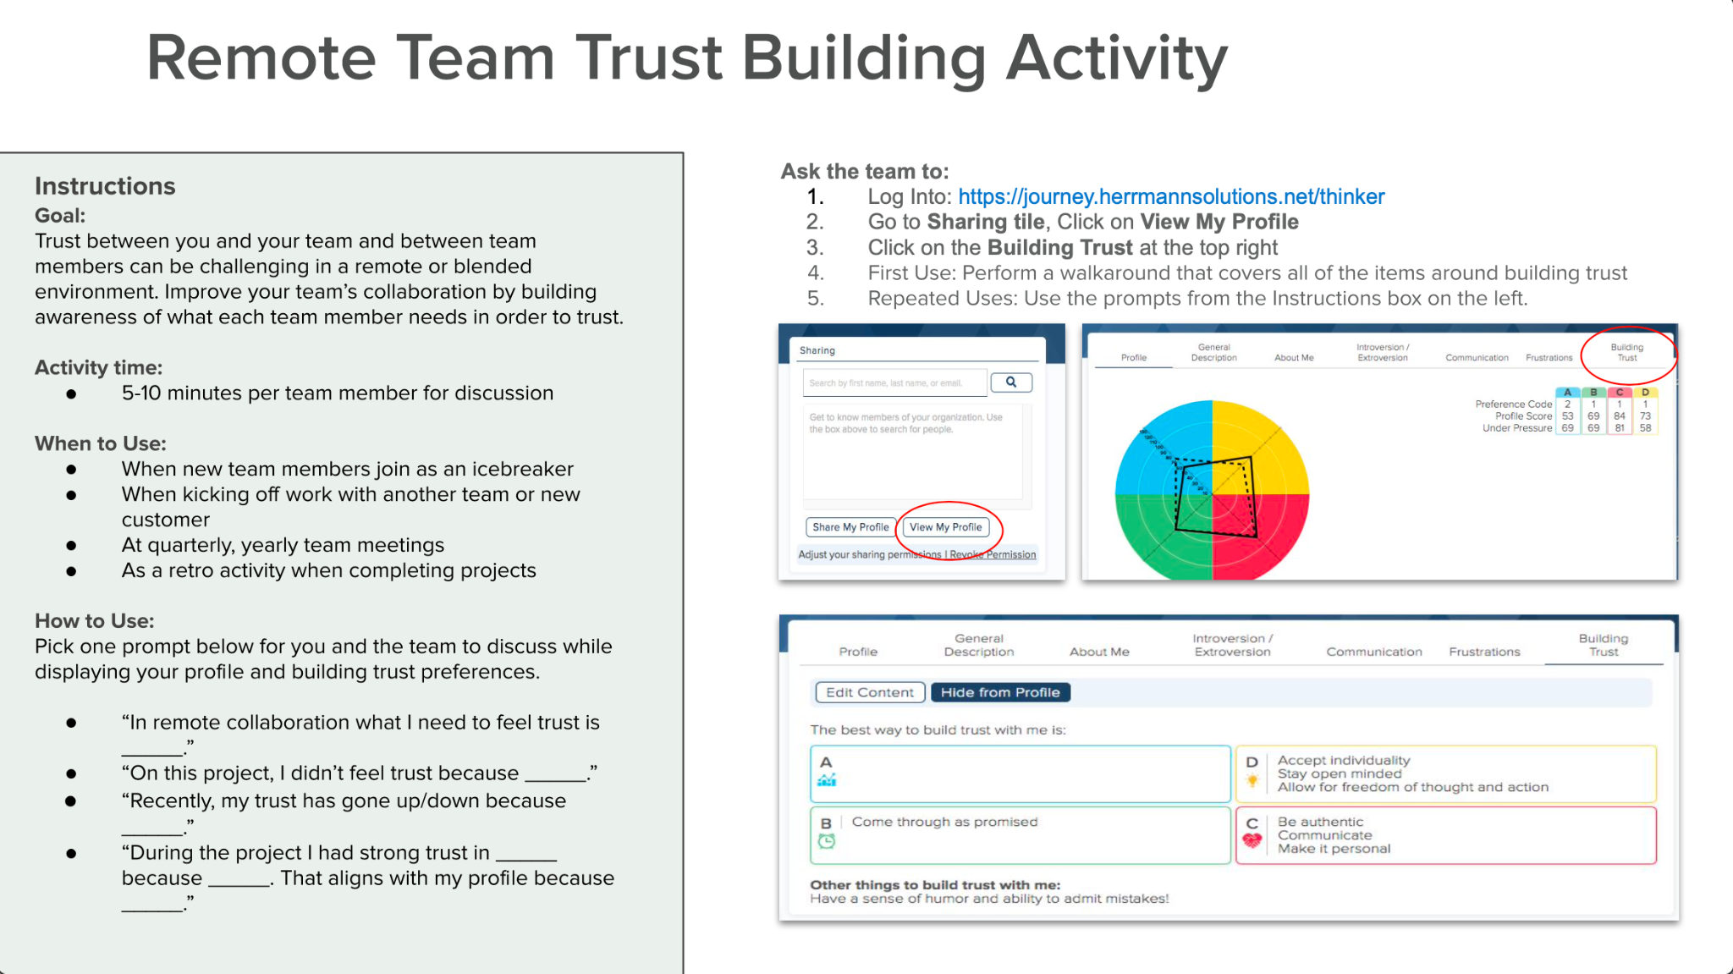
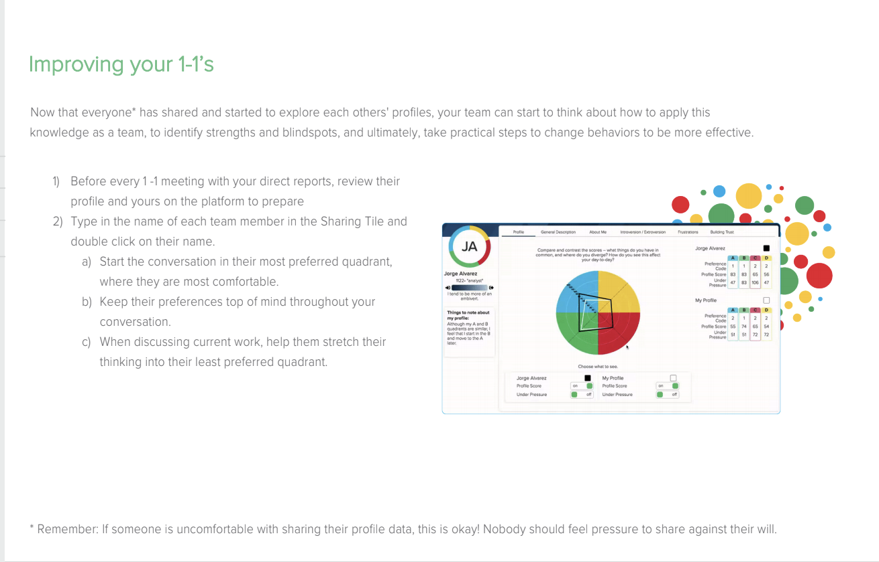
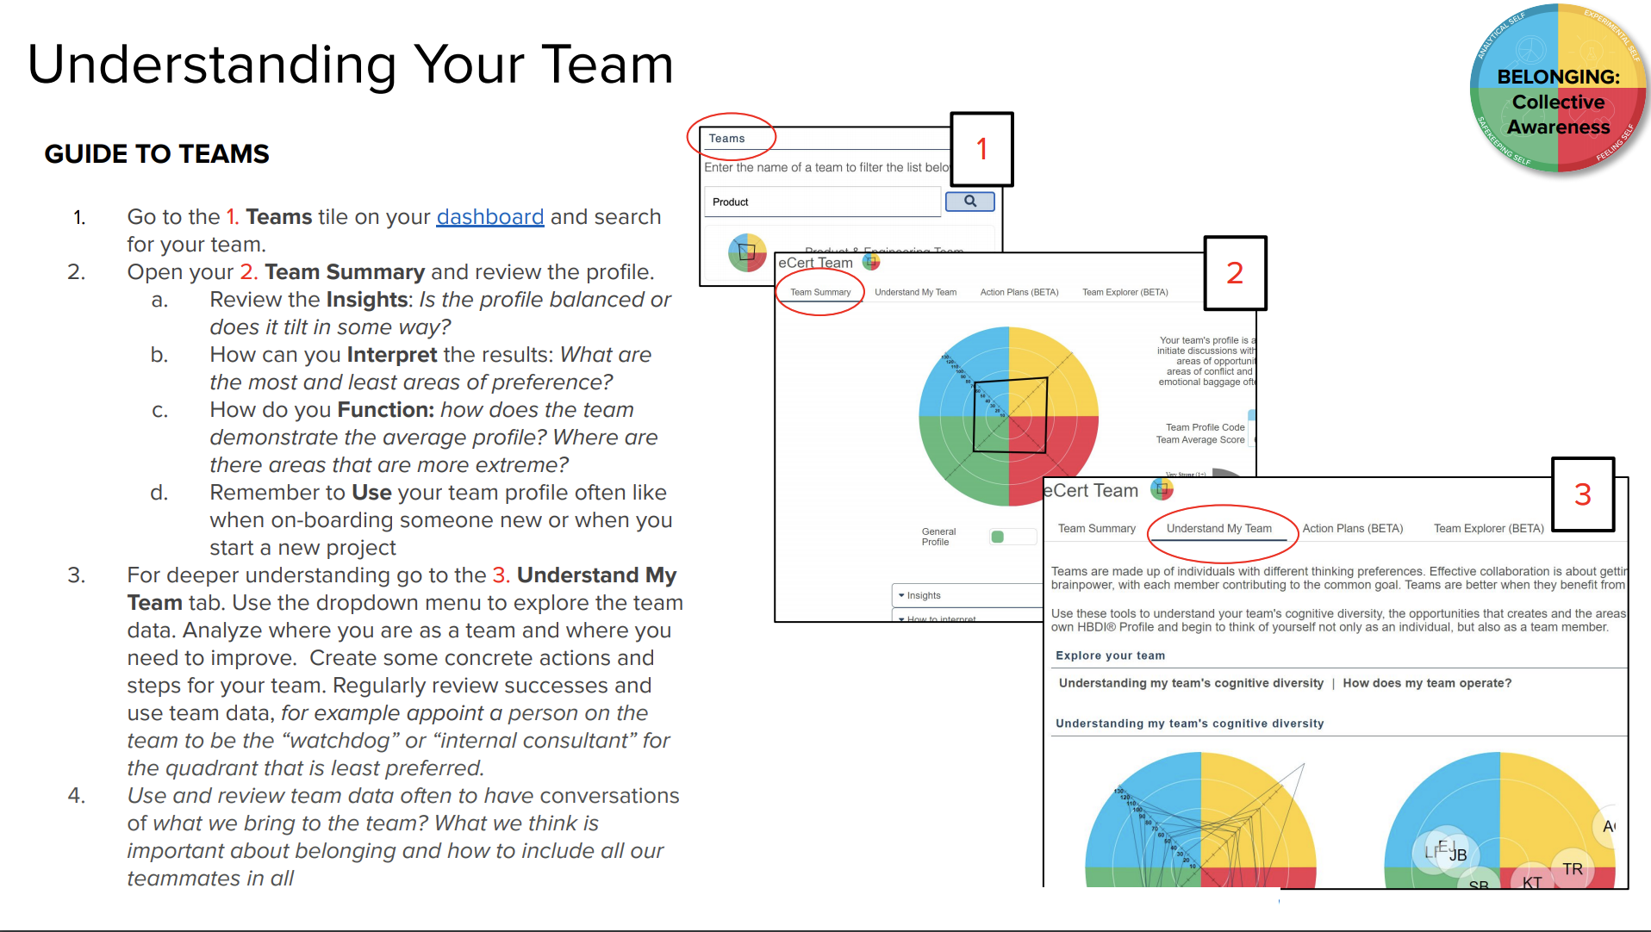
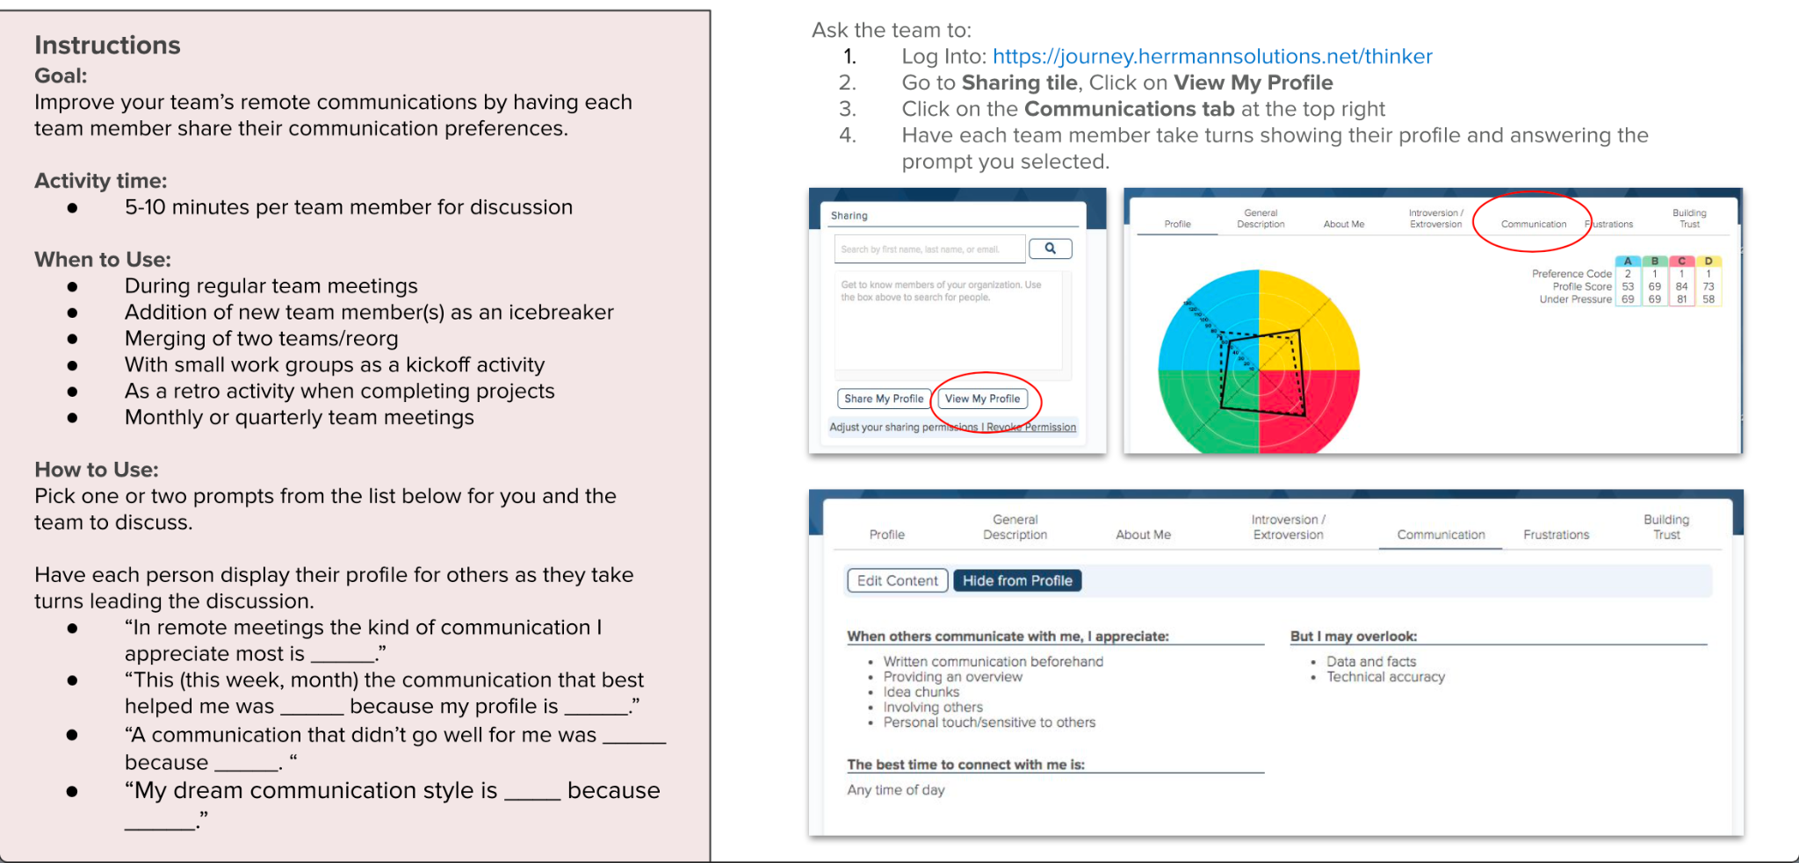
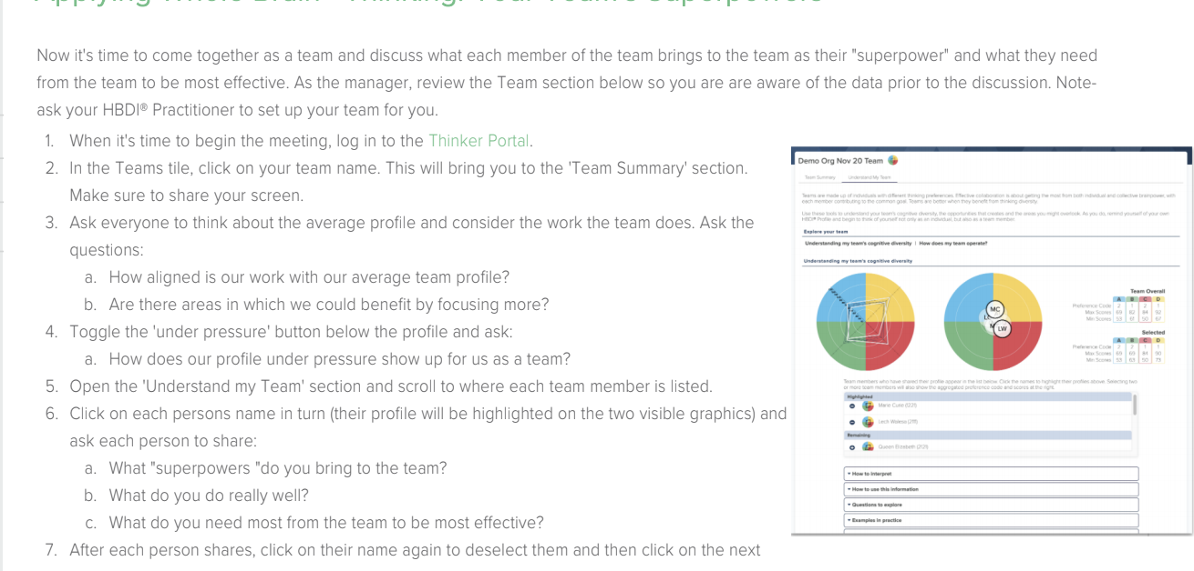
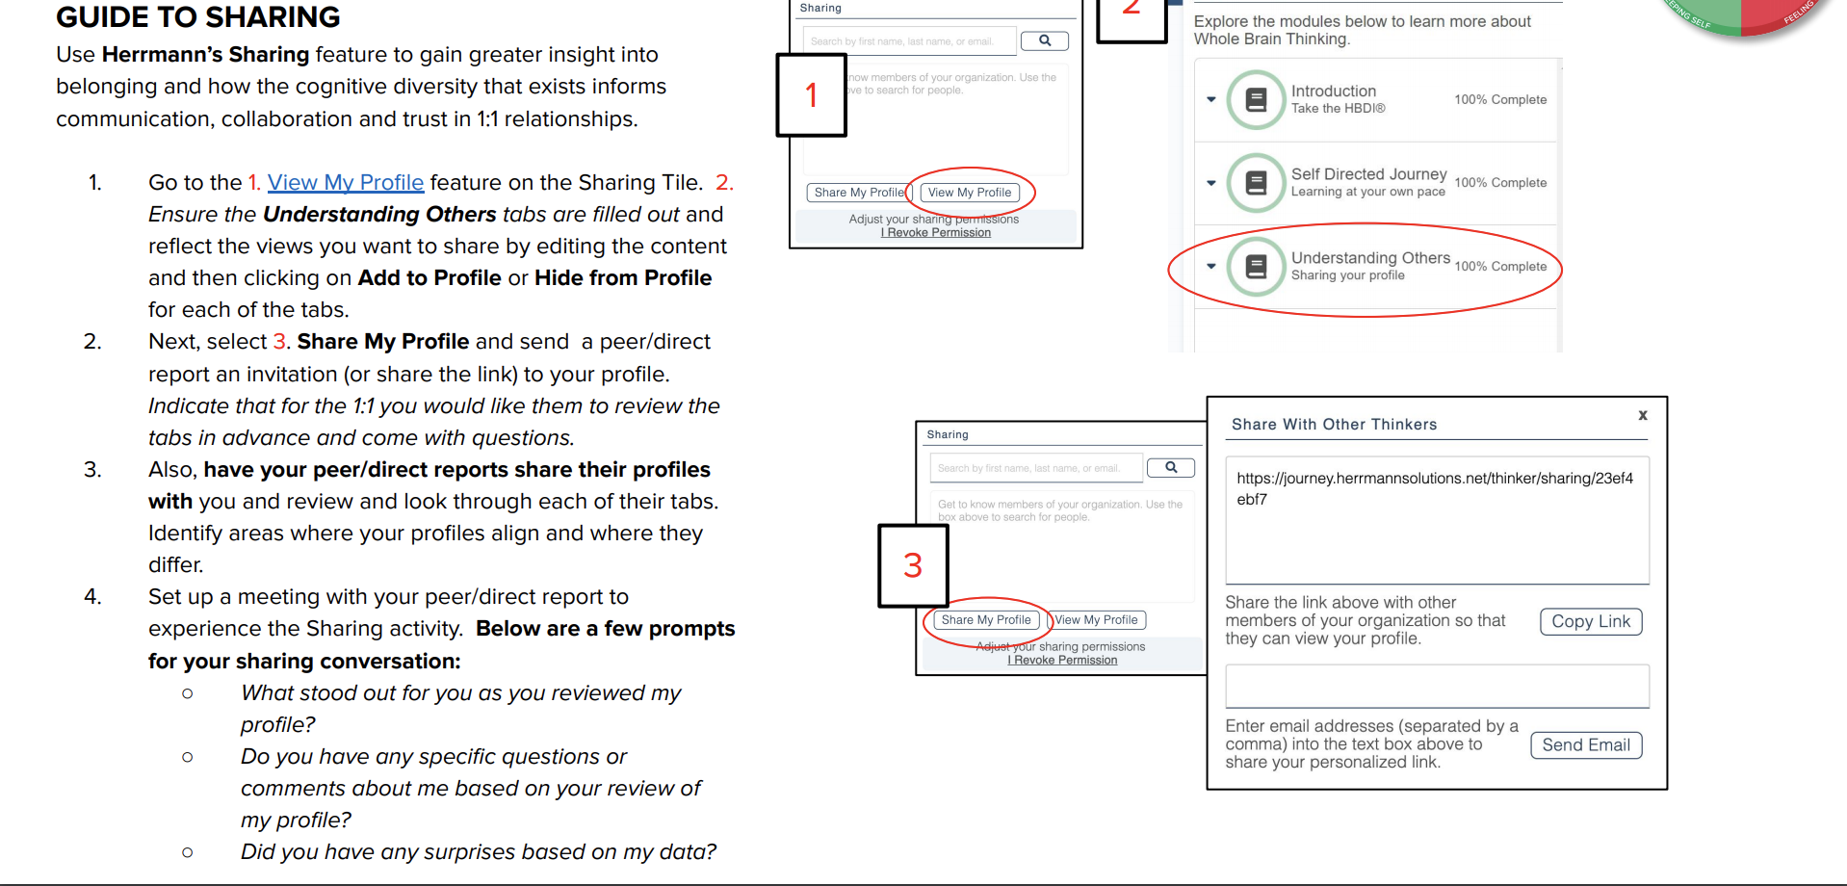
A few ways to start today
Remote Team Trust Building
Improving Your 1:1s
Understanding Your Team
Remote Team Communication
Your Team’s Superpowers
1:1 Sharing: Create Deeper Understanding
Notes:
Remember the old adage about teaching people to fish? ….
Are you doing everything you can to help teams help themselves?

Slide 34
Many potential applications
When team members join or leave the team
When there is a change in leadership on the team
At the start of a new project or initiative
For strategic planning
Address conflict on the team
Improve remote communication
Overcome frustrations
Get to know a teammate or colleague
Lead effective meetings
Solve tough challenges
Let others know how to work with you
Support DE&I initiatives
Create understanding for better inclusion
Create a sense of team belonging
Build trust
Quarterly check-in
Improve engagement
Conduct better 1:1s
Unlock your team’s superpowers
Make important decisions
Kick off team meetings
Manage change & crisis
Notes:
Role of the CP → MORE TIME to go deeper with the team profile
20 questions
Key descriptors → suggest each one reviews their key descriptors to update their shared profile
Team Effectiveness Dashboard

Slide 35
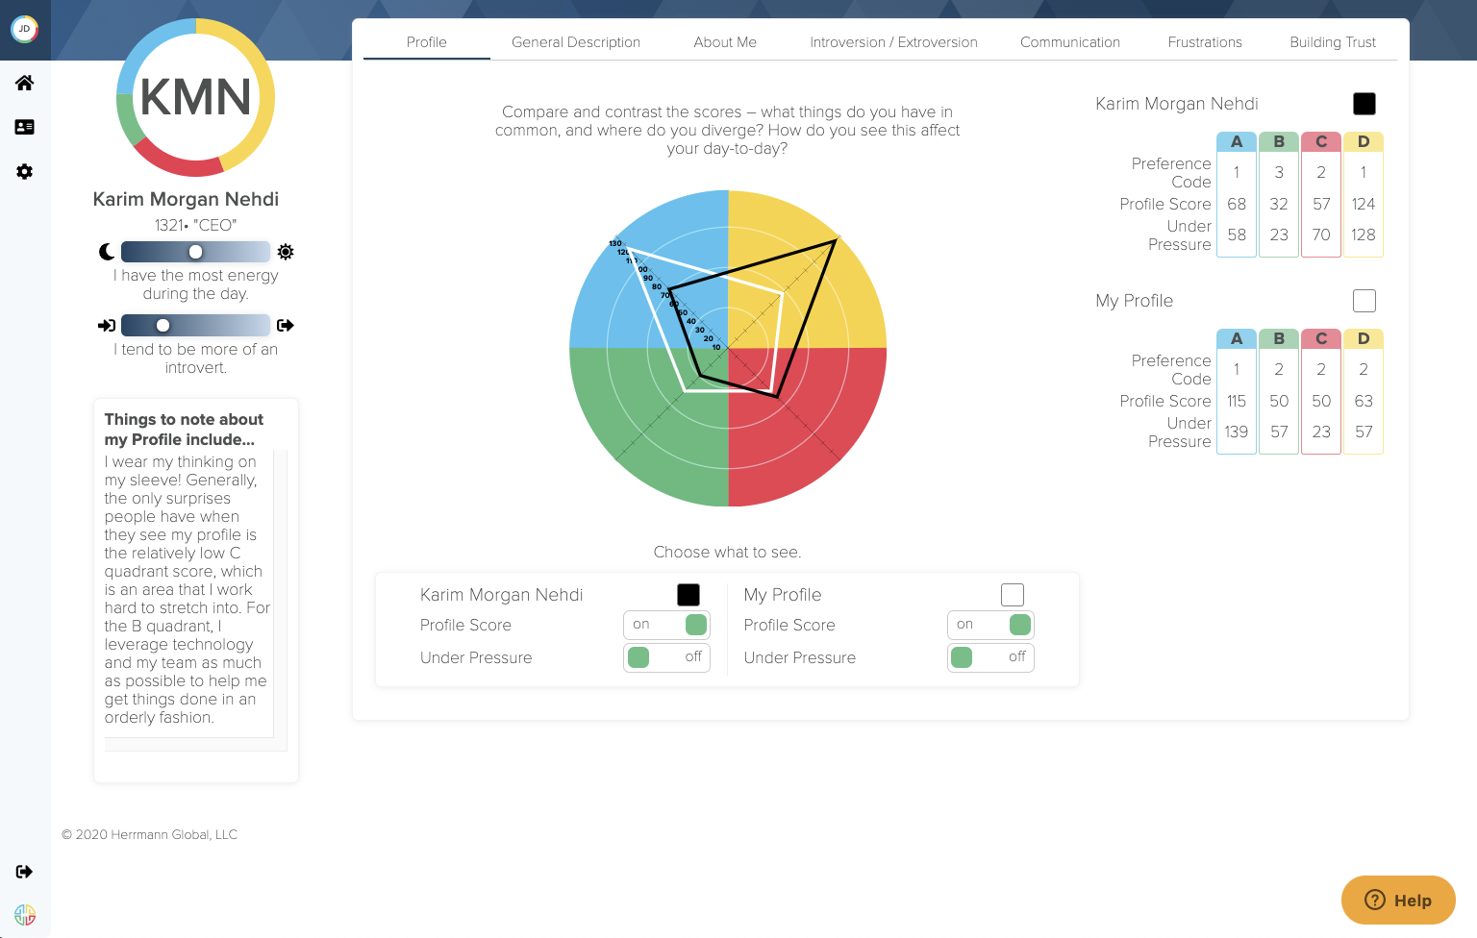
Sharing
Deeper insights and better understanding
Drive engagement with application tools that can be used on a daily basis to quickly and easily see the Thinking preferences of others at a glance
Drive deeper individual insights through self-reflection and seeing the personal reflection of other team members
Improve communication & collaboration through personalized insights contained in Thinkers’ shared profiles leading to more productive teams
Promote understanding of others’ preferences to harness cognitive diversity within your organization

Slide 36
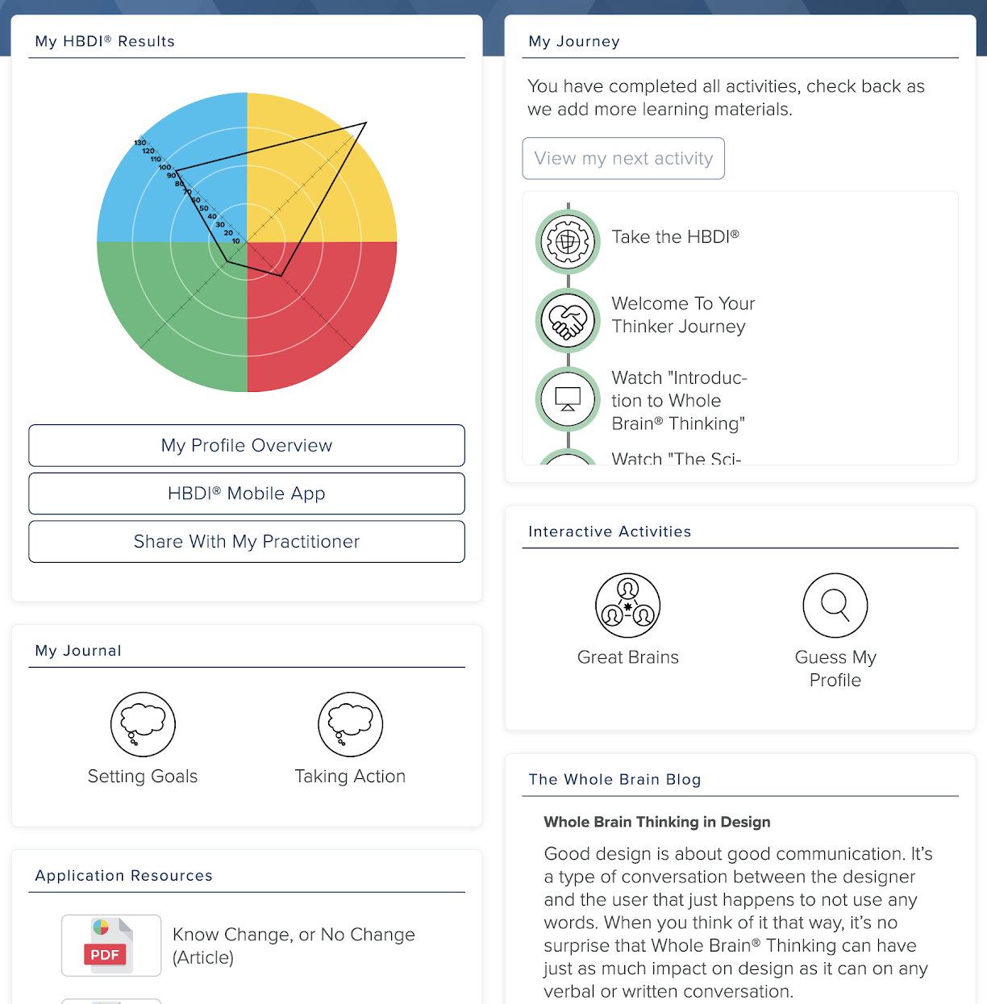
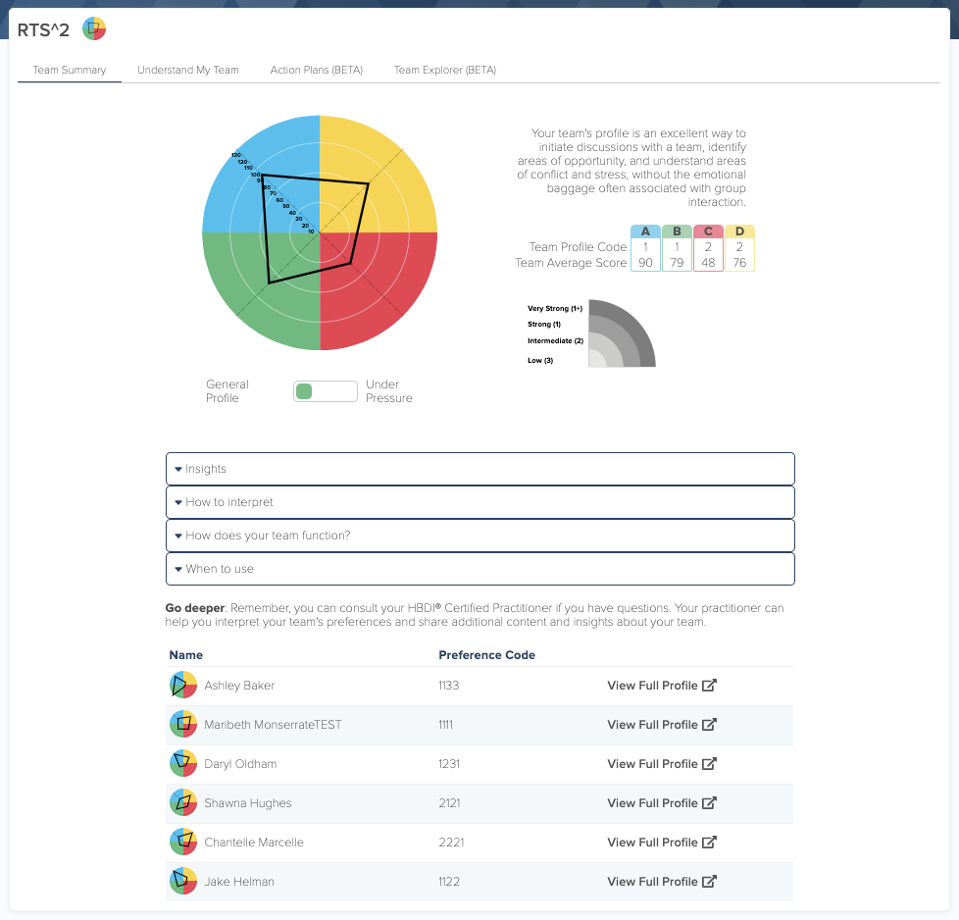
Teams
Elevating Managers & Teams to Be Whole Brain® Leaders
Provides easy-to-use tools that enable teams to become more effective by harnessing their cognitive diversity in daily interactions
Creates organizational leverage by empowering managers and teams to apply Whole Brain® Thinking without requiring delivery from a Certified Practitioner
Enables managers to take action on a variety of application areas, including:
  Improving communication
  Managing change & crisis
  Developing strategy
  Leading effective meetings
  Making important decisions
  Solving tough problems
  Managing remote/distributed teams
  ...and more!
Application tools accessible to managers and teams directly from the Thinker portal on the Herrmann platform

Slide 37
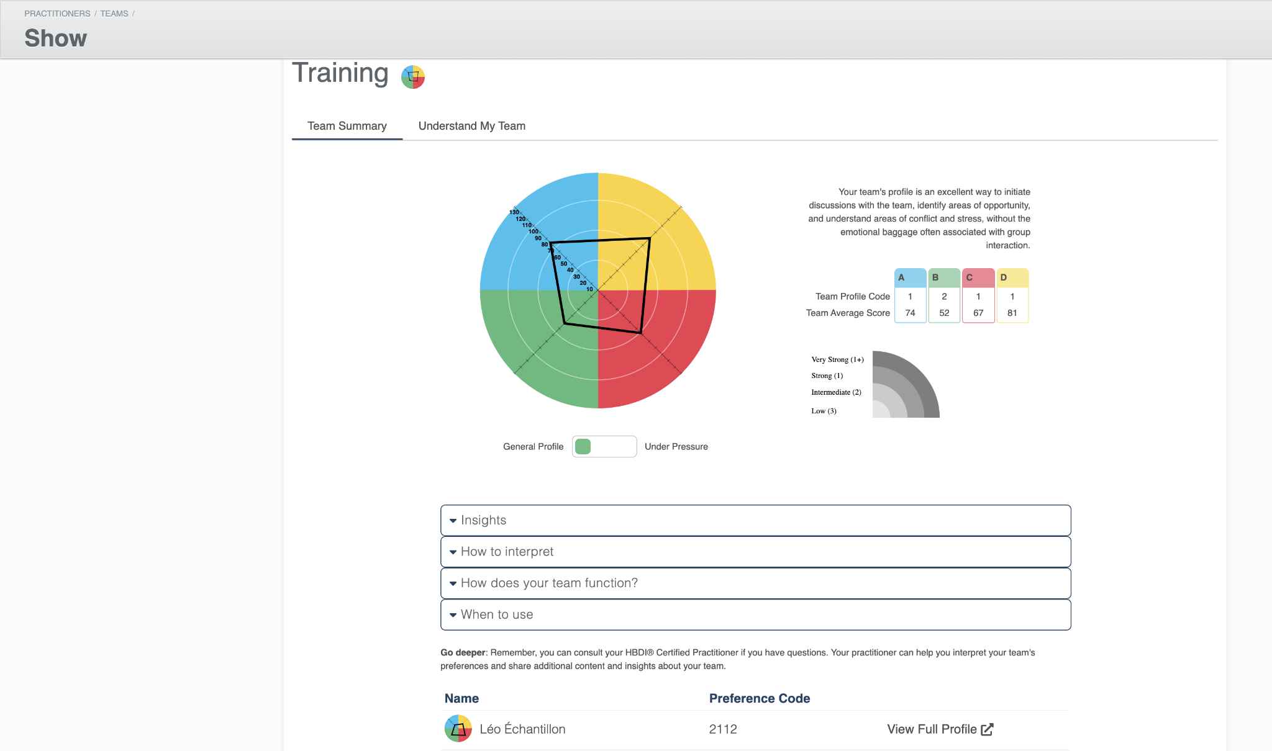
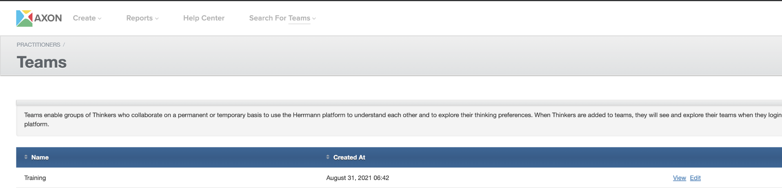
Teams as a Certified Practitioner
Elevating Managers & Teams to Be Whole Brain® Leaders
Now you can create and view the team you are facilitating with, without the need to add yourself to the team.
This will help get managers and teams familiarized with the Teams feature.

Slide 38

Stay connected
Ways to keep in touch with Herrmann

Slide 39

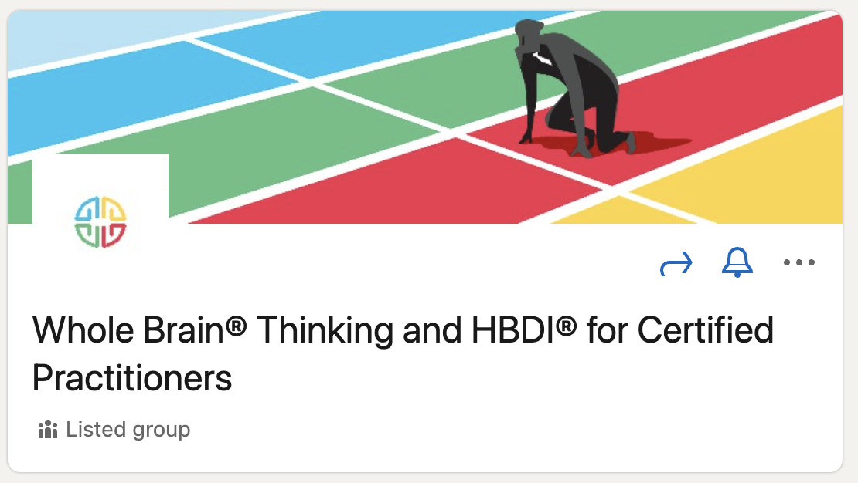
Stay Connected with Herrmann and Each Other
Join LinkedIn Group: Whole Brain® Thinking and HBDI® for Certified Practitioners
  Product updates and news
  Tips and tricks
  Crowdsource
  Upcoming CPiP workshops
Visit the practitioner portal for support materials
  https://www.thinkherrmann.com/resources (Log in)
Blog
  https://blog.thinkherrmann.com/
Contact your CSM
Notes:
If you’re not sure who your contact at Herrmann is, please drop a note to us in the chat and we’ll have someone get back to you.

Slide 40
Q&A

Slide 41


