Slide 1

The Business of Thinking®
The Business of Thinking®
ThinkAbout Decision Making
Notes:
Version: BOTDM2.2, 03-2015
Copyright: <a href='http://www.123rf.com/profile_alphaspirit'>alphaspirit / 123RF Stock Photo</a>

Slide 2
Sections of ThinkAbout Decision Making
Whole Brain® Decision Making
Personal Dynamics of Decision Making
Team Dynamics of Decision Making
Let’s Play Ball!
Notes:
‹#›

Slide 3

Participant Workbook
Notes:
Insert new cover art when available.

Slide 4
Section 1 : Whole Brain® Decision Making
Introduction
The Last Big Decision
The Whole Brain® Pre-Decision Filter
What’s Missing?
Action Plan

Slide 5
Learning Objectives
At the end of this section, you will be able to:
Leverage your thinking preferences in making decisions.
Be mindful of aspects in your decision making that receive less attention.
Use the Whole Brain® Pre-Decision Filter to prepare yourself to make decisions.

Slide 6
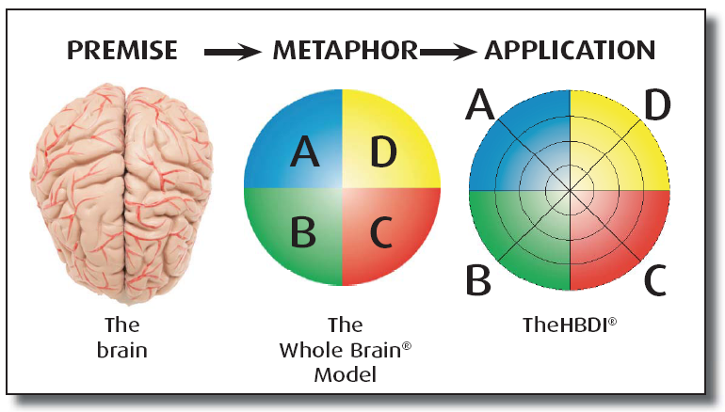
The Organizing Principle and Architecture
The basis of our mental preferences: four interconnected, specialized processing modes that function together situationally and iteratively.
The four-color, four-quadrant graphic and Whole Brain® are registered trademarks of Herrmann Global, LLC.
Notes:
‹#›

Slide 7

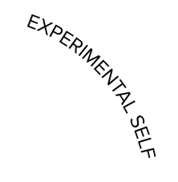


Our Four Different Selves
A
D
Analyzes
Quantifies
Is logical
Is critical
Is realistic
Likes numbers
Knows about money
Knows how things work
Infers
Imagines
Speculates
Takes risks
Is Impetuous
Breaks rules
Likes surprises
Is curious / Plays
Takes preventive action
Establishes procedures
Gets things done
Is reliable
Organizes
Is neat
Timely
Plans
Is sensitive to others
Likes to teach
Touches a lot
Is supportive
Is expressive
Is emotional
Talks a lot
Feels
B
C
The four-color, four-quadrant graphic and Whole Brain® are registered trademarks of Herrmann Global, LLC.
Notes:
‹#›

Slide 8

The Last Big Decision

Slide 9
Whole Brain® Pre-Decision Filter
Why
What
Why are you making this decision?
Why is it important?
What is the decision?
What are the facts?
How are you going to make
the decision?
How are you going to
manage any risk involved?
Who is involved in the decision?
Who will it impact on?
How
Who

Slide 10

What’s Missing?

Slide 11
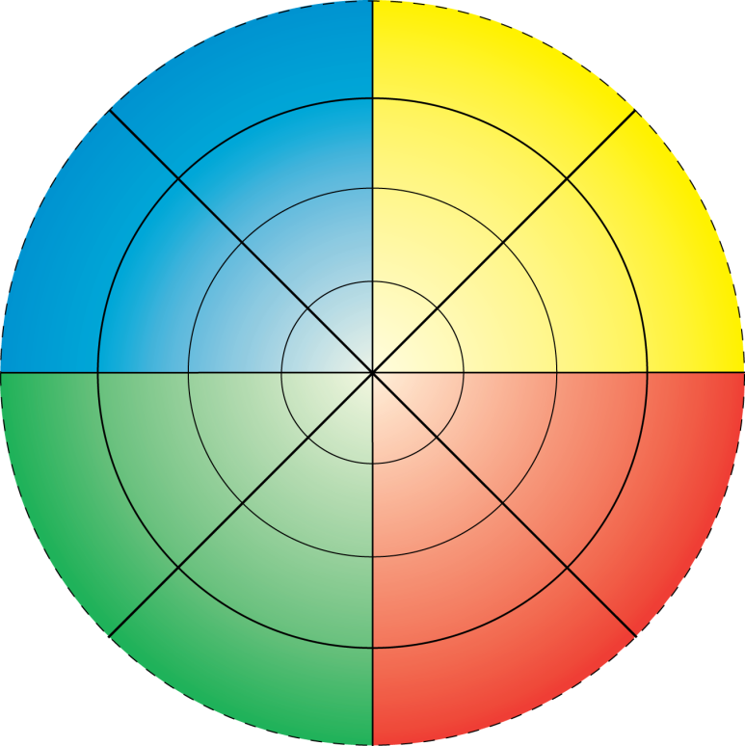




Situational “Stretch”
“Life is like a ten speed bicycle –
we all have gears that we never use.”
- Charles Schultz
The four-color, four-quadrant graphic and Whole Brain® are registered trademarks of Herrmann Global, LLC.
Notes:
‹#›

Slide 12

Key Thoughts
Your thinking preferences affect your decision making approach.
You might be “missing pieces” in your decision making, based on your thinking preferences.
Using the Whole Brain® Pre-Decision Filter can help you be better prepared to make decisions.

Slide 13
Learning Objectives 🡪 Outcomes
At the end of this section, you will be able to:
Leverage your thinking preferences in making decisions.
Be mindful of aspects in your decision making that receive less attention.
Use the Whole Brain® Pre-Decision Filter to prepare yourself to make decisions.

Slide 14

Action Plan
Which quadrant(s) typically represent your “missing pieces” in decision making?
What types of questions will you remind yourself to ask in order to make more balanced decisions?
Notes:
Copyright: <a href='http://www.123rf.com/profile_gajus'>gajus / 123RF Stock Photo</a>
‹#›

Slide 15

Section 1: Whole Brain® Decision Making
End of Section 1
Next:
Personal Dynamics of Decision Making

Slide 16
Section 2 : Personal Dynamics of Decision Making
Introduction
A Major Purchasing Decision
Don’t Overlook
Making an Investment
Strengths in Decision Making
Action Plan

Slide 17
Learning Objectives
At the end of this section, you will be able to:
Identify your strengths in decision making.
Identify what you may be overlooking in decision making.
Apply Whole Brain® Thinking to your decision making.

Slide 18

A Major Purchasing Decision

Slide 19
Whole Brain® Thinking – Making a Purchase
Wants to see data and statistics on performance
Looks at energy efficiency
Looks at cost of vehicle, trade-in value
Comparison shops against other vehicles
Considers ease of maintenance
Wants to know how it works
Likes power and precision handling
Looks at the aesthetic qualities: sportiness, color, form, “cutting edge” qualities
Wants it to fit the dream, personal image, long-range plans
Is more willing to experiment and take some risks
Is often a first-model buyer, early innovator
The Situation: Buying a Car
Interested in safety features and durability
Looks at the practicality of size, number of doors, storage space, stain resistant materials; features such as interior trunk/fuel unlock
Looks at maintenance requirements
Has done research and knows what they want
Considers the “feel” and comfort of the; user friendliness of controls
Wants to “love” the car
Impacted by friendliness of sales and service organization
“Feels” it’s the right choice
Will buy based on a friend’s recommendations

Slide 20
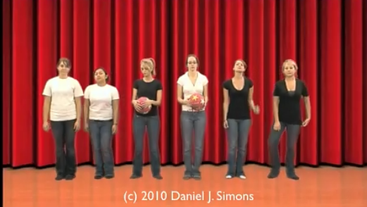

We Sometimes Overlook
Notes:
The Monkey Business Illusion
URL: http://theinvisiblegorilla.com/blog/2010/05/10/the-monkey-business-illusion/
‹#›

Slide 21

We Sometimes Overlook

Slide 22

We Sometimes Overlook

Slide 23
Whole Brain® Thinking – Making an Investment
Tends to be risk-oriented and entrepreneurial
Looks for strategic alignment
Looks for significant long-term goals
Looks for new perspectives & opportunities
May overlook short-term planning
May overlook lower risk alternatives
May overlook details
Tends to be financial & legal
Looks for market leadership
Wants financial pay-off and consistent performance
May overlook the value of intuition
May overlook long-term aspects
The Situation: Making an Investment
Tends to be conservative, operational & administrative
Looks for a well-known and established broker
Likes organizational effectiveness
Wants reliability & stability
May overlook opportunities for higher yield with higher risk
May overlook long-term perspectives
Likes a team & “partnering” approach
Looks for a friendly broker
Wants alignment of values
Has an intuitive feeling of “rightness”
May overlook in-depth financial analysis
May overlook strategic aspects
May overlook long-range financial planning

Slide 24
Strengths in Decision Making
Gathering facts
Analyzing issues
Arguing rationally
Forming theories
Measuring precisely
Problem solving logically
And more …
Reading the signs of coming change
Seeing the big picture
Recognizing new possibilities
Tolerating ambiguity
Integrating ideas and concepts
Challenging established policies
And more …
Finding overlooked flaws
Approaching problems practically
Standing firm on issues
Maintaining a standard of consistency
Providing stable leadership and supervision
And more …
Recognizing interpersonal difficulties
Anticipating how others will feel
Intuitively understanding how others feel
Picking up the non-verbal cues of interpersonal stress
Engendering enthusiasm
And more …
Notes:
‹#›

Slide 25
Key Thoughts
Your thinking preferences provide you with strengths in your decision-making.
Your thinking preferences may also cause you to overlook some aspects of decision making.
When you use Whole Brain® Thinking, you can make more balanced decisions.

Slide 26
Learning Objectives 🡪 Outcomes
At the end of this section, you will be able to:
Identify your strengths in decision making.
Identify what you may be overlooking in decision making.
Apply Whole Brain® Thinking to your decision making.

Slide 27

Action Plan
Consider your personal decision-making process.
How will you ensure that your “strengths” do not over-power your decisions?
What will you do to include more of the “strengths” that you did not check?
Notes:
Copyright: <a href='http://www.123rf.com/profile_rnl'>rnl / 123RF Stock Photo</a>
‹#›

Slide 28
Section 2: Personal Dynamics of Decision Making
End of Section 2
Next:
Team Dynamics of Decision Making

Slide 29
Section 3: Team Dynamics of Decision Making
Show Your Cards
How the Quadrants Decide
The Team’s Profile
Action Plan

Slide 30
Learning Objectives
At the end of this section, you will be able to:
Identify the thinking preferences of fellow team members.
Recognize how the team's decision making may be different when under pressure.
Use the strengths of the team to help make better decisions.

Slide 31
Show Your Cards

Slide 32
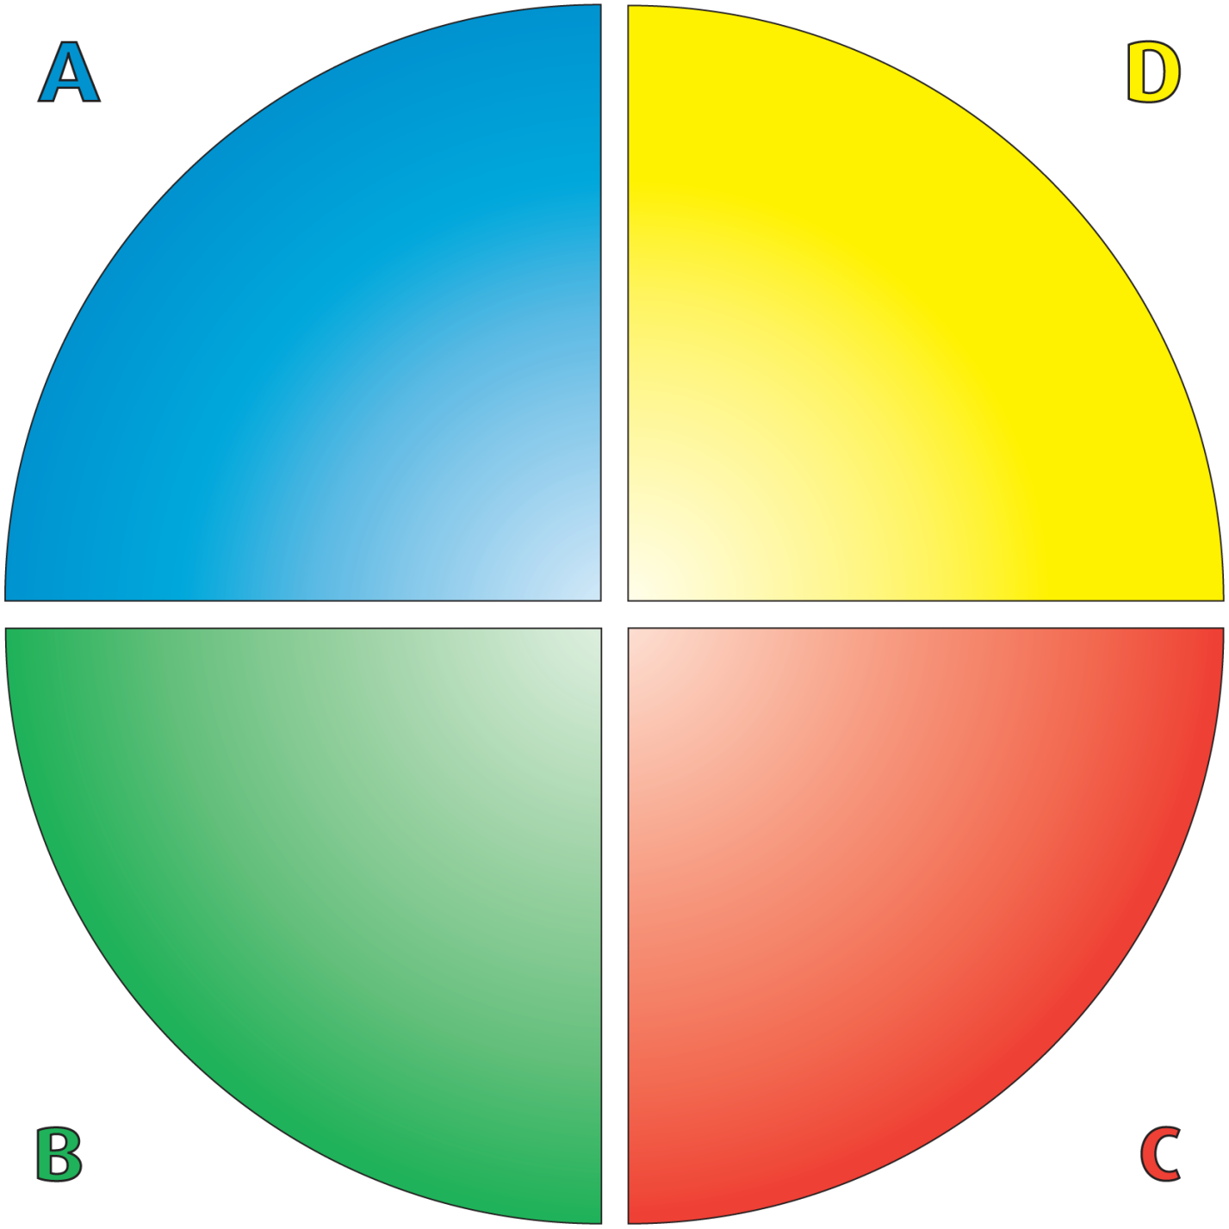
Whole Brain® Decision-Making Model
Approaches:
Pragmatic
Data-based
Theoretical
Concern: Do I have all the facts?
May overlook: Feelings
Synergistic opportunities
Approaches:
Imaginative
Forward looking
Risk taking
Concern: Have I seen all the hidden possibilities?
May overlook: Details
Practicality
The four-color, four-quadrant graphic and Whole Brain® are registered trademarks of Herrmann Global, LLC.
Approaches:
Organized
Conservative
Procedural
Concern:
Will I be in control?
May overlook:
Alternative solutions
Novel ideas
Big picture
Approaches:
Emotional
Interpersonal
Intuitive (feelings)
Concern: How will I affect others?
May overlook:
Data
Planning
Notes:
‹#›

Slide 33
How the Quadrants Decide
Analysis
Opportunity
Consequences
Intuition
Notes:
‹#›

Slide 34
Strengths in Decision Making
Gathering facts
Analyzing issues
Arguing rationally
Forming theories
Measuring precisely
Problem solving logically
And more …
Reading the signs of coming change
Seeing the big picture
Recognizing new possibilities
Tolerating ambiguity
Integrating ideas and concepts
Challenging established policies
And more …
Finding overlooked flaws
Approaching problems practically
Standing firm on issues
Maintaining a standard of consistency
Providing stable leadership and supervision
And more …
Recognizing interpersonal difficulties
Anticipating how others will feel
Intuitively understanding how others feel
Picking up the non-verbal cues of interpersonal stress
Engendering enthusiasm
And more …
Notes:
‹#›

Slide 35
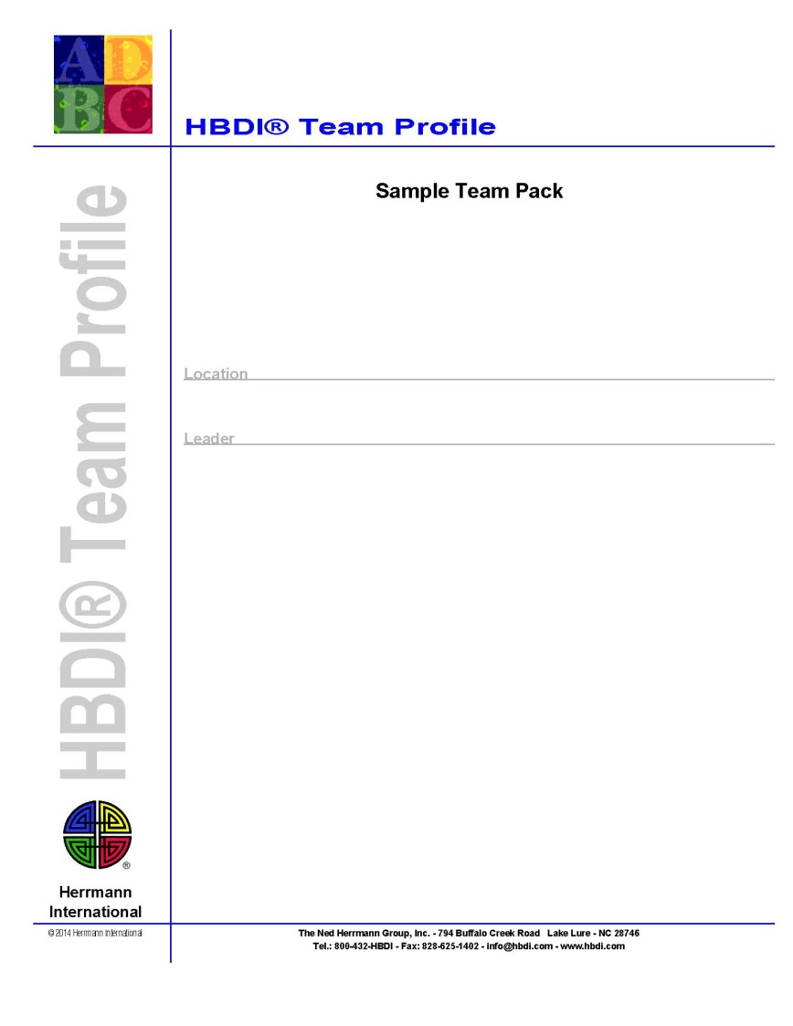
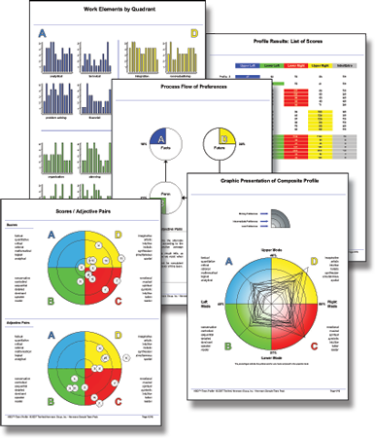
The HBDI® Team Profile

Slide 36
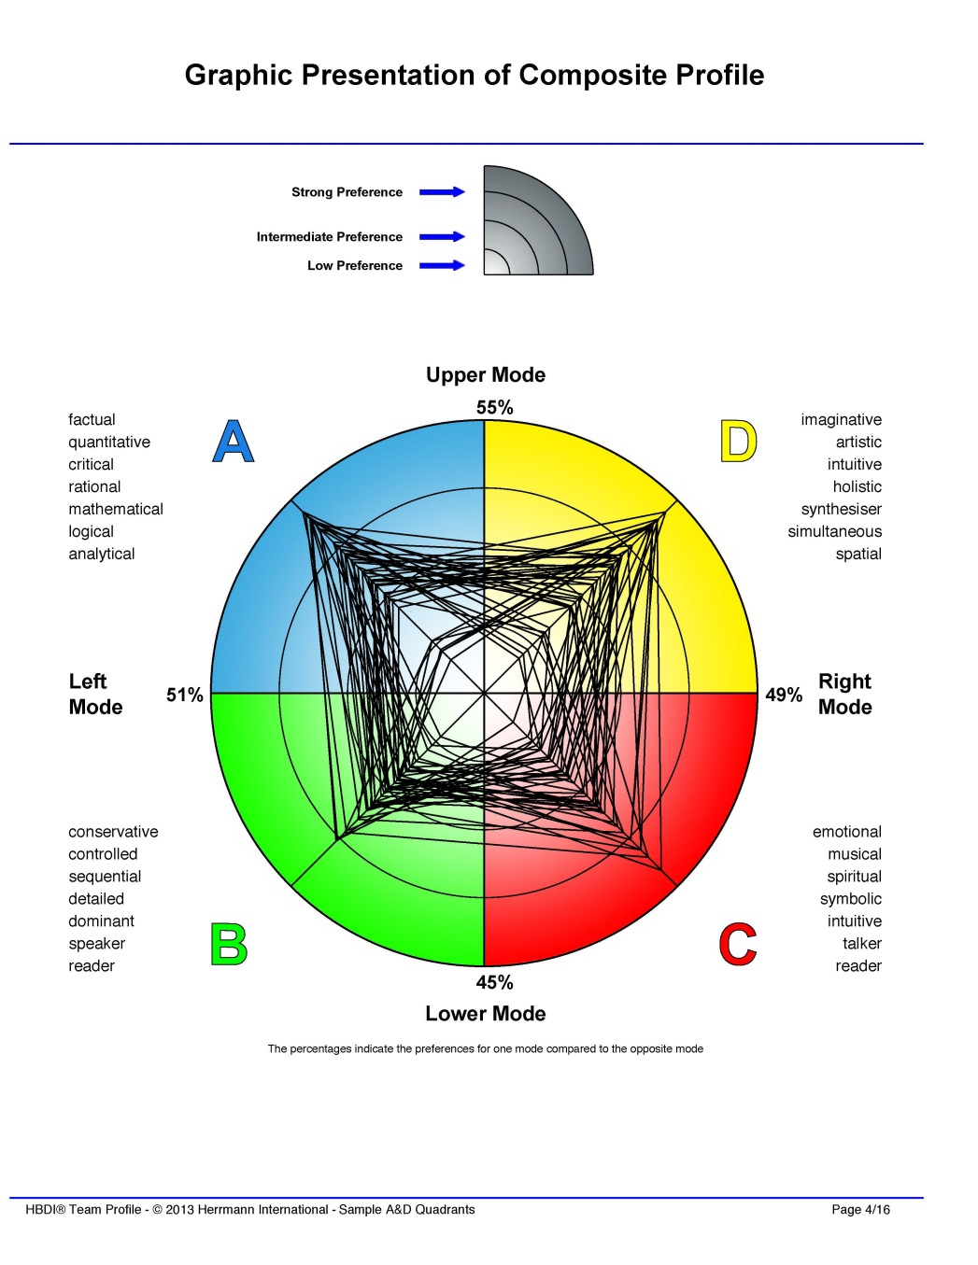
Team Composite – Sample

Slide 37
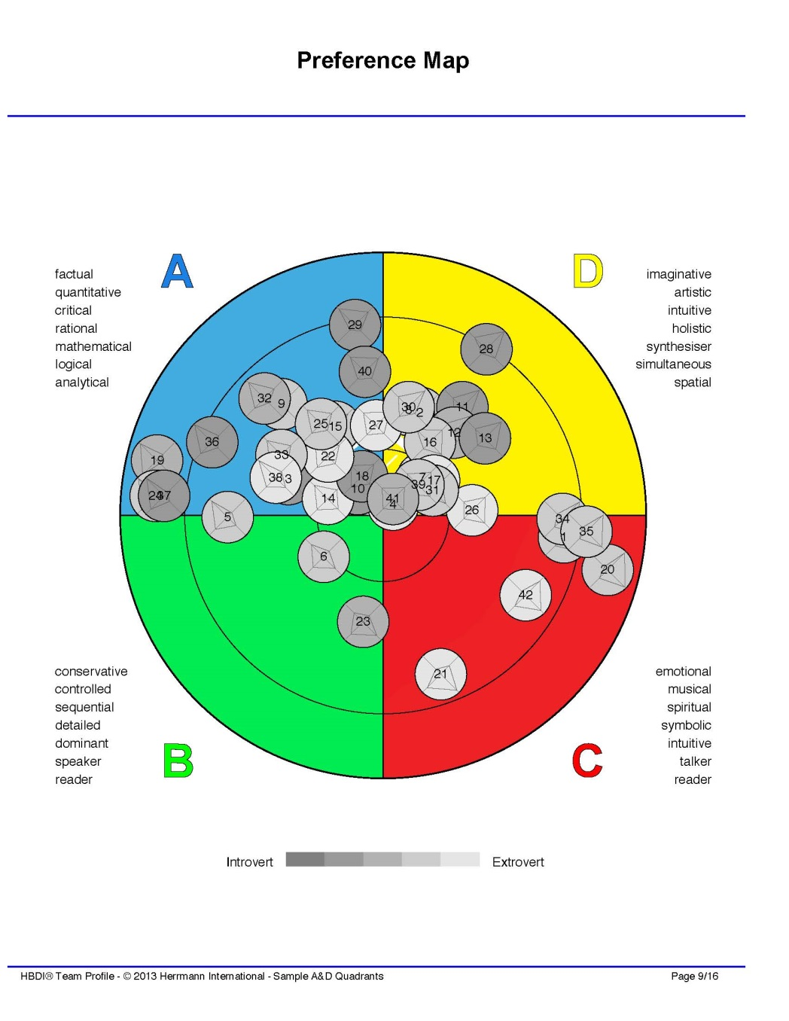
Preference Map – Sample

Slide 38
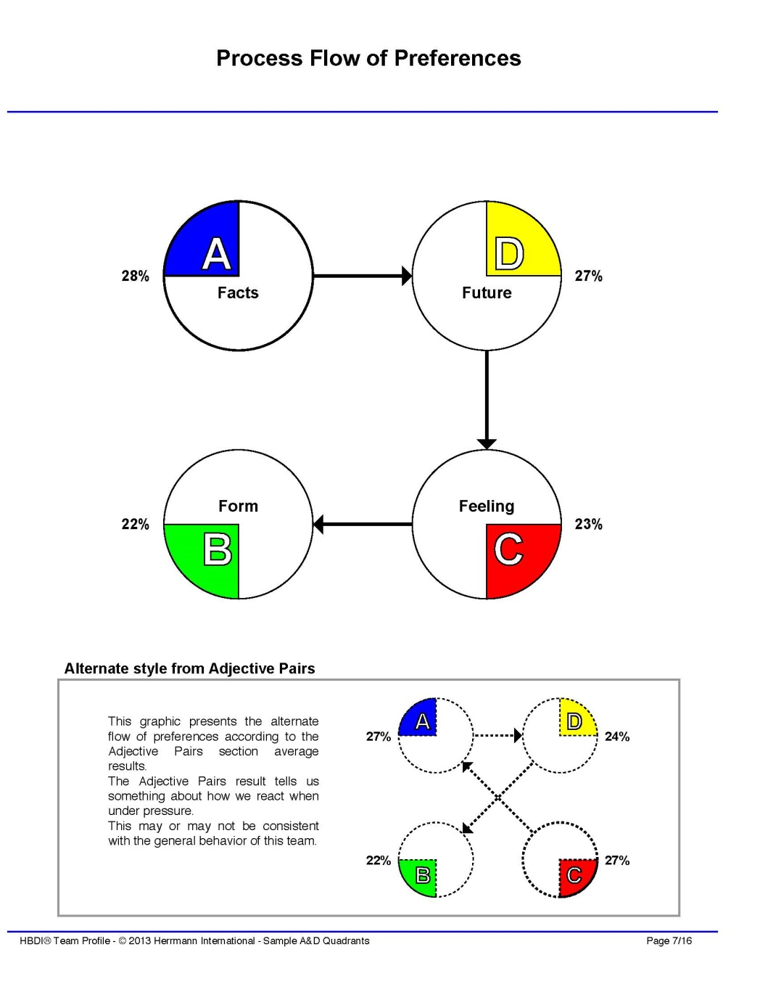
Process Flow of Preferences – Sample

Slide 39
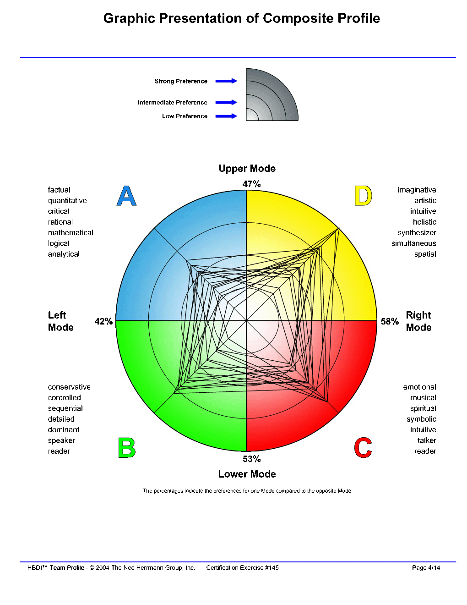
Team Composite – Your Team
Insert Composite Profile Slide Here
(request from Herrmann International)

Slide 40
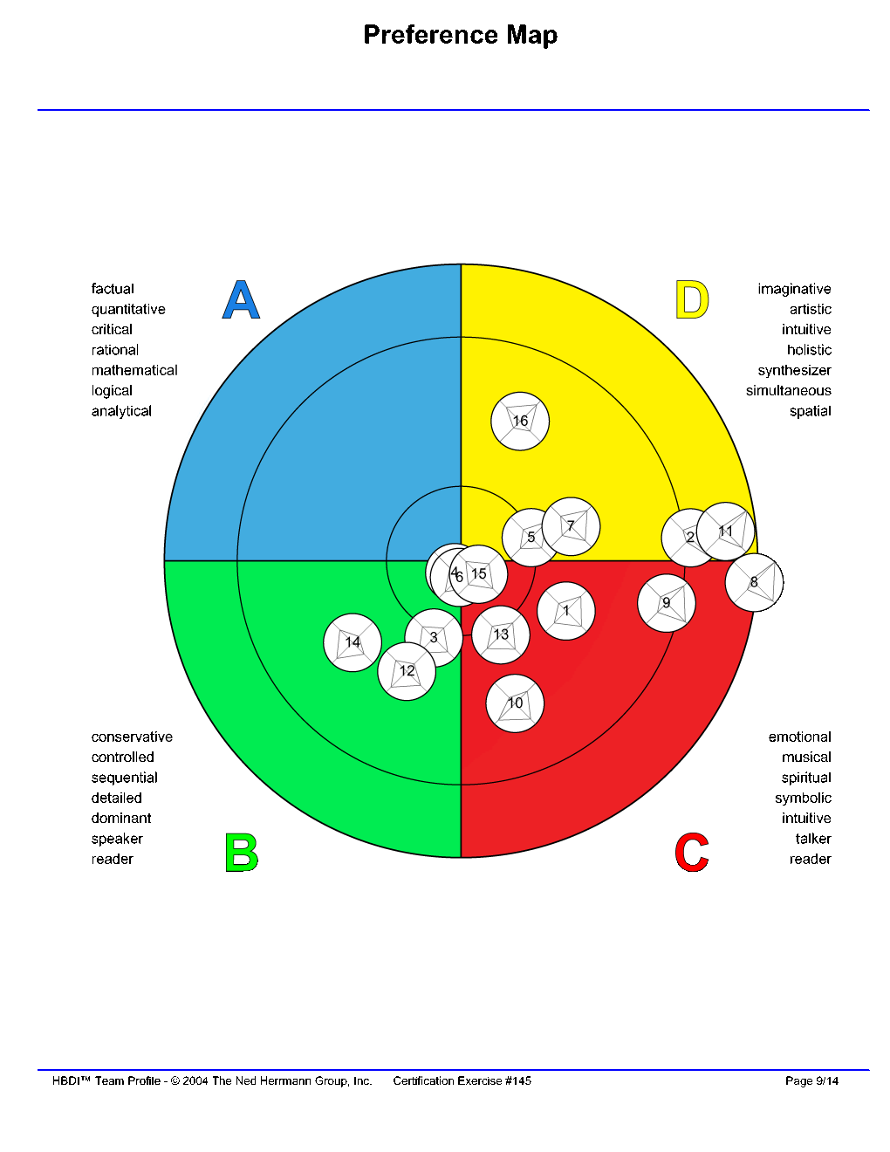
Preference Map – Your Team
Insert Preference Map Slide Here
(request from Herrmann International)

Slide 41
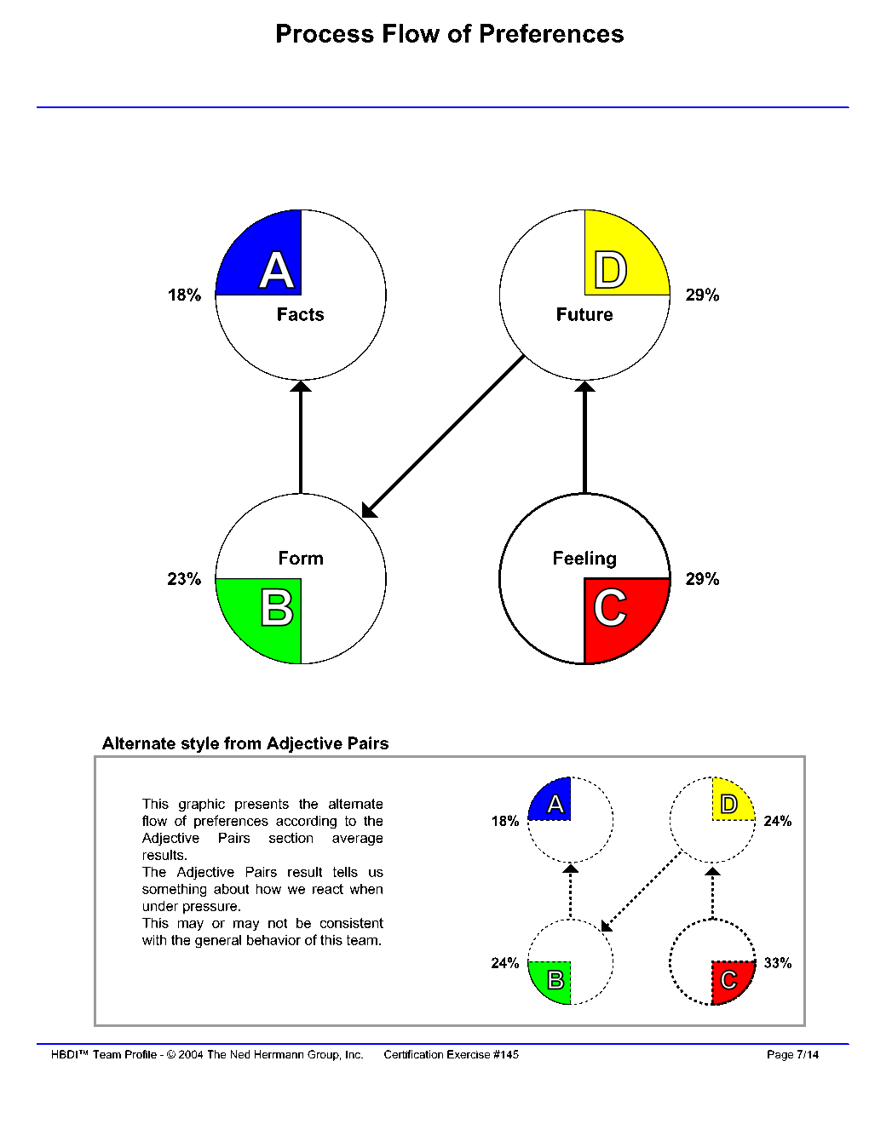
Process Flow of Preferences – Your Team
Insert Process Flow Slide Here
(request from Herrmann International)

Slide 42
Your Team

Slide 43
Key Thoughts
When making decisions with a team, remember to honor all quadrants in order to reach a more balanced decision.
Sharing your thinking preferences upfront when working on a team, can be beneficial to the team’s decision-making process.
A blind spot of one team member may be a strength of another.

Slide 44
Learning Objectives 🡪 Outcomes
At the end of this section, you will be able to:
Identify the thinking preferences of fellow team members.
Recognize how the team's decision making may be different when under pressure.
Use the strengths of the team to help make better decisions.

Slide 45
Action Plan
How will you make a conscious effort to include Whole Brain® Thinking in your team decision making?
For example:
Agree to value Whole Brain® Thinking
“Show your cards” to others
Get input from people with strengths in all four quadrants
Include all four quadrants in brainstorming
Communicate the decision in a Whole Brain® way

Slide 46
Section 3: Team Dynamics of Decision Making
End of Section 3
Next:
Let’s Play Ball!

Slide 47
Section 4: Let’s Play Ball!
Introduction
Making Balanced Decisions
Whole Brain® Decision-Making Walk-Around
Let’s Play Ball!
Action Plan

Slide 48
Learning Objectives
At the end of this section, you will be able to:
Analyze a decision-making approach to ensure that it is whole-brained.
Ask questions from all four quadrants to make whole-brained decisions with your team.
Utilize Whole Brain® Thinking in your future decisions.

Slide 49

Indecision
“Indecision may or may not be my problem.”
Jimmy Buffett

Slide 50

Making Balanced Decisions
Deciding upon a healthcare plan
for your employees
Who will be affected positively/negatively with each different plan option?
Should we be willing to take a risk with a new plan that offers a variety of options?
Are there clear instructions for filing claims and identifying an in-network provider?
__________________________________
8
Notes:
‹#›

Slide 51

Making Balanced Decisions
Deciding on a new copy machine for the office
What else can it do? Scan, email, fax? How does it affect the whole operation?
How “user-friendly” is it to operate? Is personal training for users available?
What is the cost per copy, black/white and color?
__________________________________
8

Slide 52

Making Balanced Decisions
Deciding on the use of social media
How will it be updated on a regular basis?
Can we afford to hire personnel to maintain it?
Can using social media help us to connect personally to our customers?
____________________________________
8
8

Slide 53

Making Balanced Decisions
Deciding on a new employee
position/role to include on the team
Is the compensation structure appropriate for the position?
Do we have clear job requirements and performance metrics?
Will this new position allow us to develop in new areas, as well as bring about change?
_____________________________________
8
8
Notes:
NOTE: When using Whole Brain® Thinking to help make a decision about a new hire, it is illegal and unethical to use HBDI® Profiles to screen the candidates, in any way, for a position. This would be discriminatory, as the HBDI® Assessment predicts preferences, not competencies.
‹#›

Slide 54
Whole Brain® Decision-Making Walk-Around
“Do we have all the facts?”
Approaches:
Pragmatic
Data-based
Theoretical
“Have we seen all the hidden possibilities?”
Approaches:
Imaginative
Forward looking
Risk taking
May overlook:
Feelings
Synergistic opportunities
May overlook:
Details
Practicality
“How will we control the process?
Approaches:
Organized
Conservative
Procedural
“How will this affect others?”
Approaches:
Emotional
Interpersonal
Intuitive (feelings)
May overlook:
Alternative solutions
Novel ideas
Big picture
May overlook:
Facts
Planning

Slide 55
Situational “Stretch”
“Life is like a ten speed bicycle –
we all have gears that we never use.”
- Charles Schultz
The four-color, four-quadrant graphic and Whole Brain® are registered trademarks of Herrmann Global, LLC.
Notes:
‹#›

Slide 56

Let’s Play Ball!
You work for a local sports team and
this question has come up:
Should we rebrand the team?
This would entail: new name, colors, uniforms, signage, business cards, letterhead, advertising, ticket design, contracts, etc.
There are 20 team members, including players, coaches and support staff.

Slide 57
Key Thoughts
Asking questions from all four quadrants creates a balanced approach to decision making.
The Whole Brain® Decision-Making Walk-Around prompts you to approach decision-making in a Whole Brain® way.
The Whole Brain® Decision-Making Walk-Around reminds you to include aspects of a decision that you might overlook.

Slide 58
Learning Objectives 🡪 Outcomes
At the end of this section, you will be able to:
Analyze a decision-making approach to ensure that it is whole-brained.
Ask questions from all four quadrants to make whole-brained decisions with your team.
Utilize Whole Brain® Thinking in your future decisions.

Slide 59
Action Plan
Commit to using the tools from this module including the Whole Brain® Decision-Making Walk-Around.
What decisions are facing you now, to which you can immediately apply these tools?

Slide 60
Section 4: Let’s Play Ball!
End of Section 4
Next:
Think About Decision Making Wrap-Up

Slide 61
ThinkAbout Decision Making
What We’ve Covered
Why Whole Brain® Thinking
How We Did It
Who Benefits
Notes:
‹#›

Slide 62
A – What We’ve Covered
The Whole Brain® Pre-Decision Filter
Personal Dynamics of Decision Making
Strengths in Decision Making
Show Your Cards
How the Quadrants Decide
The Team’s Profile
Making Balanced Decisions
Whole Brain® Decision-Making Walk-Around
Notes:
‹#›

Slide 63
B – How We Did It
The Last Big Decision
The Whole Brain® Pre-Decision Filter
What’s Missing?
A Major Purchasing Decision
Don’t Overlook
Making an Investment
Whole Brain® Decision-Making Walk-Around
Let’s Play Ball!
Notes:
‹#›

Slide 64
C – Who Benefits
Self
Team Members
Colleagues
Coworkers
Managers
Organization
Clients
Customers
Others Outside our Organization

Slide 65
D – Why Whole Brain® Thinking
Better Thinking. Better Performance. Better Results

Slide 66

Questions?

Slide 67







Introducing the new…
Better Thinking, In Hand
UNDERSTAND YOUR HBDI® PROFILE
APPLY THE INSIGHTS
SHARE YOUR THINKING
Learn more at http://app.hbdi.com
Notes:
‹#›

Slide 68
The Business of Thinking®
The Business of Thinking®
ThinkAbout Decision Making
Notes:
Copyright: <a href='http://www.123rf.com/profile_alphaspirit'>alphaspirit / 123RF Stock Photo</a>

Slide 69
The Business of Thinking® Series
Start Thinking
ThinkAbout Teams
ThinkAbout Communicating
ThinkAbout Creative Thinking
ThinkAbout Decision Making
ThinkAbout Problem Solving
ThinkAbout Your Customer

Slide 70
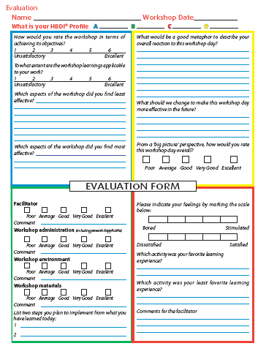
The four-color, four-quadrant graphic and Whole Brain® are registered trademarks of Herrmann Global, LLC.
Notes:
‹#›

Slide 71


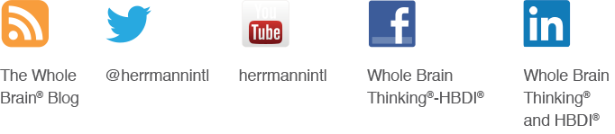
Better Thinking. Better Performance. Better Results.
828.625.9153 l herrmannsolutions.com
Connect with us:

Slide 72
Appendix
Additional Facilitator Resources

Slide 73

Break it up!
The brain needs time to process.
Taking a break during class/learning helps retain the information
just learned.
Notes:
Insert in deck as needed.
‹#›

