Slide 1
Whole Brain® Coaching GROW Model
DELIVERY PPT

Slide 2
Welcome
Purpose
Using the Whole Brain® Coaching GROW model will create a strong baseline for coaching employees based on their goals.
Learning Objectives
To become familiar with the Whole Brain® Coaching GROW model
To have participants use the GROW model for greater understanding of where to begin a coaching conversation

Slide 3
Agenda
Introduction & Ground Rules
5 min
Activity
30-45 min
Action Planning
5 min
Wrap Up
5 min

Slide 4
Ground Rules:
Approach the Learning in a Whole Brain® Way

Slide 5
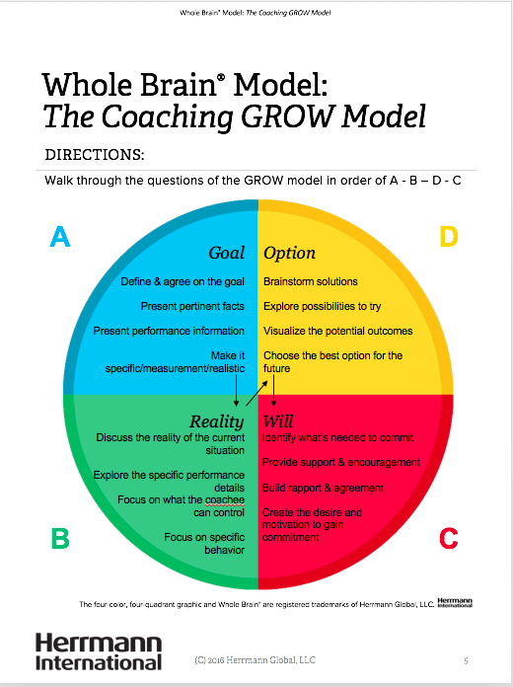
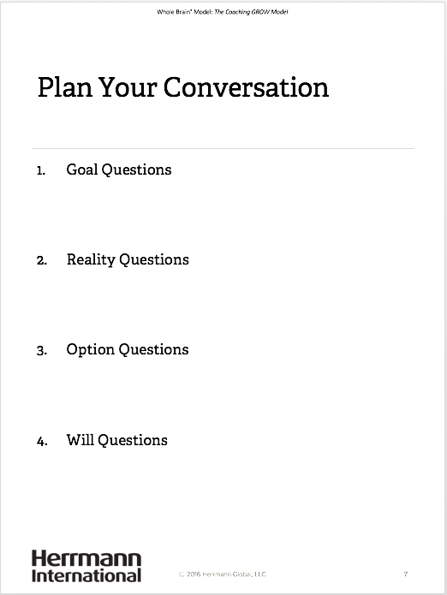
Activity
Review the Coaching GROW Model
Plan a mock coaching conversation using the handout
With a partner, practice a coaching conversation following the model
Time: 45 minutes

Slide 6

Whole Brain® Model: Coaching GROW Model
A
Goal
Define & agree on the
goal
Present pertinent facts
Present performance information
Make it specific/measurement/ realistic
Option
Brainstorm solutions
Explore possibilities to try
Visualize the potential
outcomes
Choose the best option for the future
D
Reality
Discuss the reality of the current situation
Explore the specific
performance details
Focus on what the
coachee can control
Focus on specific
behavior
Will
Identify what’s needed to commit
Provide support &
encouragement
Build rapport & agreement
Create the desire and
motivation to gain
commitment
B
C
Whole Brain® and the four-color, four-quadrant graphic are registered trademarks of Herrmann Global, LLC.

Slide 7
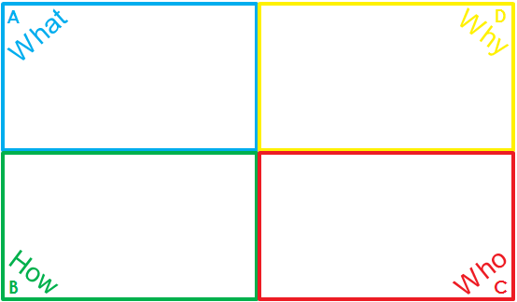
Reflections & Action Planning
What did you notice in this exercise?
What actions will you take based on this activity?

Slide 8

Wrap Up
What is your biggest take-away (learning)
from today’s session?

Slide 9

thinkherrmann.com

