Slide 1

Facilitator
Slides

Slide 2
Facilitator Notes
Schedule a meeting with the team! Be sure they have enough time to complete their HBDI® assessment and journey. Completing the journey is required for activities in the session.
In your meeting invitation, be sure to let the team know you will send them an invite to complete their HBDI® and journey (if they haven’t already completed both) - and ensure sharing is enabled for their Thinker Portal profile.
If you can, meet with the team lead to give them a preview of the session and ask for any insights into their strengths and areas for growth. Also talk to the team lead about making sure everyone completes the steps above.
Review the full slide deck before delivering your session so you can be prepared to guide participants in the Thinker Portal and set up breakout rooms for activities.
For the session, you will want to be sure you are added to the Team you are delivering to on the Thinker Portal as a “Practitioner”. This will allow you to open the team profile just as the team sees it on the portal.
Final note: This workshop is designed for a virtual environment - but it includes notes on how to adjust activities for an in-person delivery. Be sure, however, that if you are running this session in person team members have a computer to easily access the Thinker Portal.

Slide 3
Herrmann Revision History
The following notes highlight the date of the most recent revisions and summarize updates to the slide content.
Revision Date | Summary of Updates
1/23/26 | Slideshow updates finalized

Slide 4
Whole Brain® Foundations for Teams Workshop: 2 hours 30 mins
Duration | Activity | Slides | EST Time | Other Time Zone
15 mins | Welcome and Introduction | 7-11
5 mins | Welcome Slide | 7
1 min | Facilitator Introduction | 8
7 mins | Share Your “Superpowers” | 9
1 min | Agenda | 10
1 min | What You’ll Walk Away With | 11
35 mins | Share “About Me” | 13-15
3 mins | The Whole Brain® Model and the HBDI® | 13
7 mins | Reading the HBDI® Profile Preference Code | 14
25 mins | Sharing Your Preferences | 15
30 mins | Teams on the Thinker Portal | 17-21
5 mins | The Whole Brain® Business Model | 17
5 mins | Team Average | 18
5 mins | Composite Profile and Group Preference Map | 19
5 mins | Our Team Under Pressure | 20
10 mins | Complete the Team Pulse Survey | 21
10 mins | Break | 22
35 mins | Whole Brain Communication | 24-30
2 mins | Introduction Slide | 24
1 min | Thinking Agility | 25
2 mins | Communication Preferences by Quadrant: A Quadrant | 26
2 mins | Communication Preferences by Quadrant: B Quadrant | 27
2 mins | Communication Preferences by Quadrant: C Quadrant | 28
2 mins | Communication Preferences by Quadrant: D Quadrant | 29
24 mins | Sharing Your Communication Preferences | 30
17 mins | Apply a Whole Brain® Process | 32-33
12 mins | Four Critical Questions Activity | 32
5 mins | Four Critical Questions Activity Debrief | 33
8 mins | Your Next Steps | 35
8 mins | Your Next Steps | 35
Total 2 hrs 30 mins
Notes:
NOTES:

Slide 5
Learning Objectives
Overall Objective: Describe the principles of the Whole Brain® Model, identify their own thinking preferences, and build their awareness of the preferences of others to collaborate more effectively in real-time work scenarios through the application of Whole Brain® Thinking.
By the end of the session, participants will be able to …
Demonstrate confidence in sharing their thinking preferences and describe strategies for engaging effectively with the preferences of their teammates.
Analyze individual and team HBDI® profiles and data to identify strengths and potential gaps that influence collaboration.
Apply Whole Brain® tools in workplace scenarios to stretch thinking and enhance decision-making, communication, or problem-solving.
Identify strategies to continuously develop Whole Brain® Thinking habits that lead to improved collaboration and sustainable performance.

Slide 6
Welcome and Introduction

Slide 7

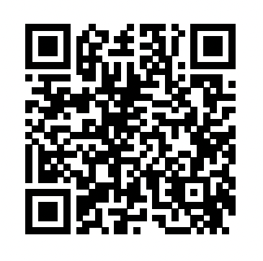

Whole Brain® Foundations: Align and Collaborate
Notes:
Note to Facilitator: The 5 minutes here is to accommodate team members who may log on a few minutes after the formal start time. Once everyone is logged in and has opened their “Whole Brain Profile”, start the session. Note to Facilitator: The QR code on the screen takes participants to the Thinker Portal on their mobile phone where they will be asked to sign in to view their profile. If your participants are all using computers, you can delete this QR code. 5 mins NOTES:
As people arrive, ask them to log into the their Thinker Portal and load their “My HBDI®” page.
Have your “My HBDI®” page open in a web browser so you are ready to help participants land on the right page.
Link to Thinker Portal: https://journey.herrmannsolutions.net/thinker
When everyone has arrived, start the session.
SAY: Welcome everyone to Whole Brain® Foundations: Align and Collaborate! I hope you all enjoyed seeing your profiles and learning more about your thinking preferences in your journey - I know I am excited for all of you to start learning more about each other and how you can start improving your work together! TRANSITION: None, move to next slide.

Slide 8
Welcome!
I’m {name here}.
{Title} {Second line for additional info}
{Profile score, ex. 2211 Thinker}
Replace with facilitator photo
Notes:
1 mins Note to Facilitator: Use this slide template to introduce yourself to the group before you get started with the icebreaker. You can add any notes you would like to share below.
TRANSITION: Let’s get started with a quick activity.

Slide 9




Share Your “Superpowers”
Accomplishing results
Analyzing data
Solving tough problems
Logical processing
Applying formulas and analysis
Providing vision
Integrating ideas and concepts
Bringing about change
Experimenting or inventing solutions
Promoting new ideas
A
D
Keeping projects on track
Planning things out
Establishing order
Detailed tasks
Creating structure for others
Building relationships
Mentoring and coaching
Facilitating connection and dialogue
Building team alignment
Teaching or guiding others
B
C
Notes:
Note to Facilitator: If delivering in person, and the team is small (5 or less), you can have participants share their responses verbally. Note to Facilitator: This activity uses the chat to collect responses from participants. If the team is smaller (3-5 people), you can skip the chat and use the time to have participants share their superpowers verbally. 7 minutes SAY: To get us started, let’s do a quick warm-up called “Share your superpowers.” Each quadrant brings unique strengths - or superpowers. Take a look at each quadrant with a focus on your most preferred quadrant(s). Then, in chat, type the two superpowers you most identify with. These are the things you do best - where you bring the most value or feel the most confident in your work.
DO: As the responses come in, notice how different they are - and how each one reflects a different kind of thinking. Also watch the time to gauge how much time you have for volunteers to share about their preferences.
ASK: Would one or two volunteers be willing to share one of your superpowers - and a word or two about why it matters in your role? Note to Facilitator: You should have a 3-4 minutes to hear from participants. Reassure other participants that they will have time to share more about their superpowers in a few minutes when we do an activity where they share more about their thinking preferences with a partner.
TRANSITION: Before we dive into to learn more about your individual and collective thinking preferences, let’s look over our agenda for the day.

Slide 10
Agenda
Share “About Me”
Teams on the Thinker Portal
10 Minute Break
Whole Brain® Communication
Apply a Whole Brain® Process
Your Next Steps
The four-color, four-quadrant graphic and Whole Brain® are registered trademarks of Herrmann Global, LLC.
Notes:
1 min
SAY: Today we will …
Share “About Me” - this module will give you the chance to share your thinking preferences with members of your team.
Introduce you to Teams on the Thinker Portal.
Take a 10 minute break.
Discuss Whole Brain® Communication, and give you a chance to share your communication preferences.
Apply a Whole Brain® Process you can use in your day-to-day work.
And go over Your Next Steps in bringing Whole Brain® Thinking to your team.
TRANSITION: No transition, go to “What You’ll Walk Away With” slide.

Slide 11
What You’ll Walk Away With
Confidence
Insight
Experience
Practical Strategies
Notes:
Note to Facilitator: This slide will appear without any of the arrow graphics on the screen. They will appear one-by-one as you click forward as instructed in the notes.
1 min
SAY: So what will you walk away with?
(Click to reveal) Confidence in sharing your thinking preferences together.
(Click to reveal) Insight into your individual and team thinking preferences to spot strengths and surface potential gaps.
(Click to reveal) Hands-on experience using tools to help you stretch your thinking in the real work situations you’ll face.
(Click to reveal) Practical strategies to keep building your Whole Brain® Thinking “muscle” for ongoing impact.
TRANSITION: Now that we know what we will cover today, let’s jump into our session by talking about the Whole Brain® Model, the HBDI® and give you all the chance to share more about your individual thinking preferences.

Slide 12
Share
“About Me”

Slide 13
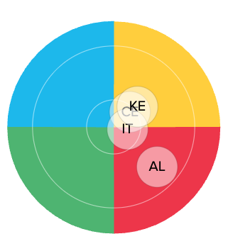
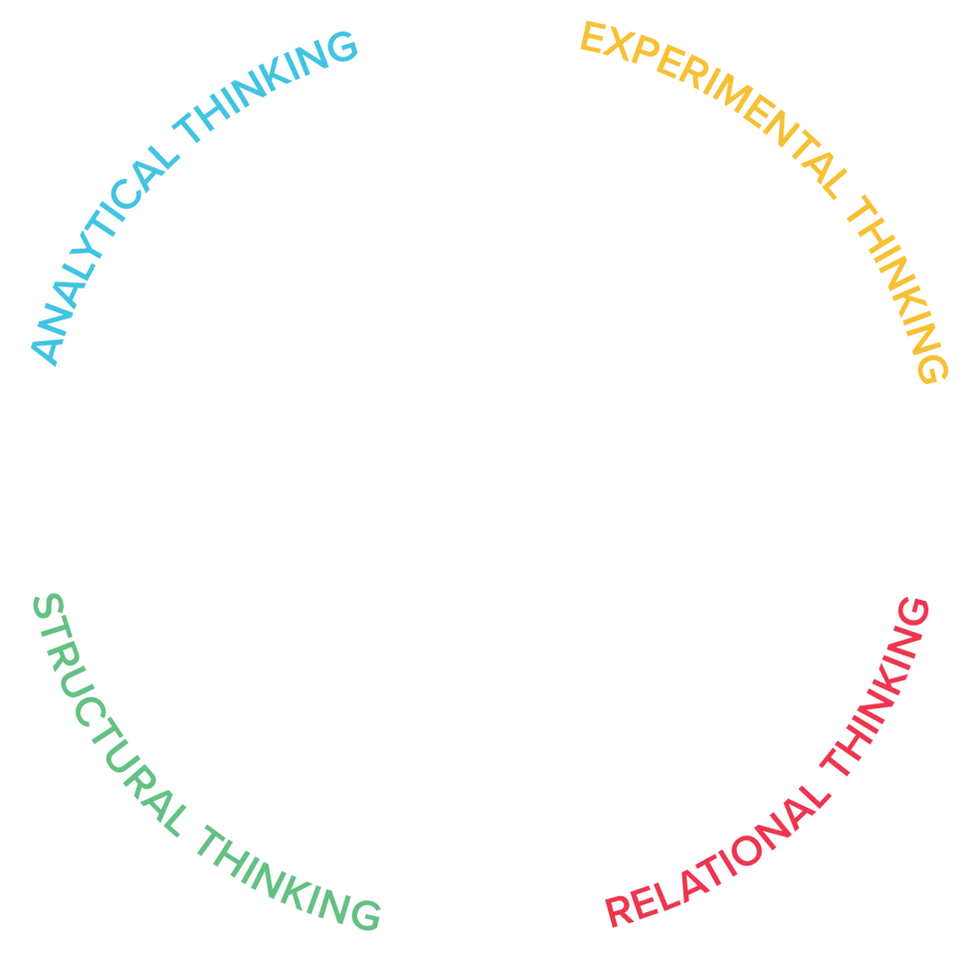
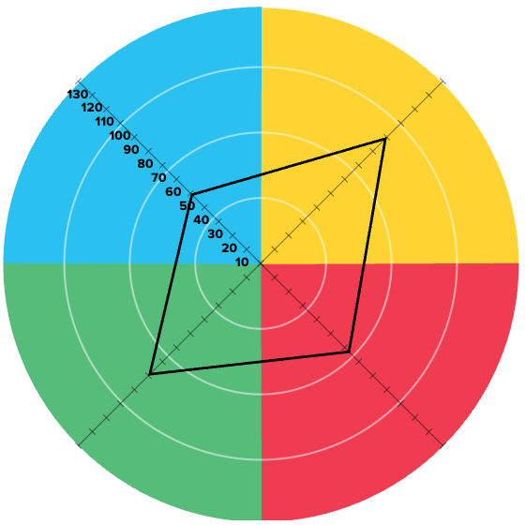
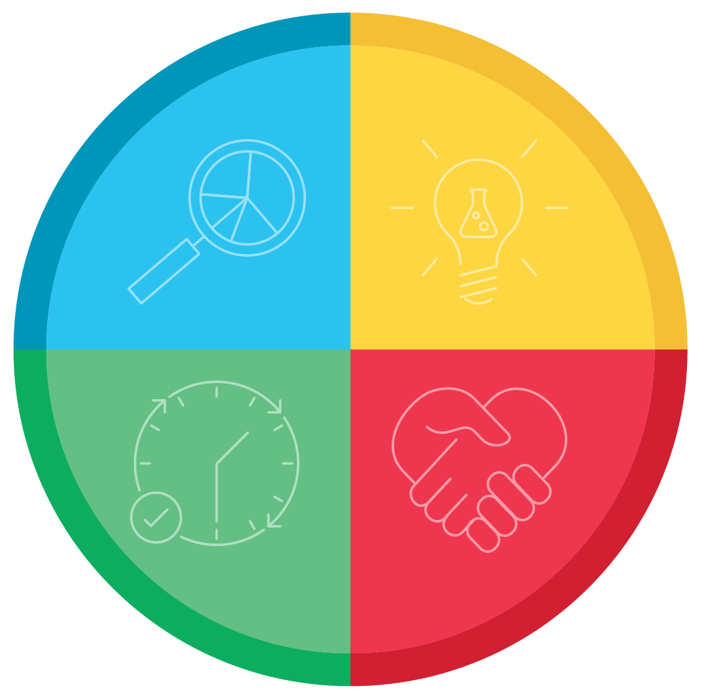
The Whole Brain® Model and the HBDI®
A
D
Logical
Analytical
Fact-based
Quantitative
Holistic
Experimental
Integrating
Synthesizing
Organized
Sequential
Planned
Detailed
Interpersonal
Empathic
Kinesthetic
Emotional
B
C
The four-color, four-quadrant graphic and Whole Brain® are registered Trademarks of Herrmann Global, LLC.
Notes:
Note to Facilitator: This slide has a build. The graphics in the center will go from the core Whole Brain® model, to the individual kite and the team kite as you click forward.
3 mins SAY: The Whole Brain® Model is an organizing principle for how we think. It outlines four distinct ways of thinking that shape how we solve problems, communicate, learn, and collaborate. One helpful way to think about it is this: the Whole Brain® Model gives us the map - the full terrain of thinking that helps us navigate our day-to-day. We all have access to each quadrant. The difference is where we naturally start when we think and work. If the model is the map … DO: (Click to reveal) the HBDI® profile kite overlay on the model. SAY: The HBDI® helps us understand our coordinates on that map - or which quadrants we prefer, or look to first, as compared to others. The new graphic you see on the middle of the slide is an individual profile, and as you can see the kite gives us an example of the degree of preference this person has in each quadrant. Much like you have seen with your own data in the Thinker Portal. Some of you may have seen and heard this before …but today we are going to add another layer to your knowledge of reading the “Whole Brain® map”. DO: (Click to reveal) the team graphic overlay on the model.
SAY: What you see now is one of our team maps called the group preference map. This shows the coordinates of four team members on the Whole Brain® Model. This is one of several ways we are going to explore your preferences as a team today, but we are going to build up to exploring your team data - just like we have done on this slide.
TRANSITION: Understanding the Whole Brain® Model and our HBDI® data encourages us to stretch beyond our natural preferences and consider other approaches - whether it’s analyzing data, taking action, building relationships, or generating new ideas. Let’s do a quick check in on reading your HBDI® profile, get started learning more about our individual preferences, and then after a short break we will dig into your team data on the Thinker Portal.

Slide 14
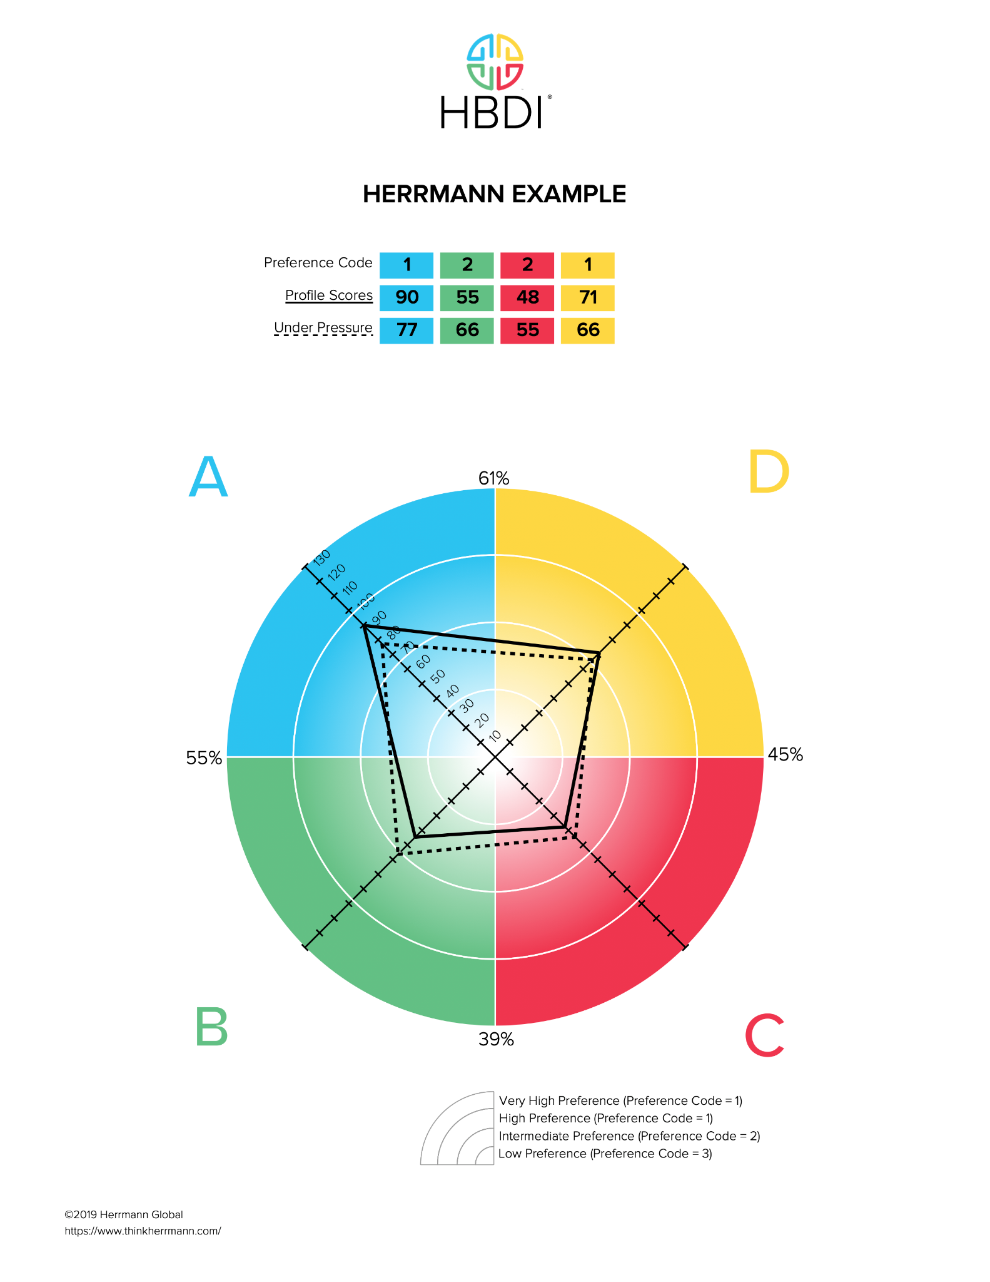
Reading the HBDI® Profile Preference Code
VERY STRONG 1+
STRONG 1
INTERMEDIATE 2
LOW 3
UNDER PRESSURE
The four-color, four-quadrant graphic and Whole Brain® are registered Trademarks of Herrmann Global, LLC.
Notes:
Note to Facilitator: This slide has a build. The preference strength text will appear one-by-one as you click and appear in the order of low, intermediate, strong and then very strong. Another click will reveal the under pressure text. 7 mins DO: Ask participants to pull up the Thinker Portal (https://axon.herrmannsolutions.net/account/login) and go to the “My HBDI®” tab so they can view their profile.
SAY: It is important to remember, the HBDI® doesn’t measure skills or intelligence - it measures your thinking preferences across the four quadrants of the Whole Brain® Model. It’s about how you prefer to think, not how well you think. DO: (Click to reveal) Each preference marker on the slide as you provide the quick description.
If you have a 3, or low preference (33 or below): These ways of thinking can drain your energy - but it is important to keep in mind that if someone has a low preference, don’t make assumptions. For example, people with low scores in the C, or red quadrant, have feelings like anyone else. They just might not express them as much as others.
If you have a 2, or intermediate (34–66): This is often a comfort zone, it isn’t a preference and it isn’t something that you find draining.
A 1, or strong preference (67–100): These are primary preferences that you find energizing.
A 1+, or very strong preference (100+): This level of preference is often so strong, it is visible to others. So if you are trying to hide it, forget it, everyone already knows.
DO: (Click to reveal) the dotted under pressure line.
SAY: The dotted line shows how your preferences may shift when you are under pressure or stress. Sometimes the under pressure profile is very close to the day-to-day – which means others don’t see “the pressure” even if a person is feeling it. Or, it can also be noticeably different. Often, people perceive you more from the dotted line…because they remember you under pressure.
DO: Take 4 minutes to answer any questions. ASK: Does anyone have any questions about reading the HBDI® profile preference code? Or the HBDI® in general? Note to Facilitator: Here are some questions you might hear:
Can my profile change? ANSWER: Yes, someone's HBDI® profile can change over time - but the changes are typically gradual, not dramatic, and often related to life stage, role changes, or significant personal development.
What if my under pressure score in a specific quadrant is zero? ANSWER: A zero in an HBDI® quadrant under pressure means the person has no measurable preference for that type of thinking under pressure, not that they lack the ability - it’s an insight into where they’re least likely to focus when under pressure. It highlights potential blind spots and growth areas, especially under pressure, but everyone still has access to all four quadrants.
TRANSITION: Great! Now let’s spend some time learning more about the individual preferences we bring to the team!

Slide 15
Sharing Your Preferences
A: What strengths do you bring to this team’s work?
D: What future possibility excites you most about this team?
C: What builds trust for you when working with a team?
B: What do you need from others to stay on track and do your best work?
20 minute breakout
The four-color, four-quadrant graphic and Whole Brain® are registered Trademarks of Herrmann Global, LLC.
Notes:
Note to Facilitator: If the team is large, you might want to skip the debrief question at the end of this activity. It is a short debrief and you will want to save time for the team data on the Thinker Portal. Note to Facilitator: This activity is designed for participants to share primarily in trios, but depending on the total number of people you might have to use trios and pairs. Feel free to make adjustments to the set up to accommodate your groups as needed.
Note to Facilitator: Encourage participants to take a screenshot of the slide for their breakout groups. Disregard if you are in-person, you can just leave the slide on the screen and ask participants to group up in the room. 25 min SAY: Now that we’ve touched on how your preferences show up on the HBDI®, let’s make them real. This activity is about trust - sharing what those preferences mean for you in action, and hearing the same from others. We all bring unique thinking preferences to the table and today the goal is not to label but to understand each other better.
When we open up about how we prefer to think, it creates space for stronger collaboration. Understanding how colleagues approach problems makes it easier to connect, avoid misunderstandings, and co-create solutions.
For this breakout activity, we will send you into trios or pairs for 20 minutes - so trios will have about 6 minutes per person to share. We will ask you to take turns sharing the following insights about your thinking:
A (Blue): What strengths do you bring to this team’s work?
D (Yellow): What future possibility excites you most about this team?
C (Red): What builds trust for you when working with a team?
B (Green): What do you need from others to stay on track and do your best work?
SAY: I will give you a moment to open your “Whole Brain® Profile” in the Thinker Portal (https://axon.herrmannsolutions.net/account/login) for insights now and when you are in your breakout rooms. Hover over your initials in the top right corner of the Thinker Portal to find your “Whole Brain® Profile”.
DO: Give everyone a chance to open their “Whole Brain® Profile” and then send them to their breakout rooms for 20 minutes. Also encourage participants to take screenshots of the slide if needed for reference in their breakout rooms.
DEBRIEF: Welcome back, let’s hear from one or two volunteers - how did the sharing go? DO: Take 1-2 minutes to hear a few responses and thank people for sharing. TRANSITION: Understanding your preferences is just the starting point. As we talked about before our activity, we want this session to be an opportunity your your team to map your preferences individually and as a team. We will take a 10 minute break and when we return we will dig into your team profile data on the Thinker Portal.

Slide 16
Teams on the Thinker Portal
Notes:
Note to Facilitator: After slide 17 you will be closing your slideshow and opening up the team profile on the Thinker Portal as a “Practitioner”. The “Practitioner” role allows you to be a part of the team without your data being calculated into the team profile.

Slide 17
The Whole Brain®
Business Model
Efficiency
Financials
Technology
Past trends
Performance
Measurements
Goals/Objectives
Competition
Environment
Future trends
New concepts
National - World
Vision - Purpose
Long term strategy
A
Purpose
(Investment)
D
Possibilities
(Innovation)
B
Process
(Implementation)
Methods/Regulations
Quality/Perfection
Risk reduction
Resources
Control
Timing
Policy
Training - Development
Teams - Relationships
Community Relations
Customer Relations
Communications
Culture - Values
Recognition
C
People
(Interaction)
The four-color, four-quadrant graphic and Whole Brain® are registered Trademarks of Herrmann Global, LLC.
Notes:
Note to Facilitator: This slide has a build. The quadrant and characteristics will appear with the slide. You will need to click forward to reveal the four “P”s that are titles for each quadrant. 5 mins SAY: Before we get into your team data, let’s take a moment to review the Whole Brain® Business Model. This helps us understand how the whole brain map can provide clearer landmarks for teams and organizations when we add more complex coordinates - like the HBDI® team profile data. This layer of context can help teams and organizations manage the complexity and competing priorities we experience in our day-to-day to achieve our shared goals and adopt a mindset that considers and aligns:
DO: (Click to reveal) the “A Purpose”, “B Process”, “C People”, and “D Possibilities” headers one-by-one, reading them aloud to the large group. Think about your organization. Consider the following question … ASK: What quadrant, or quadrants, does the culture of your organization focus on? DO: Solicit responses from each participant verbally or in chat. DO: Share insights on which quadrants are mentioned frequently, and which might be overlooked. Solicit specific “aha’s” if any TRANSITION: The key to putting this model to work is applying and discussing the thinking preferences of your team so you can clearly map where your strengths, gaps and opportunities for improved effectiveness are - which is exactly what we will do on the Thinker Portal right now.

Slide 18
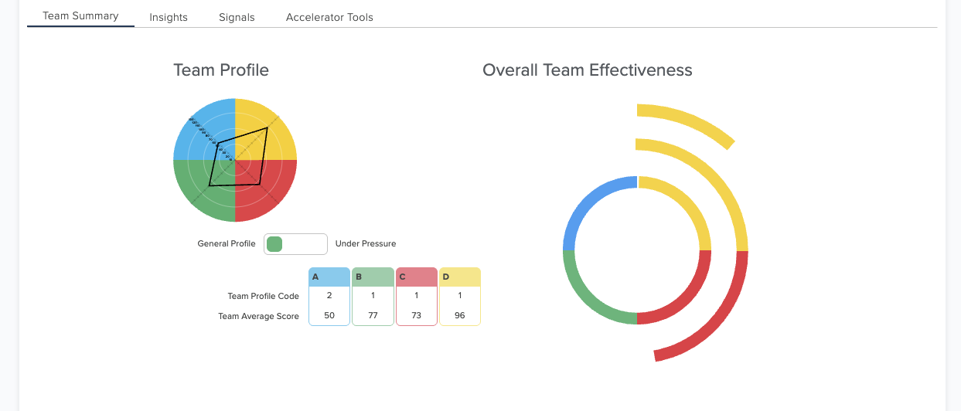
Team Average
Demo Data
The four-color, four-quadrant graphic and Whole Brain® are registered Trademarks of Herrmann Global, LLC.
Notes:
Note to Facilitator: You will close out the slideshow after this slide and resume sharing the slides on Slide 22. 5 mins SAY: Go to the “Home” tab on your Thinker Portal and find your team. You should see the “Team Summary” tab. DO: Close out the slideshow and share the web browser where you have the team profile open on the Thinker Portal. Help participants find the team profile page as needed. SAY: The team average is a summary of the preference code for each person on your team.
ASK: What do you notice? DO: Follow up with questions below and ask for a few responses based on the initial insights:
How does this relate to how your team shows up?
How do your meetings go?
Where do you spend the most time?
What are the implications for your low preferences?
If the profile is balanced, ask what the implications are for a more “whole brained” profile.
DO: Quickly share any additional key points of the data that they may not have mentioned from your preparation.
TRANSITION: Now let’s take a look at your Composite Profile and Group Preference Map.

Slide 19
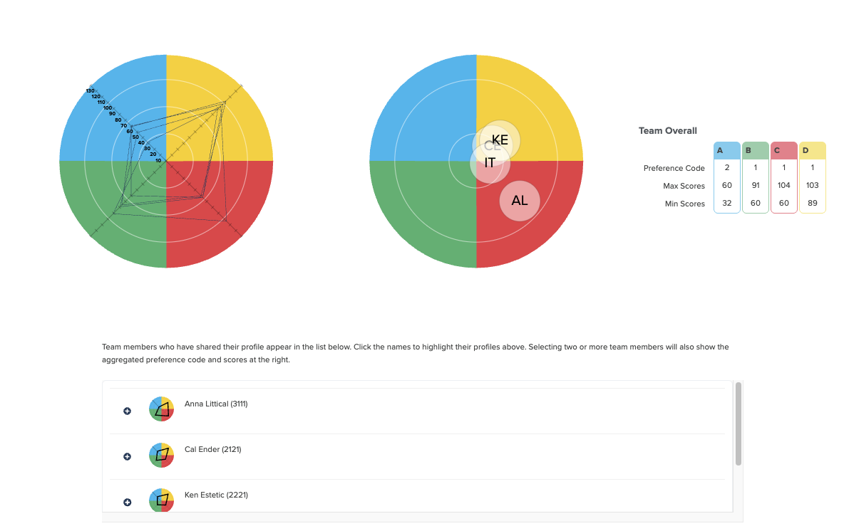
Composite Profile and Group Preference Map
Close slides and share Team Profile for walkthrough. Switch back for slide 33.
The four-color, four-quadrant graphic and Whole Brain® are registered Trademarks of Herrmann Global, LLC.
Notes:
Note to Facilitator: Review the activity yourself before the session. Jot down a few notes about insights and recommendations you can share to close the short activity. Note to Facilitator: Be sure you are sharing the team profile data on the Thinker Portal. 5 mins
SAY: Now let’s take a look at the “Insights” tab of your team profile page. The Composite profile shows all team member's profiles overlaid on each other, providing a quick comparison of the similarities and differences across the group. The Group Preference Map indicates the preference tilt of each participant relative to the team. Each person’s profile is placed on the map based on its degree of preference. The more whole brained a profile is, the closer to the center of the grid it appears. The degree of tilt for a quadrant increases as the profile moves further into the A, B, C, or D areas.
ASK: What do you notice? Are there quadrants where you have groups of stronger preferences, or quadrants that aren’t represented at all? What might this mean for your work? Note to Facilitator: Insights here might include …
Identifying the natural pull of the team to the right, left, upper or lower mode.
Groups that exist on the team in different quadrants or modes. You can ask if these might be sub-teams or working groups and how they communicate to offer stretching opportunities to better connect.
Are there profiles that stand alone or are separate from other profiles? These team members might be able to help the group ensure they aren’t overlooking a quadrant.
TRANSITION: Now let’s take a quick look at your team under pressure. Scroll down to the “How does my team operate section”.

Slide 20
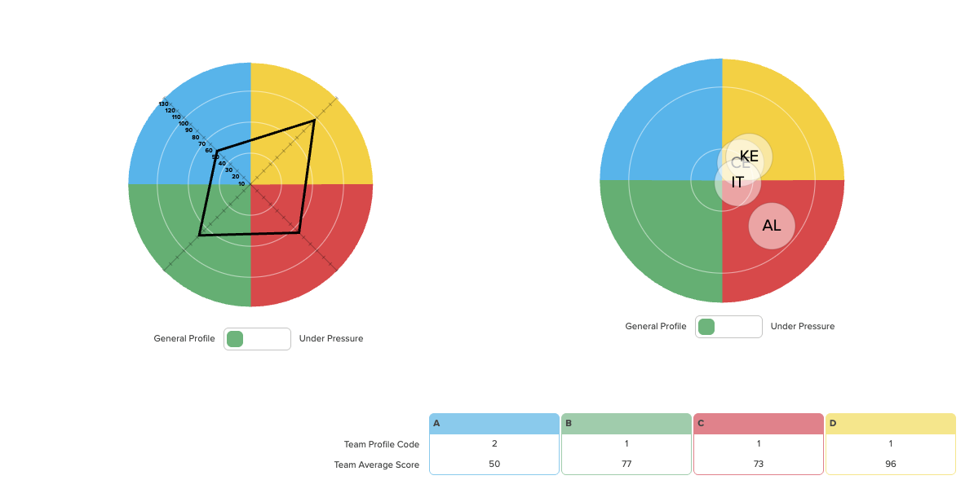
Our Team Under Pressure
Close slides and share Team Profile ifor walkthrough. Switch back for slide 33.
The four-color, four-quadrant graphic and Whole Brain® are registered Trademarks of Herrmann Global, LLC.
Notes:
Note to Facilitator: Review the activity yourself before the session. Jot down a few notes about insights and recommendations you can share to close the short activity. Note to Facilitator: Be sure you are sharing the team profile data on the Thinker Portal. 5 mins
SAY: Here we have your Team’s Average Profile, or General Profile, and your Group Preference Map. You will notice there is a toggle button underneath. SAY: First, toggle your Team Profile between your General Profile and Under Pressure Profile for a moment. ASK: What do you notice? DO: Take a moment for participants to share their responses and offer additional insights. SAY: Now do the same with your Group Preference Map to the right.
ASK: What do you notice? DO: Take a moment for participants to share their responses and offer additional insights. DO: Share any insights and recommendations you jotted down if you haven’t shared them in response to participant insights. TRANSITION: Great sharing and insights everyone! We are going to take a quick look at some data from your team report and jump into an activity that will help you think about how you collaboratively get your work done.

Slide 21
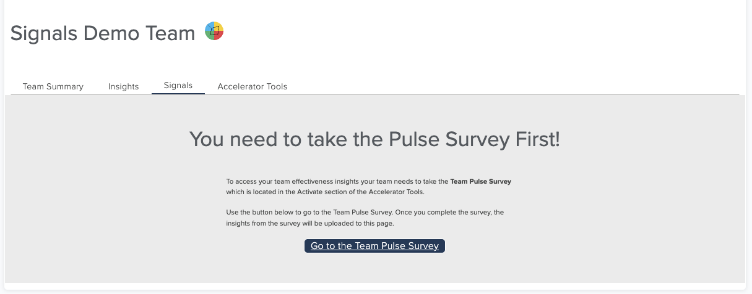
Complete the Team Pulse Survey
Close slides and share Team Profile ifor walkthrough. Switch back for slide 33.
The four-color, four-quadrant graphic and Whole Brain® are registered Trademarks of Herrmann Global, LLC.
Notes:
Note to Facilitator: For this part of the module, you will have the team complete the Team Pulse Survey and give them an introduction to their data. Note to Facilitator: Pay close attention to the time here, as you will go back to the Signals data before wrapping up the activity. 10 mins
SAY: Now go to the “Signals” tab. I would like everyone to take a moment to complete their Team Pulse Survey. You can click the link to go to the Team Accelerator tools to submit your survey. Let me know when you are done in the chat. DO: Ask participant to reload their “Signals” tab when everyone has completed taking the survey. SAY: Here you see the “Signals” tab with all of your results. You can take the Team Pulse Survey once a month to assess the effectiveness of your team by exploring: Note to Facilitator: As you quickly discuss each area of the Signals tab, use your mouse to help call out the section your are highlighting.
Your assessment of your overall team effectiveness. You will see the score for the month, how it has changed since the month before and you can toggle a comparison with up to four months of previous data.
You can also review team strengths, watchouts and your profile as you consider the insights.
You will also notice recommended actions to improve your effectiveness - which we will cover in more detail before we wrap up today.
Note to Facilitator: Be sure to keep a tab open on your browser that shows the recommendations made by the Signals tab for this team. You will be asked to share this at the end of the session so the team can decide with activity they will apply in the next two weeks.
SAY: For now, let’s go back to the menu under “Signal Data”. Click on “Effectiveness by Quadrant”. Take a moment to go to the Relational Thinking (C quadrant data). ASK: What stands out to you, what surprises you? Note to Facilitator: We will use this data as a bridge to the communication activity that is next. The goal will be to see areas where they can improve. Note the areas so you can reference them later. DO: Take a few minutes for participants to share their responses and take note of any specific areas they identified for improvement. SAY: Let’s quickly take a look at the other quadrants. DO: Walkthrough the responses in the A, B, and D quadrant. ASK: Are there any quadrants that you can see the opportunity to improve your effectiveness? DO: Give participants a minute or two to share their responses. DO: Highlight and note any specific quadrants they called out. Note to Facilitator: Also note if there is a specific quadrant that the team has identified for improvement. This data will be used in the “Apply a Whole Brain® Process” later in the session. TRANSITION: Great sharing and insights everyone! For the rest of our time today we are going to first talk about Whole Brain® communication as a foundation for improving your effectiveness. Then we will take some time to practice using a Whole Brain® process that you can take with you into your day-to-day. The great part is, after we are done you can apply what you learned and in a month’s time take the survey again to assess how you have improved. Let’s talk about Whole Brain® communication.

Slide 22
10 Minute Break

Slide 23
Whole Brain® Communication

Slide 24
Whole Brain® Communication
"The single biggest problem in communication is the illusion that it has taken place."
- George Bernard Shaw,
Irish Playwright
The four-color, four-quadrant graphic and Whole Brain® are registered Trademarks of Herrmann Global, LLC.
Notes:
2 minute
SAY: George Bernard Shaw once said, “The single biggest problem in communication is the illusion that it has taken place.”
This quote reminds us that communication isn't just about sending a message. It's about making sure it lands with the other person. And often, we think we've communicated well simply because we've communicated in the way we prefer.
But the truth is, people with different thinking preferences want and need different things in communication - this might mean moving towards their coordinates on the Whole Brain® map, or helping being them over to yours. Note to Facilitator: Use insights from Team Pulse data to highlight the area of communication and quadrant the team highlighted for improvement. Ask them to keep this in mind as they go through this exercise.
TRANSITION: What helps us figure out how we need to adjust our approach?

Slide 25
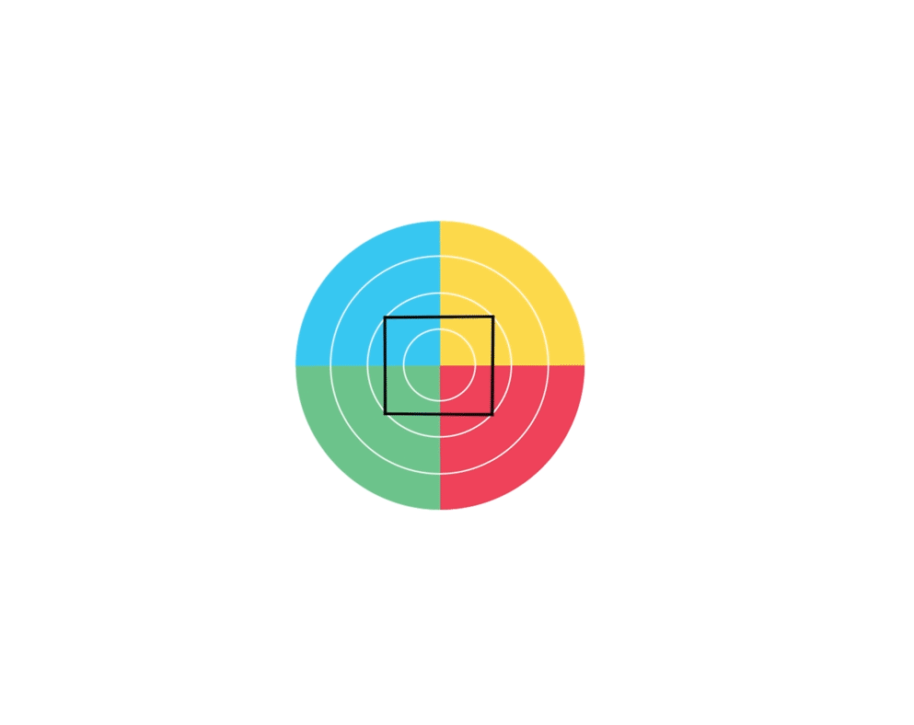
Thinking Agility
The ability to quickly and intentionally stretch beyond your default preferences and biases to adapt to new circumstances
The four-color, four-quadrant graphic and Whole Brain® are registered Trademarks of Herrmann Global, LLC.
Notes:
1 min
SAY: Thinking agility - which is having the ability to quickly and intentionally stretch beyond your default preferences and biases to adapt to new circumstances. Whether you’re problem-solving or collaborating as a team, thinking agility enables you to collaborate more effectively to deal with change, complexity and uncertainty - all themes that aren’t going away anytime soon.
TRANSITION: With this concept in mind, let’s explore the communication preferences of each quadrant.

Slide 26
Communication Preferences by Quadrant
What they prefer:
Clear goals and objectives
Data, facts, and logic
Technical accuracy
Structured, logical flow
Direct and to-the-point messages
What they’re listening for:
Brief, clear, and precise information
Data and fact-based charts
Logical arguments with evidence
Connection to business outcomes
A
The four-color, four-quadrant graphic and Whole Brain® are registered Trademarks of Herrmann Global, LLC.
Notes:
2 minutes
SAY: The A quadrant values logic over emotion and efficiency over embellishment. This quadrant sifts for relevance, so if your message wanders, they may tune out. ASK: Take a moment to review the slide and reflect on a time when your message didn’t resonate with a data-driven audience. What would you add or remove to be more credible and concise?
DO: Ask for 1 volunteer to share their response before going to the next slide.

Slide 27
Communication Preferences by Quadrant
What they prefer:
Step-by-step details
Written schedules and action plans
Clear roles and responsibilities
Consistency and reliability
Reference to established procedures
What they’re listening for:
How and when things will happen
Clear timelines and milestones
Past precedent or evidence it’s worked
A sense of order and control
B
The four-color, four-quadrant graphic and Whole Brain® are registered Trademarks of Herrmann Global, LLC.
Notes:
2 minutes
SAY: The B quadrant finds comfort in structure and process. This quadrant tunes in when they hear timelines, checklists, or documented steps - and may disengage when messages feel chaotic or spontaneous. ASK: Take a moment to review the slide and reflect on when have you seen a well-structured message improve clarity or build trust? What made it work?
DO: Ask for 1 volunteer to share their response before going to the next slide.

Slide 28
Communication Preferences by Quadrant
C
What they prefer:
Open, informal conversation
Emotional tone and warmth
Personal stories or human examples
Empathy and inclusion
Authentic, expressive dialogue
What they’re listening for:
Who is involved and how they feel
Empathy and personal consideration
Signs of trust and connection
An inclusive, people-centered tone
The four-color, four-quadrant graphic and Whole Brain® are registered Trademarks of Herrmann Global, LLC.
Notes:
2 minutes
SAY: The C quadrant is listening for connection. This quadrant notices tone, facial expressions, and whether people feel included or heard.
ASK: Take a moment to review the slide and reflect on a time a message truly connected with you emotionally. What was said - or how was it said - that made it feel so human and sincere?
DO: Ask for 1 volunteer to share their response before going to the next slide.

Slide 29
Communication Preferences by Quadrant
What they prefer:
Big-picture thinking
Visuals, metaphors, or storytelling
Imaginative, future-focused ideas
Freedom to ideate and explore
Energetic, informal exchanges
What they’re listening for:
Vision and possibility
Creative or unconventional ideas
Connections to strategy or innovation
High-level framing or conceptual models
D
The four-color, four-quadrant graphic and Whole Brain® are registered Trademarks of Herrmann Global, LLC.
Notes:
2 minutes
SAY: The D quadrant want to be inspired. This quadrant responds to “what if” thinking, metaphor, and imagination - not micromanagement.
ASK: Take a moment to review the slide and reflect on a pitch or idea that really captured your imagination. What creative or high-level element made it compelling or exciting?
DO: Ask for 1 volunteer to share their response.
TRANSITION: Now let’s take some time to share our communication preferences.

Slide 30
Sharing Your Communication Preferences
What do I listen for?
When I am asking questions, what quadrant am I usually in?
Which quadrant do I naturally go to when sharing information? What does that sound or look like?
15 minute breakout
The four-color, four-quadrant graphic and Whole Brain® are registered Trademarks of Herrmann Global, LLC.
Notes:
Note to Facilitator: This activity is designed for participants to share primarily in trios, but depending on the total number of participants you might have to use trios and pairs. Feel free to make adjustments to the set up as needed.
Note to Facilitator: Encourage participants to take a screenshot of the slide for their breakout groups.
Note to Facilitator: Have your notes about which areas of communication the team would like to improve on hand. You will use this in the activity debrief. 24 min SAY: For this breakout activity, we will send you into trios or pairs for 15 minutes - so trios will have 5 minutes per person to share. We will ask you to take turns sharing the following insights about your communication preferences:
What do I listen for?
When I am asking questions, what quadrant am i usually in?
Which quadrant do I naturally go to when sharing information? What does that sound or look like?
SAY: I will give you a minute to take down some notes and remember you can view your profile in the Thinker Portal (https://axon.herrmannsolutions.net/account/login) for insights now and when you are in your breakout rooms.
DO: When everyone has had the chance to jot down a few notes, send them to their breakout rooms for 15 minutes. Also encourage participants to take screenshots of the slide if needed for reference in their breakout rooms.
DEBRIEF: Welcome back, we have a few minutes here to debrief our sharing - and I would like to connect this back to the team pulse survey. DO: Share the area of communication the team highlighted for improvement. ASK: With what you have heard from your teammates, what are some ideas for you you can improve the area of communication you highlighted in your signals data? DO: Facilitate a discussion with the team for 4-5 minutes to identify ways they can improve their communication. TRANSITION: Great work and insights everyone! More importantly, awesome work identifying ways you can improve your collaboration and effectiveness. Let’s take what we have learned a step further and practice applying a whole brain process before we wrap up for the day. This will be an easy to use tool that you can apply in your day-to-day as you make decisions and work on projects.

Slide 31
Apply a Whole Brain® Process

Slide 32
Four Critical Questions Activity
A
D
Task: Create a plan to integrate new people into your team.
Process: Map action steps for this task in the following order:
A > D > C > B
Tools: The “Four Critical Questions” and AI Action Plans.
D
What is the task?
Define it as clearly as you can including just the critical facts.
2. Why is it important?
Why does this matter now and how does it align with where we are headed?
4. How should we move forward?
What are the action steps steps we should follow?
3. Who is most impacted?
Think of internal and external stakeholders. Include clients, sponsors and colleagues.
B
C
10 minute activity
Notes:
Note to Facilitator: This is a large group activity, so no need for breakout groups. If the team is large (use your discretion here), you can use breakout rooms. Just be sure to adjust the instructions, take a screenshot of the slide, and share it with the large group in chat. Note to Facilitator: Below this note you will find alternative recommendations for a problem or decision to be made by the team. Before the session, select one of the prompts and update the slide and prompt if it is more aligned with what you know about the team’s work - or meet with the team leader before the session to find a team-specific scenario you can use.
How can we redesign our regular team meetings to make them more productive.
How can we reinvent our hybrid or remote (edit to align with the team’s status) work experience to improve consistency in collaboration and results.
12 mins Note to Facilitator:
SAY: For this activity, you will collaborate as a team to plan how you will take on the following task:
Create a plan to integrate new people into your team.
We will take 10 minutes to map action steps for this task in the following quadrant order: A > D > C > B
We will use the “Four Critical Questions” to the right of the slide to help think about your action steps.
Note to Facilitator: Check your notes to see if there are specific quadrants the group has called out as wanting to improve their effectiveness. You might want to switch up the timing of the flow below to focus on insights into that quadrant.
SAY: While we won’t complete a full plan, this practice will show you how to apply the Four Critical Questions. We start the four questions with “what” - our “what” is creating a plan to integrate new people onto our team.
Before we do anything else, we need to understand why this task is important. ASK: Thinking as a team looking to improve their onboarding - why does this matter? DO: Take about 3-4 minutes to gather responses from the group and thank people for their contributions.
ASK: Who’s is impacted by our onboarding process? DO: Take about 3-4 minutes to gather responses from the group and thank people for their contributions.
ASK: How should we move forward? With what we heard, what would some immediate actions be that would ensure a successful plan is created?
DO: Take about 3-4 minutes to gather responses from the group and thank people for their contributions.
TRANSITION: Great work everyone! I know this was a quick walk through of the model. The goal was to do a quick practice of applying the Four Critical Questions. Let’s talk about the experience.

Slide 33

Four Critical Questions Activity Debrief
Reactions?
What worked well? What was challenging?
What tasks or projects could you apply this approach to?
Notes:
Note to Facilitator: This slide has a build. The first bullet point will be on the slide when it appears. The next two bullet points will appear one-by-one as you click forward. 5 mins ASK: What are your reactions from the activity?
DO: Give participants a minute to respond. DO (click to reveal): Second bullet. SAY: What worked well? What was challenging?
DO: Give participants a minute to respond.
DO (click to reveal): Third bullet. SAY: What tasks or projects could you apply this approach to?
DO: Give participants a minute to respond.
TRANSITION: Great work everyone! Let’s wrap up the day and talk about your next steps as a team.

Slide 34
Your Next Steps

Slide 35


Your Next Steps
Use the insights and tools from today.
In the next few weeks: Use the Four Critical Questions.
A month from now: Take your Team Pulse Survey and review your Signals data!
Notes:
8 mins SAY: First, be sure to use the insights you gathered and tools you learned as you get back to work together. You all learned more about your thinking and communication preferences. We also started to dig into your team data to discuss insights and actions you can take to improve collaboration. In the next few weeks, use the Four Critical Questions. Find a project or task you can start practicing with so you can start to build the rhythm of the four quadrant flow into your thinking to make sure you aren’t overlooking critical aspects of the work. A month from now, go back into your Thinker Portal and take your Team Pulse Survey. This will update your Signals reporting tab with another month of data. The Signals tab tracks your data over time and makes it easy to assess where you have improved - or where you might need to start focusing more of your attention. And remember, you will get team accelerator tool recommendations for activities that can help jumpstart your effectiveness. ASK: As a quick check in before we wrap up - what is one takeaway from today that you will carry with you into your flow of work? Is there something you learned about your preferences, the preferences of a teammate? Or maybe a tool on the screen? DO: Take 3-4 minutes to hear insights from the team. TRANSITION: Thanks everyone! I will hang around for a few minutes if you have any question, and if you are interested in further learning around Whole Brain® Thinking and the HBDI® I am always happy to help!

Slide 36
Presenter Name
+1 212-555-5555
presenter@email.com

