Slide 1

Facilitator
Slides

Slide 2
Facilitator Notes
Schedule the workshop with the group! Be sure they have enough time to complete their HBDI® assessment and journey beforehand. Completing the journey is required for this session.
In your meeting invitation, be sure to let the group know you will send them an invite to complete their HBDI® and journey (if they haven’t already completed both).
If there is a lead contact for the group session, meet with them to give them a preview of the session and ask for any insights they might have about customizing the prompts in the activities.
Review the full slide deck before delivering your session so you can be prepared to guide participants in the Thinker Portal and set up breakout rooms for activities.
Final note: This workshop is designed for a virtual environment - but it includes notes on how to adjust activities for an in-person delivery.

Slide 3
Herrmann Revision History
The following notes highlight the date of the most recent revisions and summarize updates to the slide content.
Revision Date | Summary of Updates
1/23/26 | Slideshow updates finalized

Slide 4
Whole Brain® Foundations for Groups Workshop: 120 mins
Duration | Activity | Slides | EST Time | Other Time Zone
18 mins | Welcome and Introduction | 7-11
5 mins | Welcome Slide | 7
2 mins | Facilitator Introduction | 8
8 mins | Who Are You on Vacation? | 9
1 min | Agenda | 10
2 mins | What You’ll Walk Away With | 11
11 mins | The Whole Brain® Model and the HBDI | 13-17
3 mins | The Whole Brain® Model and the HBDI® | 13
2 mins | Quick Quiz: C Quadrant | 14
2 mins | Quick Quiz: B Quadrant | 15
2 mins | Quick Quiz: A Quadrant | 16
2 mins | Quick Quiz: D Quadrant | 17
27 mins | Share “About Me” | 19-20
7 mins | Reading the HBDI® Profile and Preference Code | 19
20 mins | Share “About Me” | 20
5 mins | Break | 21
27 mins | Cluespotting | 23-25
2 mins | Whole Brain® Communication | 23
12 mins | Cluespotting Compass | 24
12 mins | Identifying Blended Clues | 25
2 mins | Thinking Agility | 25
26 mins | Thinking Agility | 27-30
2 mins | Thinking Agility | 27
7 mins | What Matters When Buying a Car | 28
10 mins | Convince Me | 29
7 mins | Convince Me Debrief | 30
6 mins | Your Next Steps | 33
2 mins | What We Covered Today | 32
4 mins | Your Next Steps | 33
Total 120 mins

Slide 5
Learning Objectives
Overall Objective: Describe the core principles of the Whole Brain® Model, identify their own thinking preferences, and begin applying Whole Brain® Thinking to improve communication and collaboration in everyday work.
By the end of the session, participants will be able to …
Share their thinking preferences with confidence and recognize how differences in thinking impact communication and collaboration.
Apply foundational Whole Brain® tools to stretch their thinking and connect more effectively with colleagues in real-time scenarios.
Identify practical ways to build Whole Brain® Thinking habits that support stronger collaboration and workplace results.

Slide 6
Welcome and Introduction

Slide 7



Whole Brain® Foundations: Understand and Connect
Notes:
Note to Facilitator: The 5 minutes here is to accommodate group members who may log on a few minutes after the formal start time. Once everyone is logged in and has opened their “Whole Brain® Profile”, start the session. Note to Facilitator: The QR code on the screen takes participants to the Thinker Portal on their mobile phone where they will be asked to sign in to view their profile. If your participants are all using computers, you can delete this QR code. 5 mins NOTES:
As people arrive, ask them to log into the their Thinker Portal and load their “My HBDI®” page.
Have your “My HBDI®” page open in a web browser so you are ready to help participants land on the right page.
Link to Thinker Portal: https://journey.herrmannsolutions.net/thinker
When everyone has arrived, start the session.
SAY: Welcome to our Whole Brain® Foundations workshop - Understand and Connect! I hope you all enjoyed seeing your profiles and learning more about your thinking preferences in your journey - I know I am excited for all of you to start learning more about each other and how Whole Brain® Communication can help improve how you connect with others! TRANSITION: None, move to next slide.

Slide 8
Welcome!
I’m {name here}.
{Title} {Second line for additional info}
{Profile score, ex. 2211 Thinker}
Replace with facilitator photo
Notes:
2 mins Note to Facilitator: Use this slide template to introduce yourself to the group before you get started with the icebreaker. You can add any notes you would like to share below. TRANSITION: Let’s kick things off with a fun activity to learn a little more about each other.

Slide 9
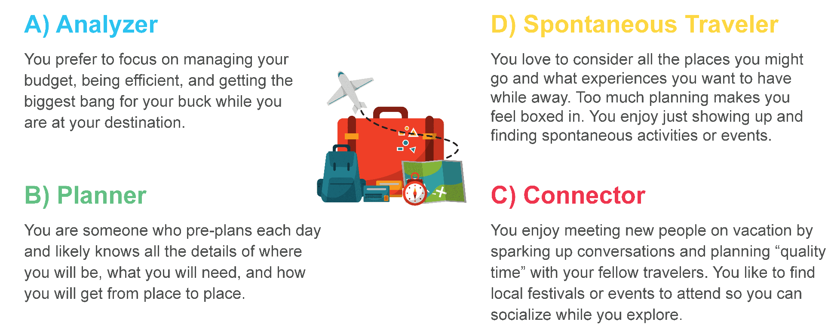
Who Are You on Vacation?
Notes:
Note to Facilitator: Review this activity before you delivery your workshop. If the group is large, ask participants to share their responses only in chat. If the group is smaller, you can have them share verbally. If the group is in-person, you can set up the activity where groups of 2-3 people at tables share their responses for 5 minutes, there are a few minutes of space here to get the group into and back from their discussion. 8 mins
SAY: To get us started, let’s do a quick icebreaker called, “Who Are You on Vacation. Take a moment to review the personas on the screen. They provide a summary of different ways we think about and enjoy vacations with family or friends. Once you’ve had a chance to review, share “who you are on vacation” verbally or in chat.
DO: Take 5 minutes for participants to share who they are on vacation and comment on responses and trends.
SAY: Thank you all for sharing! TRANSITION: Let’s take a look at our agenda for the day.

Slide 10
Agenda
Review the Whole Brain® Model and HBDI®
Share “About Me”
5 Minute Break
Cluespotting
Thinking Agility
Your Next Steps
The four-color, four-quadrant graphic and Whole Brain® are registered trademarks of Herrmann Global, LLC.
Notes:
1 min
SAY: Today we will …
Quickly review the Whole Brain® Model and HBDI®.
Break into small groups to share “About Me” - in other words, share our individual thinking preferences.
Discuss cluespotting, a great resource from the Whole Brain® communication toolkit.
Introduce and practice thinking agility.
Discuss ways you can continue to build “Whole Brain® Muscle” after our session.
SAY: Let’s take a moment to talk about what you’ll walk away with and then we will get started.

Slide 11
What You’ll Walk Away With
Confidence
Insight
Experience
Practical Strategies
Notes:
Note to Facilitator: This slide will appear without any of the arrow graphics on the screen. They will appear one-by-one as you click forward as instructed in the notes.
2 min
SAY: So what will you walk away with?
(Click to reveal) Confidence in sharing your HBDI® insights to better understand your individual thinking preferences.
(Click to reveal) Insight into your individual thinking preferences to spot strengths and surface potential gaps.
(Click to reveal) “Hands-on” experience using tools to help you stretch your thinking in the real work situations you’ll face.
(Click to reveal) Practical strategies to keep building your Whole Brain® Thinking “muscle” for ongoing impact.
SAY: Let’s start with a review of the Whole Brain® Model and HBDI®

Slide 12
The Whole Brain® Model and the HBDI®

Slide 13
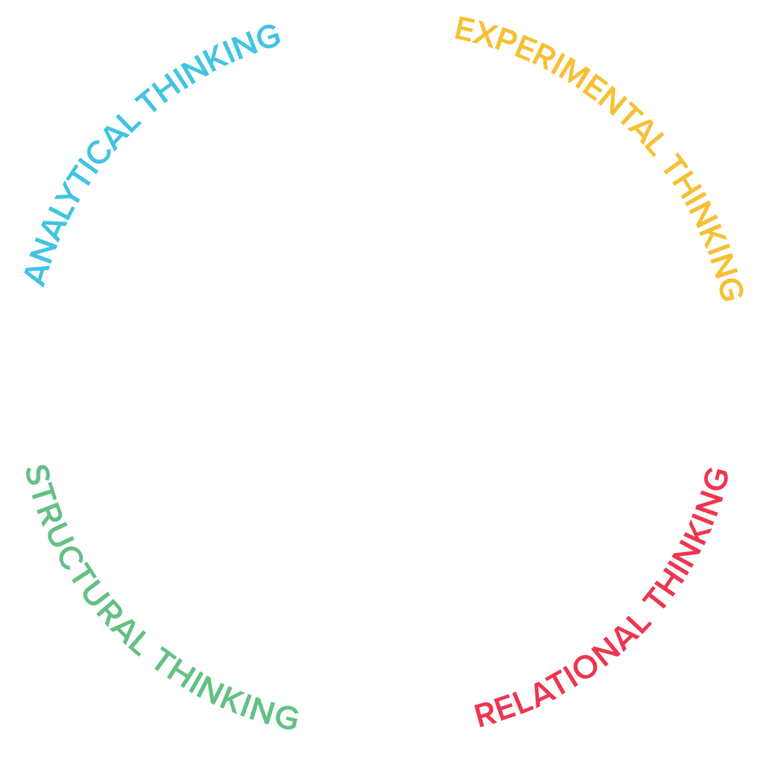
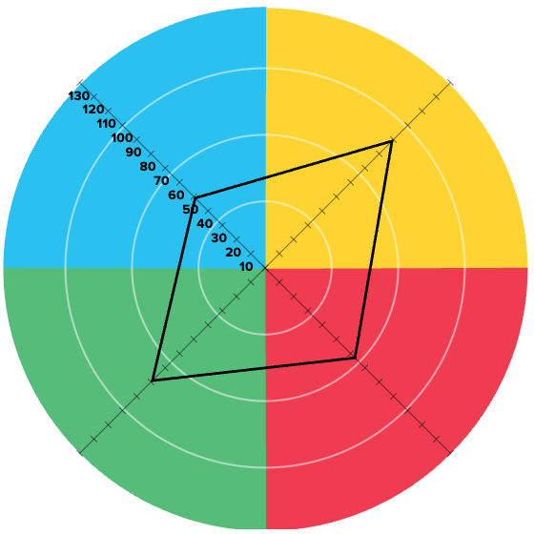

The Whole Brain® Model and the HBDI®
A
D
Logical
Analytical
Fact-based
Quantitative
Holistic
Experimental
Integrating
Synthesizing
Organized
Sequential
Planned
Detailed
Interpersonal
Empathic
Kinesthetic
Emotional
B
C
The four-color, four-quadrant graphic and Whole Brain® are registered Trademarks of Herrmann Global, LLC.
Notes:
Note to Facilitator: This slide has a build. The slide will start with the Whole Brain® Model core graphic in the middle of the slide. When you click forward, a profile kite will appear to help support the teaching point in the notes below. 3 mins SAY: The Whole Brain® Model is an organizing principle for how we think. It helps us understand how we engage with the world around us. It outlines four distinct ways of thinking that shape how we solve problems, communicate, learn, and collaborate. One helpful way to think about it is this: the Whole Brain® Model gives us the map - the full terrain of thinking that helps us navigate our day-to-day. We all have access to each quadrant. The difference is where we naturally start when we think and work. If the model is the map … DO: Click to reveal the HBDI® graphic overlay on the model. SAY: The HBDI® helps us understand our coordinates on that map - or which quadrants we prefer, or look to first, as compared to others.
TRANSITION: Understanding the Whole Brain® Model and our HBDI® data encourages us to stretch beyond our natural preferences and consider other approaches - whether it’s analyzing data, taking action, building relationships, or generating new ideas. Before we shift focus to the HBDI® and your data, let’s do a quick activity to brush up on your knowledge of the Whole Brain® Model.

Slide 14
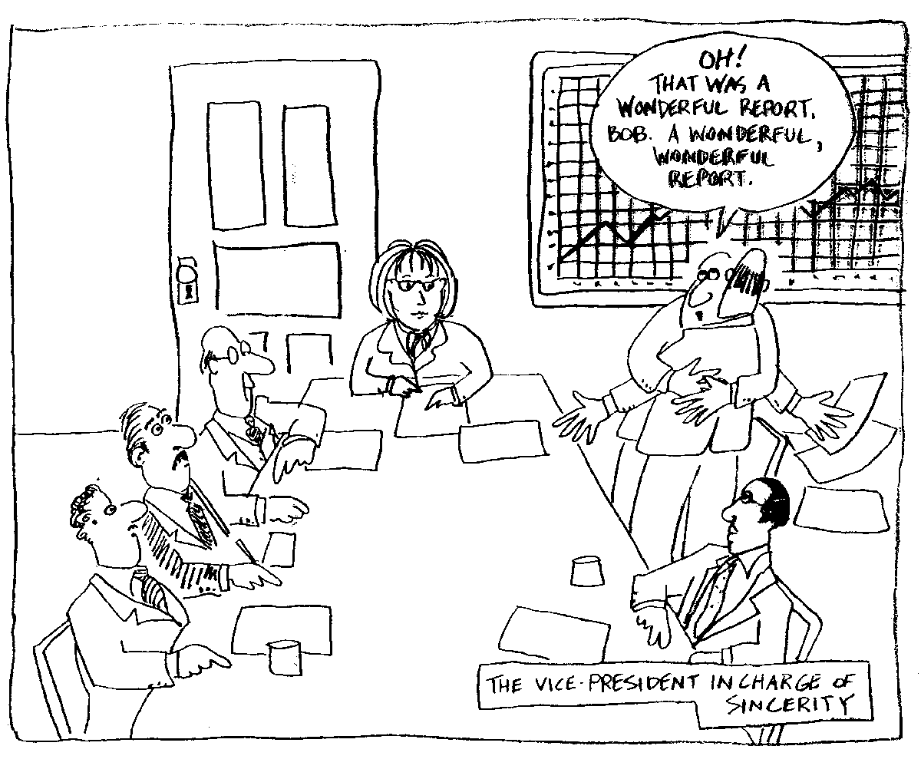
Oh! That was a
wonderful report Bob!
A wonderful report!
THE VICE-PRESIDENT
IN CHARGE OF ENTHUSIASM
Notes:
Note to Facilitator: This slide has a build. The cartoon will be on the screen and the red background will appear when you click forward.
Note to Facilitator: You can adjust this activity as needed based on group size or delivery method. For example, if the group is small and virtual, you can just have participants share their guesses verbally while taking some time to ask participants why they made a certain guess. If the group is in person, you can have participants decide on their guesses together in small groups or at tables - the 2 minutes accommodates some time for them to formulate a guess together before you reveal it, you will just want to be sure you let the group know we will be going through multiple rounds so you can keep their attention.
2 min
SAY: What quadrant does this cartoon best represent? Type your response in chat.
DO: Give participants a moment to type their responses. DO: Share that red is correct because it shows enthusiasm, hugs - a focus on relationships.
TRANSITION: Here’s our next image.

Slide 15
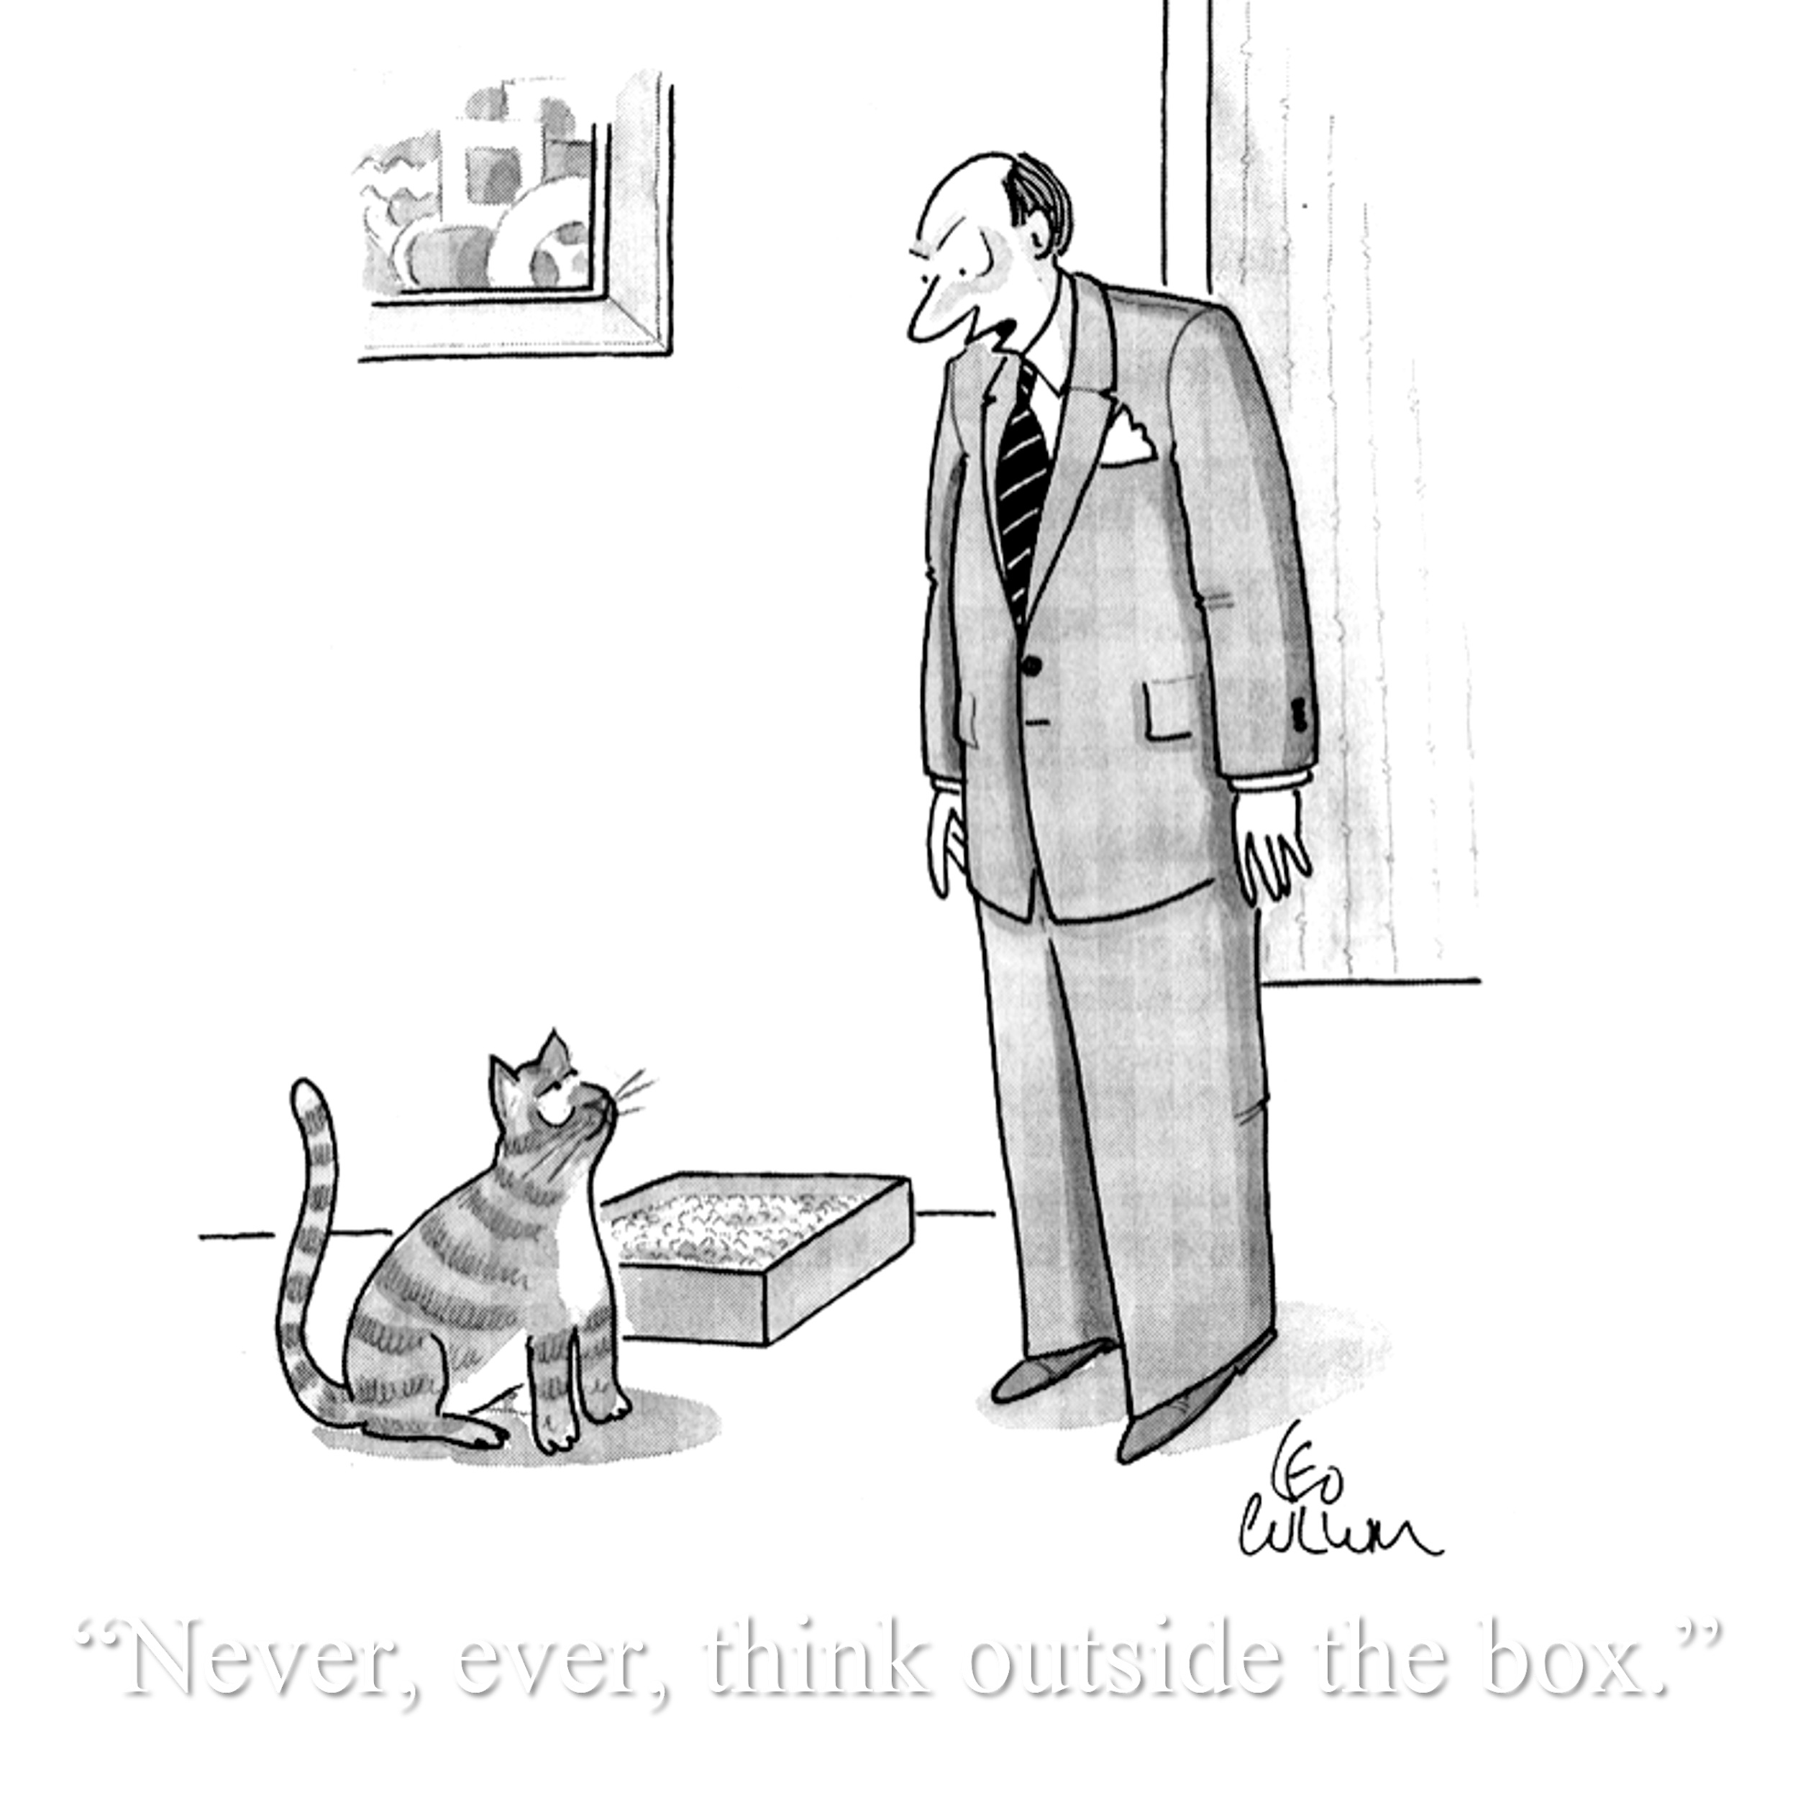
Notes:
Note to Facilitator: This slide has a build. The cartoon will be on the screen and the green background will appear when you click forward. Note to Facilitator: You can adjust this activity as needed based on group size or delivery method. For example, if the group is small and virtual, you can just have participants share their guesses verbally while taking some time to ask participants why they made a certain guess. If the group is in person, you can have participants decide on their guesses together in small groups or at tables - the 2 minutes accommodates some time for them to formulate a guess together before you reveal it, you will just want to be sure you let the group know we will be going through multiple rounds so you can keep their attention.
2 min
SAY: What quadrant does this cartoon best represent? Type your response in chat.
DO: Give participants a moment to type their responses. DO: Share that green is correct because it shows a commitment to enforcing the rules.
TRANSITION: Here’s our next image.

Slide 16

In God We Trust…
All Others Must Have
Notes:
Note to Facilitator: This slide has a build. The cartoon will be on the screen and the blue background will appear when you click forward. Note to Facilitator: You can adjust this activity as needed based on group size or delivery method. For example, if the group is small and virtual, you can just have participants share their guesses verbally while taking some time to ask participants why they made a certain guess. If the group is in person, you can have participants decide on their guesses together in small groups or at tables - the 2 minutes accommodates some time for them to formulate a guess together before you reveal it, you will just want to be sure you let the group know we will be going through multiple rounds so you can keep their attention.
2 min
SAY: What quadrant does this cartoon best represent? Type your response in chat.
DO: Give participants a moment to type their responses. DO: Share that blue is correct because it demonstrates a strong trust in data.
TRANSITION: Here’s our next image.

Slide 17
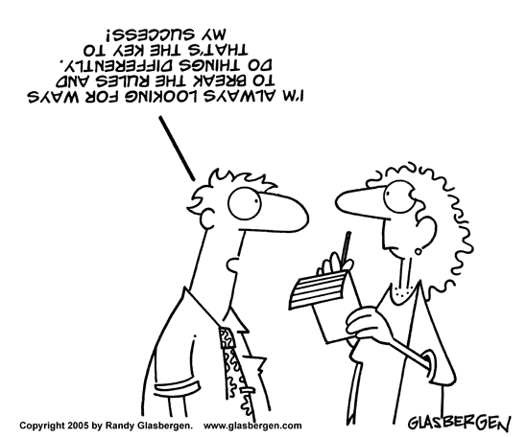
Notes:
Note to Facilitator: This slide has a build. The cartoon will be on the screen and the yellow background will appear when you click forward. Note to Facilitator: You can adjust this activity as needed based on group size or delivery method. For example, if the group is small and virtual, you can just have participants share their guesses verbally while taking some time to ask participants why they made a certain guess. If the group is in person, you can have participants decide on their guesses together in small groups or at tables - the 2 minutes accommodates some time for them to formulate a guess together before you reveal it, you will just want to be sure you let the group know we will be going through multiple rounds so you can keep their attention.
2 min
SAY: What quadrant does this cartoon best represent? Type your response in chat.
DO: Give participants a moment to type their responses. DO: Share that yellow is correct because it shares a perspective that is not traditional, willing to break the rules.
TRANSITION: Great work! You clearly have a good working knowledge of Whole Brain® Thinking. Now let’s do a quick refresher on the “coordinates” your HBDI® profile provides and share our preferences.

Slide 18
Share “About Me”

Slide 19
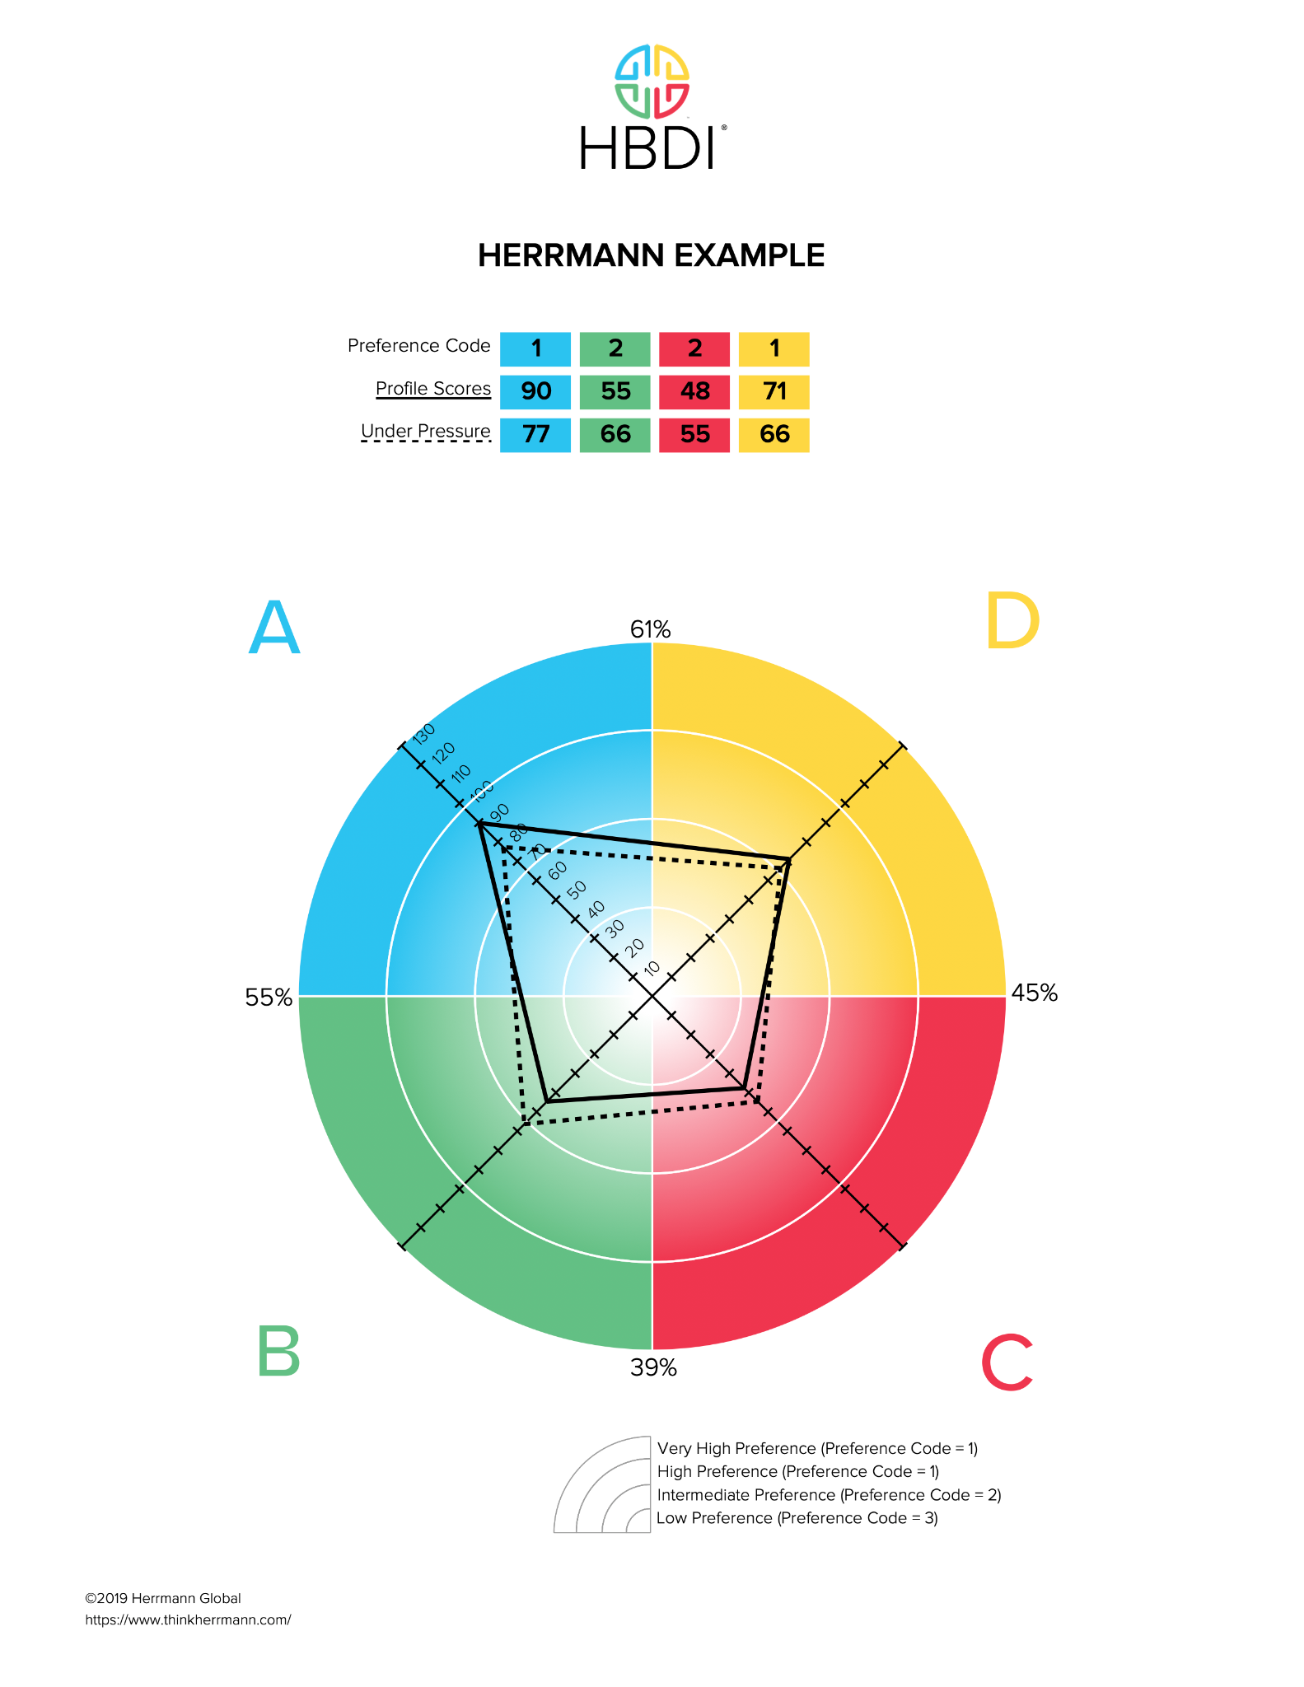
Reading the HBDI® Profile Preference Code
VERY STRONG 1+
STRONG 1
INTERMEDIATE 2
LOW 3
UNDER PRESSURE
The four-color, four-quadrant graphic and Whole Brain® are registered Trademarks of Herrmann Global, LLC.
Notes:
Note to Facilitator: Depending on the group size, or if you are doing an in-person delivery, you might want to make adjustments to the Q&A section of these notes. If the group is large, you may want to skip this portion as you don’t have a lot of time - and you might need the extra time for other activities. Note to Facilitator: This slide has a build. The preference strength text will appear one-by-one as you click and appear in the order of low, intermediate, strong and then very strong. Another click will reveal the under pressure text. 7 mins DO: Ask participants to pull up the Thinker Portal (https://axon.herrmannsolutions.net/account/login) and go to the “My HBDI®” tab so they can view their profile.
SAY: The HBDI® doesn’t measure skills or intelligence - it measures your thinking preferences across the four quadrants of the Whole Brain® Model. It’s about how you prefer to think, not how well you think. DO: (Click to reveal) Each preference marker on the slide as you provide the quick description.
If you have a 3, or low preference (33 or below): These ways of thinking can drain your energy - but it is important to keep in mind that if someone has a low preference, don’t make assumptions. For example, people with low scores in the C, or red quadrant, have feelings like anyone else. They just might not express them as much as others.
If you have a 2, or intermediate (34–66): This is often a comfort zone, it isn’t a preference and it isn’t something that you find draining.
A 1, or strong preference (67–100): These are primary preferences that you find energizing.
A 1+, or very strong preference (100+): This level of preference is often so strong, it is visible to others. So if you are trying to hide it, forget it, everyone already knows.
DO: (Click to reveal) the dotted under pressure line.
SAY: The dotted line shows how your preferences may shift when you are under pressure or stress. Sometimes the under pressure profile is very close to the day-to-day – which means others don’t see “the pressure” even if a person is feeling it. Or, it can also be noticeably different. Often, people perceive you more from the dotted line…because they remember you under pressure.
DO: Take 4 minutes to answer any questions. ASK: Does anyone have any questions about reading the HBDI® profile preference code? Or the HBDI® in general? Note to Facilitator: Here are some questions you might hear:
Can my profile change? ANSWER: Yes, someone's HBDI® profile can change over time - but the changes are typically gradual, not dramatic, and often related to life stage, role changes, or significant personal development.
What if my under pressure score in a specific quadrant is zero? ANSWER: A zero in an HBDI® quadrant under pressure means the person has no measurable preference for that type of thinking under pressure, not that they lack the ability - it’s an insight into where they’re least likely to focus when under pressure. It highlights potential blind spots and growth areas, especially under pressure, but everyone still has access to all four quadrants.
TRANSITION: Thank you for your questions! Now that we have an understanding of how the data is presented, let’s give you some time to share how you think!

Slide 20
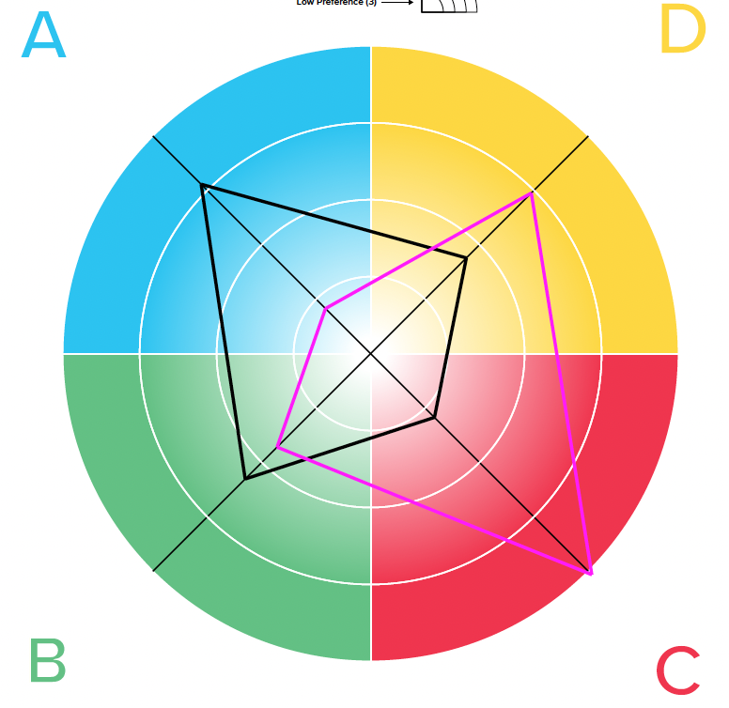
Share About Me
A: What I do best
D: What I am working toward
C: What motivates me
B: How to best work with me
Reflect on the four questions and how your profile shows up. Take turns sharing your responses in your small group.
15 minute breakout
Notes:
Note to Trainer: This activity uses breakout rooms, so be sure to set up groupings before hand, or use random assignments if the group is large. Note to Trainer: If delivering in person, you can have people form small groups at their tables. 20 mins
SAY: For this activity, we will:
Send you to breakout groups of three.
Each person will have 5 minutes to discuss how their profile shows up by sharing their insights related to how they interpret their profile, what they do, what they are working towards, what motivates them and how best to work with them.
I will give you a minute open your “Whole Brain® Profile” in the Thinker Portal (https://axon.herrmannsolutions.net/account/login) for insights now and when you are in your breakout rooms. Hover over your initials in the top right corner of the Thinker Portal to find your “Whole Brain® Profile”.
You will all have 15 minutes in your small groups before we bring you back.
DO: Ask if there are any questions and send participants into their small groups of three. Send reminders every 5 minutes if possible to nudge the group to have the next person share. DO: Stay on this slide for the welcome back from the activity. SAY: Thank you all for your sharing! We are going to take a 5 minute break and when we get back we will dig into a key aspect of Whole Brain® Communication - we call it cluespotting.

Slide 21
5 Minute
Break

Slide 22
Cluespotting

Slide 23

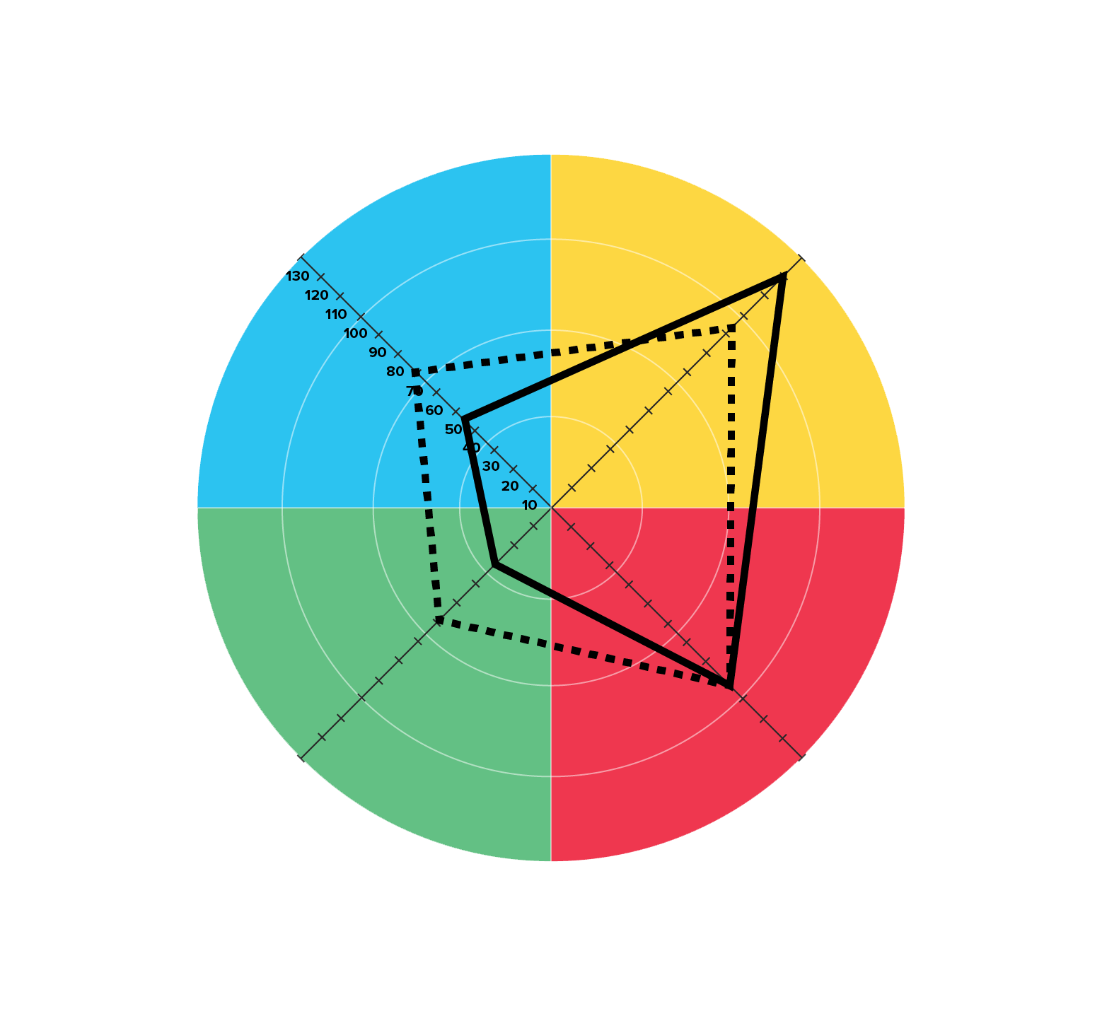
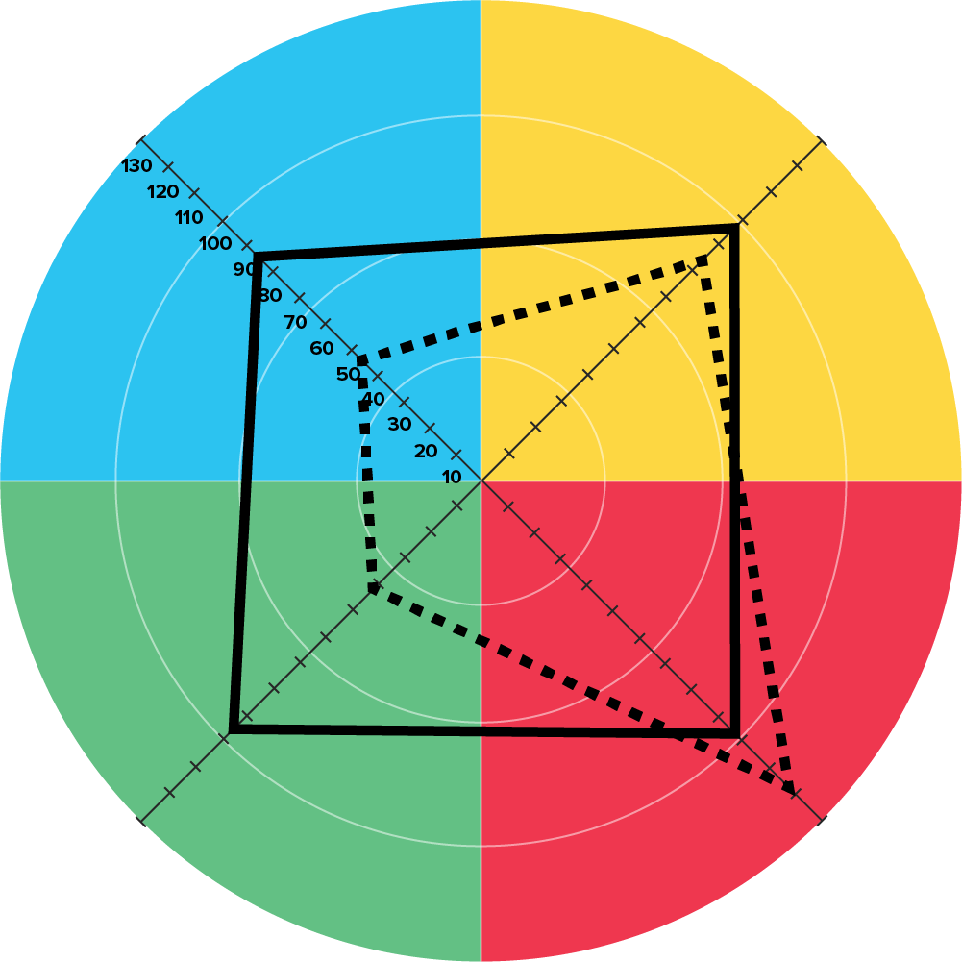
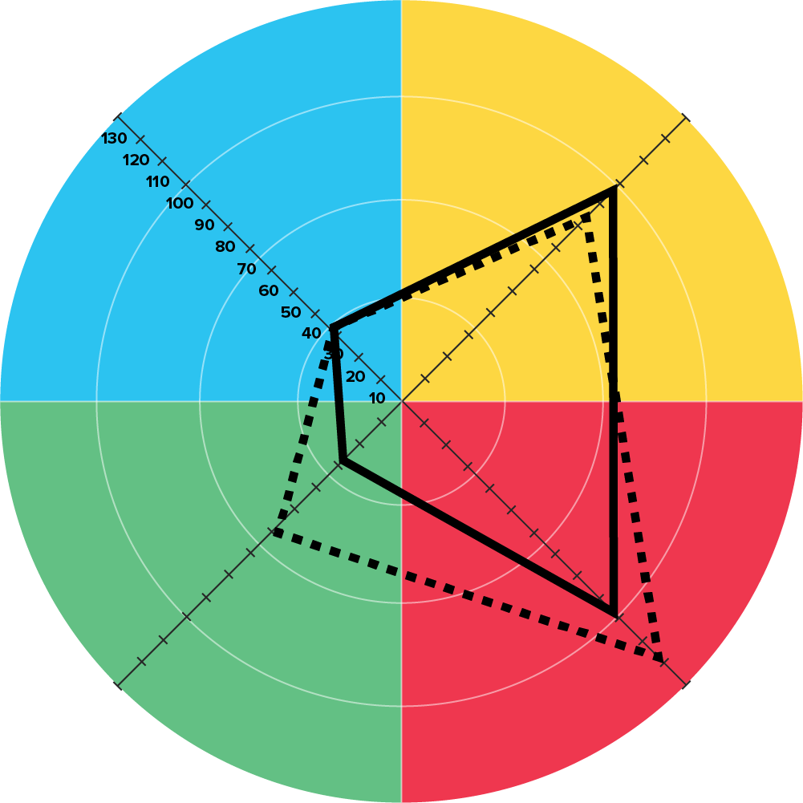
Whole Brain® Communication
"Seek first to
understand, then
to be understood."
- Stephen Covey
Notes:
Note to Facilitator: This slide contains a build. The quote and image on the slide will appear when you click to move forward. 2 mins
SAY: Have you ever walked out of a meeting or conversation thinking, “That did not land the way I meant it to”? Maybe you shared something important - and got silence. Or someone reacted in a way that totally caught you off guard.
These moments aren’t just misfires. They’re often mismatches in how we think - and how we communicate.
DO: (Click to reveal) quote and image.
Stephen Covey once said, "Seek first to understand, then to be understood." It’s a powerful reminder - and one that aligns well with the principles of Whole Brain® communication. Whole Brain® communication is about recognizing that people with different thinking preferences want and need different things when they communicate.
We often believe we’ve sent our message clearly - because we used language that we understand. But effective communication isn’t just about what we say - it’s about making sure it lands.
That’s where Cluespotting comes in. It’s a tool to help you listen for the subtle, quadrant-specific signals others give and respond in a way that meets them where they are.
TRANSITION: Let’s explore how Cluespotting helps you recognize those patterns in real time - so you can connect more effectively, immediately.

Slide 24




Cluespotting Compass
What do the numbers say?
Be logical, be realistic.
Measure it, prove it.
Show me the facts.
What if we tried … ?
Let’s imagine possibilities.
Think outside the box.
Look at the big picture.
A
D
What’s the process?
Stick to the plan.
Be on time.
Follow the steps.
B
C
How does this impact us?
Let’s support each other.
I feel strongly about this.
We need to involve everyone.
Notes:
Note to Facilitator: If your group is large, you can adjust the facilitator notes so the short activity is a table or pair conversation. For example, you could introduce each of the quadrants, provide commentary and then give participants 5 minutes to discuss a key question or two from the original activity. Note to Facilitator: This slide has a build. The phrases in each quadrant will be revealed as you click forward in the presentation. 13 mins
SAY: People rarely tell us directly, "I prefer facts" or "I want to focus on people." Instead, they give us clues in their words, tone, pace, and energy.
Maybe someone lights up when talking about data…
Or leans in when discussing timelines…
Or gets animated when brainstorming ideas…
Or focuses on how a change will impact the team.
These subtle signals are all thinking clues.
The Cluespotting Compass helps us organize what we notice so we can better understand where someone is coming from - and adapt our response so our message connects.
Just like a compass points to direction, this helps us orient in conversations. Once we notice where the clues point, we can choose how to stretch.
DO: (Click to reveal each quadrant) After each reveal:
Briefly highlight one key phrase (you do not need to read them all).
Ask: "What's a phrase you've heard someone else say recently that feels like a clue for this quadrant?" OR "When have you heard language like this show up in your team's conversations?"
Invite responses in chat or verbally (keep verbal examples to 1–2).
After 2-3 examples, ASK: "And when you hear phrases like these, what does that tell you about what that person needs from the conversation?"
Acknowledge patterns you hear (e.g., "Lots of Blue clues today - makes sense given the nature of your work!").
SAY: This awareness matters because we naturally tune into clues that match our own preferences. If you're strong in the A quadrant, you might immediately pick up on someone asking "What's the ROI?" but completely miss when they're also worried about team morale. Cluespotting is about widening your listening range.
TRANSITION: Of course, conversations aren't always this neat. People blend preferences all the time. Someone might start with the facts… then shift into the process… or talk about team impact while pitching a big idea. These blended clues are just as important because they tell us we may need to stretch in more than one direction depending on what the moment calls for.
Let's practice with a few examples.

Slide 25
Identifying Blended Clues
This idea has energizing potential - let’s reframe it to spark engagement and align with our shared purpose.
D
C
Let’s stay on track with our delivery milestones while ensuring the team stays motivated.
B
C
Our current metrics are promising - could we leverage this momentum to pilot a new approach in the next iteration?
A
D
Given the insights and regulatory context, let’s structure a phased rollout aligned with our compliance framework.
A
B
Notes:
Note to Facilitator: If the group is large, you can shift this to a table activity. You can have participants quickly share their guesses, keep a tally of correct answers and then give them 3-4 minutes to debrief around a question from the original debrief. Note to Facilitator: This slide has a build. One click forward will reveal the first statement. The next click will reveal the answer. There are a total of four statements and they will follow this pattern. 12 minutes
DO: Introduce the activity, “I will bring a statement up on the screen. Read the statement and guess in chat which two quadrants are being used in the statement. When we have guesses in we will reveal the answer. We have a total of four statements.” Then click forward to reveal statements, provide some light commentary and reveal the answers.
(Click to reveal) This idea has energizing potential - let’s reframe it to spark engagement and align with our shared purpose. (Click to reveal) Answer: D+C
(Click to reveal) Let’s stay on track with our delivery milestones while ensuring the team stays motivated. (Click to reveal) Answer: B+C
(Click to reveal) Our current metrics are promising - could we leverage this momentum to pilot a new approach in the next iteration? (Click to reveal) Answer: A+D
(Click to reveal) Given the insights and regulatory context, let’s structure a phased rollout aligned with our compliance framework. (Click to reveal) Answer: A+B
DEBRIEF: Spend a few minutes asking participants:
Which quadrant clues are were easy for them to spot.
Which clues were tougher for them to notice.
Highlight how blended clues are common in real communication, and noticing both quadrants helps us respond in ways that make people feel heard and keep the conversation moving forward.
TRANSITION: Great! You're getting good at hearing the clues - recognizing where someone is coming from, even when they're blending multiple preferences in one conversation.
But here's the thing: spotting the clues is only step one. The real power comes in what you do next.
Once you know someone is asking "What's the process?" or lighting up about future possibilities, you have a choice. You can respond from your natural preference, or you can stretch to meet them where they are. That stretching? That's where communication actually connects.
So now we're going to practice that second step: tapping into your thinking agility to match what the moment - and the person - needs.

Slide 26
Thinking Agility

Slide 27

Thinking Agility
The ability to quickly and intentionally stretch beyond your default preferences and biases to adapt to new circumstances
The four-color, four-quadrant graphic and Whole Brain® are registered Trademarks of Herrmann Global, LLC.
Notes:
2 min
SAY: As we just experienced, building your Whole Brain® muscle is not just about knowing which quadrants you prefer, but having the ability to quickly and intentionally stretch beyond your default preferences and biases to adapt to new circumstances - or meet others in alignment with their preferences. Whether you’re problem-solving or collaborating as a team, thinking agility enables you to collaborate more effectively to deal with change, complexity and uncertainty - all themes that aren’t going away anytime soon. Think of it this way, Whole Brain® Thinking gives us the map. HBDI® data and cluespotting gives us the coordinates and thinking agility is how we choose to move. There are times where we move towards the preferences of others and times where we want to guide others to ours.
TRANSITION: Before we get a fun activity to stretch our thinking, let’s take a little time to talk about how our preferences show up in a common decision making process.

Slide 28
What Matters When Buying a Car
Performance data and statistics
Cost, trade-in value, energy efficiency
Comparison shopping
Technical details and how it works
Warranty terms and coverage details
Aesthetic qualities: color, form, sportiness
New and innovative features
Fit with personal image
Long-range plans and vision
Early adoption and experimentation
Having a checklist to evaluate options
Safety features and durability
Maintenance requirements
Reliability and quality
Long-term practicality
Feel and comfort of the vehicle
Authenticity of sales staff
Friend recommendations
User-friendliness
Gut feeling and emotional connection
Notes:
Note to Facilitator: There are instances where a participants least preferred quadrant might be the quadrant they use when buying a car. For an example, someone might score low in the A quadrant on the HBDI®, but they tap into this quadrant when they make a major purchase. If you receive a question around this, advise the participant they can select the the quadrant they least think about when buying a car. 7 min SAY: Let’s start by taking a little walkaround a common decision we have, or will, make - buying a car. This approach gives us the opportunity think about the types of things each quadrant pays most attention to. Take a moment to review the considerations in each quadrant. ASK: Which considerations most align with your approach to buying a car? How do these align with your most preferred quadrants? DO: Ask for a few volunteers to share their response to the questions. SAY: Now, think about your least preferred quadrant - which will be the focus of our next activity - quickly review what that quadrant focuses on when buying a car. DO: Give participants a moment to review the considerations in their least preferred quadrant. TRANSITION: Very good, let’s get to our activity.
Next Slide: Convince Me

Slide 29
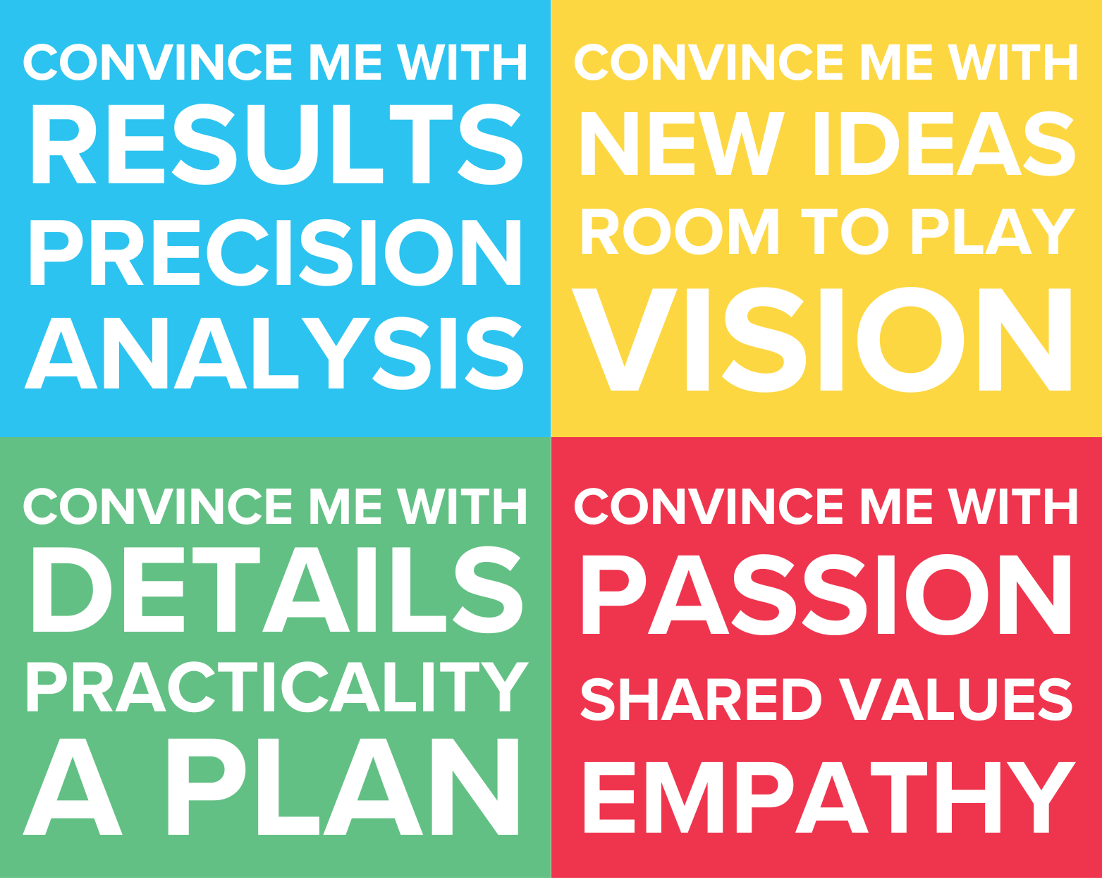
Convince Me
You will have 2 minutes to:
Sell the others a car using only your least preferred quadrant.
Pay attention to how it feels to intentionally stretch your thinking.
8 minute breakout
Notes:
Note to Facilitator: If you are delivering this workshop in-person, you can ask participants to form groups of two to three people at their tables. Note to Facilitator: For this activity you will be sending participants into breakout groups of 2-3 people. Set these up ahead of time so you can easily facilitate the activity. 10 mins
SAY: For this activity we will place you in breakout groups of 2-3 people. Each of you will have 2 minutes to sell the others a car using only your least preferred quadrant. We know this can be challenging, pay attention to how it feels to intentionally stretch your thinking.
DO: Answer any questions and then send participants to their breakout groups.

Slide 30

Convince Me Debrief
Describe it - in one word!
What did you find most challenging?
Notes:
Note to Facilitator: If you are delivering this workshop in person, you can adjust the slide to share both questions at the same time and ask the groups who worked together to debrief their experience for 5 minutes.
Note to Facilitator: This slide has a build. The first bullet point will be on the slide when it appears. The next bullet point will appear as you click forward. 7 mins
SAY: Welcome back!
ASK: In one word - how did it feel to stretch into your least preferred quadrant?
DO: Give participants a moment to share in chat or aloud.
DO: (Click to reveal) the second bullet.
ASK: What did you find most challenging about it?
DO: Take 3-4 minutes for participants to respond and provide commentary.
SAY: Thank you for sharing! That was a big stretch - and it might have felt awkward, forced, or even a little uncomfortable.
But here’s the good news: you just practiced one of the hardest kinds of thinking agility - intentionally operating in a space that doesn’t come naturally to you.
And in your real, everyday work? Stretching doesn’t have to be that extreme.
You won’t always be “selling from your least preferred quadrant” - but you will face moments where someone’s coming from a different place than you. And now, you’ve got a framework and tool to help you flex, connect, and communicate more effectively in those moments.
This is what building thinking agility looks like - not trying to operate equally in every quadrant, but knowing how to shift your thinking intentionally when it matters most.
TRANSITION: Thanks again for your hard work, let’s talk about your next steps.

Slide 31
Your Next Steps

Slide 32
What We Covered Today
Your Thinking
Your HBDI® profile and your preferences
Understanding your data
Stretching Your Thinking
Thinking Agility: adapting beyond your default preferences
Communication across the quadrants
Tools for Action
Cluespotting Compass
Thinker Portal: Access your profile and resources anytime
Connecting with Others
Sharing and hearing "About Me"
Cluespotting: recognizing which quadrant someone is speaking from
Notes:
Note to Facilitator: This slide has a build. Each quadrant will appear as you click forward in the A, B, C, D order. 2 mins
SAY: Let's take a moment to recap what we covered today. DO: (Click to reveal) the A quadrant.
SAY: We started by exploring your thinking - your HBDI® profile and your preferences - and spent some time helping you understand your data.
DO: (Click to reveal) the C quadrant. SAY: Then we focused on connecting with others. You shared your "About Me" insights and learned cluespotting - how to recognize which quadrant someone is speaking from so you can communicate more effectively. DO: (Click to reveal) the B quadrant.
We gave you tools for action. You now have the Cluespotting Compass to guide your listening and your Thinker Portal where resources like your HBDI® profile and journey live.
DO: (Click to reveal) the D quadrant. And finally, we practiced thinking agility and you were able to see and hear communication approaches across the quadrants - all in an effort to stretch your thinking.
TRANSITION: So what's next? How do you take this forward?

Slide 33


Your Next Steps
This week: Share your profile
This month: Practice cluespotting
Bring Whole Brain® Thinking to Your Team
Notes:
Note to Facilitator: If you are working with a large group, you can adjust the quick reflection question at the end of the notes how you see fit. With a large group, it might not fit to ask the question. If you are in-person and the group is the right size, you can have participants share their responses verbally. 4 mins
SAY: So what's next? How do you take what you learned today and keep building momentum?
This week, book some time to share your profile with someone on your team. Use your "About Me" section in the Thinker Portal to share your thinking preferences and how you work best - then ask them to share about their preferences. This is a low-stakes way to start building shared language.
This month, practice cluespotting. Pick one day, or a meeting, and use the Cluespotting Compass throughout your interactions. Try to identify which quadrant your colleagues are speaking from and practice applying your thinking agility - both moving towards their preferences and bringing them to yours.
And if you found this valuable, consider bringing Whole Brain® Foundations to your team. When your whole team maps their coordinates - or preferences - together, you can see your collective strengths, identify watchouts, and learn how to navigate differences more effectively using the Whole Brain® Model. [If applicable: I'm happy to talk with you about what that might look like for your team.]
ASK: Thinking about all we covered today, what is one word that captures your experience? Feel free to share verbally or in chat. DO: Give participants a minute to share responses.
CLOSING: Thank you all for your time today and remember to continue sharing and applying what you have learned! I will hang around for a few minutes if you have any questions.

Slide 34
Presenter Name
+1 212-555-5555
presenter@email.com

